Slide 1
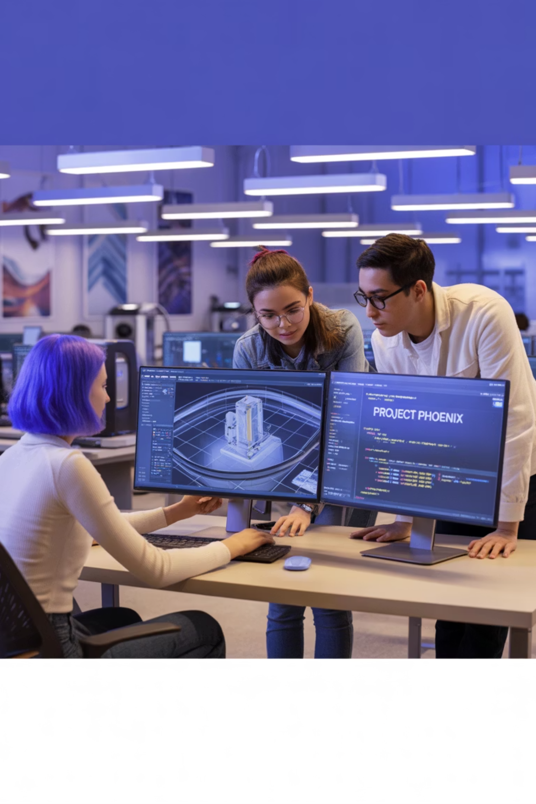

CAMUL – Multimedia Conception and Authoring
Instituto Superior de Engenharia do Porto
Paula Escudeiro

Slide 2
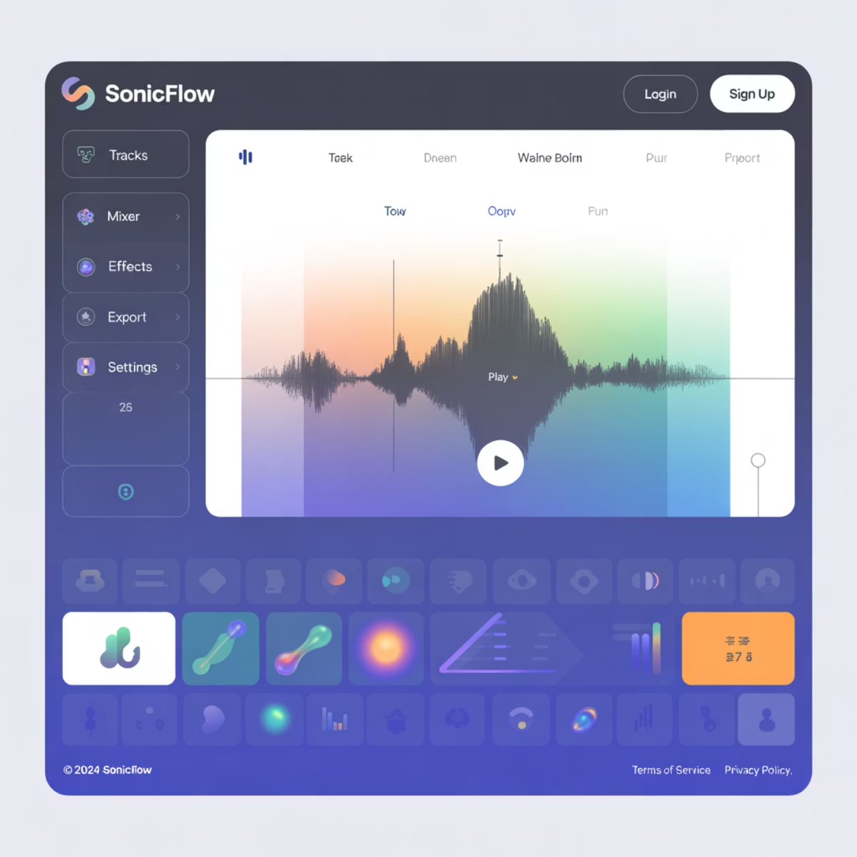

What is Multimedia?
The term "multimedia" refers to the sophisticated integration of diverse media types—text, imagery, audio, video, and animation—to create rich, interactive experiences that engage multiple senses simultaneously.
This convergence of different content formats enables creators to communicate complex ideas more effectively than any single medium could achieve alone. Multimedia transforms passive consumption into active engagement, allowing users to interact with information in meaningful ways.
In today's digital landscape, multimedia has become the cornerstone of effective communication across educational, commercial, and creative domains.

Slide 3
Historical Evolution of Multimedia
1800-1900: Photography & Illustration Era
1
The foundation of visual communication through static imagery and artistic representation
2
1920-1930: Cinema & Radio Revolution
Moving pictures and broadcast audio transform mass entertainment and information dissemination
1960-1970: First Human-Computer Interactions
3
Early interactive systems emerge, establishing the groundwork for digital multimedia experiences
4
1980s: Digitalisation & CD-ROM Technology
Digital storage revolutionises content distribution and enables portable multimedia libraries
1990s: Internet & Web Multimedia
5
World Wide Web enables global multimedia sharing and interactive web-based experiences
6
2000s: Media Streaming & Social Networks
Real-time content delivery and user-generated multimedia content reshape digital interaction
2010-2020: Virtual & Augmented Reality
7
Immersive technologies create unprecedented levels of user engagement and presence
8
Present & Future: Ubiquitous Multimedia
AI-driven content creation and seamless cross-platform multimedia integration

Slide 4
The Importance of Multimedia
Effective Communication
Complex Concept Visualisation
Enhanced Engagement & Memory Retention
Multimedia bridges language barriers and communicates complex concepts through multiple sensory channels, ensuring messages resonate with diverse audiences.
Abstract ideas become tangible through visual representations, animations, and interactive demonstrations that clarify understanding.
Multi-sensory experiences create stronger neural pathways, improving information retention and recall rates significantly.
Capturing Audience Attention
Emotional Impact
Diverse Learning Style Accommodation
Dynamic, visually appealing content cuts through information noise and maintains viewer focus in our distraction-rich environment.
Strategic use of multimedia elements creates emotional connections that influence decision-making and behaviour change.
Visual, auditory, and kinaesthetic learners all benefit from multimedia's comprehensive approach to information delivery.
Creativity & Innovation
Multimedia tools empower creators to explore new forms of expression and push the boundaries of traditional communication.

Slide 5







Multimedia Applications Across Industries
Education
Entertainment
Advertising & Marketing
Interactive learning environments facilitate comprehension of complex concepts through visualisations, simulations, and gamified experiences that transform traditional pedagogical approaches.
Immersive experiences in gaming, cinema, and digital content create emotional connections and memorable experiences that captivate global audiences.
Creative, interactive campaigns leverage multimedia storytelling to build brand awareness, drive engagement, and influence consumer behaviour across multiple touchpoints.
Corporate Communication
Healthcare
Business Operations
Visual presentations and interactive content enable effective information transmission, facilitating better decision-making and stakeholder engagement in business environments.
Clear, accessible health information delivery improves patient understanding and compliance whilst supporting medical education through detailed anatomical visualisations.
Streamlined internal and external communication processes enhance productivity, training effectiveness, and customer relationship management across organisations.
Art & Design
Digital platforms provide unprecedented opportunities for artistic experimentation, enabling creators to blend traditional techniques with innovative technological possibilities.

Slide 6
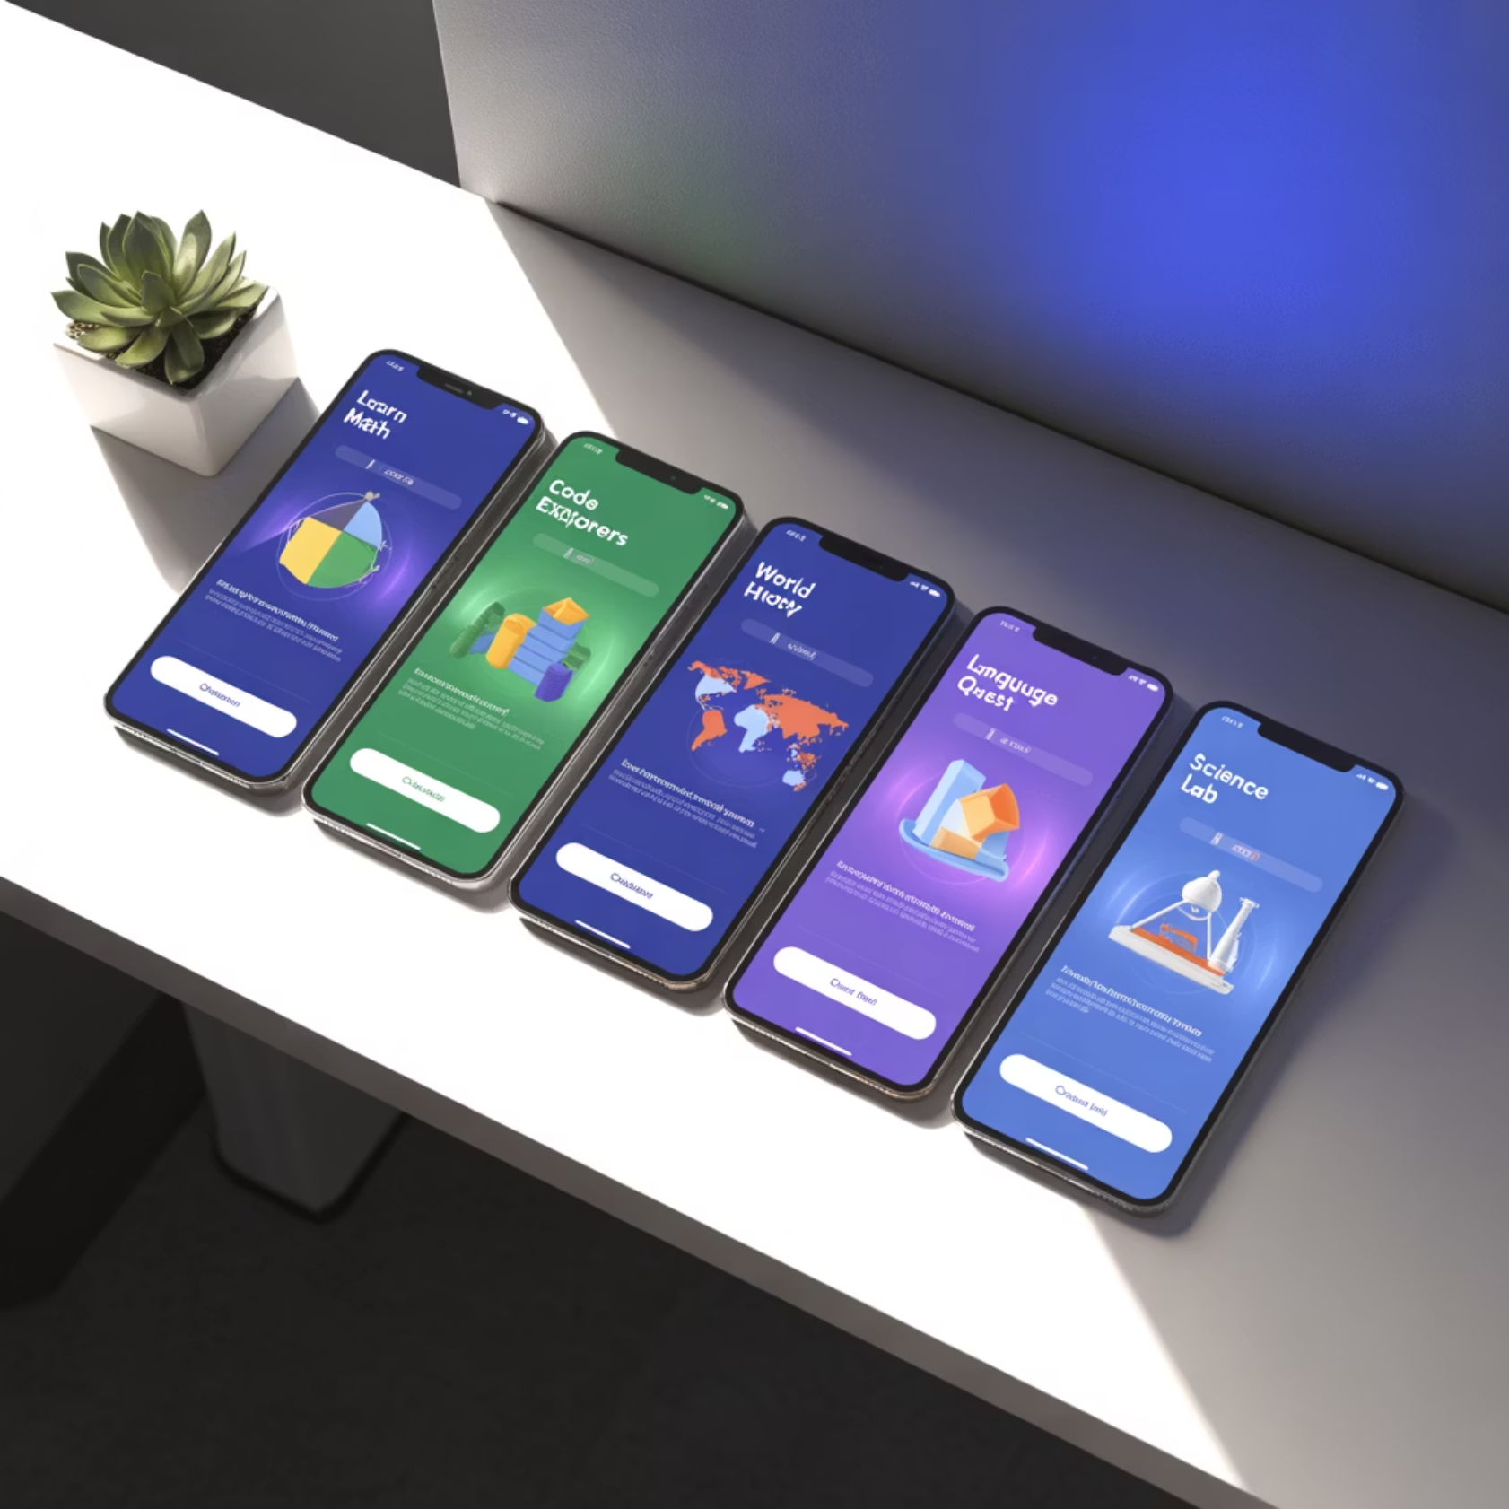
Notable Multimedia Applications
Education Platforms
Kahoot - Interactive quiz platform transforming classroom engagement
Duolingo - Gamified language learning with adaptive multimedia content
Entertainment Systems
Netflix - Streaming platform revolutionising content consumption
Pokémon GO - Augmented reality gaming experience
Healthcare Solutions
Complete Anatomy - 3D medical visualisation platform
VR Exposure Therapy - Immersive treatment environments
Business Tools
Prezi - Dynamic presentation software with spatial navigation
Salesforce - Integrated business management with multimedia dashboards
Creative Platforms
Adobe Spark - Accessible multimedia content creation suite
Google Arts & Culture - Virtual museum experiences and cultural exploration

Slide 7
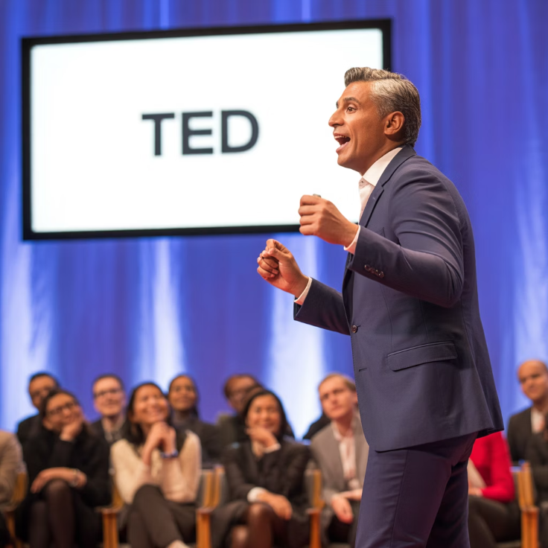
TED Talks
Ideas Worth Spreading
TED Talks represent the gold standard of multimedia presentations, combining compelling storytelling with sophisticated visual design. These presentations demonstrate how effective speakers leverage multimedia elements to create memorable, impactful experiences.
Key characteristics include minimalist slide design, strategic use of imagery, compelling narrative structure, and seamless integration of multiple media types. TED speakers understand that visuals should support, not compete with, their message.
The TED format has influenced presentation design globally, establishing new benchmarks for clarity, engagement, and visual sophistication in public speaking.

Slide 8
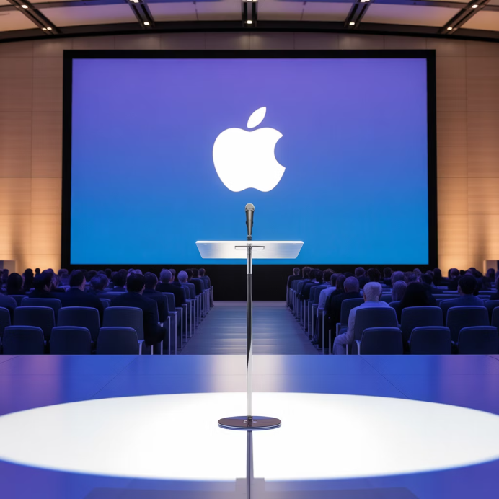
Apple Keynotes
Masterclass in Product Storytelling
Apple's keynote presentations have redefined corporate communication through meticulous attention to visual design, narrative pacing, and multimedia integration. These events demonstrate how technology companies can create excitement and anticipation through expertly crafted presentations.
The Apple approach emphasises clean aesthetics, bold typography, high-quality imagery, and seamless transitions between concepts. Each slide serves a specific purpose in building toward product reveals and key messages.
These presentations have influenced corporate communication standards worldwide, showing how multimedia can transform product launches into cultural events.

Slide 9
Prezi
Spatial Storytelling Revolution
Prezi revolutionised presentation design by introducing spatial navigation and non-linear storytelling capabilities. Unlike traditional slide-based presentations, Prezi enables creators to design presentations on an infinite canvas, allowing for smooth transitions between topics and concepts.
This platform demonstrates how multimedia presentations can break free from linear constraints, enabling more natural storytelling flows that mirror human thought processes. The zooming interface creates engaging visual experiences that maintain audience attention.
Prezi's approach has influenced presentation design thinking, encouraging creators to consider spatial relationships between ideas and to use motion graphics as storytelling tools.

Slide 10
Constraint-Based Presentation Formats
Ignite Talks
PechaKucha
Slidedocs
20 slides, 15 seconds each, auto-advancing format that demands precision and creativity. Forces presenters to distil complex ideas into their essential components whilst maintaining engagement through rapid-fire delivery.
20 slides × 20 seconds format originating from Tokyo's creative community. This constraint encourages visual storytelling and prevents speakers from dwelling too long on individual points, maintaining audience energy.
Hybrid format combining presentation slides with document functionality. Designed for both live presentation and standalone reading, requiring careful balance between visual impact and comprehensive information.
These constrained formats demonstrate how limitations can enhance creativity and effectiveness in multimedia presentations. By imposing specific rules, they force presenters to focus on essential messages and innovative visual communication techniques.

Slide 11
Multimedia Design Challenges
Element Balance
Accessibility
Achieving harmonious integration of text, visuals, audio, and interactive components without overwhelming users or creating cognitive overload requires sophisticated design understanding.
Ensuring multimedia content remains accessible to users with diverse abilities and technological constraints whilst maintaining visual appeal and functionality across platforms.
Visual Consistency
Evolving Technology
Maintaining cohesive design language across multiple media formats and platforms whilst accommodating different technical specifications and user contexts.
Adapting to rapidly changing technological landscapes, device capabilities, and user expectations whilst ensuring content longevity and cross-platform compatibility.
Sensory Distractions
User Experience
Preventing multimedia elements from becoming distractions that detract from core messages whilst still leveraging their engagement potential effectively.
Designing intuitive interactions that enhance rather than complicate user journeys whilst accommodating diverse technical literacy levels and preferences.

Slide 12
Multimedia Opportunities
Immersive Experiences
Impactful Communication
Virtual and augmented reality technologies enable unprecedented levels of user engagement, creating memorable experiences that traditional media cannot achieve.
Strategic multimedia integration amplifies message effectiveness, enabling complex concepts to be communicated clearly across diverse audiences and cultural contexts.
Emerging Technology Exploration
Enhanced Accessibility
Artificial intelligence, machine learning, and interactive technologies open new possibilities for personalised, adaptive multimedia experiences.
Advanced multimedia tools enable better accommodation of diverse user needs through customisable interfaces and multiple content delivery methods.
Audience Participation
Personalisation
Interactive multimedia elements transform passive consumption into active engagement, fostering deeper connections between content and audiences.
Data-driven multimedia customisation enables tailored experiences that adapt to individual preferences, learning styles, and contextual requirements.
Creative Exploration
Business Innovation
Digital tools democratise creative expression, enabling new forms of artistic and communicative innovation across traditional boundaries.
Multimedia solutions drive competitive advantage through enhanced customer experiences, improved training programmes, and more effective marketing strategies.

Slide 13
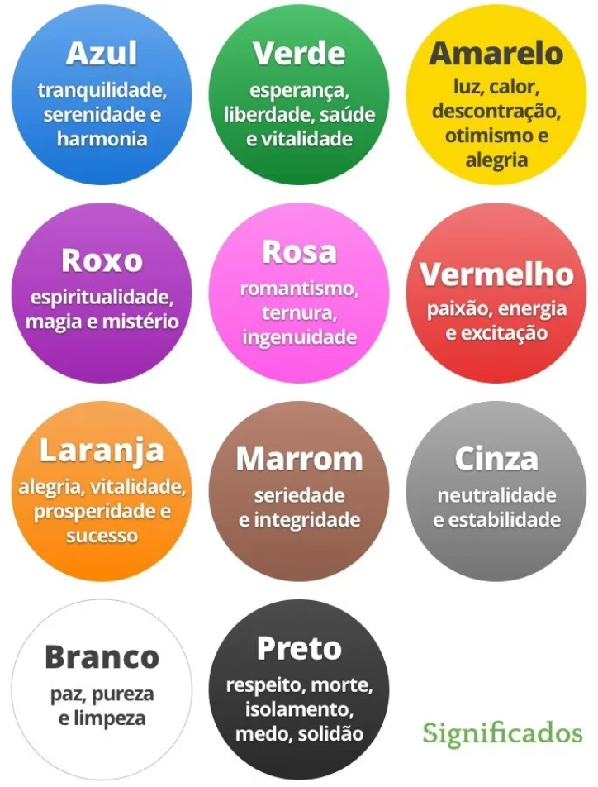
Colours and Their Meanings
The perception of colour depends fundamentally on light and how electromagnetic waves are absorbed and reflected by surfaces. Our eyes capture these reflected electromagnetic waves, and depending on their wavelengths, we perceive different colours.
Colour theory forms the foundation of effective multimedia design. Understanding how colours interact psychologically and culturally enables designers to create more impactful visual communications that resonate with target audiences.
In multimedia contexts, colour serves multiple functions: establishing mood, creating visual hierarchy, supporting brand identity, and guiding user attention through complex information landscapes.

Slide 14
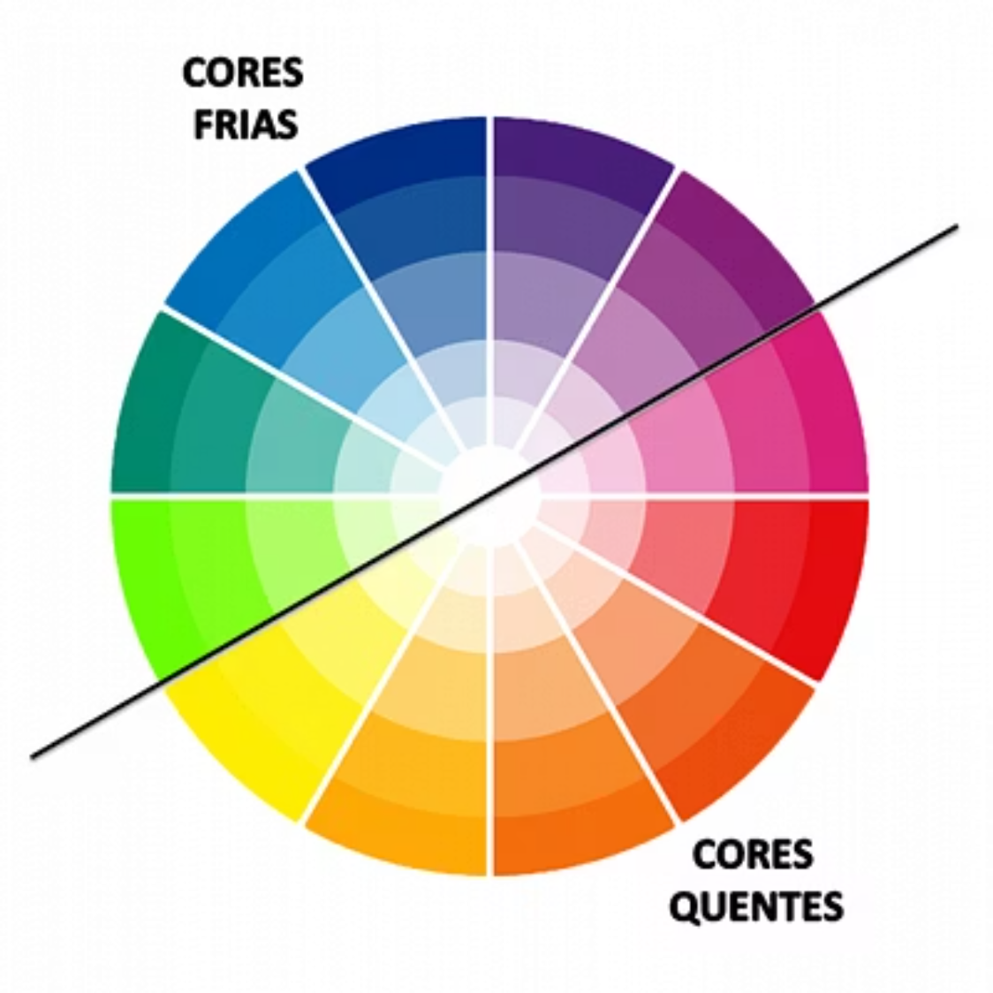
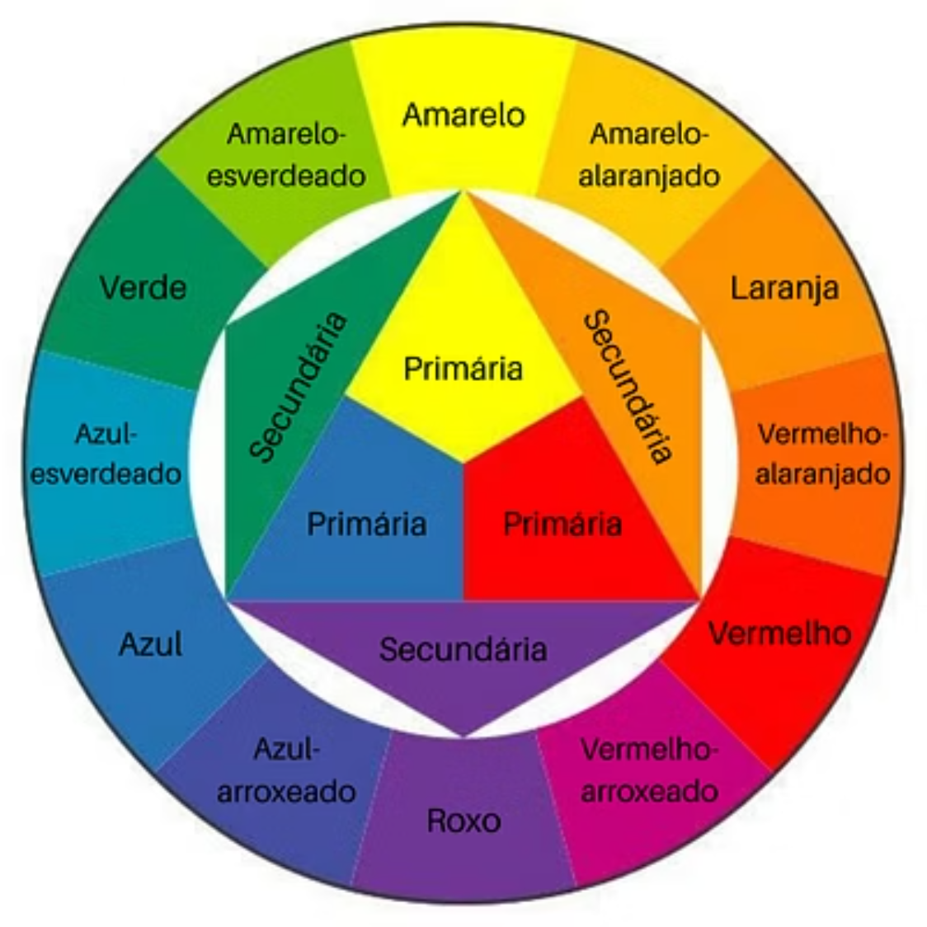
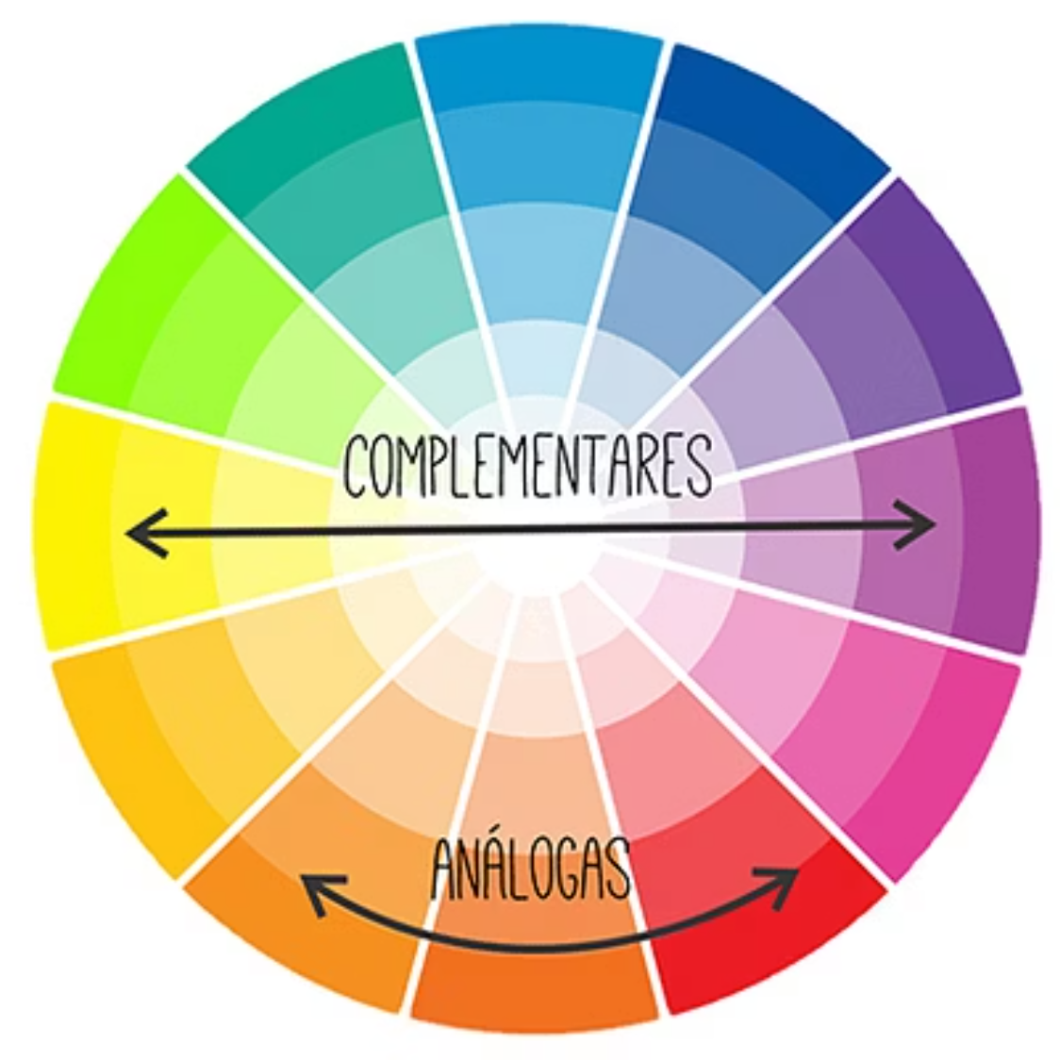
Colour Psychology in Design
Colour psychology reveals how different hues evoke specific emotional responses and behavioural patterns. Warm colours like red and orange create energy and urgency, whilst cool colours like blue and green promote calm and trustworthiness.
Understanding cultural colour associations is crucial for global multimedia projects. Colours carry different meanings across cultures—white symbolises purity in Western contexts but mourning in some Eastern traditions.
Strategic colour selection in multimedia design can influence user engagement, brand perception, and information processing effectiveness. Successful designers leverage these principles to create more persuasive and memorable experiences.

Slide 15
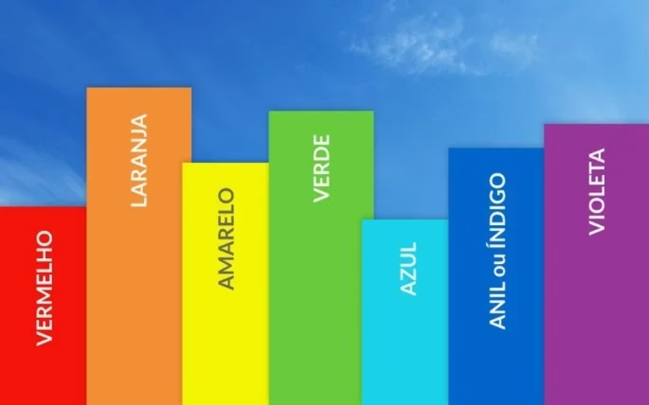
Colour Systems: RGB vs CMYK
RGB (Additive Colour)
Red, Green, Blue colour model used for digital displays. Light-based system where colours combine to create white light. Ideal for screens, monitors, and digital multimedia content.
CMYK (Subtractive Colour)
Understanding these colour systems is fundamental for multimedia creators working across digital and physical platforms. RGB excels in digital environments with vibrant, light-emitting displays, whilst CMYK ensures accurate colour reproduction in printed materials.
Cyan, Magenta, Yellow, Black model used for print production. Pigment-based system where colours combine to create black. Essential for physical multimedia materials and printed outputs.
Successful multimedia projects often require careful colour management between these systems to maintain consistency across different output media and platforms.

Slide 16

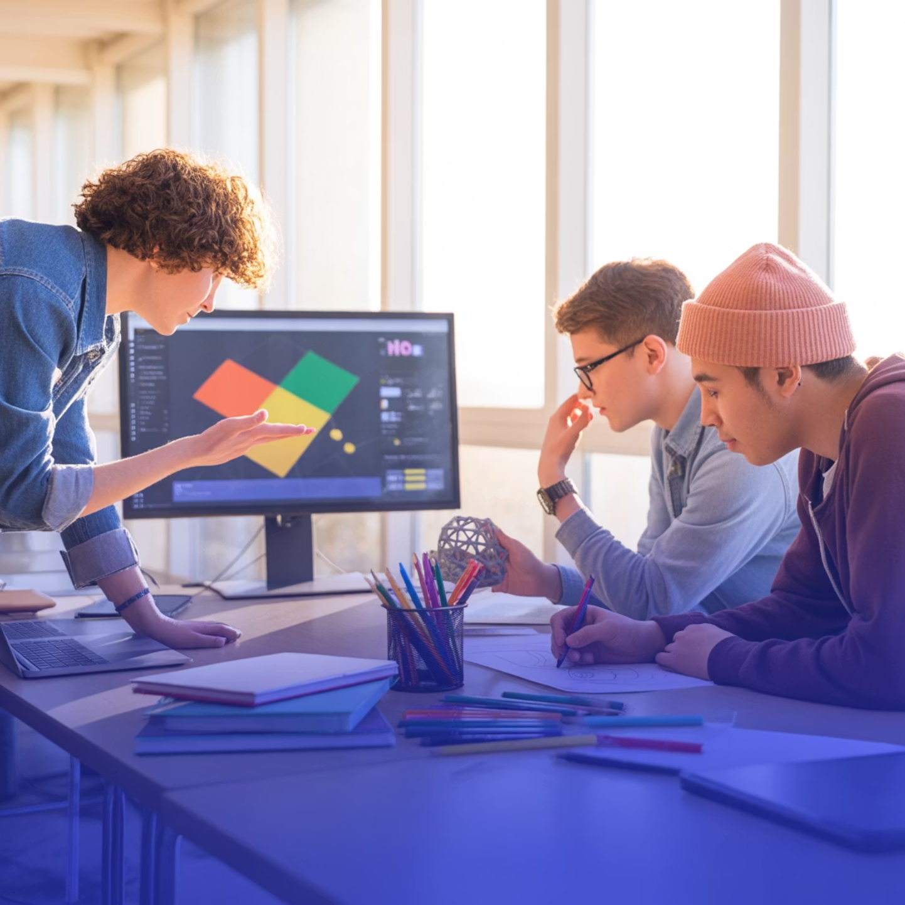
Research Assignment:
Course Activity
Study on the Importance and Meaning of Colour in Multimedia Content Production
This assignment challenges you to explore the deep relationship between colour theory and effective multimedia design. You'll investigate how colour choices impact user experience, brand communication, and information retention.
Your research should examine both psychological and cultural dimensions of colour usage, providing practical insights for multimedia creators working in diverse contexts.

