Slide 1
From Search to Arrival: A Web Application for Enhancing College Selection and Travel Experience using Google Map Services.
Presentation by
Name: Tejas Thakare & Khushboo Yadav
Roll No.:79,89

Slide 2
Introduction
Our web application is aimed at addressing the common problems faced by students while traveling to their college, college selection.
To solve these problems, we have developed a user-friendly web application that provides advanced college search features, optimal routing from home to college, detailed information about specific colleges.
Objective:
To provide a comprehensive solution to the common problems faced by students while traveling to college, including college selection, optimal routing, and detailed college information.
To simplify the college selection process and enable students to make informed decisions about their education.
To provide an intuitive and user-friendly interface that allows students to easily access and compare information about different colleges.

Slide 3
Introduction
2. Tools and techniques:
Mern stack (MongoDB, Express.js, React, and Node.js) for building the web application.
Google map services including Google Maps JavaScript API, Direction API services, Geocode API, and Place API for providing mapping and geolocation functionality.
AWS cloud technology for hosting the web application and ensuring its scalability.
SQL database for storing and managing data related to different colleges.
Colab for dataset preprocessing.

Slide 4
Introduction
3. Necessity of the project:
Many students face challenges while traveling to college, including finding the optimal route, selecting the right college, and comparing different colleges.
Existing solutions are either limited in functionality or difficult to use, making it challenging for students to make informed decisions.
Our web application provides and addresses all of these challenges and simplifies the college selection and travel planning process.
The use of Google map services and other advanced technologies ensures the accuracy and reliability of the information provided, making it an essential tool for any student looking to pursue higher education.

Slide 5
Literature Review
Sr. No. | Title | Year | Algorithm and Methodology | Conclution
1 | Hopper | 2019 | AI
2 | Mobile Application Development for Tourist Guide in Pekanbaru City | 2020 | KNN
3 | Mobile Smart Travelling Application For Indonesia Tourism | 2017 | image recognition using landmark detection feature from Google | The application is named Smart Travelling and has many features
4 | A TRAVEL GUIDE ANDROID APPLICATION | 2021 | Android Studio, Firebase | The motive of this android application,
5 | TRAVEL WITH US MOBILE APPLICATION | 2021 | Android studio, Java programming | This research paper explains the evolution of tourism industry and applications.
6 | Advanced Tour Guide Android App | 2022 |  | Tourism App Help User to Search Best location For the Holiday.
7 | Mobile Application Based Intelligent Role of Information Technologies in Tourism Sector | 2021 | React Native, Apollo GraphQL, Redux

Slide 6
8 | Virtual reality and modern tourism | 2020 | VR technology,3D visualizations | The purpose of this paper is to provide an insight as to how recent trends in virtual reality
9 | Digital business models in cultural tourism | 2021 |  | Digitalization had a relevant impact on the cultural tourism sector, both demand and supply.
10 | Amdavad | 2018
11 | College Raptor | 2014 | Predictive Analytics | College Raptor is a college search website that provides information on colleges and scholarships. Their college search tool allows students to filter by factors such as location, majors, and cost.
12 | CollegeSimply | 2011 | Search Engine | CollegeSimply is a college search website that provides information on colleges and scholarships. Their college search tool allows students to filter by factors such as location, majors, and test scores.
13 | The College Board | 2011 | Search engine | BigFuture is a college planning website that provides information on colleges and financial aid. Their college search tool allows students to filter by factors such as location, majors, and test scores.
14 | Unigo | 2008 | Search engine | Unigo is a website that provides reviews and ratings of colleges and universities. Their college search tool allows students to filter by factors such as location, majors, and campus life.

Slide 7
literature review conclusion
In conclusion, while many colleges have their own websites and there are numerous college search engines available, they can be overwhelming for the average student due to the vast amount of data presented.
Moreover, options for filtering and comparing colleges can be limited, and the user interface can sometimes be subpar.
This is where our application comes in, as it aims to simplify the college search process and help students make informed decisions about the best-fit college for them.

Slide 8
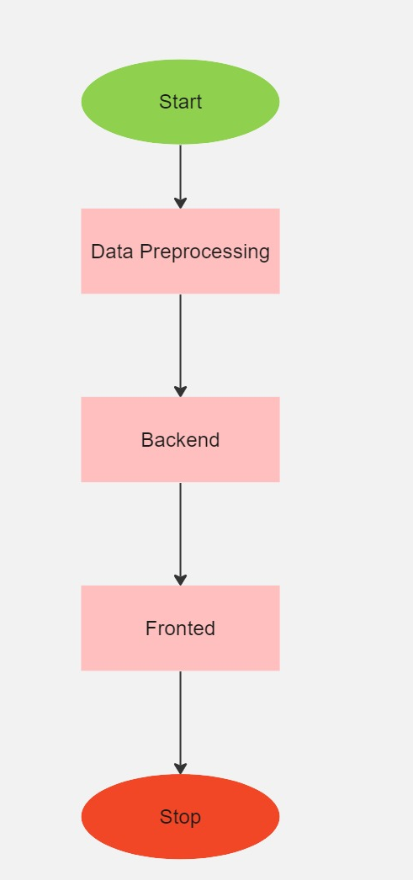

Slide 9
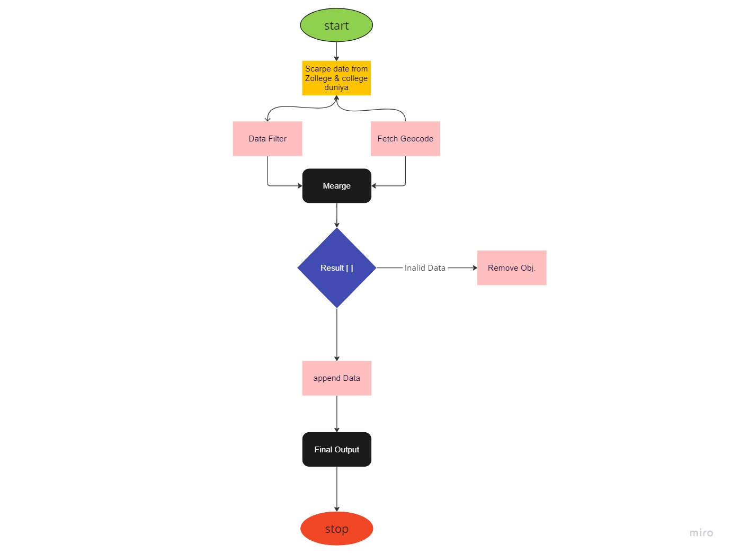
Data Pre-Processing
scrapping data from zollege and college duniya website
filter data and add geocode (lat, lng) of this colleges
Extract unnecessary data from scraped data
export final dataset in JSON object file

Slide 10
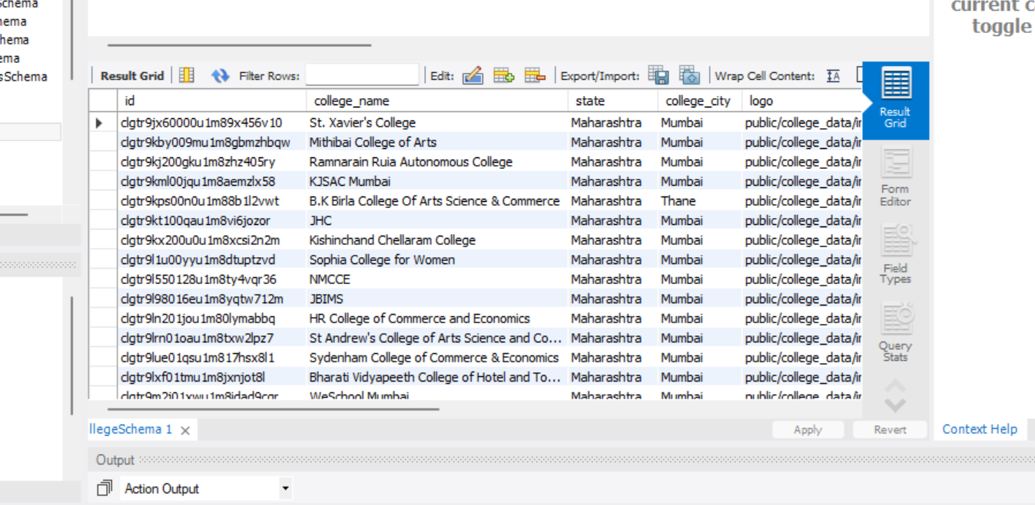
Extracted data

Slide 11
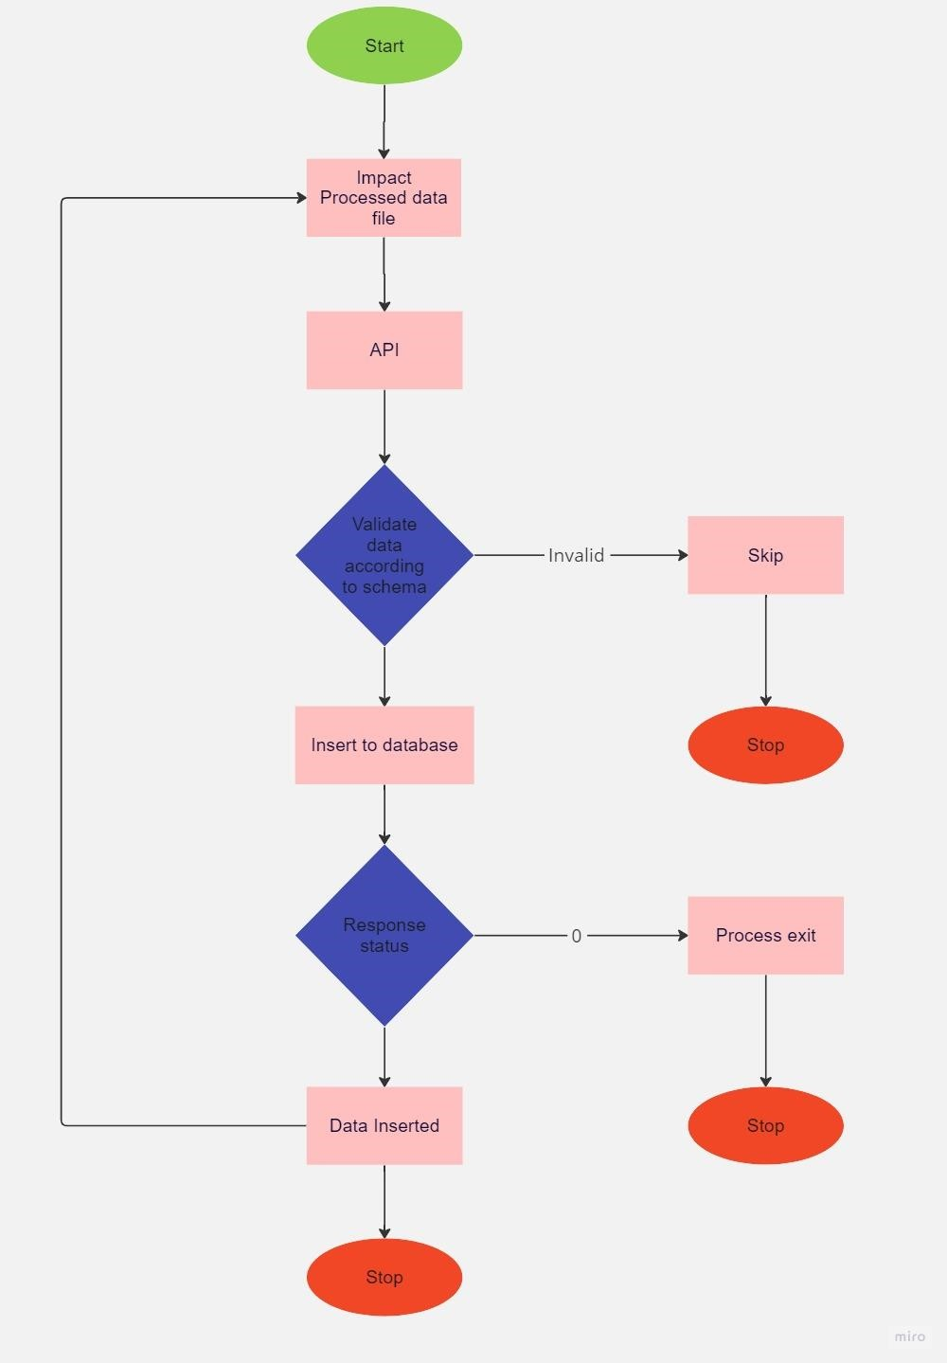
Backend
create schemas of (Location, CollegeBasic, FetureCourse, Course, Faculty, Facility, Placement)
Creating apis (CURD) for this Schemas
Connect to sqlserver DB with using Prisma ORM
Validate data and insert to the database

Slide 12
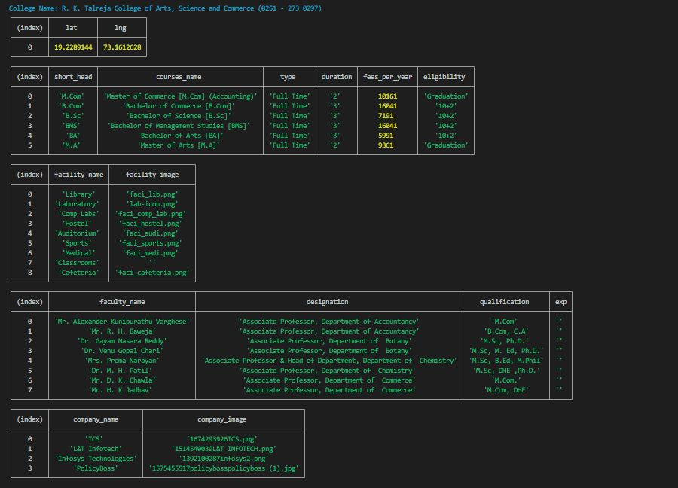
Backend Data

Slide 13
3. Fronted

Slide 14
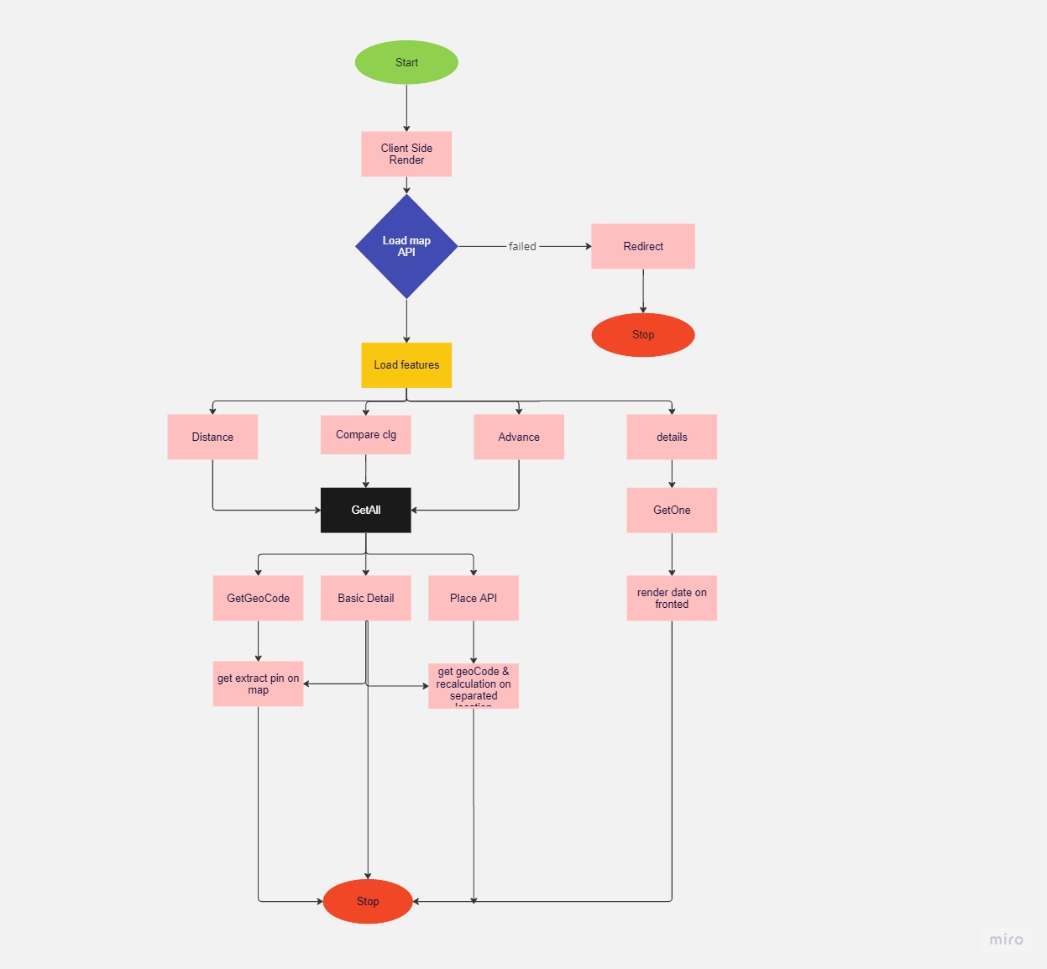
Frontend
create React viteJS project with basic template setting and configurations
create Routing, context, custom hooks, clientside reader entrypoint, eslinter, uglyfyJS, prittierJS,
create 4 features (Advance, detail, routing and compare)
connect frontend with apis and hydrate the client side render
at every api call fetch data from backend and re-render frontend with fetched data

Slide 15
Performance Measure
As it's web application we can measure performance in 3 aspects
1. time required in api calls which is
50ms - 250ms (it's industry standard)
2. Error/exception Handling
for every api call and frontend render we are using best practices as possible
frontend:- batching, error boundary, HOC, etc
backend:- try and catch, maintain error logs
3. Chaching Data
we are using radise as cashing data
4. make use of best practices
a. debounce for search, avoid uncontrol component use, testing

Slide 16
Hardware and Software use
Hardware: 1. Computer
Cloud: 1. git pod, AWS
Software used
Editor- 1. VScode, gitpod, docker, postman, Wordbeanch
Backend- 2. prisma, expressjs nodejs, redise, MVC, sqlServer
fronend- 3. react18, viteJS, googleapi, jest, RTL (React Testing library), DaisyUI, tailwind

Slide 17
Implementation details
This college travel website created using React JS with 4 different components: advance, distance, detail, and compare components. Each of these components has its own unique features.
The website allows users to search for college names and locations using a search box feature.
Additionally, there is an advanced feature that allows users to customize their search results based on their specific requirements. After applying the desired filters and customization, the website generates a map that displays the most efficient travel routes using different modes of transportation such as walking, car, plane, train, and bus

Slide 18
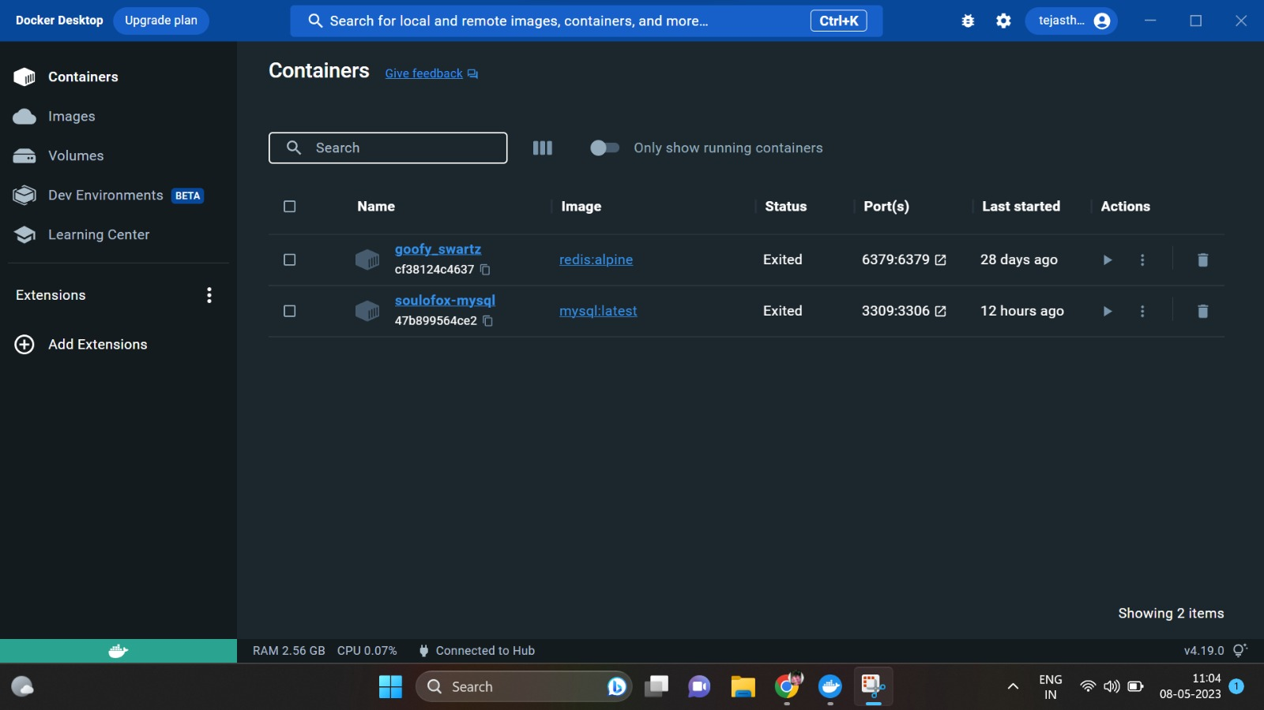
Experimental setup and results Fronted View 1. Open Docker and run container to start database

Slide 19
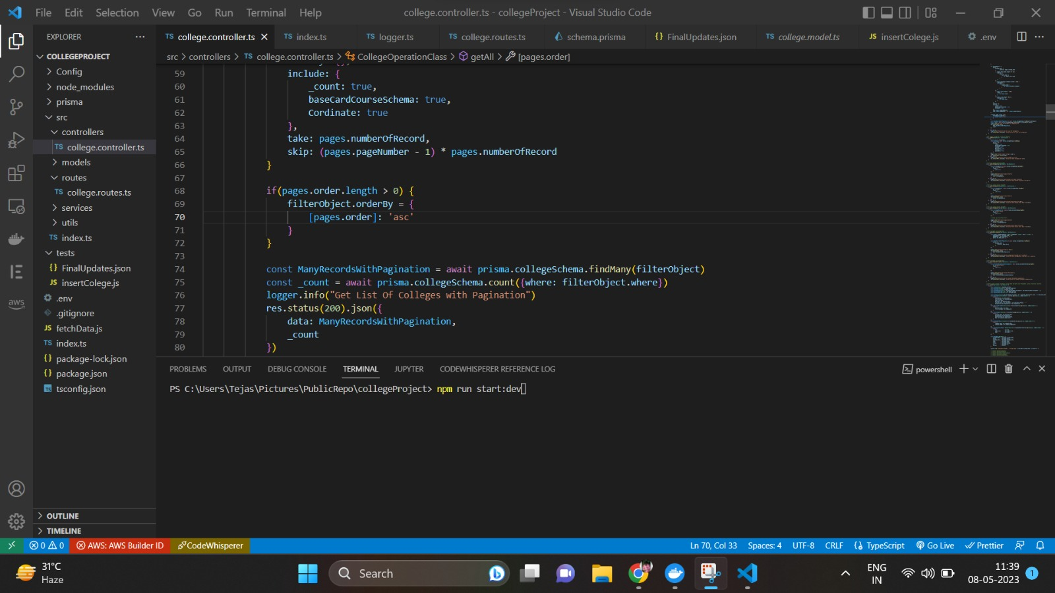
2. open vs code and run (npm run start:dev) to start development build of backend this will automatically connect to database and show server is running msg in terminal

Slide 20
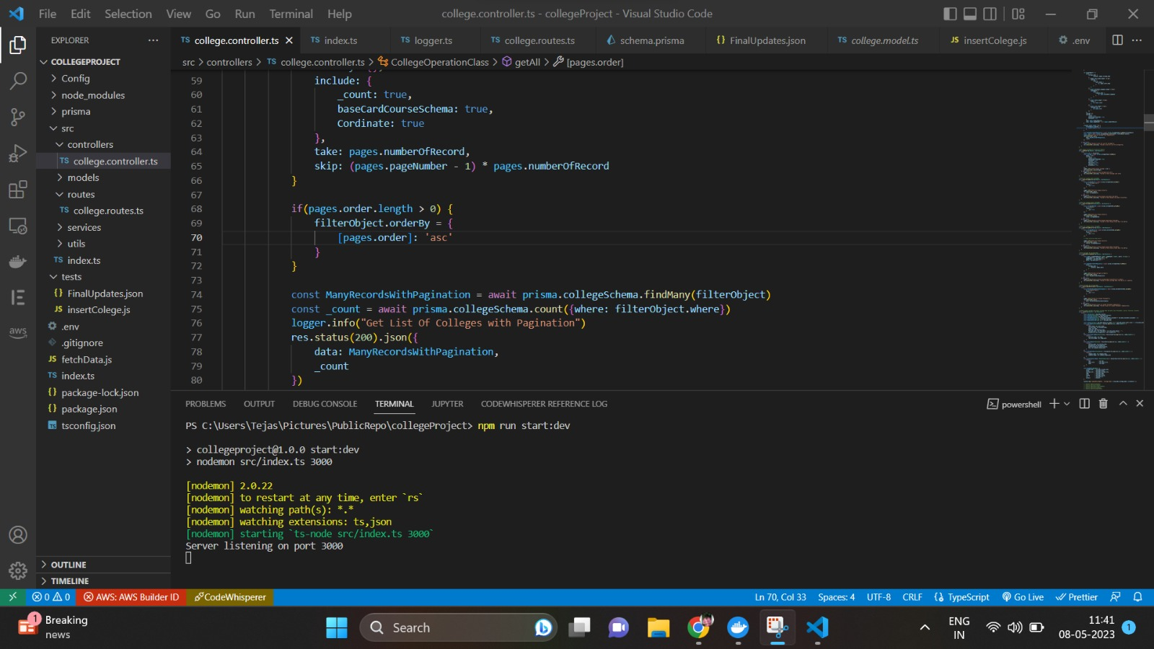
3. this msg will show in backend terminal logs

Slide 21
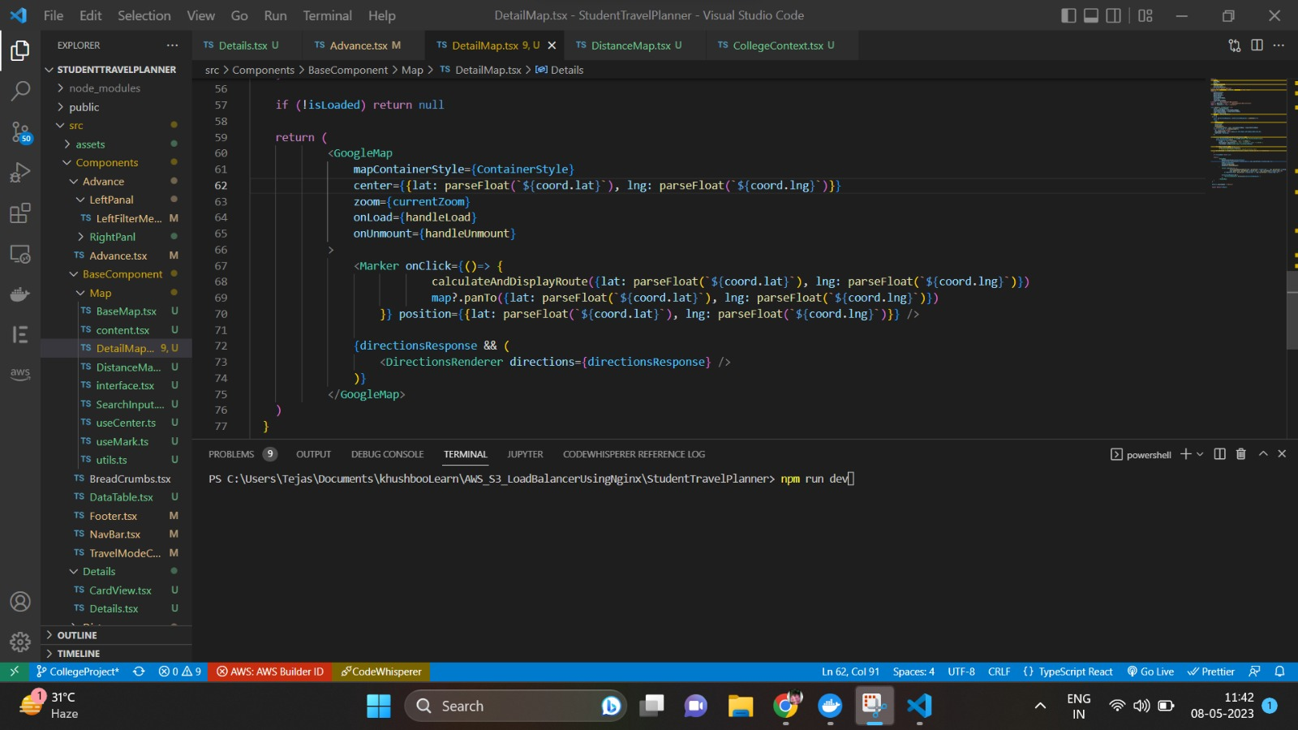
4. open another vscode and run (npm run dev) to start development build of frontend (development build mean it's for developer not ready yet for production)

Slide 22
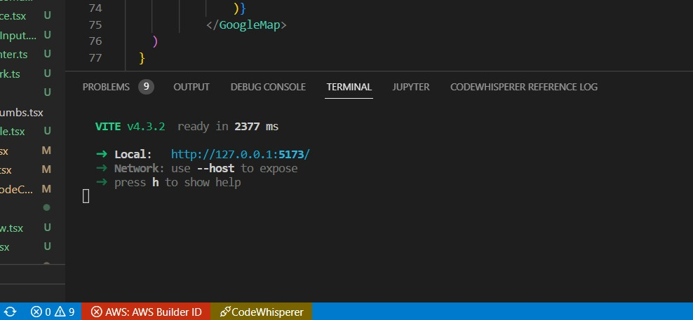
5. after that this msg will prompt server ip address (address where project is running) and some extra details like (VITE v4.3.2) which mean project bundle will manage by VITE in production

Slide 23
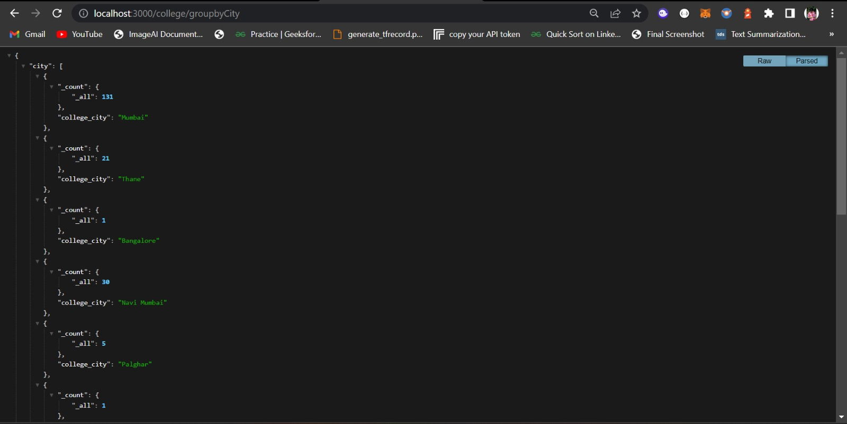
6. open browser and hit both backend and frontend ip's and check if both are working perfectly backend: http://localhost:3000 frontend: http://127.0.0.1:5173/

Slide 24
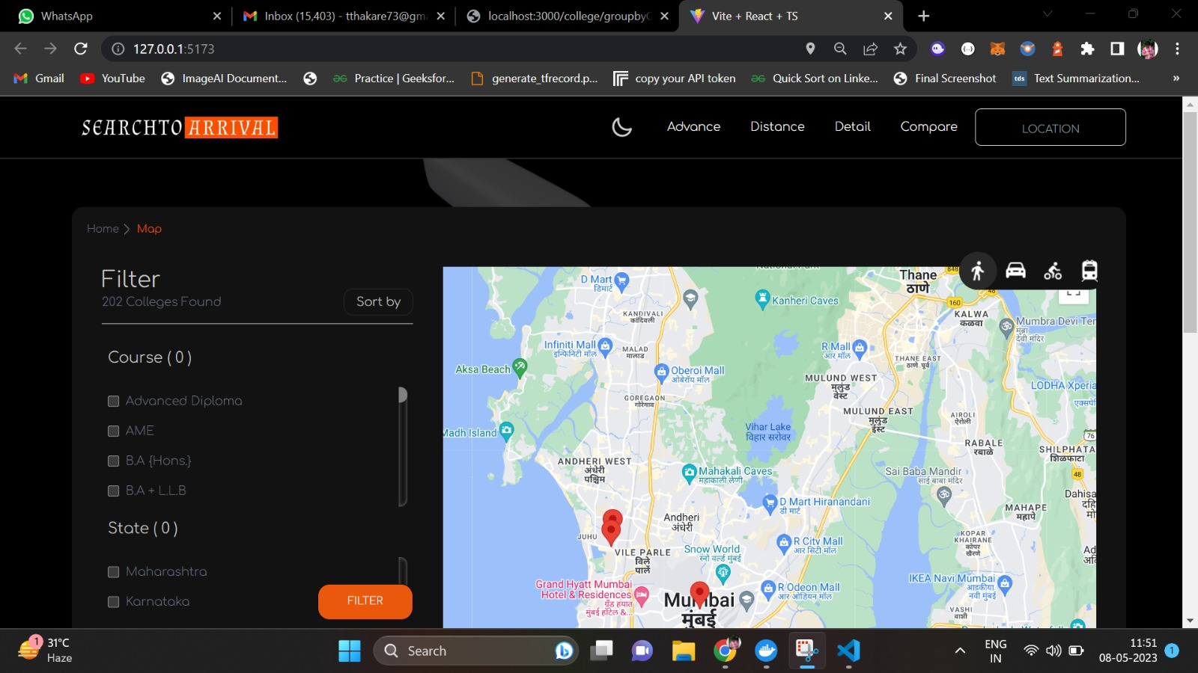
7. if frontend running properly that you will see this result

Slide 25
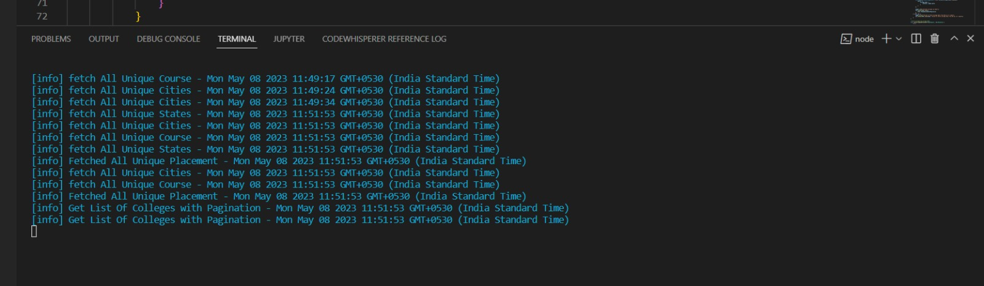
8. backend result after running perfectly while in every api hit in from frontend backend terminal show which api is being hit and logging server will let you know the status of api, "[info]":- in above result mean api is successfully executed with status code 200 and there is no error

Slide 26
Analysis of the results
User-Friendly Interface: Our website offers a user-friendly interface that allows students to easily navigate and explore college options. The advanced search, locality search, and comparison features are intuitive and help users find relevant information efficiently.
Real-Time Results: The advanced search feature of our website displays results in real-time on a map, providing students with instant insights into colleges that meet their criteria. This dynamic feature saves time and enhances the user experience.
Customization and Filtering: Our website offers multiple filters and sorting methods, enabling students to customize their search based on specific preferences such as courses, facilities, faculty, and fees. The ability to apply multiple filters enhances the accuracy of search results.

Slide 27
Locality-based Search: The locality search feature allows students to specify a desired scan area, making it convenient to explore colleges in a particular location of interest. This targeted approach helps students find colleges within their preferred geographic range.
Comparative Analysis: The comparison feature of our website enables students to compare colleges side by side. The ability to evaluate colleges based on parameters like distance, placement companies, courses, and fees assists students in making informed decisions and saves them time in the research process.
Integration of Google Maps: We leverage Google Maps services, providing a familiar and reliable platform for users. It offers interactive maps for visualizing college locations, which enhances the overall user experience and aids in decision-making.
Efficiency and Time-saving: Our website streamlines the college search process by providing comprehensive information and a range of search options. This saves students time by presenting relevant results quickly and enabling them to compare and evaluate colleges efficiently.

Slide 28
Conclusion
The web application provides a comprehensive solution to the common challenges faced by students while traveling to college.
The use of advanced technologies and tools ensures the efficiency and scalability of the web application.
The user-friendly interface of the application simplifies the college selection process and enables students to make informed decisions about their education.

Slide 29
Future enhancement
Integration of real-time data: The website could be enhanced to include real-time data about transportation schedules, traffic updates, and other relevant information that could improve the accuracy and reliability of the travel recommendations.
Personalization features: Additional customization features could be added to the website that allow users to further personalize their travel plans based on their specific preferences, such as preferred modes of transportation or specific landmarks they want to visit.
Mobile optimization: The website could be optimized for mobile devices, allowing users to access the site and plan their travels on-the-go from their smartphones or tablets.
Improved user interface and design: Additional time and resources could be devoted to improving the user interface and design of the website, making it more visually appealing and user-friendly.
Expanded coverage: The website could be expanded to cover additional colleges and universities, as well as additional locations beyond just the immediate vicinity of each school.

Slide 30
References
https://github.com/narukashu/Travel_Jaipur
https://github.com/DhrumilShah98/FifthProject-TourGuideApp
https://github.com/coding-catie/Tour-Guide-of-Tomodachi-Life
https://github.com/RB-93/TourGuideApp
https://ieeexplore.ieee.org/document/9491136
https://ieeexplore.ieee.org/document/9103380
https://www.emerald.com/insight/content/doi/10.1108/IJEBR-01-2021-0070/full/html#sec005

Slide 31
Thank you !

