Slide 1
Axi Stream
Advisor: Tsung-Chu Huang
Speaker: Kuan-Yu Huang

Slide 2
Outline
Python-MNIST
Viits HLS
Pynq

Slide 3
Python MNIST
Dataset :MNIST
Accuracy:96.9
Neural network structure:
784x64x62x10

Slide 4
Vitis HLS-Stream [1]
AXI4-Stream without side channel
ap_axiu<32,0,0,0>
AXI4-Stream with side channel
ap_axiu<32,1,1,1>
T<DWIDTH,Wuser,Wid,WDset>
T | Stream data type
WUser | Width of the TUSER signal
WId | Width of the TID signal
WDest | Width of the TDest signal

Slide 5
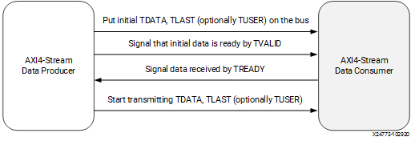
Vitis HLS-Stream
Necessary:TVALID,TREADY,TLAST
Optinal:TKEEP,TSTRB,TUSER,TID…

Slide 6

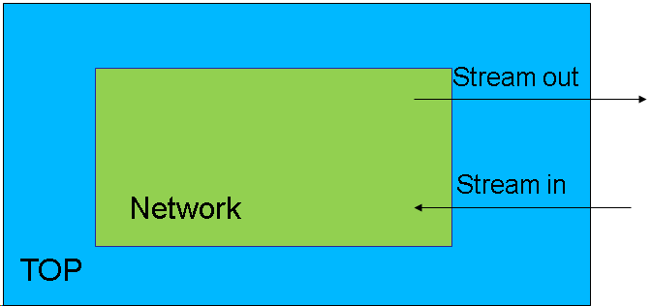
Vitis HLS-Block Diagram

Slide 7
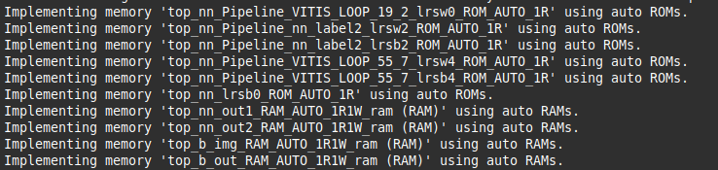
Vitis HLS

Slide 8
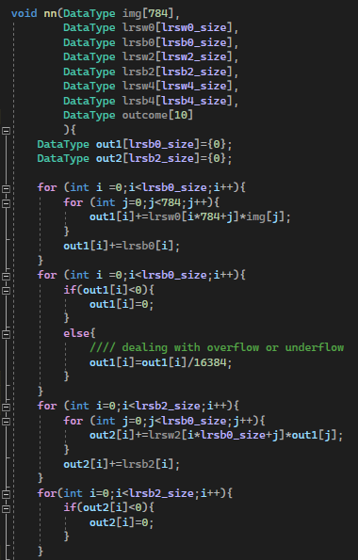
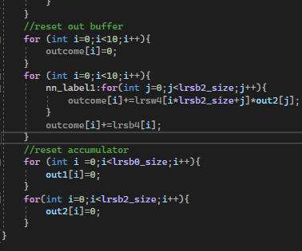
Vitis HLS

Slide 9
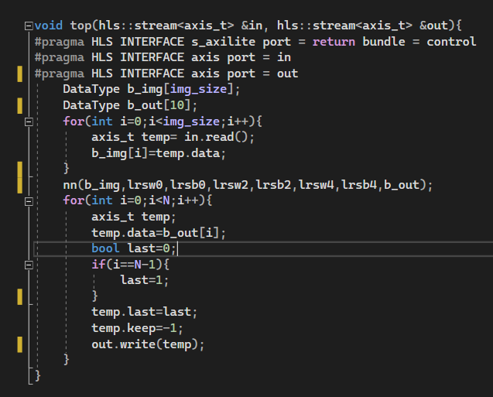
Vitis HLS

Slide 10
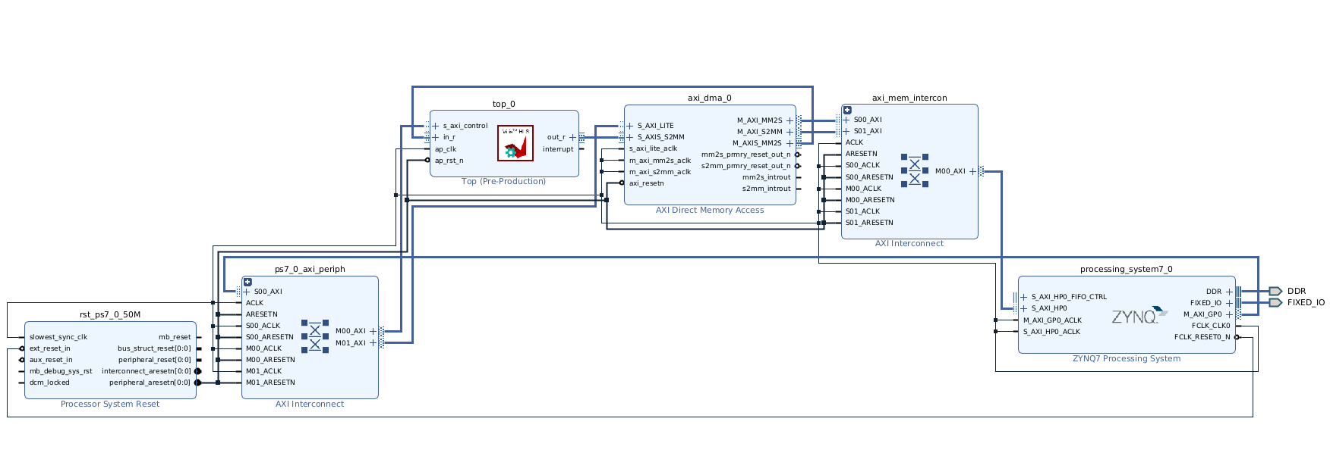
Vitis HLS-IP

Slide 11
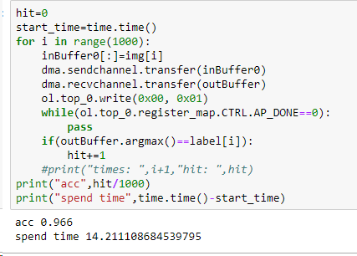
Pynq

Slide 12
Reference
https://docs.xilinx.com/r/en-US/ug1399-vitis-hls/AXI4-Stream-Interfaces

Slide 13
Thank you for your attention.

