Slide 1
Hypothesis testing to optimize northwind trading
An investigation by Thien nguyen

Slide 2
The methodology
Two-sample, two-tailed T-test - measures differences in averages between two groups
ANOVA (Type II)– To measure overall effects of variables

Slide 3
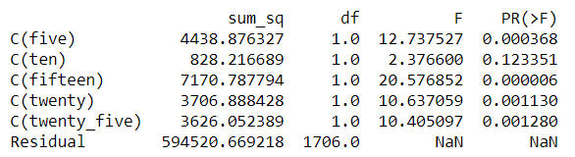
Q1. Do discounts work? If so, which one works the best?
ANOVA Results
A 15% discount works the best
A 10% discount is not effective!
The smaller, the better

Slide 4
Q1. Takeaways & Caveats
TAKEAWAYS
Avoid discounting items by 10%
Instead of increasing a discount to 20%, it would be wiser to just round down to 15%
CAVEATS
Another factor may be affecting sales rate. More research is necessary into other possible explanations (e.g. expiration date).
Unit Price and net profit is not accounted for.

Slide 5
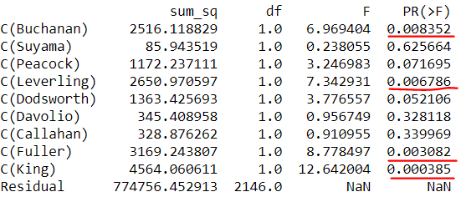
Q2. Do certain employees do better or worse than others in terms of quantity? Who has the most impact?
ANOVA results
The ANOVA results suggest that Buchanan, Leverling, Fuller, and King have a significant impact on the number of items sold with King having the most impact.

Slide 6
Q2. Takeaways & Caveats
TAKEAWAYS
Have the four most influential salesmen mentor the 4 least influential salemen
Consider recognizing those individuals through praise or rewards
CAVEATS
Other factors may be affecting sales rate. More research is necessary into other possible explanations (e.g. experience, client rapport)
Sales quantity does not necessarily equal net profit. Client access must also be considered

Slide 7
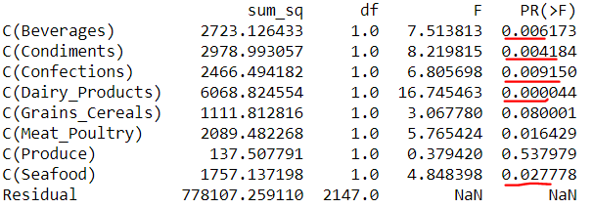
Q3. Do different categories of item sell more or less food? If so, which one sells the most?
ANOVA results
The ANOVA results suggests beverages, condiments, confections, dairy products, and seafood have a significant impact on the number of items sold with dairy having the most impact.

Slide 8
Q3. Takeaways & Caveats
TAKEAWAYS
The five categories sold often should be kept in stock
CAVEATS
More time is necessary to determine if differences exist across categories by season or month.
With more information, brand popularity can be assessed for items in the same category

Slide 9
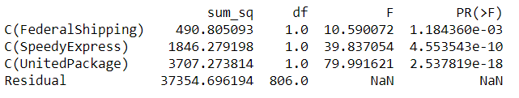
Q4 - Does shipping company affect the downtime between order and shipment? If so, which shipping companies ship the fastest?
ANOVA results
The ANOVA results suggests all companies has a statistically significant effect on downtime, but Federal Shipping has the smallest impact on downtime, which makes it the fastest.

Slide 10
Q4. Takeaways & Caveats
TAKEAWAYS
Federal Shipping is reliably faster than other competitors for shipping downtime
CAVEATS
Difference between order and delivery date is unknown. More data is needed.
Cost of using Federal Shipping over competitors needs to be ascertained
Notes:
1. Caveats/Future Considerations (be clear about that)
2. Slides – Shorten Text; One Idea per slide. Put all details into slide notes. Leave main idea on slides. Make them LISTEN
3. Use more stats tests to justify results
4. Remove all errors from notebook

