Slide 1
Linux Cluster
Send me your TUM-ID, I will open a LRZ account for you.
Log in, initialize
Two-Factor Authentication: Prerequisites
  https://doku.lrz.de/two-factor-authentication-prerequisites-35882365.html
Download software (xshell for windows / Termius for Mac) for connecting your PC to LRZ

Slide 2
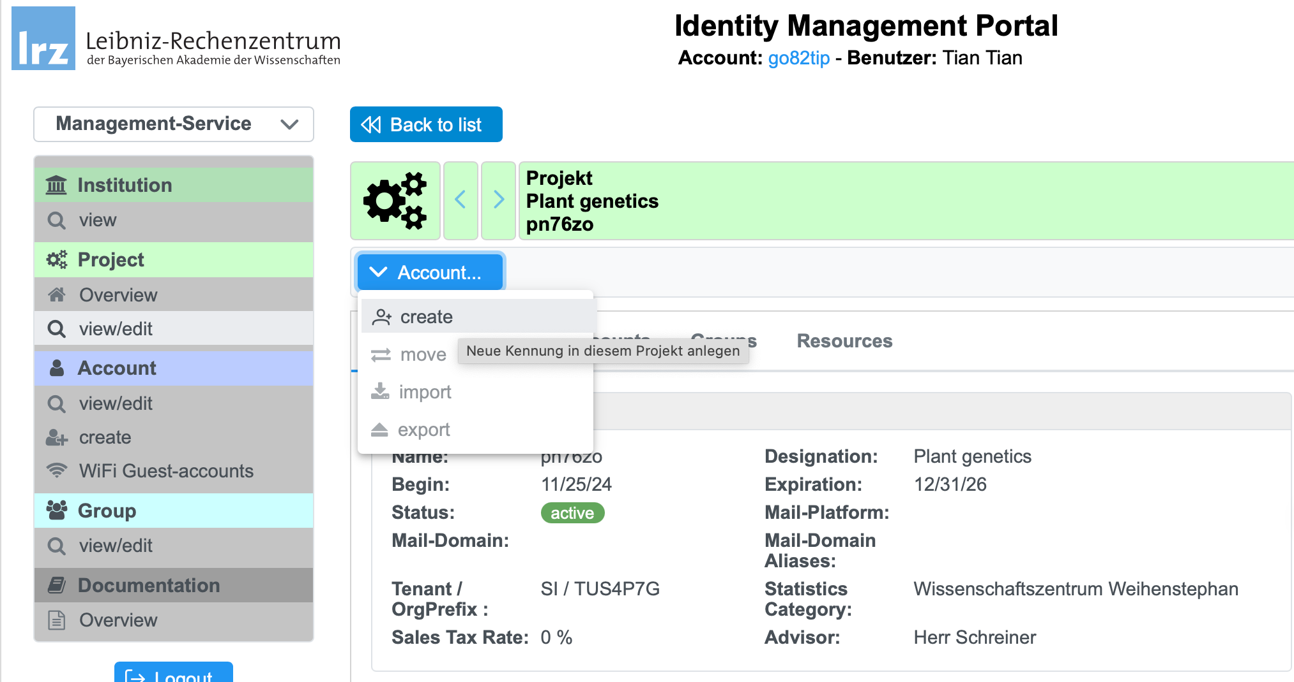
Create accounts by Tian, then Log in, initialize
https://idmportal2.lrz.de/jidmp/sim/verwaltung/projekt.xhtml?id=0000000000F440F1

Slide 3
Setting Two-Factor Authentication: Prerequisites
  https://doku.lrz.de/two-factor-authentication-prerequisites-35882365.html

Slide 4
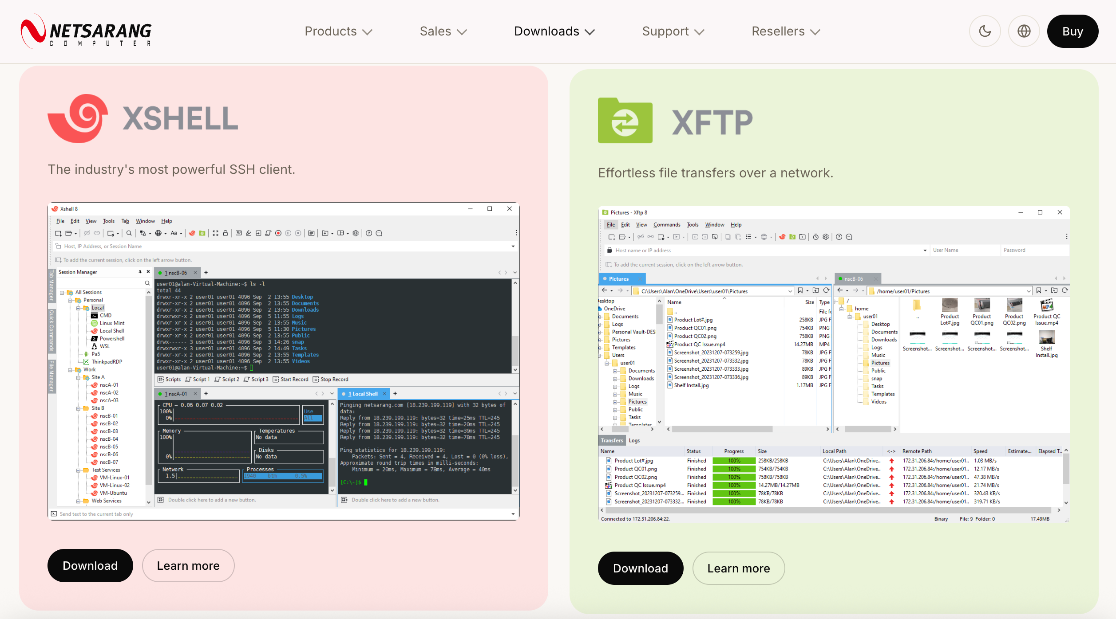
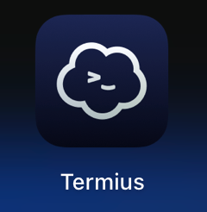
Download software for connecting your PC to LRZ server
For Windows
For Mac
https://www.xshell.com/en/free-for-home-school/
App store

Slide 5
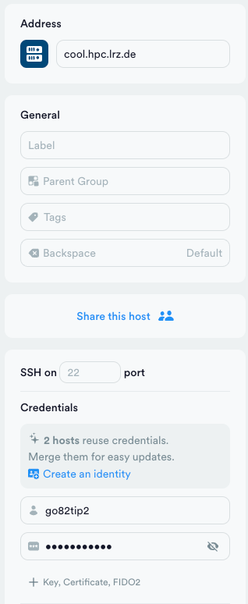
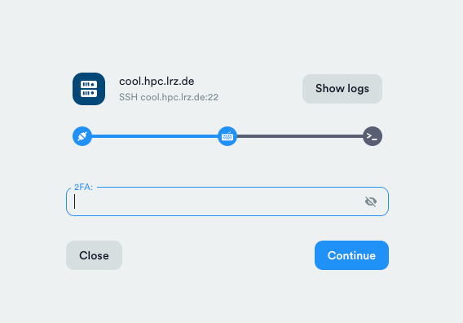
Login with your password and 2FA
address
Your token in your phone
TUM-ID
password

Slide 6
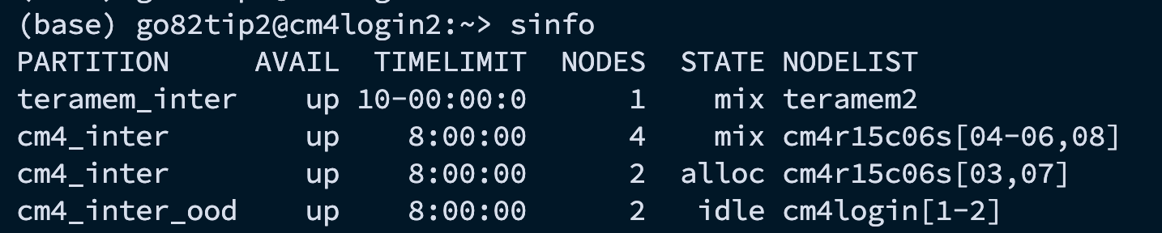
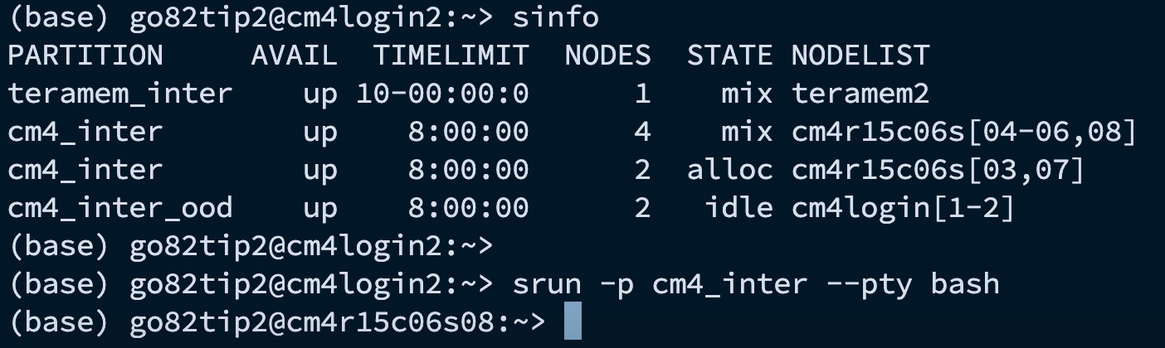
Enter the Compute Node
Login node
Compute node
Notes:
srun -p cm4_inter -t 03:00:00 -c 8 --pty bash

Slide 7
Install conda and other softwares … in your own LRZ environment

