Slide 1
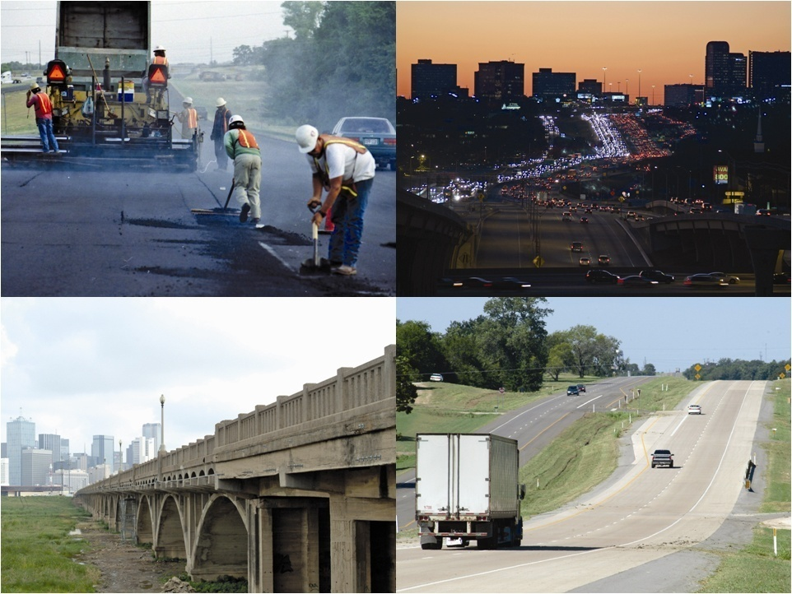

Recommendations

Slide 2
Volunteer committee appointed by Chair Delisi – experienced, respected stakeholders guiding independent research
C. Michael Walton, Chair
Austin
David Marcus, Vice-Chair
El Paso
Ken Allen
San Antonio
Ruben Bonilla, Jr.
Corpus Christi
Drew Crutcher
Odessa
The Honorable Ed Emmett
Houston
Tom Johnson
Austin
David Laney
Dallas
Cullen Looney
Edinburg
Drayton McLane, Jr.
Temple
Roger Nober
Fort Worth
Gary Thomas
Dallas

Slide 3
Process
Committee’s charge - provide an independent, authoritative assessment of the state’s transportation infrastructure and mobility needs from 2009 to 2030
Research team from the TTI, CTR, UTSA
6 Committee meetings
6 Public hearings - Amarillo, Austin, Corpus Christi, Dallas, El Paso, Houston
Formal public input period January 09

Slide 4
Public Input
91 comments from oral and written testimony during public hearings
Website visits
September 1st through February 23rd - 2,556 Unique Visitors
January 9th through February 23rd - 519 Unique Visitors
180 suggestions and comments through its website, by regular mail and by facsimile

Slide 5
Committee Scope and Goals
Scope
Comprehensive update on the maintenance (pavements and bridges) and mobility (urban and rural) needs of Texas
Overview other transportation needs, especially potential for Texas’ relying increasingly on non-highway modes
Goals
Preserve and enhance the value of transportation infrastructure
Preserve and enhance urban and rural mobility and their value to the economic competitiveness of Texas
Enhance the safety of Texas’ traveling public
Initiate discussion on strategic role of all modes of transportation

Slide 6
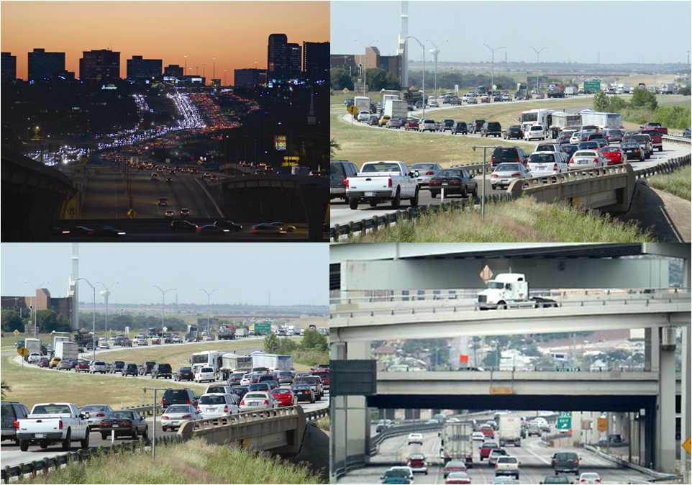
Total and State Investment Needed (Billions 2008 $)
 | Needs 2009 - 2030 |  |  | Annual Investment
 | Total |  | State Investment | Total |  | State Investment
Pavements | $ 89 |  | $ 89 | $ 4.0 |  | $ 4.0
Bridges | $ 36 |  | $ 36 | $ 1.6 |  | $ 1.6
Urban Mobility | $ 171 | * | $ 106 | $ 7.8 | * | $ 4.8
Rural Mobility/Safety | $ 19 |  | $ 19 | $ 0.9 |  | $ 0.9
TOTAL | $ 315 |  | $250 | $14.3 |  | $11.3
* Historically about 2/3 of Urban Mobility has been State responsibility, 1/3 local

Slide 7
QUESTIONS?

