Slide 1
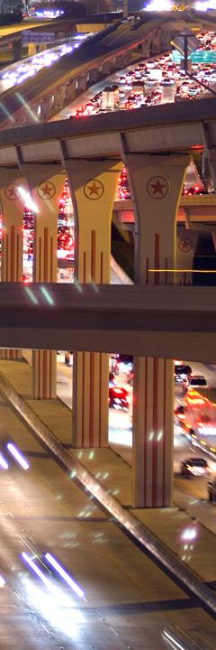
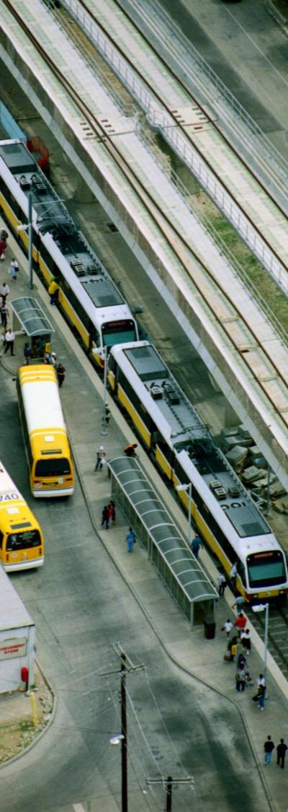
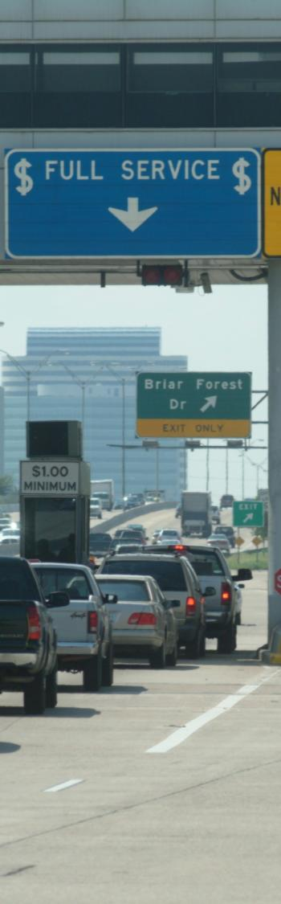
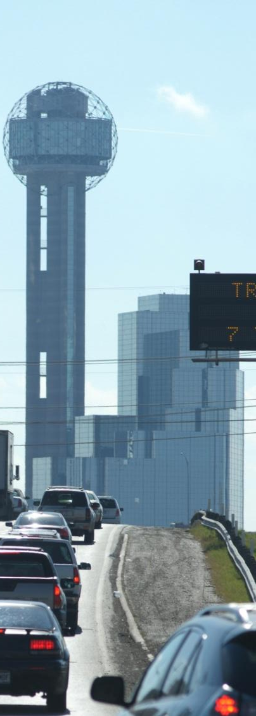


Slide 2
It’s About Time:
Investing in Transportation to Keep Texas Economically Competitive
March 31, 2011

Slide 3
C. Michael Walton, Chair
Austin
David Marcus, Vice-Chair
El Paso
Ken Allen
San Antonio
Drew Crutcher
Odessa
The Honorable Ed Emmett
Houston
Judy Hawley
Corpus Christi
Tom Johnson
Austin
Cullen Looney
Edinburg
Roger Nober
Fort Worth
Gary Thomas
Dallas

Slide 4
Primary 2030 Report Researchers
Texas Transportation Institute
David Ellis, Tim Lomax, Terri Parker, Brianne Glover, Nick Norboge,
Wally Crittenden, David Schrank
Center for Transportation Research, The University of Texas at Austin
Rob Harrison, Mike Murphy,
Zhanmin Zhang, Seokho Chi
The University of Texas at San Antonio
Jose Weissmann, Angela Weissmann

Slide 5
Committee Accomplishments
Scenarios describe possible “futures”
Transportation infrastructure – roads & bridges
Urban and rural mobility
Effect on economic competitiveness & quality of life
Possible funding options
Guiding principles for projects/programs
How Texans will pay for transportation
Information for future decisions

Slide 6
How is the 2011 Report Different from the 2009 Report?
Scenarios – components & time scales
Pavement quality
Bridge quality
Urban mobility
Rural connectivity
Many possible funding options - but no easy ones
Transportation Action Principles
Quantified costs
Taxes, fees, tolls
Vehicle use & maintenance, time, fuel
2011 to 2015
2016 to 2019
2020 to 2035

Slide 7
Texas Transportation Action Principles
Priorities
Local & state officials in best position to choose projects
Preserve infrastructure first – enormous penalties if maintenance postponed
Ensure maximum “bang for the buck”
Display results & be accountable
Approach
Involve everyone in the solution – commuters, employers, carriers, shippers, manufacturers, etc.
Attack problems , but also seize opportunities that support economic development
Users pay for services they “consume”
Make timely decisions & react quickly to avoid greater expense in the future

Slide 8
Committee Scenarios Conditions, Funding and Letter Grade
F - Unacceptable Conditions – What will happen if policies do not change? Conditions deteriorate & congestion grows rapidly
D - Worst Acceptable Conditions – Preserve enormous infrastructure investment, but congestion grows rapidly
C - Minimum Competitive Conditions – Conditions equal to or better than median of peer cities & states
B - Continue 2010 Conditions – Maintain current quality & congestion levels
F – Unacceptable Conditions
D – Worst Acceptable Conditions
C – Minimum Competitive Conditions
B – Continue 2010 Conditions

Slide 9
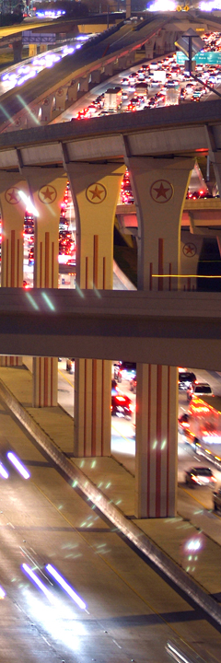
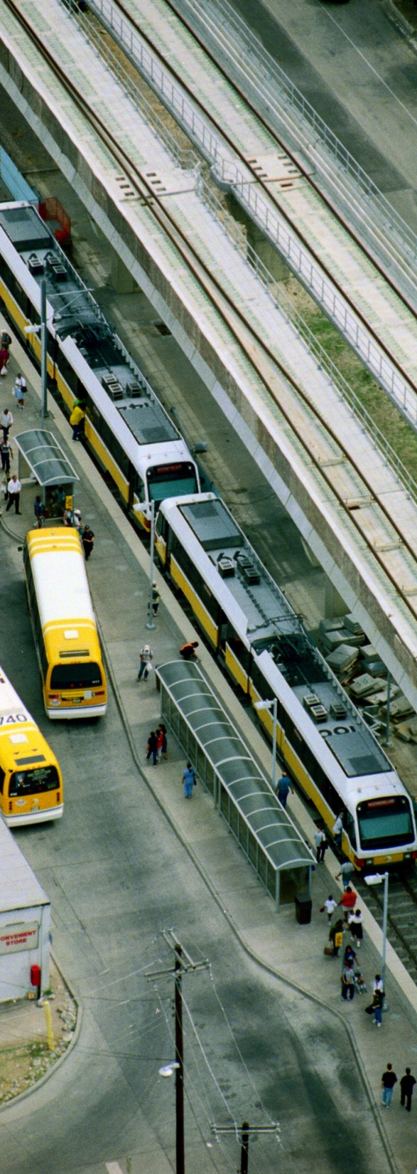
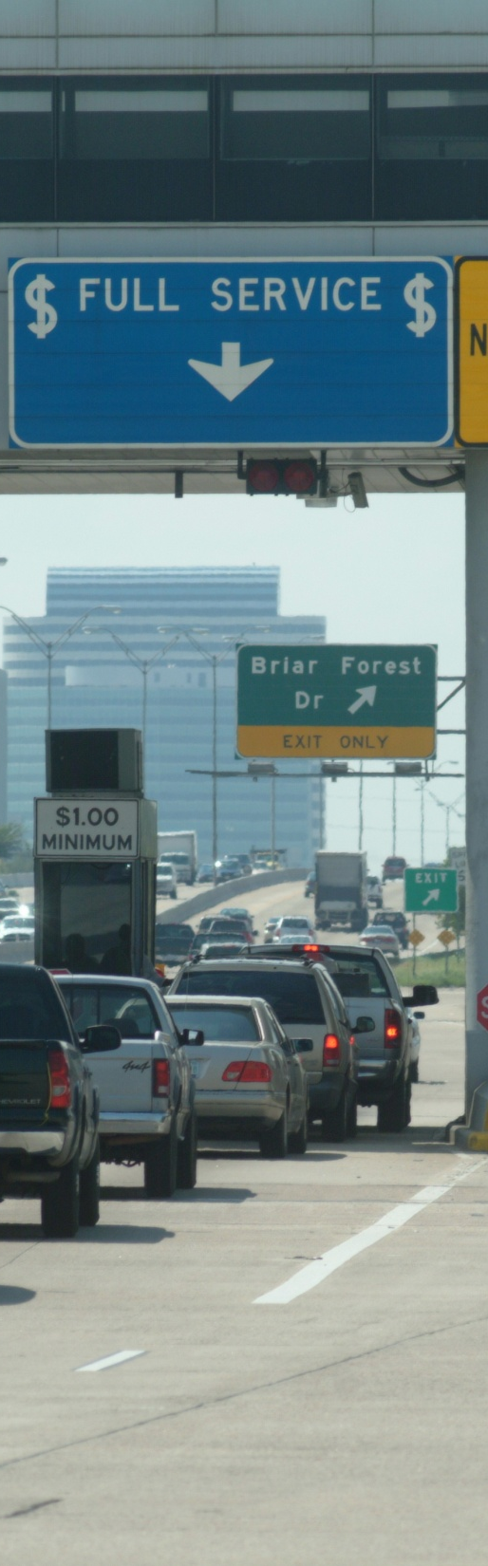
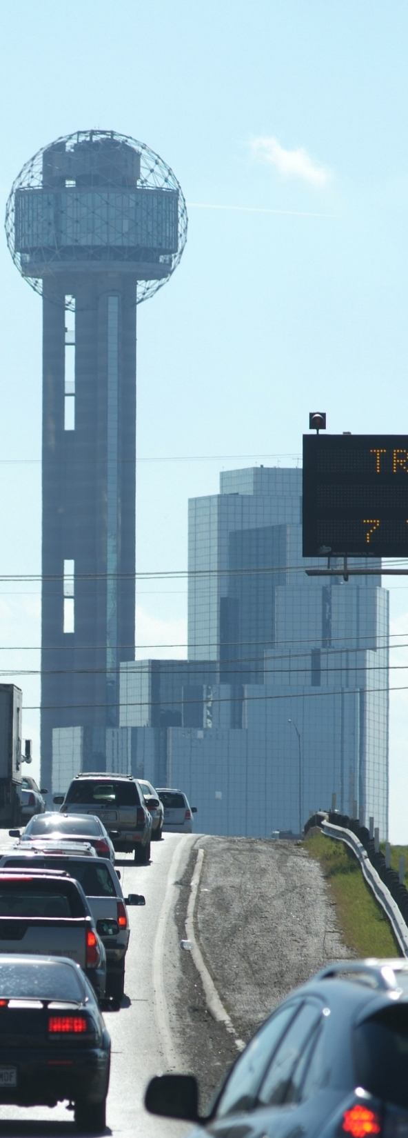
Average Annual Transportation Costs per Household, 2011 to 2035
No Change in Funding or Policy Trends
Preserve Infrastructure, Rapid Congestion Growth
Equal to or Better than Median of Peers
Maintain 2010 Quality & Conditions

Slide 10
Annual Investment 2011 to 2035
Scenario & Grade | Total Investment $Billion ($2010) | Average Cost per Household
F - Unacceptable Conditions | $4.0 | $232
D - Worst Acceptable | $7.0 | $406
C - Minimum Competitive | $8.7 | $511
B - Continue 2010 Conditions | $10.8 | $634

Slide 11
Examples of Revenue Options
Capture existing revenue
$100+ million/year from a variety of truck fees
Transfers to DPS: $600 million per year
System-wide sources
Fuel tax
Vehicle registration fee
Targeted options
Toll roads
Project-specific incentives
Public-private partnerships
Area approaches
Local option vehicle registration fees
Local option fuel tax

Slide 12
Committee Conclusions
Certain – Texans will pay more for transportation in the future
Uncertain – the answer to “how?” and “how much?”
Local and state officials should select projects
Transportation Action Principles should guide investment decisions
Many funding options are available
.
Pay more & suffer ? OR Pay less & solve ?
Doesn’t seem like a difficult choice
texas2030committee.tamu.edu

