Slide 1

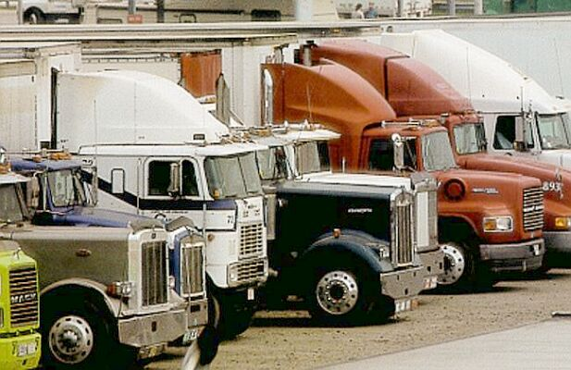
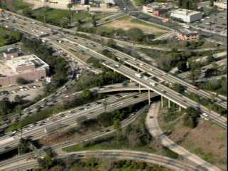
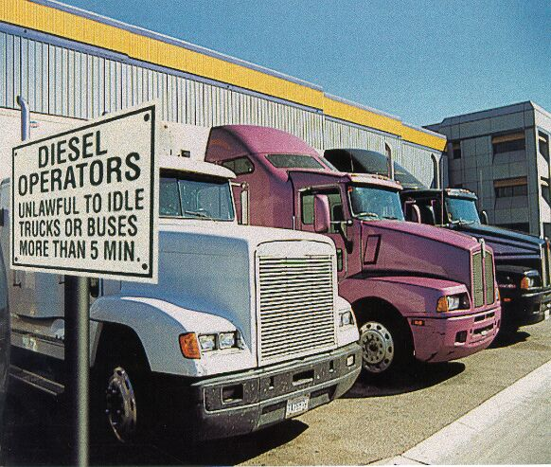
State and Local Idling Laws
EPA SmartWay Transport Partnership
July 19, 2006

Slide 2
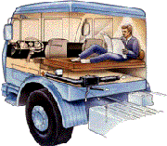
Background 1
Why do trucks idle?
  Non-Discretionary: traffic light, traffic.
  Discretionary (but necessary): during legally mandated rest period for cab comfort purposes (heat, cooling); engine conditioning.

Slide 3
Background 2
How long do they idle?
  1,000 – 3,000 hours per year, or 40%-50% of total engine operating time.
How many truck idle for extended periods?
  500,000 Class 8 heavy-duty diesel vehicles
Impacts:
  2 billion gallons of fuel consumed ($5 billion)
  11 million tons of CO2 (GHG)
  180,000 tons of NOx (Ozone)
  5,000 tons of PM
  Impaired driver health and safety; noise; increased maintenance costs and shortened engine life.

Slide 4
Background 3
What are the alternatives to idling:
  Mobile technologies
    Auxiliary power units
    Direct Fired Heaters
    Battery/electric HVAC systems
  Stationary technologies
    Electrified parking spaces (also known as “truck stop electrification”)
  For more info: http://www.epa.gov/smartway/idlingalternatives.htm
Key Point: alternatives are available, affordable, and effective.

Slide 5

Idle Restriction Laws
Federal: Not Applicable
State: 15 state-wide
Counties/Towns: 90 (in 30 states)
  List of State/Local laws: http://www.epa.gov/smartway/idle-state.htm
Original Intent: reduce emissions and noise
Compliance: generally poor
Enforcement: generally low priority
  Some active enforcement programs: MA, CT, NY

Slide 6
Concerns: Inconsistency
State vs. State
  New York: 5 minute limit; 10 exemptions
  New Jersey: 3 minute limit; 10 exemptions
State vs. County
  New York State: 5 minute limit; 10 exemptions
  NY Counties/Towns: Brighton (15 min.), Bronkville (3 min; 2 exemptions), Clifton Park (10 min), Flower Hill (2 min.), Ithaca (5 min; 4 exemptions), Lawrence (3 min., 2 exemptions), Mamaroneck (5 min., 2 exemptions), Milton (10 min), New Rochelle (5 min), NYC (3 min., 1 exemption), North Salem (5 min.; 2 exemptions), Northport (5 min.; 5 exemptions), Nyack (5 min), Port Chester (3 min.; 2 exemptions)
Key Point: knowledge of each state by state, or county/town within a state is difficult to know, absent signage and/or education.

Slide 7
Concerns: Impracticality
Weather exemption that allow idling for heat:
  PA: below 40 degrees F
  NY: below 25 degrees F
  DC: below 32 degrees F
  CT: below 20 degrees F
Average U.S. household winter thermostat setting: 70 degrees F
Key Point: many of the laws were written without input from the intended audience (truck drivers).

Slide 8
Status of State/Local Laws
Easy: state/local jurisdictions view enacting laws as their response to citizen complaints
Lack of Compliance: absent a more consistent, practical law, truck drivers will not comply with these laws making the law ineffective.
Lack of Enforcement: faced with competing priorities, law enforcement will not actively enforce idling laws

Slide 9
EPA-Trucking Industry-States
Develop model state idling law
  Goal: bring states and truck drivers/owners together, in small workshop setting, to reach agreement on model law
  Help 5 public workshops in Summer 2005: Atlanta, Baltimore, Chicago, New Haven, and San Francisco.
EPA’s Role:
  Not promulgating any type of regulation regarding vehicle idling.
  Our role is that of a facilitator on behalf of Federal government.
  This model does not represent EPA or any other federal government department or agency views regarding idling laws.

Slide 10
Model State Idling Law (Highlights)
Model Idling Law and Workshop Summaries: http://www.epa.gov/smartway/idle-state.htm
Purpose: in addition to emissions and noise, the need to conserve fuel and maintain adequate rest and safety of all truck drivers.
Applicability: in addition to truck drivers, applies to locations where trucks idle (load/unload locations), but not truck stops (due to lack of control).
Exemptions:
  Traffic; safety or health emergency; law enforcement; maintenance; work related operations.

Slide 11
Key Provision
Sleeper Berth Idling: allows idling for cab comfort purposes until the state implements a financial assistance program for idle reduction technologies (then sleeper berth idling is prohibited).
  Rationale:
    Simply passing a law prohibiting sleeper berth idling may not achieve the goal of the law and places the financial burden squarely on an industry that lacks the resources to adopt such technologies.
    Without financial assistance and based on low priority enforcement, truck drivers may simply pay the fine as a cost of doing business.
      Lose-Lose situation

Slide 12
Examples of State Financial Assistance Programs for IRTs
Arkansas and Minnesota: Low cost loans for IRTs
Oregon: (Lane Regional Air Pollution Authority) “Everybody Wins”
    Low cost lease-to-own program for IRTs
    Expanding to include SmartWay Upgrade Kits (incl IRTs) along the I-5 Corridor
California:
    AB 1901 creates revolving loan program for SmartWay Upgrade Kits (incl. IRTs)
    AB 2647 creates revolving loan program for Truck Parking Space Electrification
    Carl Moyer Program offers incentives for installing IRTs.
Washington: SB 6512 creates tax credits and incentives for IRTs
Pennsylvania: Grant and loan program for IRTs
Texas: Texas Emission Reduction Program offers grants for IRTs
Virginia: Small business loan program for IRTs
Ohio: HB 245 creates grant and revolving loan program for diesel projects
Wisconsin: Truck idling reduction grant program

Slide 13
Ways to Improve Effectiveness 1
1) Adopt model law (consistent/practical)
2) Proper training of LE, especially empowering Parking Enforcement Officers to issue idling tickets
3) Post signs at all high idle locations (truck stops, distribution centers, etc.)
4) Post hotline telephone number to report violations
5) Issue mock tickets as warnings

Slide 14
Ways to Improve Effectiveness 2
6) Publish and distribute directory of state/local idling laws with specifics at all truck stops
7) Include state law in SIP to increase potential enforcement and receive ERCs
8) Establish data tracking system for repeat violators within state
9) Encourage creation of “idle-free zones” as part of EPA’s SmartWay Transport Partnership for truck stop owners/operators
- Includes state offer of “enforcement discretion” (no active enforcement) at locations that sign on to implementing idle-free zones

