Slide 1
INTERNATIONAL TRADE DATA AND ASIAN TRADE ON THE
TEXAS – MEXICO BORDER
A Presentation to the
Texas Border Partnership Working Group
September 9, 2006
by
John P. McCray, P.E., Ph.D., UT San Antonio
210 458-2507 jmccray@utsa.edu

Slide 2
ASIAN TRADE ON THE
TEXAS – MEXICO BORDER
Introduction
Asian Imports at LA - Long Beach
Re-exports to Mexico
Texas Border Regions
Asian Trade Flow to the Border
Conclusions

Slide 3
ASIAN TRADE ON THE
TEXAS – MEXICO BORDER
Introduction
Asian Imports at LA - Long Beach
Re-exports to Mexico
Texas Border Regions
Asian Trade Flow to the Border
Conclusions

Slide 4
WE ALL KNOW THAT ASIA – PRIMARILY CHINA IS THE LARGEST TRADING PARTNER OF THE U.S.
BUT WHAT IMPACT DOES THIS TRADE HAVE ON THE TEXAS MEXICO BORDER?
To answer this question I will show the imports from Asia at LA/LB and relate the imports to re-exports to Mexico from ports along the Texas – Mexico Border

Slide 5
ASIAN TRADE ON THE
TEXAS – MEXICO BORDER
Introduction
Asian Imports at LA - Long Beach
Re-exports to Mexico
Texas Border Regions
Asian Trade Flow to the Border
Conclusions

Slide 6
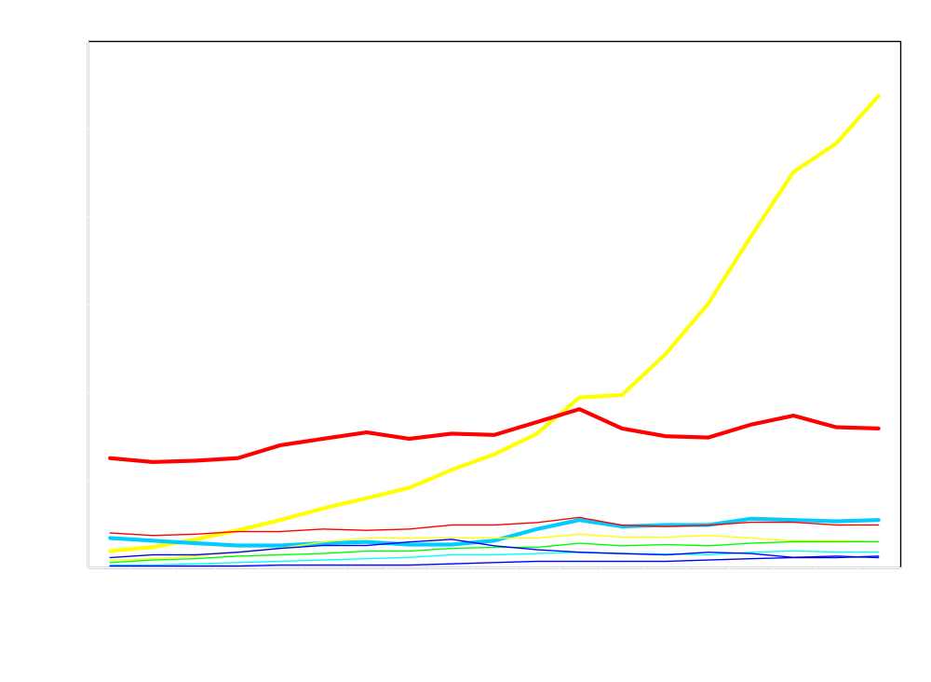
ESTIMATED 2007 ASIAN IMPORTS AT LA/LB
Billions
China 107
Japan 31
Korea 11
Taiwan 10
Others 21
China
Billions of U.S. Dollars
Japan
Korea and Taiwan
Others
John P. McCray, P.E., Ph.D. U Texas San Antonio jmccray@utsa.edu

Slide 7
ASIAN TRADE ON THE
TEXAS – MEXICO BORDER
Introduction
Asian Imports at LA - Long Beach
Re-exports to Mexico
Texas Border Regions
Asian Trade Flow to the Border
Conclusions

Slide 8
U.S. Re-exports
U.S. re-exports are products that have been imported into the U.S. and remained unchanged and then exported from the U.S.
Re-exports are a special type of exports delineated in some international trade data.
Re-exports from the U.S. ports along the Texas – Mexico border are the interest of this research

Slide 9
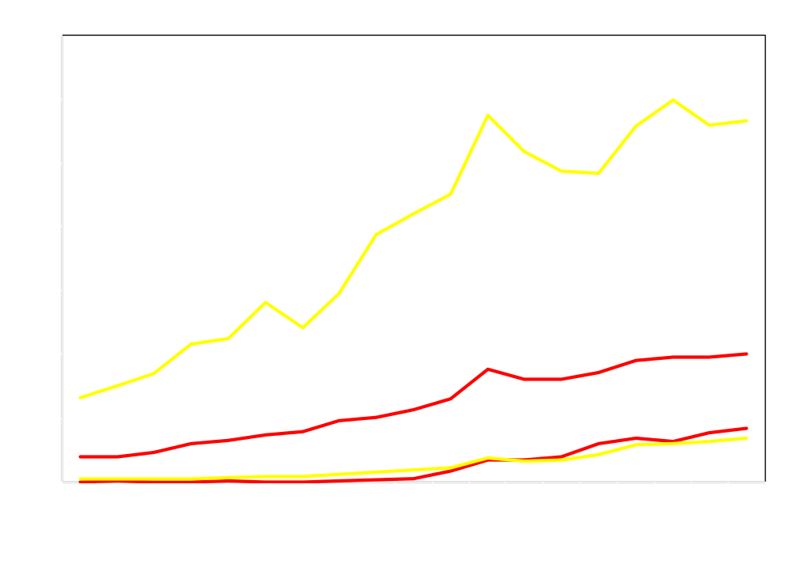
TOTAL U.S. EXPORTS AND RE-EXPORTS TO MEXICO IN SOUTH TEXAS AND WEST TEXAS
Re-exports are roughly half of U.S. exports to Mexico in West Texas and 17% in South Texas
Total South Texas Exports to Mexico
Billions of U.S. Dollars
Total West Texas Exports
West Texas Re-Exports
South Texas Re-Exports
John P. McCray, P.E., Ph.D. U Texas San Antonio jmccray@utsa.edu

Slide 10
ASIAN TRADE ON THE
TEXAS – MEXICO BORDER
Introduction
Asian Imports at LA - Long Beach
Re-exports to Mexico
Texas Border Regions
Asian Trade Flow to the Border
Conclusions

Slide 11
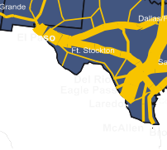
The two Texas Border Regions developed in this research are West Texas which includes ports in West Texas and New Mexico and South Texas which includes the ports from Del Rio to Brownsville as shown below.
WEST TEXAS/NM
SOUTH TEXAS

Slide 12
ASIAN TRADE ON THE
TEXAS – MEXICO BORDER
Introduction
Asian Imports at LA - Long Beach
Re-exports to Mexico
Texas Border Regions
Asian Trade Flow to the Border
Conclusions

Slide 13
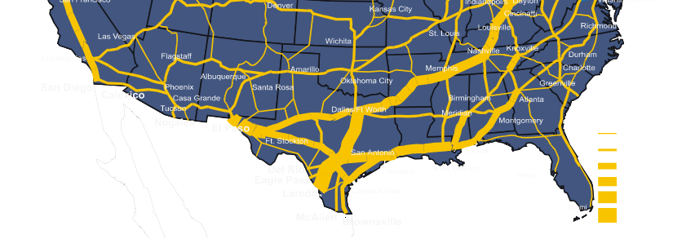
Asian import shipments at LA/LB are $180 billion primarily bound for the U.S. market.
However approximately $15 Billion will Move along the U.S. Southern Highway and Rail Corridor to the Texas Border.
Rail and Highway Corridor

Slide 14
Asian Shipments Bound for the Texas Border are Moved along the U.S. Southern Highway and Rail Corridor.
Rail and Highway Corridor
Approximately $15 billion of these Asian Imports have remained unchanged and will be re- exported to Mexico

Slide 15
Estimated 2007 Asian Shipments of $15.35 Billion are moved along the Southern Highway and Rail Corridor and then Moved into Mexico as Re-exports.
$15.35 Billion
Rail and Highway Corridor
$8.46 Billion
Computers 4.59
Semiconductors 1.96
Other 1.91
$6.88 Billion
Computers 1.94
Semiconductors 1.28
Other 3.66

Slide 16
TOTAL U.S. EXPORTS AND RE-EXPORTS TO MEXICO IN SOUTH TEXAS AND WEST TEXAS
Re-exports are roughly half of U.S. exports to Mexico in West Texas and 17% in South Texas
Total South Texas Exports to Mexico
Billions of U.S. Dollars
Total West Texas Exports
West Texas Re-Exports
South Texas Re-Exports
John P. McCray, P.E., Ph.D. U Texas San Antonio jmccray@utsa.edu

Slide 17
ASIAN TRADE ON THE
TEXAS – MEXICO BORDER
Introduction
Asian Imports at LA - Long Beach
Re-exports to Mexico
Texas Border Regions
Asian Trade Flow to the Border
Conclusions

Slide 18
SUMMARY
Asian trade on the Texas – Mexico border is dominated by imports from China and Japan.
It is estimated that in 2007 $15 Billion of Asian trade landed at Los Angeles – Long Beach will become U.S. re-exports to Mexico from ports along the U.S. – Mexico Border.
Asian imports that are re-exported to Mexico constitute 17% of south bound trade in South Texas and nearly one half of the south bound trade in West Texas.
Increasing Asian trade on the border will place additional pressure on the southern highway and rail corridor.
Increasing Asian trade on the border will provide economic development opportunities related to specific products like computers and semiconductors.
Understanding Asian trade flow to the Texas border ports is a critical component of economic development and transportation infrastructure planning.
John McCray jmccray@utsa.edu

Slide 19
ASIAN TRADE ON THE
TEXAS – MEXICO BORDER
Introduction
Asian Imports at LA - Long Beach
Re-exports to Mexico
Texas Border Regions
Asian Trade Flow to the Border
Conclusions

Slide 20
ASIAN TRADE ON THE
TEXAS – MEXICO BORDER
Introduction
Asian Imports at LA - Long Beach
Re-exports to Mexico
Texas Border Regions
Asian Trade Flow to the Border
Conclusions

