Slide 1
Potential Implications of NAFTA Truck Traffic:

Slide 2
for better or for worse?
Potential Implications of NAFTA Truck Traffic:

Slide 3
for better or for worse?
Potential Implications of NAFTA Truck Traffic:
Dr. Jorge A Prozzi
The University of Texas
Border Partnership Working Group
7 September 2006, Austin, Texas

Slide 4
Presentation Outline
Effect of Loads on Pavement Damage
  Historical (ESAL)
  Recent Findings (TxDOT Research 0-4510)
Data Analysis
Preliminary Results
Preliminary Findings

Slide 5
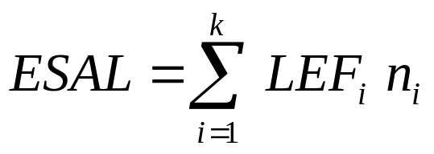
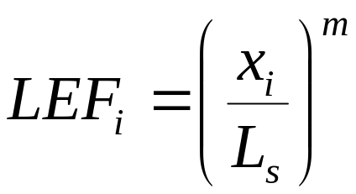
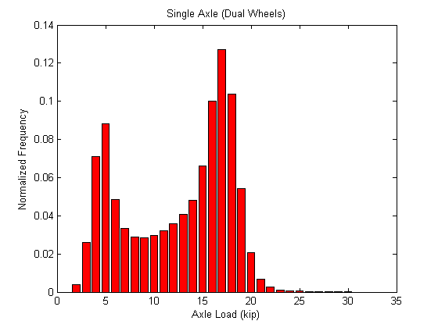
Historical: ESAL
Where,
LEF_{i} : load equivalency factor for load i-th
n_{i} : number of axles of load i-th
x_{i} : axle load i-th
L_{S} : standard axle load
m : power, usually 4.0

Slide 6
Historical: ESAL
Power value, m:
  4.0 according to analysis of the AASHO Road Test (based on riding quality)
  3.0-5.0 for fatigue cracking
  Around 1.0-2.0 for rutting or surface deformation
  Other research studies found values varying from less than 1.0 to 6.0 or even larger
So, which exponent (power) should we use?
Is it safe to use a higher power value?

Slide 7
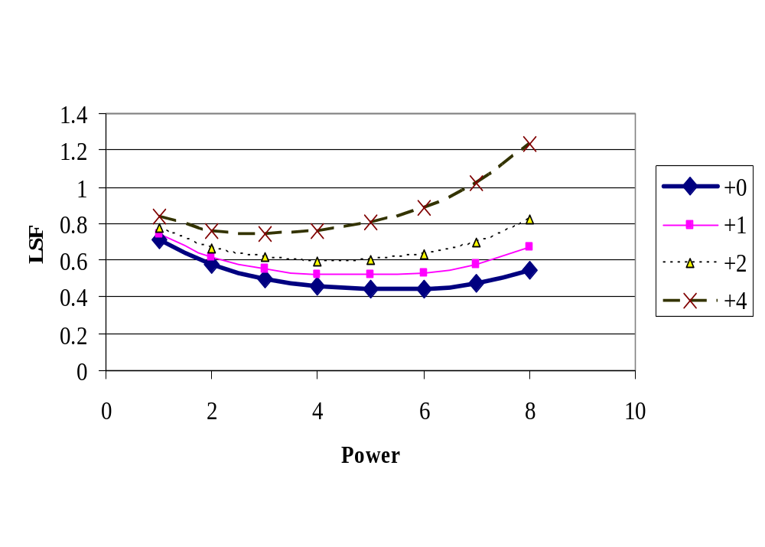
Historical: ESAL

Slide 8
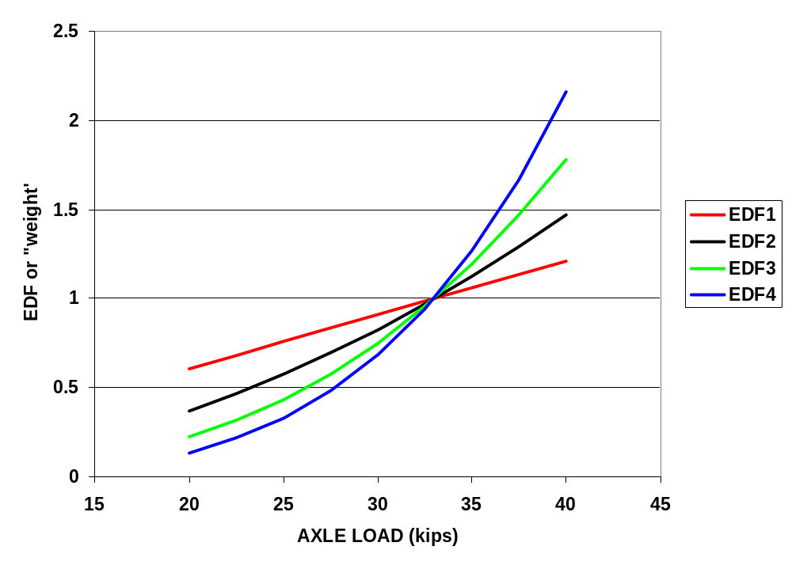
Historical: ESAL

Slide 9
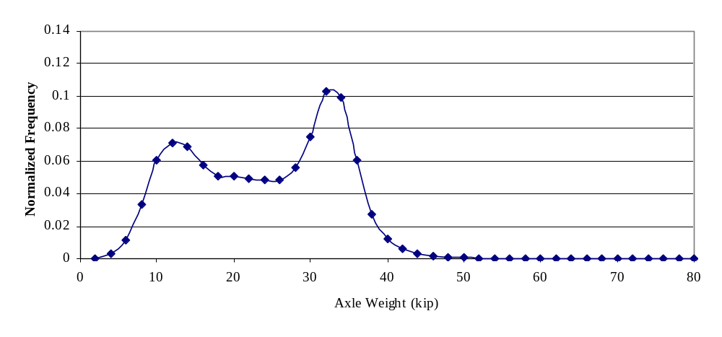
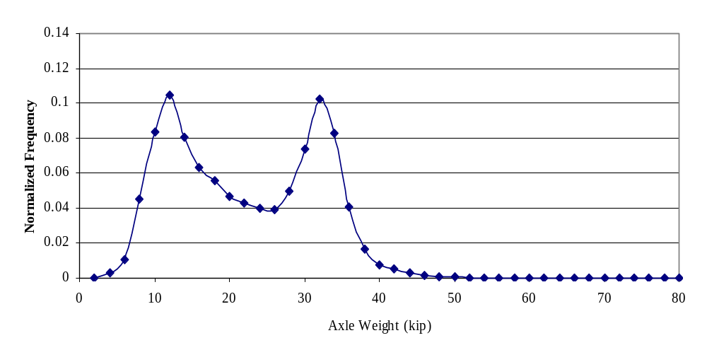
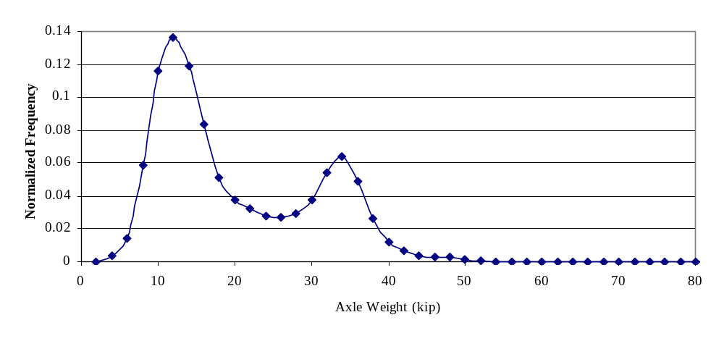
Historical: ESAL
Type III
Type II
Type I

Slide 10
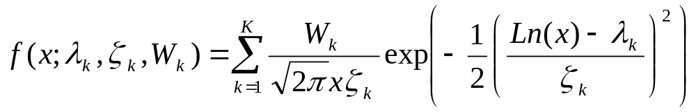
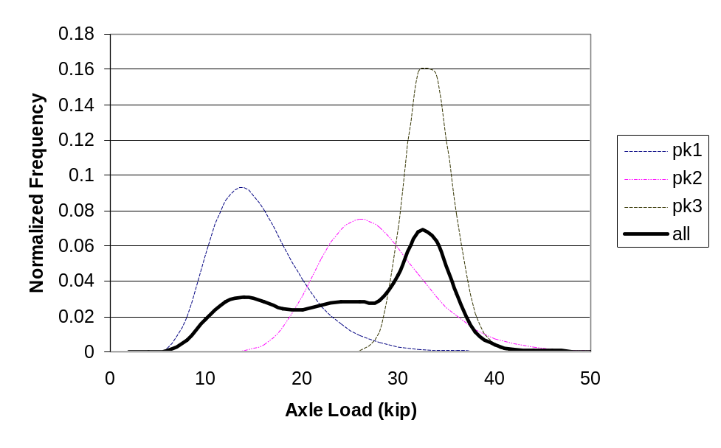
Recent Findings: TxDOT 0-4510
Mixed Lognormal distribution
Where
  x: axle load, kip
  k: the k-th peak
  K: number of peaks, (1-3)
  λ_{k}, ζ_{k}: parameters
  W_{k}: weights, ∑W_{k} = 1

Slide 11
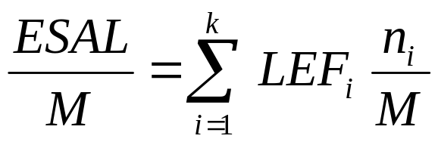
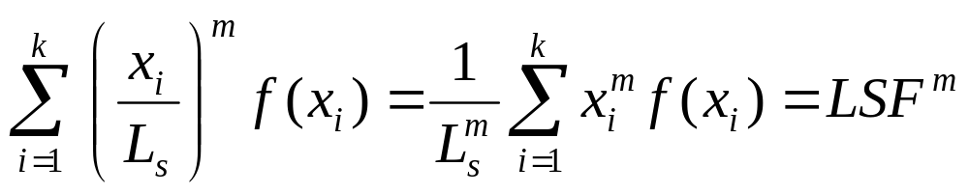
Recent Findings: TxDOT 0-4510
Where
  M : total number of axles
  f(x) : relative frequency of axle load i-th,
  LSF : load spectra factor, which represents the number of ESALs of a “representative” axle.

Slide 12
Recent Findings: TxDOT 0-4510
Advantages of the log-normal random variable X:
The logarithm of X (axle load) is normal.
X is non-negative, as axle loads are.
The parameters have physical meaning.
It has a close-form expression for the LSF, which captures the damaging effect of loads on pavements:

Slide 13
Data Analysis
TxDOT operates approximately 15-20 permanent WIM stations, mostly on rural interstate and US highways
Selection criteria:
  enough time series data, and
  close to US-Mexico border
D522, near McAllen (Hidalgo), on US 281
D516, near San Antonio, on IH 35

Slide 14
Data Analysis
Class 9 (3S2) and Class 5 were analyzed in detail; they account for +80% of the volume
Analysis was done
  per direction (north- and southbound)
  per axle type (steering, single, and tandem)
  per year (to establish and document trends)
We calculated pavement damage by applying the LSF concept explained earlier

Slide 15
Preliminary Results

Slide 16
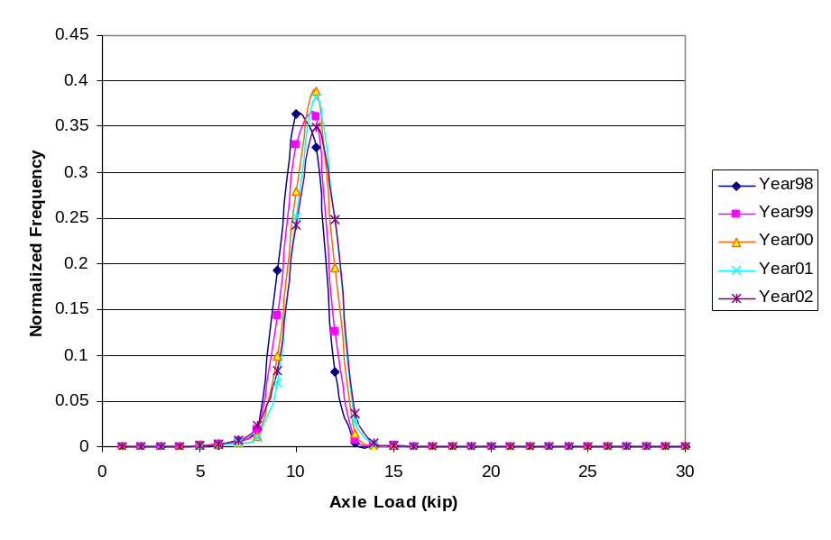
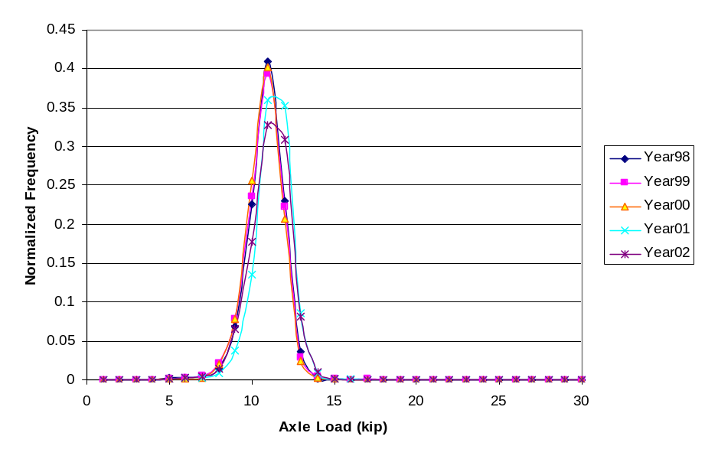
D522 – US 281, McAllen
Class 9, steering axle load distribution for northbound and southbound lanes

Slide 17
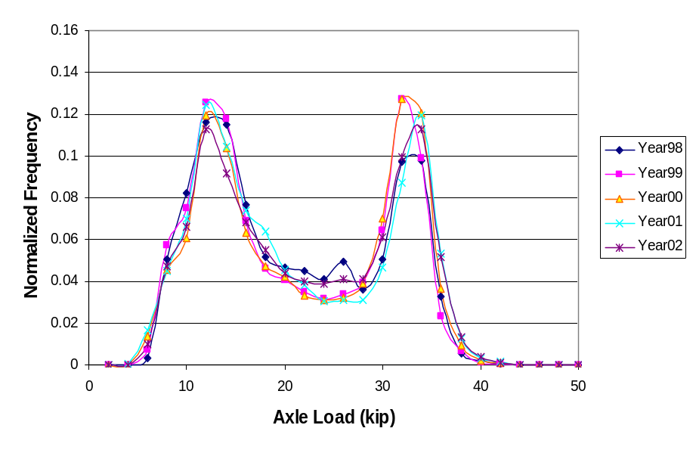
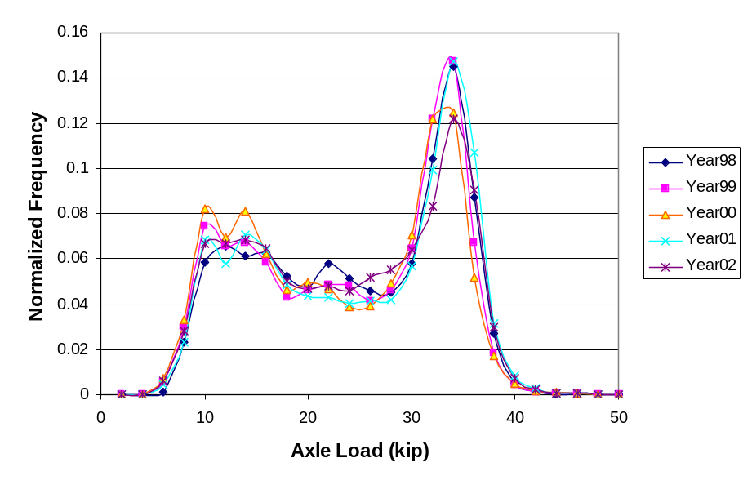
D522 – US 281, McAllen
Class 9, tandem axle load distribution for northbound and southbound lanes

Slide 18
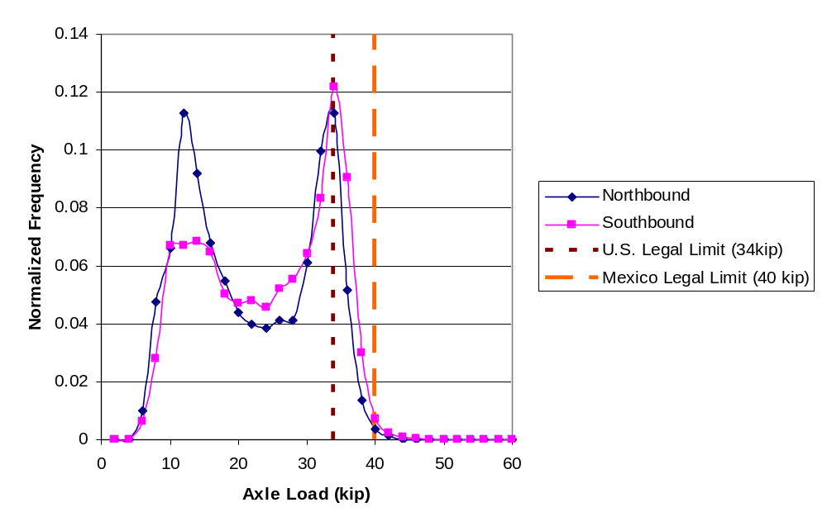
D522 – US 281, McAllen
Class 9, tandem axle load distribution for northbound and southbound lanes in 2002

Slide 19
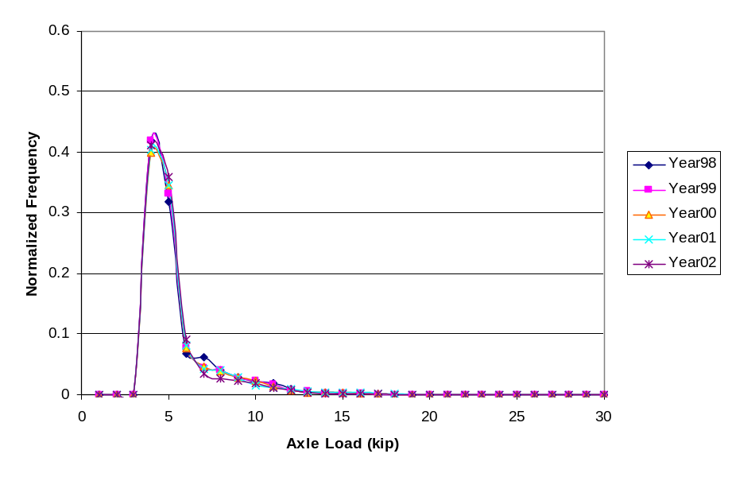
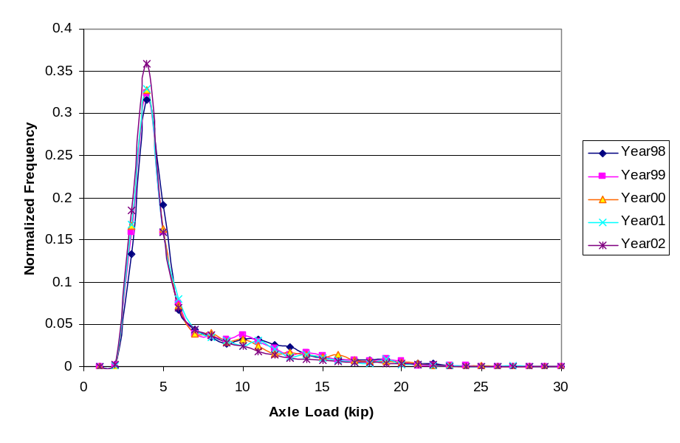
D522 – US 281, McAllen
Class 5, steering and single axle load distribution for southbound direction

Slide 20
Preliminary Findings (D522)
Class 9
  bi-modal for tandem, uni-modal for steering
  small but steady rightward shift
  northbound traffic is heavier than southbound
  northbound is Type III; southbound, Type II
Class 5
  steering and single show uni-modal spectra
  not significant directional distribution, nor load increase (rightward shift)

Slide 21
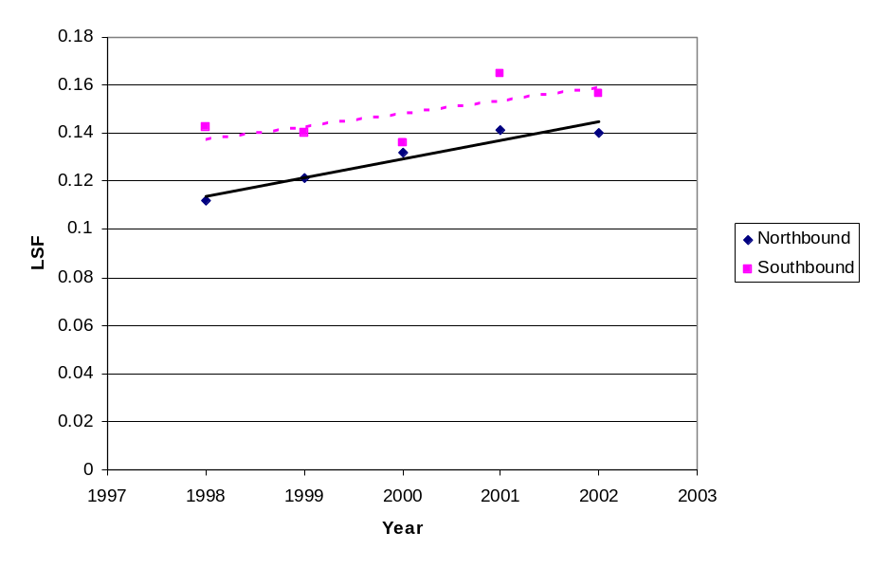
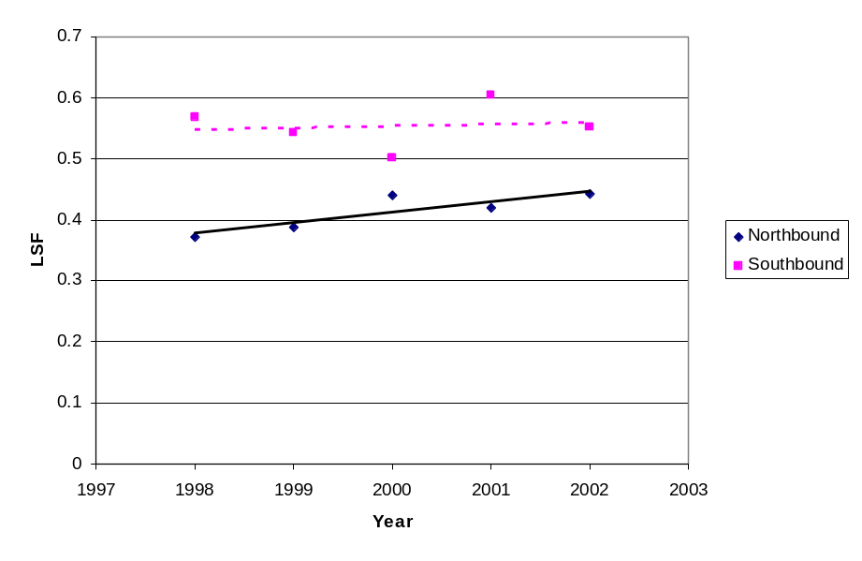
Preliminary Findings (D522)
Class 9, LSF estimation for steering and tandem axles in northbound and southbound directions.
Note that the “number of ESALs per vehicle” is increasing.

Slide 22
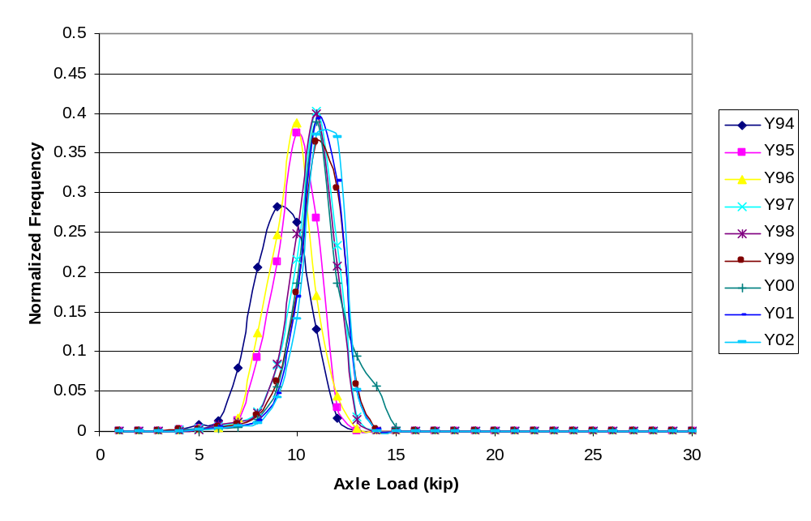
D516 – IH 35, San Antonio
Class 9, steering axle load distribution for northbound direction

Slide 23
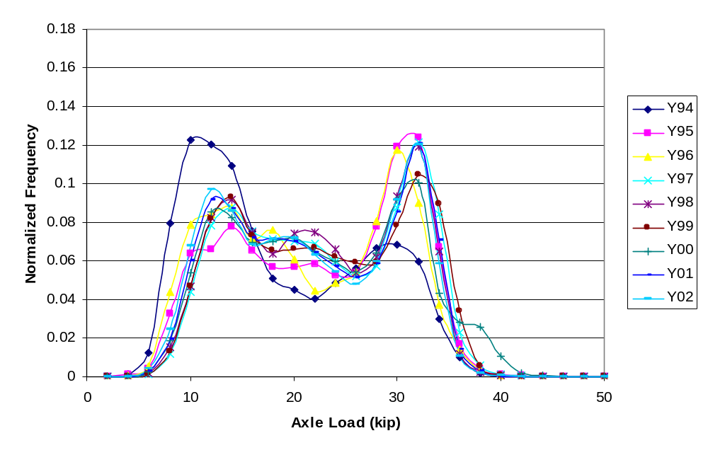
D516 – IH 35, San Antonio
Class 9, tandem axle load distribution for northbound direction

Slide 24
Preliminary Findings (D516)
Class 9
  bi-modal distribution for tandem axles
  uni-modal for steering axles
  consistent rightward shift
  spectra is changing from Type II to Type III
  no significant difference per direction
Class 5
  similar findings as for D522

Slide 25
Preliminary Conclusions
In addition the volume increase, the LSF, ESAL per vehicle, should be closely monitored.
The LSF captures the load-associated pavement damage “contained” in the load distribution.
We captured the change in the mid-1990s due to NAFTA, therefore, we should capture any future shift, even is it is small
Small changes, however, may cause significant increase in pavement damage and, therefore, on TxDOT maintenance and rehabilitation activities.

Slide 26
What is next?
We will incorporate at least two more WIM stations from the border region or I-10.
We are trying to obtain similar data from Mexican bordering states to carry out a similar analysis.
We want to evaluate the potential increase in the proportion of six-axle trucks (3S3).

