Slide 1
Interstate Oasis Program
Talking Freight Seminar
July 19, 2006
Hari Kalla
MUTCD Team Leader
FHWA

Slide 2
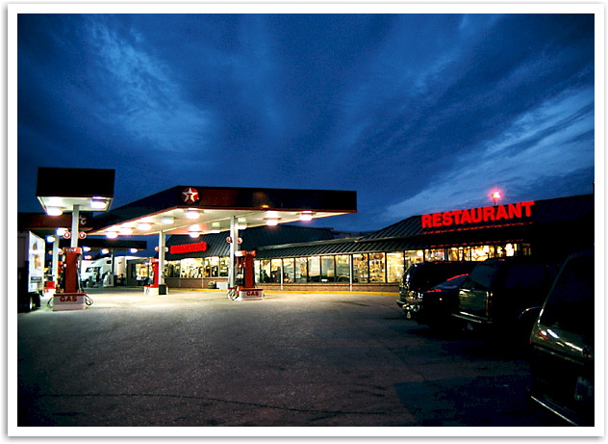
What is an Interstate Oasis?
Off-freeway facility, such as truck stop
Supplement public rest areas
A Rest Area/Stop Within Public Right-of-way is NOT an Interstate Oasis

Slide 3

SAFETEA-LU Section 1310:
Interstate Oasis Program
Secretary of Transportation shall:
  Establish an Interstate Oasis Program
  Develop standards for designating a facility as an Interstate Oasis
Facility must offer:
  Products and services to the public
  24-hour access to restrooms
  Parking for autos and heavy trucks
Facility must meet other standards as established by Secretary
Notes:
Vermont and Utah have established programs (Utah’s sign is shown for illustration purposes only)
Had stakeholder workshop in December (AASHTO, MISA, organizations representing truck stop operators, independent truckers, others) --- Barry Warhoftig and 3 other State DOTs participated.

Slide 4
SAFETEA-LU Section 1310:
Interstate Oasis Program
Standards for designation must include criteria relating to:
  Appearance of facility
  Proximity of facility to Interstate Highway
If a State elects to participate in program, any facility meeting standards established by Secretary shall be eligible for designation as Oasis
Interstate Oasis Logo
Notes:
Secretary shall design a logo to be displayed by facility designated as Oasis

Slide 5
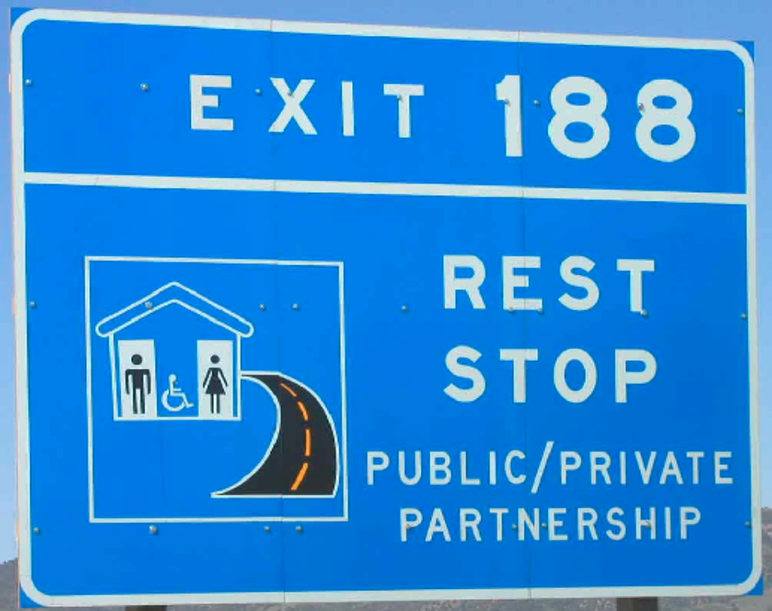
Existing Utah & Vermont Programs
UTAH DOT sign for ILLUSTRATION ONLY

Slide 6
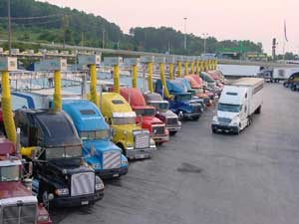
Interstate Oasis Program
Stakeholder Meeting 12/05
  AASHTO
  NATSO
  OOIDA
  MISA
  UT & VT DOTs
  Others
2/06 Federal Register request for comments
  “Non-rulemaking”
  Draft program & criteria
  9 Questions – input to help finalize program
Notes:
Non-rulemaking Federal Register Notice published Feb. 2006
First draft of program---minimum national eligibility criteria
Requested comments on draft and on several specific questions (including signing details), to help further refine and finalize program
After review of comments, plan to publish final policy in Federal Register (Summer ’06?)
Symbol (probably some form of palm tree) needs research before adopting---probably word message only on signs initially
Adopt symbol and text on eligibility criteria & signing into future MUTCD edition via normal rulemaking process

Slide 7
Draft Program Criteria
No more than 3 miles from an Interchange
Accessibility from Interstate Highway
Physical lay-out
Rest rooms and drinking water
Adequate Parking for all vehicles (Trucks allowed for 10 hrs)
Staffed 24/7
Products and services:
  Public Phones/food/Fuel, oil, and water for vehicles

Slide 8
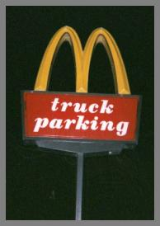
Interstate Oasis Program
Some Issues
Max. distance from interchange?
How to assess safety & convenience of access route & on-site layout?
No. and duration of truck parking
What required products & svcs?
Logo design?
Freeway signing for Oasis & relationship to Specific Service Signs (gas, food “logo” signs)

Slide 9
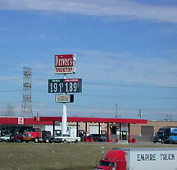

Status
Docket closed 4/28/06
  39 comments – reviewed & analyzed
  Good input, revisions made
  No clear consensus on logo design
Final policy in Federal Register later this summer
Symbol—needs human factors study
Normal rulemaking process to add symbol & text to MUTCD in future

Slide 10
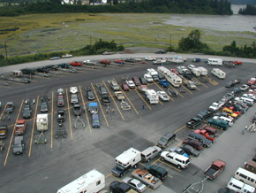
For More Information
http://mutcd.fhwa.dot.gov/
http://dms.dot.gov/
  FHWA Docket No. FHWA-2006-23550

Slide 11
Questions?
Hari Kalla
(202) 366-5915
Hari.Kalla@dot.gov

