Slide 1
Smart Park: Real-Time Truck Parking Information
Quon Kwan
Program Manager
FMCSA

Slide 2
Why Should You Be Interested in Truck Parking?
The Washington Times, March 9, 2006
  “Fatal Crashes Prompt Concern over Truckers”
    Blames lack of truck parking
Washington Post, April 16, 2006
  “Trucks on the Highway: How to Live with Them”
    Urges more truck parking

Slide 3
Smart Park: Real-Time Truck Parking Information
Outline
  FMCSA Mission
  Background
  Purpose
  White Paper
  Steps

Slide 4
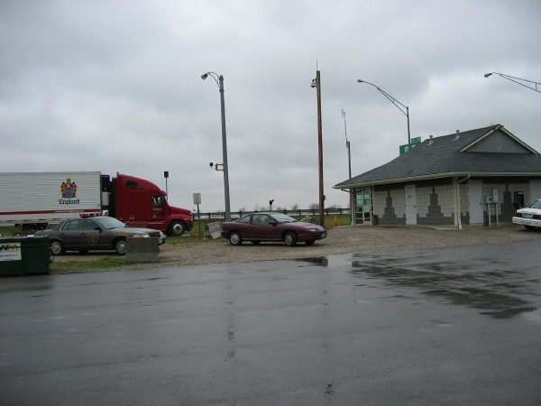
Smart Park: Real-Time Truck Parking Information
Mission:
  To reduce the number and severity of commercial vehicle (truck and motorcoach) crashes and enhance the efficiency of these vehicle operations

Slide 5

Smart Park: Real-Time Truck Parking Information
Background
  FMCSA focus on safety is primarily on the driver
  Driver fatigue accounts for the following:
    8.15% of all fatal truck crashes
    16% of all truck crashes
  Lack of safe, available parking contributes to truck driver fatigue

Slide 6
Smart Park: Real-Time Truck Parking Information
Background (continued)
  Facilitating parking is “flip-side” of Hours of Service (HOS) Rule
  Truck parking facilities
    Truck stops − Public rest areas
    Weigh/inspection stations − Park & Ride lots
    Ports

Slide 7
Smart Park: Real-Time Truck Parking Information
Background (continued)
  NTSB in Highway Special Investigation Report (SIR-00/01)
    Notes lack of information on safe, available parking for trucks on/near interstate highways
    Recommends FMCSA compile a guide on truck parking locations & availability

Slide 8
Smart Park: Real-Time Truck Parking Information
Background (continued)
  FHWA in Congressionally-mandated Study of Adequacy of Commercial Truck Parking Facilities (FHWA-RD-01-158)
    Notes adequate parking, but spaces are not where the demand is
    Recommends ITS deployment to provide parking information

Slide 9

Smart Park: Real-Time Truck Parking Information
Purposes
Demonstrate technology for providing information on parking availability in real time to truckers on the road
  Phase I
  Phase II

Slide 10
Smart Park: Real-Time Truck Parking Information
Purposes (continued)
  Phase I. Demonstrate a technology for
    Collecting data on space occupancy at a truck parking facility AND
    Determining from the collected data how many spaces are available

Slide 11
Smart Park: Real-Time Truck Parking Information
Purposes (continued)
  Phase II. Demonstrate technologies for
    Disseminating parking availability information
    Forecasting availability based on history
    Diverting truckers from filled parking areas to parking areas with available capacity along a corridor or within a region

Slide 12
Smart Park: Real-Time Truck Parking Information
White Paper
  Tasked Volpe with white paper, “ITS & Truck Parking” in February 2005
  http://www.fmcsa.dot.gov/safetyprogs/research/researchpubs.htm
  Provide background information and lay out issues
    Is there a shortage of parking?
    Is the shortage likely to worsen?
    What are potential solutions?
    How to match available supply with demand?
    What role can technology play?

Slide 13
Smart Park: Real-Time Truck Parking Information
White Paper (Continued)
Is there a parking shortage?
♦ Nationwide, truck parking appears adequate but regional shortages exist
♦ Under HOS rules, drivers may run out of driving time and not be near available parking

Slide 14
Smart Park: Real-Time Truck Parking Information
White Paper (Continued)
Will shortage increase?
♦ Truckload segment needs overnight parking
♦ Truckload segment experiencing substantial growth
♦ Increased “just-in-time” delivery contributes to demand for truck parking

Slide 15
Smart Park: Real-Time Truck Parking Information
White Paper (Continued)
What are potential solutions?
♦ Approaches to solving truck parking shortage fall into three major categories:
▪ Making underutilized spaces more attractive
▪ Increase supply of spaces
▪ Better match supply and demand

Slide 16
Smart Park: Real-Time Truck Parking Information
White Paper (Continued)
How to better match supply and demand?
♦ First, review process in choosing a location for an overnight rest—driver makes this decision
♦ Truck stop guides, guides and websites developed to help driver plan this decision
♦ No historical information provided on when parking likely to fill up each evening

Slide 17
Smart Park: Real-Time Truck Parking Information
White Paper (Continued)
Is there a role for technology?
♦ Yes, but appropriate technology and approach must be determined on a case-by-case basis
♦ Real-time parking information system must include:
▪ Parking data collection
▪ Conversion of data to parking availability info
▪ Information dissemination to drivers on the road

Slide 18
Smart Park: Real-Time Truck Parking Information
  Steps
  Replaced BAA with a GovWorks Pre-Solicitation in December 2005
  Sent Solicitation to Qualified bidders in January 2006
  Evaluated proposals in March 2006; no award yet

Slide 19
Smart Park: Real-Time Truck Parking Information
Steps (continued)
  FMCSA currently negotiating with GovWorks
  GovWorks will issue another solicitation in August 2006
  Solicitation will appear in FedBizzOps

Slide 20
Smart Park: Real-Time Truck Parking Information
Quon Kwan
  quon.kwan@dot.gov
  (202) 385-2389
  Technology Division
  Federal Motor Carrier Safety Administration
  400 Virginia Ave., SW, Suite 600
  Washington, DC 20024
  TTY Access: (800) 877-8339

