Slide 1
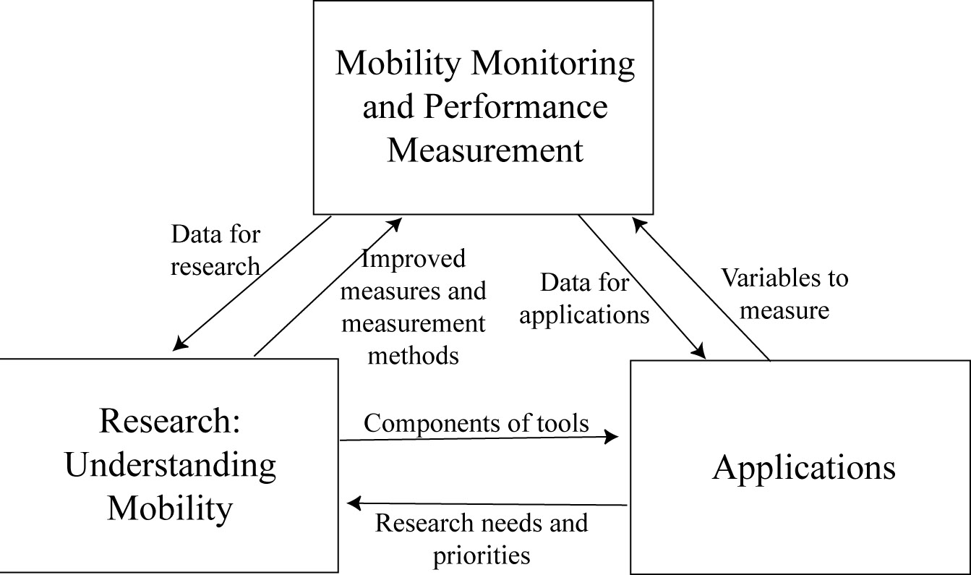
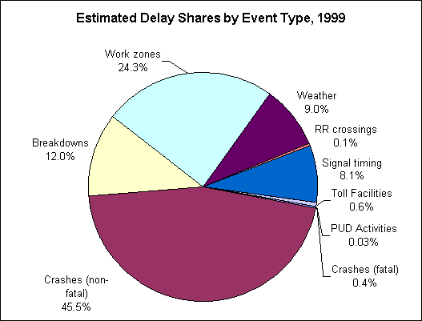
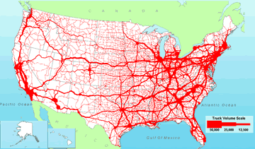

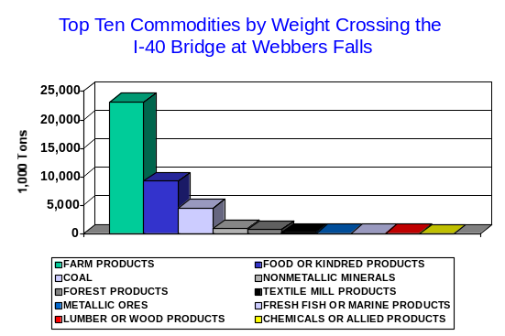
State Freight Transportation Data Needs
Rolf R. Schmitt
Office of Freight Management and Operations
September, 2006
Notes:
Thank you for the opportunity to provide some observations on freight transportation data needs of states. These observations are based primarily on the last three decades of experience with freight data at the U.S. Department of Transportation and the deliberations of the data committees of the Transportation Research Board (the TRB).

Slide 2

Freight has moved to center stage
Current freight volumes are straining the capacity of highway and rail networks.
Growth in freight volumes is likely to continue.
Demands for timeliness and reliability are unprecedented in our just-in-time economy.
Markets and supply chains have become global.
Rediscovering that freight transportation matters to local economic health.
Notes:
Freight transportation issues are not new. In the 1970s and early 1980s, national debates focused on deregulation and on truck size and weight while states dealt with short line railroads and regional commissions considered better freight access for economic development.
Freight transportation has become a major issue at all levels of government in recent years as steady growth of freight to be moved adds stress to already crowded highway and railroad networks. Many states are seeking to understand the current and future demand for freight to meet the logistical needs of their local businesses and deal with congestion, especially where passenger travel and goods movement share facilities.

Slide 3
Freight is different
Volumes fluctuate more rapidly due to local and national economic conditions
Flows are more heterogeneous and do not average out (e.g. agriculture vs steel mill vs clothing retail)
External flows are a major contributor to local congestion and local congestion affects external flows
Waterways, pipelines, and private railroads play major roles in freight movement
Trucks are more than big cars
Notes:
Central to the understanding of freight is that it is very different from passenger travel. Freight demand responds to volatile economic forces, is more heterogeneous, and often overwhelms local activity with interregional flows. Freight involves a different mix of modes which are dominated by private service providers. And on highways, the trucks that carry freight have different operating characteristics, infrastructure demands, fuel types, and emission characteristics than passenger vehicles.
As a consequence, data collections and forecasting models for understanding passenger travel do not necessarily apply to the world of freight.

Slide 4
Data Needs Assessments
An early perspective on freight statistics
  A. Lincoln, speech in favor of public improvements to transportation, 1848
    “Statistics will save us from doing what we do in wrong places.”
    “… that which is produced in one place to be consumed in another; the capacity of each locality for producing a greater surplus; the natural means of transportation, and their susceptibility for improvement; the hindrances, delays, and losses of life and property during transportation, and the causes of each …”
    “These statistics might be equally accessible, as they would be equally useful, to both the nation and the States.”
Notes:
So how has freight been considered in the past, and what data needs have been identified?
Freight was a part of the first national transportation policy study, published in 1808 by Secretary of Treasury Albert Gallatin, who included extensive data on infrastructure and finance.
Data needs were not articulated for the next two score and zero years, when Congressman Lincoln of Illinois recommended obtaining data on commodity flows by origin, destination, and mode, as well as statistics on investment needs, delay, and safety.
Abe also recommended that the data be shared by federal and state governments, and was an early advocate of geographic information systems by saying that “statistics will save us from doing what we do in wrong places.”

Slide 5
Data Needs Assessments
Assessments of state freight data needs
  NCHRP, Freight Data Requirements for Statewide Transportation Systems Planning: Research Report, Report 177, 1977
  TRB, Identification of Transportation Data Needs and Measures for Facilitation of Data Flows, Report to the U.S. Department of Transportation, 1981
  TRB, Information Needs to Support State and Local Transportation Decision Making, Conference Proceedings 14, 1997
Notes:
TRB and the National Cooperative Highway Research Program have assessed freight data needs of states roughly once each decade over the last 30 years.

Slide 6
Data Needs Assessments
National freight data and related needs assessments
  TRB, Data Requirements for Monitoring Truck Safety, Special Report 228, 1990
  TRB, Data for Decisions: Requirements for National Transportation Policy Making, Special Report 234, 1992
  TRB, Information Requirements for Transportation Economic Analysis, Conference Proceedings 21, 2000
  TRB, Performance Measures to Improve Transportation Systems and Agency Operations, Conference Proceedings 26, 2001
Notes:
TRB has also considered freight data needs of states as part of national and subject-specific data assessments. These are examples.

Slide 7
Data Needs Assessments
National freight data and related needs assessments (continued)
  TRB, Concept for a National Freight Data Program, Special Report 276, 2003
  Committee on National Statistics, Measuring International Trade on U.S. Highways, 2005
Notes:
TRB is not the only part of the National Academies to assess freight data needs. The Committee on National Statistics has also weighed in.

Slide 8
Themes of Data Needs Assessments
Information needs for specific topics
  Freight flows
  Infrastructure condition and use
  Economics and finance
  Safety
  Energy and environment
Methods and standards
The promise of technology
Notes:
The issues and findings of these many assessments can be summarized by specific topics, as well as by the crosscutting topics of standards and technology.

Slide 9
Themes: Freight flows
Importance of origin-destination data on commodity flows for
  Transportation policy, planning, regulation
  Economic development and other non-transportation applications
More geographic detail, timeliness, accuracy
Link commodity flows to vehicle/vessel/craft movements on specific facilities
Measure domestic transportation of international trade
Notes:
The key element of most assessments is the flow of goods moving among localities, either as a measure of demand or as the denominator of safety, environmental, and hazard risk measures.
Freight flow data are critical to sorting out what should be done by whom when interregional traffic contributes significantly to local congestion and local congestion disrupts the logistics and distant companies and places, perhaps with national economic consequences.

Slide 10
Themes: Infrastructure condition & use
Compile data on facility location and connectivity
Improve both planimetric and topological accuracy
Improve consistency of definitions and methods across modes and jurisdictions
  Capacity and congestion measures
Measure temporal variation in use and capacity
Improve timeliness and reduce cost of data
Improve coverage and accuracy of truck counts
Notes:
Agencies also need to understand how freight affects the capacity of specific transportation facilities, a task made more difficult by the lack of consistent measures of capacity across the freight modes. Indeed, industry consensus on methods for measuring port and railroad capacity are currently lacking.

Slide 11
Themes: Economics and finance
Compile data to measure
  Regional economic consequences of investment
  Productivity, cost responsibility, etc.
Collect cost data for vehicle operations, carrier operations, goods movement
  Effectiveness and consequences of revenue measures
Incorporate new forms of finance into statistics on revenues and expenditures for public infrastructure
Notes:
Freight issues go beyond congestion. Inexpensive and reliable freight transportation makes our just-in-time economy with global supply chains possible. Efficient investments in freight infrastructure requires an understanding freight transportation costs, how those costs affect shippers, and how those costs in turn affect local and national economies.
Cost data are also central to forecasting how freight movements might change in response to tolling and value pricing.
And traditional statistics on tax revenues and public expenditures for transportation will need modification to incorporate the increased reliance on the private sector to finance public infrastructure.

Slide 12
Themes: Safety
The importance of VMT & flow data for exposure
Improve crash data to establish causality
Integrate data systems to match crash, medical, criminal justice, and facility inventory data to get the complete picture of the event, the circumstances surrounding the event, and the consequences of the event
Data on carrier maintenance practices
Notes:
Routing of hazardous materials, truck size and weight limits, and other aspects of freight transportation are particularly sensitive public concerns over safety. In addition to incident data, data on freight flows are needed to understand incident rates and risk exposure.

Slide 13
Themes: Energy and environment
The importance of VMT & flow data plus time-of-day, speed, & idling to understand consumption and emissions
In-use measurement of fuel efficiency and emissions
Beyond air quality: compile data on noise, invasive species, etc.
Improve data integration for a complete picture of the surrounding environment
Notes:
Air quality is a good example of how freight differs from passenger travel. Idling and diesel emissions are key aspects of freight’s contribution to air quality, and relatively minor for passenger travel.

Slide 14
Themes: Methods and standards
Adjust data collections to new forms of business and new types of commodities while maintaining comparability of statistics over time
Improve statistical quality
Minimize respondent burden and costs of data collection/processing
Transparency and accessibility of public data versus privacy and confidentiality of respondents
Notes:
In addition to specific topics, freight data needs assessments cover crosscutting issues such as data collection and analysis methods and related standards. These issues are not unique to freight transportation, although adjustments in data definitions to reflect changes in the industry and what it moves makes comparability of statistics over time a particularly difficult challenge.
Transparency -- clearly identifying how the data are generated and how good the data are -- is is worth emphasizing since it is often critical to the credibility and understandability of resulting statistics.

Slide 15
Themes: Methods and standards
Importance of classification systems
  Commodities and products
    Trade-based Standard Classification of Transported Goods (SCTG) and Harmonized System (HS) versus industry-based Standard Transportation Commodity Codes (STCC) and Census product list
    North American Product Classification System (NAPCS)
  Establishments
    North American Industrial Classification System (NAICS)
  Standard Occupation Classification (SOC)
    The number of truck drivers does not equal the number of trucking industry employees
  Land Use
Notes:
Classification systems are one of the more important and obscure crosscutting topics. These systems affect the way in which we collect and aggregate data, and thus the way in which we view the world through the resulting statistics.
National and international classification systems exist for commodities, establishments, and occupations, and freight transportation is well represented in each. Different commodity classification systems exist for different purposes, raising comparability issues that will be magnified as product classification systems are expanded from services to physical commodities. Land use classification is a less developed field, particularly from the freight perspective.

Slide 16
Themes: The promise of technology
Intelligent Transportation Systems (ITS) as a new data source
  How must we adapt planning tools to use more precise and timely data on narrower slices of transportation?
  How to filter spurious observations without losing serendipity?
ITS as a data need
  What do we need to know to deploy ITS efficiently and effectively?
Notes:
Tremendous advances in information technology are a siren call to most needs assessments. If we are instrumenting transportation systems to make them intelligent, why can’t we tap the data from those instruments to meet our information needs?
A few assessments recognize that ITS data are very different from traditional data: perhaps more accurate and certainly more detailed, but covering smaller slices of transportation. For example, we used to monitor trucks by stopping the truck, weighing it, and asking the driver questions about the cargo carried and other characteristics. Now we use weigh-in-motion equipment to get far more observations for less cost per observation and no burden to the trucker, but the data are limited to axle weights and spacing.
The differences between ITS-based data and traditional data suggest the need for new analytical tools to remove spurious observations without eliminating real but unexpected variability, to integrate narrower slices of data into a larger picture, and to take advantage of greater temporal detail of the data in models previously designed around averages.

Slide 17
Themes: The promise of technology
Geographic Information Systems (GIS)
  Improving data integration, analysis, and communications with the public through maps
  Greater demand for accuracy when data is on a map
Direct access to carrier and shipper data
  Timely and potentially less expensive
  Coverage limited to cooperating companies
  Confidentiality protection and proprietary restrictions versus transparency and availability to wider public
  Successes are possible: travel time in freight corridors project
Notes:
GIS has been one of the most promising information technologies since a DOT report on transportation information in 1969, but a TRB assessment in 2004 suggests that the promise is still largely unfulfilled.
The most successful aspect of information technology may be in the use of computer-aided telephone interviews to improve efficiency and quality of surveys. Handheld computers are providing similar benefits for roadside surveys, police reports, and other collections of data in the field.
Direct access to shipper and carrier data systems is another way to measure freight activity, but the potential is often undermined by collisions between proprietary interests and public agency desires to make data available and transparent.
The combination of technology and the private sector can be very effective if the institutional problems are overcome. A joint effort of the Federal Highway Administration and its partners in the trucking and communications industries is resulting in a wealth of travel time data being produced unobtrusively by 250,000 vehicles operating nationwide.

Slide 18
New frontiers
The post 9-11 world
  Data needs for security planning
  Security monitoring as a source of data
  The potential for respondent rebellion
Planning for pandemics
  Adapting data on commodity movements for public health risk assessments
Performance measurement
  Bridging the cultural divides between data and performance measurement shops
Notes:
So much for what’s been studied. There are new frontiers to explore in the next generation of freight transportation data needs assessments.
Current security concerns are a source of data needs. Reporting systems to support security measures are a potential source of data. And the politics of security data could turn gathering of transportation information into collateral damage if the public reacts strongly to privacy concerns.
Planning for pandemics is a major application of travel and commodity flow data to public health.
Performance measurement is a new outlet for data programs and a new reason for improving timeliness, accuracy, and integration of data.

Slide 19
National versus state and local freight data
Concept of a National Freight Data Program (TRB Special Report 276)
  The report assumed that the federal government would take responsibility for collecting data on commodity flows and related freight activity with adequate geographic detail to support project planning and design
  Project planning and design requires data for census tracts or traffic analysis zones (TAZs)
  The report was silent on federal-state-local-private relationships needed to provide data at that level of geographic detail
Notes:
Another less explored frontier is the relationships among national, state, and local freight data collection programs. This topic has been given relatively little attention since Lincoln’s assessment in 1848. Even the TRB report on a national freight data program said relatively little on who should be collecting what.

Slide 20
The problem of geographic detail
An origin-destination matrix with 6 modes, 40 commodities, and
  50 states has 600,000 cells
  114 CFS regions has 3.1 million cells
  172 BEA economic areas has 7.1 million cells
  370 Metro Statistical Areas has 32.9 million cells
  3,141 counties and equivalents has 2.4 billion cells
  33,000 zip codes (approx) has 261.4 billion cells
  65,000 census tracts (approx) has 1.0 trillion cells
How do we collect enough data to fill the cells?
Notes:
The basic problem is that most local freight is headed to or coming from someplace else. Everyone needs their detailed portion of a national picture, and that picture gets enormous very fast.

Slide 21
Strategies for nationwide collection of locally useful data
National census
Nationally required local data collection
  (e.g. unemployment data, Highway Performance Monitoring System)
National architecture for local data collection
  (e.g. ITS Architecture, National Spatial Data Infrastructure)
National control totals guiding local data collection
  (e.g. Freight Analysis Framework)
Best practice guidelines for local data collection
Purchase from the private sector
Notes:
A variety of institutional models exist for nationwide collection of locally useful data. We create national unemployment statistics from local unemployment reporting and national maps from local mapping. We require state governments to report performance measures for a sample of their highways, and we collect local journey-to-work data as part of a multi-billion dollar national census. We need to ask: what are the advantages and disadvantages of each strategy for meeting both national and local data needs, especially for freight transportation?

Slide 22
The FAF Approach
The Freight Analysis Framework (FAF) provides national context and external flows for states and localities, but is only approximate for internal flows
  Origin-destination flows by 43 commodities and 7 modes for 114 regions plus 17 international gateways and 7 foreign trade regions
  Tonnage converted to truck payloads and assigned to National Highway Planning Network
  2002 base, forecasts through 2035, provisional annual estimates
  All data and methods public and transparent
Notes:
While some modal networks such as inland waterways are small enough to cover through a national census with complete local detail, the size and complexity of commodity movements by all modes goes well beyond the resources of any one agency to measure.
The Freight Analysis Framework--also known as the FAF-- is the Department of Transportation’s two pronged approach to balancing national coverage and local data needs. The FAF combines data from the Commodity Flow Survey, other national data sources, and special estimates into a national picture of flows to, from, and through states and major metropolitan areas. The FAF also estimates the total amount of foods that moves within each area. This picture provides totals within which a state or locality can examine its local freight flows.

Slide 23
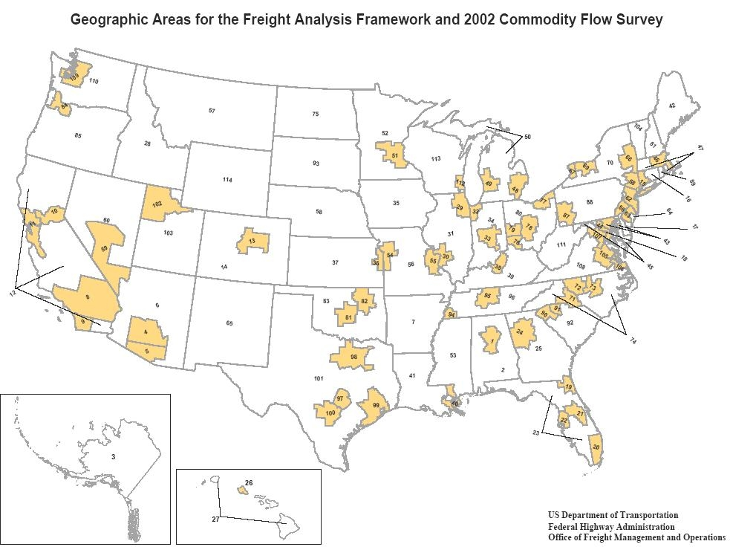
The FAF Approach
Notes:
This map gives an idea of the FAF’s geographic detail. This detail is the most that can be reasonably provided by the Commodity Flow Survey.

Slide 24
The FAF Approach
The Freight Model Improvement Program
  Develops analytical tools and data collection methods for state and local agencies to fill in local detail beyond the resolution of the FAF
  The state of the art in freight demand forecasting is decades behind travel demand forecasting. TRB conference in September 2006 is to set the agenda for catching up.
  New approaches to freight demand forecasting should guide new data requirements.
In the meantime, we all need better truck counts.
Notes:
The second prong of the FAF approach is to develop analytical and data collection methods that support local studies of freight flows within the FAF regions. This effort will start with an assessment of the state-of-the-art in freight demand forecasting models and related local data collection, and will chart a path for improvement. Travel demand models and household surveys evolved together in the metropolitan studies of the 1960s and 1970s. It is time for the freight community to begin to catch up. The Freight Model Improvement Program will be launched in September 2006 by TRB’s National Conference on Freight Demand Modeling: Tools for Public Sector Decision Making. Participation by state departments of transportation is encouraged.

Slide 25
Key questions for proposed data needs
Would decisions be different with no data or the wrong data?
How much geographic and other detail, quality, and timeliness is required for the data to make a positive difference in public and private decisions?
Notes:
To conclude, this presentation has enumerated many data desires and strategies to fill those desires; however, the potential for the desired data to affect decisions should be considered before the desires are articulated forcefully as data “needs” warranting our attention.
Good data do not guarantee good decisions. The late Edgar Horwood of the University of Washington was fond of noting that more data slows down or stops decision making. Perhaps the more important question is whether no data or bad data will result in a worse decision? And how bad is bad in terms of detail, timeliness, and accuracy?

Slide 26

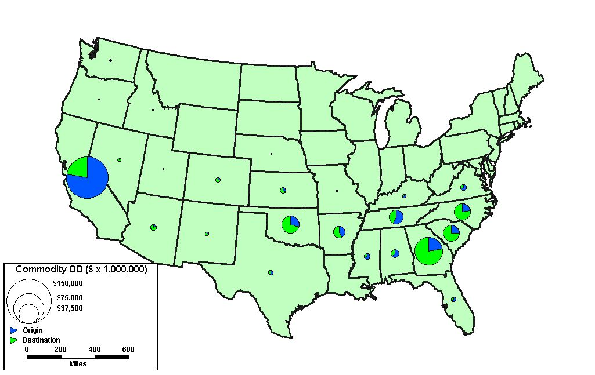
For further information
Rolf.Schmitt@dot.gov
202-366-9258
Tianjia.Tang@dot.gov
202-366-2217
WWW.DOT.GOV/FREIGHT
WWW.FMIP.GOV
Notes:
Thank you for your attention. I will be glad to answer any questions and learn from your comments.

