Slide 1
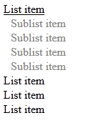
Create tree view like the following:
  When the mouse goes over an item
  the sub list should be shown
  The tree view should work with
  unlimited number of sub lists

Slide 2
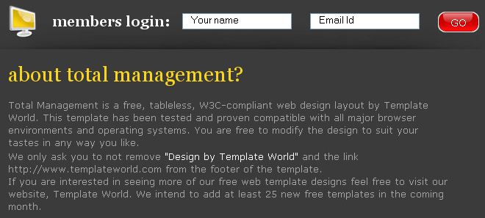
2. Create the following Web page using HTML with external CSS file. Note that the images should be PNG with transparent background.

Slide 3
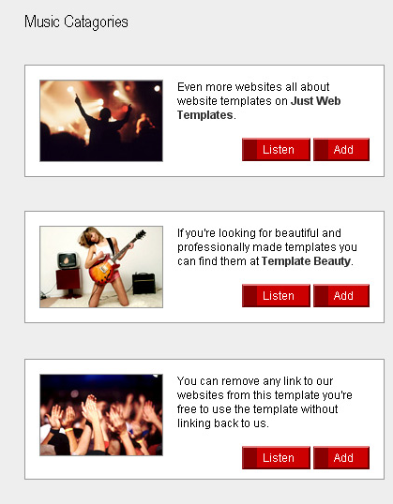
3. Create the following Web page using external CSS styles. Buttons should consist of PNG images with text over them.

Slide 4
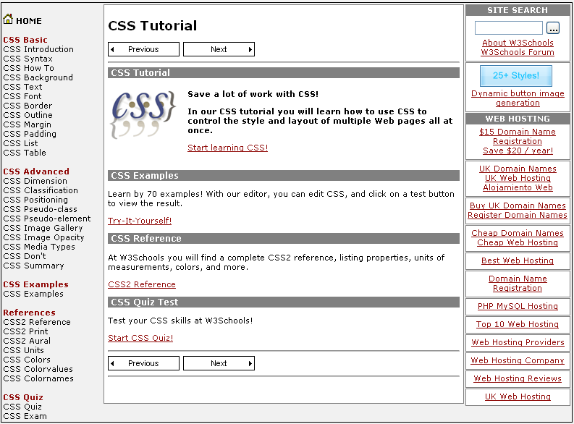
Given the picture below create the Web site
  Use CSS and HTML 5

Slide 5
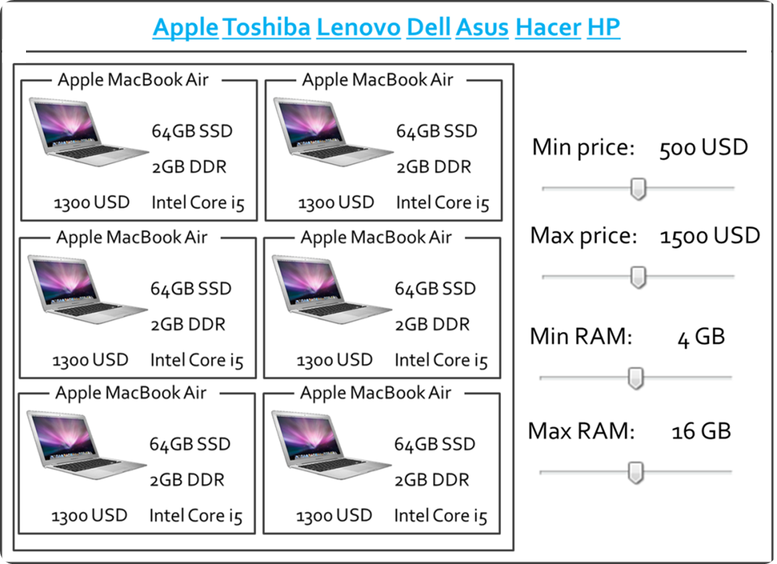
Create the following HTML 5 Page
  Do it without tables

Slide 6
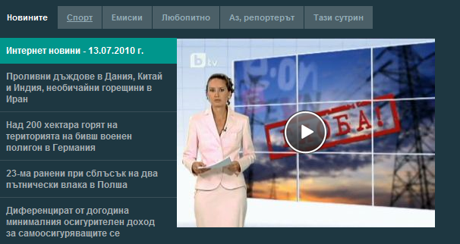
Create the following Web page using HTML and external CSS. Using tables, inline styles and deprecated tags is not allowed.

