Slide 1

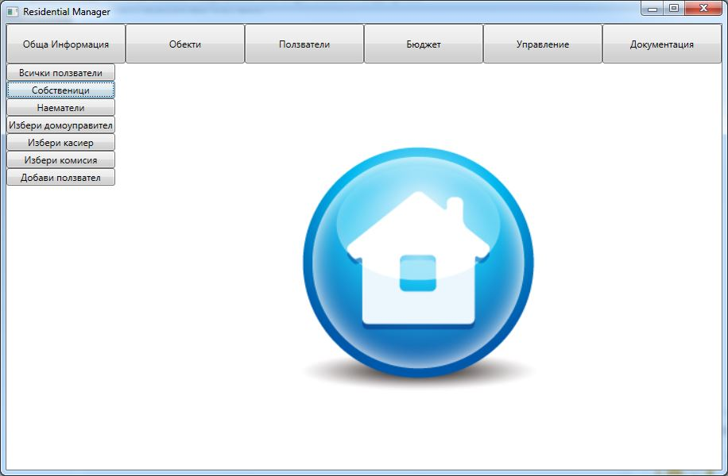
Residential Manager
The helper for the commonhold management
GOSHENITE
TEAM “GOSHENITE”:
Antoni dragomanov – dragomanov
Ivelin stanchev – teleriknetwork
Yordan bonev – Yordan.Bonev
Krasimira tsekova – KrasiTsekova
Todor todorov - ttitto

Slide 2
Residential Manager
4 interfaces
26 classes
6 abstract classes
1 exception class
1 structure
4 enumerations
1 event
2 design patterns – Singleton (2),
GOSHENITE

