Slide 1
Introduction Tapiwa Tiyemba

Slide 2
Inventory System – By Tapiwa Tiyemba

Slide 3
Specification

Slide 4
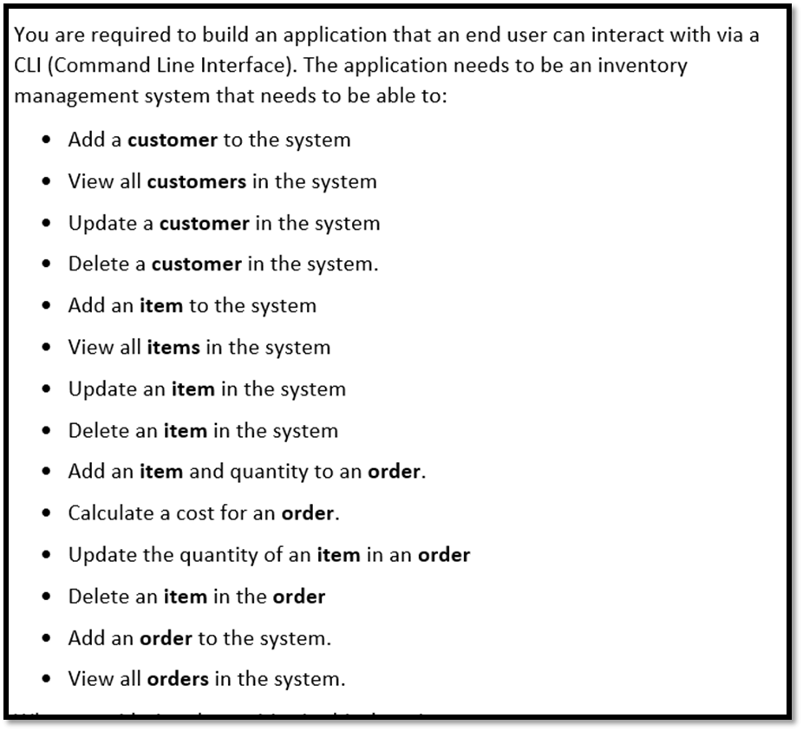

Slide 5
Analysis and Design

Slide 6
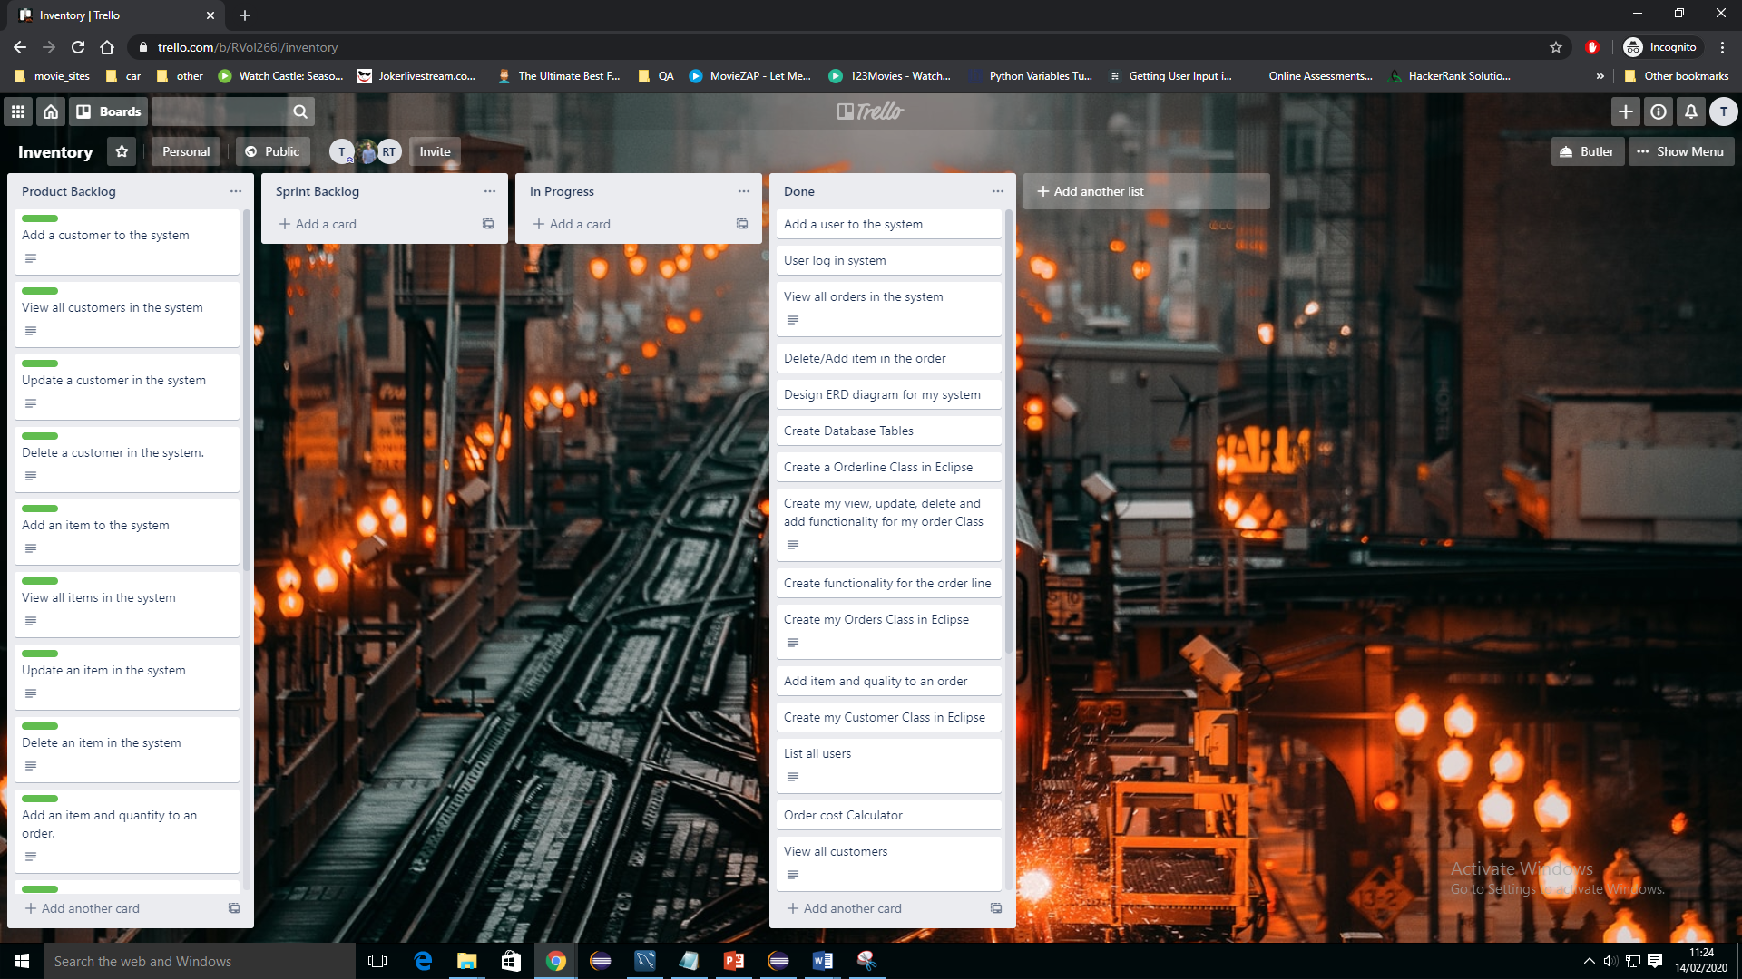
Trello Boards

Slide 7
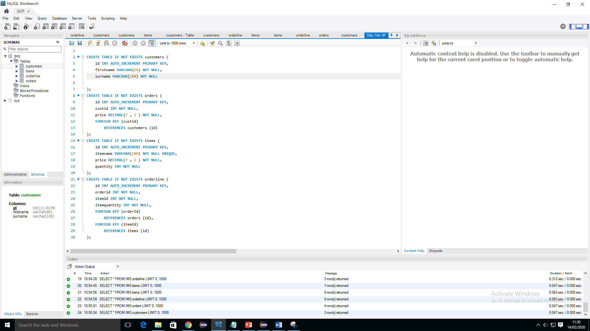
Mysql

Slide 8
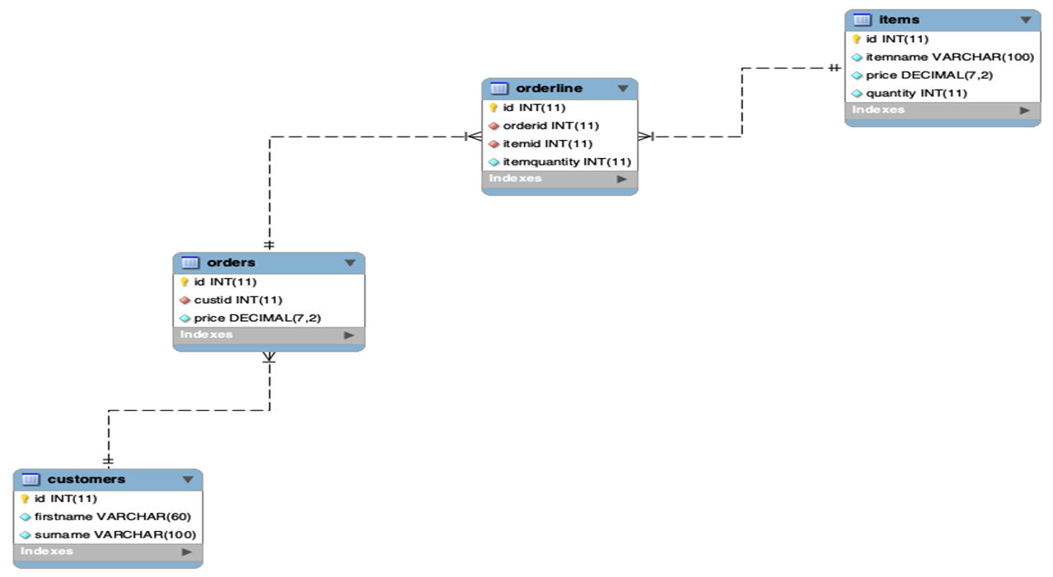
Entity Relationship Diagram

Slide 9
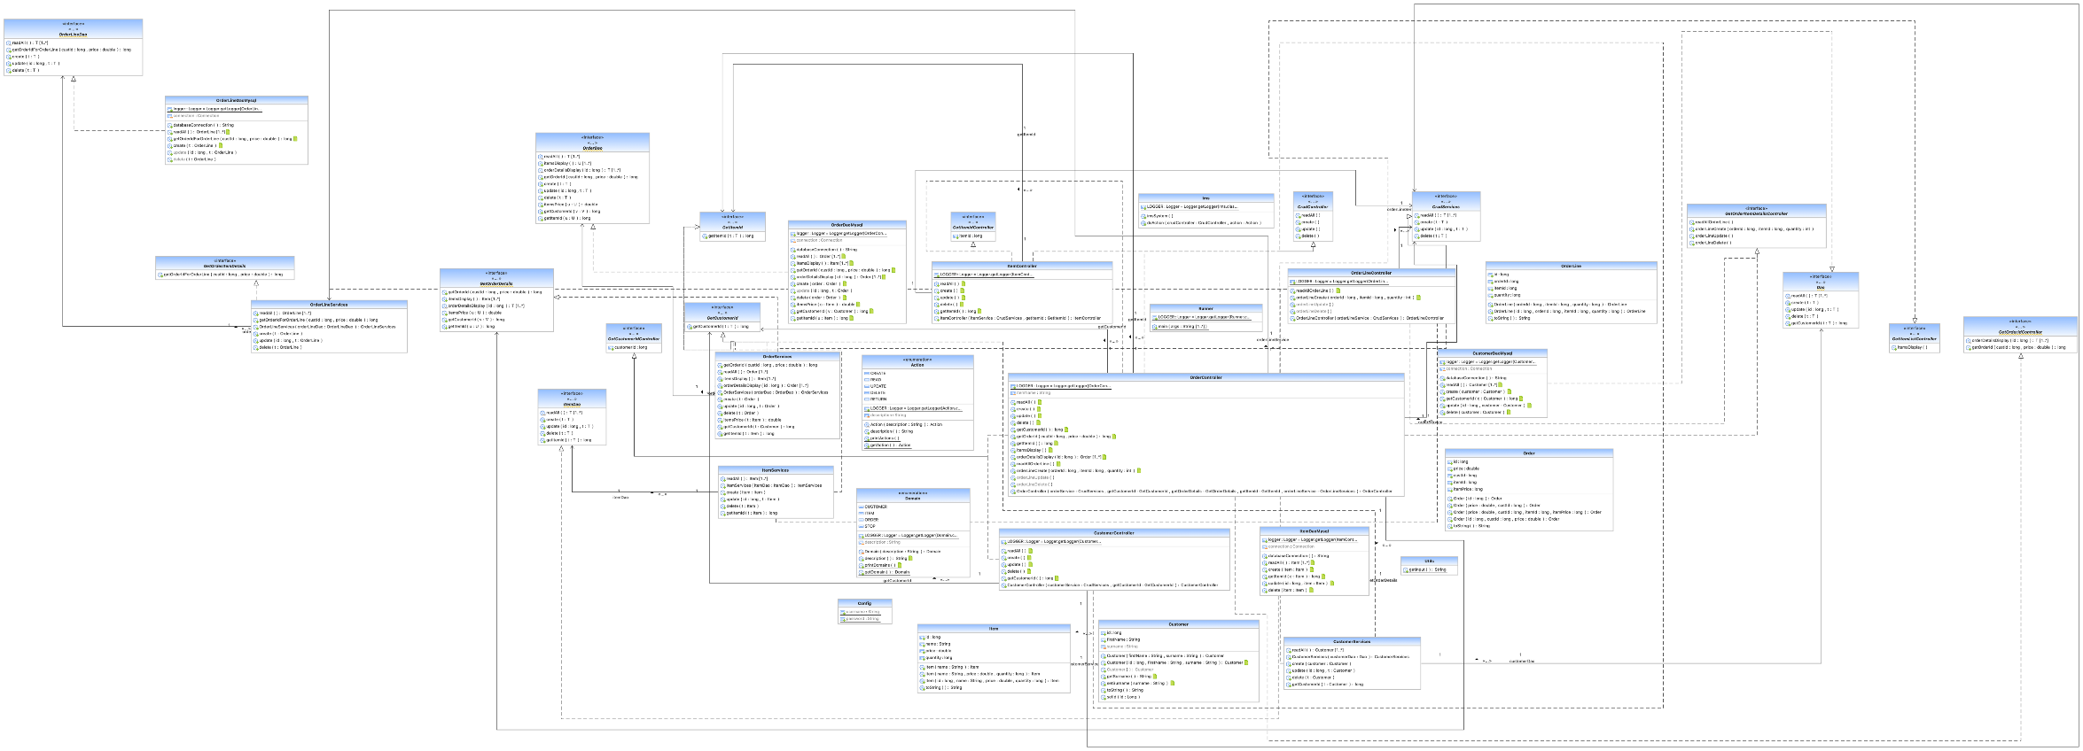
UML Diagram

Slide 10
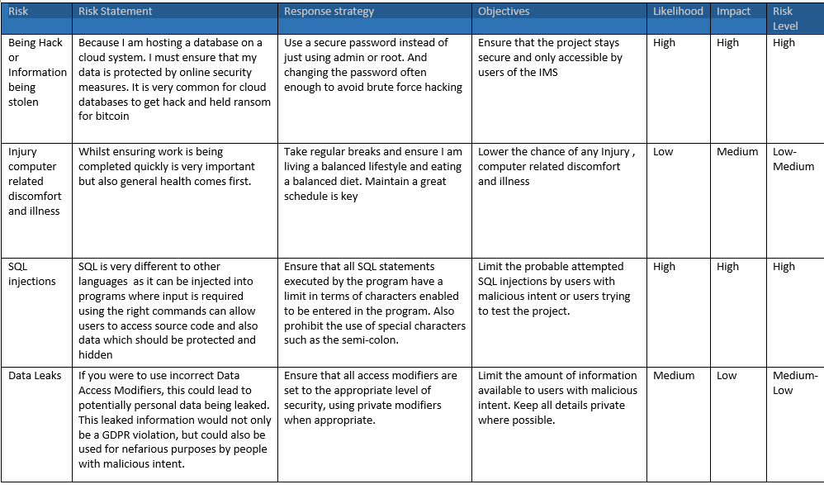
Risk Assessment

Slide 11
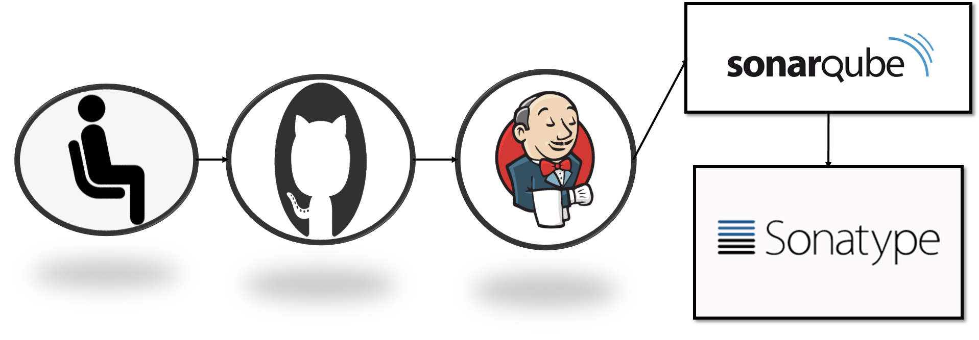
Automation

