Slide 1
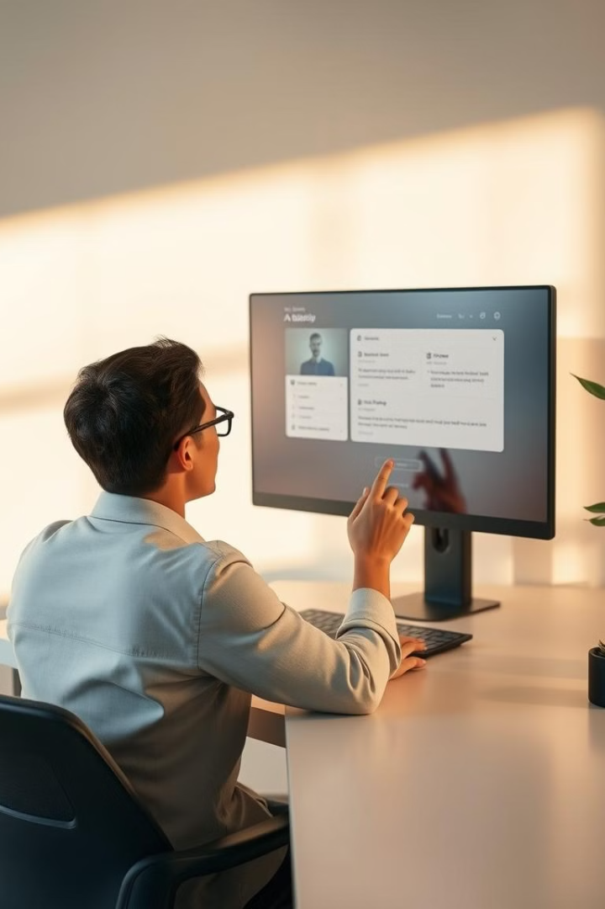

AI Assistant: Python-Powered Productivity
This presentation explores the creation of a Python-based AI assistant. Learn how to integrate various libraries and technologies to build a helpful and user-friendly assistant.
by Kathyayani Thota

Slide 2
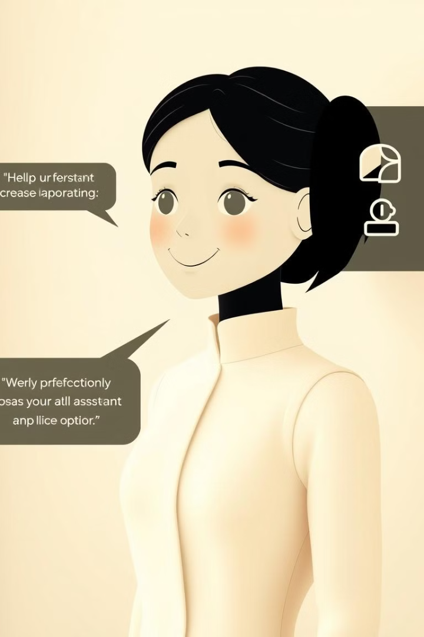
Introduction to the AI Assistant
1
Core Functionality
2
User Interaction
The AI assistant will leverage various libraries to perform tasks such as speech recognition, text-to-speech, web browsing, and information retrieval.
The assistant will respond to user commands, process information, and generate appropriate outputs, providing a seamless and engaging experience.

Slide 3
Speech Recognition with SpeechRecognition
Speech to Text
Language Support
Accuracy and Reliability
The SpeechRecognition library allows the assistant to convert spoken words into text, enabling users to interact through voice commands.
This library supports a wide range of languages, making it adaptable to different users and regions.
SpeechRecognition provides a robust foundation for speech-to-text conversion, ensuring accurate understanding of user input.

Slide 4




Text-to-Speech with pyttsx3
Text to Speech
The pyttsx3 library enables the AI assistant to synthesize text into human-like speech, allowing it to respond verbally.
Voice Customization
Users can select different voices and accents to personalize the assistant's speaking style.
Audio Output
The library can output synthesized speech through various audio devices, including speakers and headphones.

Slide 5

Web Browsing with webbrowser
Feature
Description
Open URLs
The webbrowser library allows the assistant to open specified URLs in the user's default web browser.
Search Functionality
It can be used to conduct web searches based on user queries, providing relevant results.
Automation
The library allows the assistant to automate browsing tasks, such as opening specific websites or navigating web pages.

Slide 6

Information Retrieval with Wikipedia API
Knowledge Base
Search Functionality
The Wikipedia API provides access to a vast database of information, allowing the assistant to retrieve summaries and detailed articles on various topics.
Users can query the API with specific keywords or phrases to obtain relevant information.
Information Retrieval
The assistant can extract key information from Wikipedia articles, providing summaries, definitions, and related facts.

Slide 7
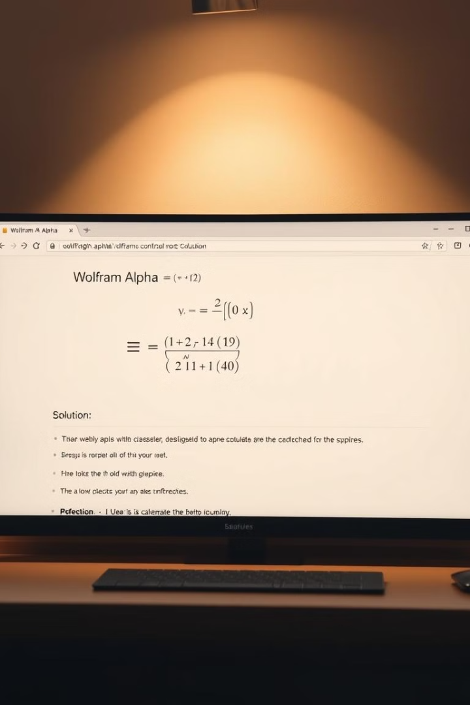




Computational Knowledge with Wolfram Alpha
Calculations
Data Analysis
The Wolfram Alpha API allows the assistant to perform complex calculations, such as mathematical equations, unit conversions, and data analysis.
It can retrieve and analyze data from various sources, providing insights and statistical information.
Knowledge Base
General Knowledge
Wolfram Alpha serves as a comprehensive knowledge base, offering information across diverse fields.
The assistant can answer general knowledge questions, provide historical facts, and explain scientific concepts.

Slide 8

Natural Language Processing with NLTK and spaCy
Tokenization
Named Entity Recognition
NLTK and spaCy break down text into individual words, enabling the assistant to understand the structure of sentences.
They recognize and categorize named entities, such as people, places, and organizations, enabling the assistant to understand specific references in text.
1
2
3
4
Part-of-Speech Tagging
Sentiment Analysis
These libraries identify the grammatical role of each word, helping the assistant to interpret the meaning of sentences.
NLTK and spaCy can analyze the emotional tone of text, providing insights into the speaker's feelings and intentions.

Slide 9
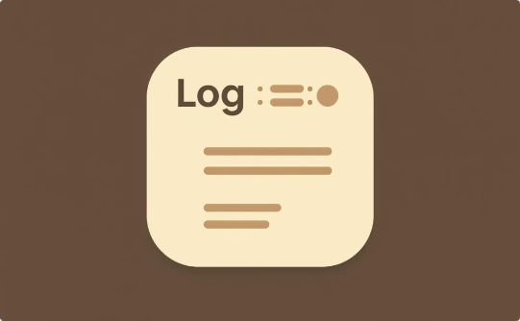


Logging, Requests, and gTTS for Robust Functionality
Logging
Requests
gTTS
The logging library records important events and errors, helping developers track the assistant's performance and debug issues.
The requests library enables the assistant to make HTTP requests to external APIs, retrieving data and interacting with web services.
The gTTS library provides text-to-speech functionality using Google's powerful speech synthesis engine, enhancing the assistant's voice quality.

