Slide 1
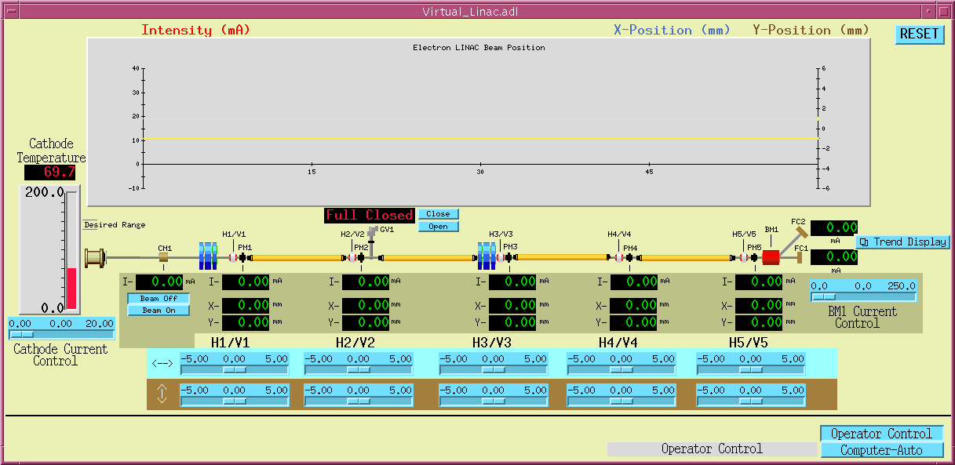
The Advanced Photon Source “virtual” LINAC Control System
The LINAC:
The electrons that circulate in the APS Storage Ring originate in a machine called a Linear Accelerator (LINAC). The electrons are generated by heating a cathode in an “electron gun” and are accelerated as they travel through “accelerating cavities” along the LINAC. Because electrons are charged particles, they can be steered through the narrow vacuum chamber using electro-magnets (magnets that vary in strength as the current is changed through their coils). If the electrons are mis-steered and hit the side of the vacuum chamber, they immediately lose their energy and are lost.
The Operator:
Using the APS Remote Control System, the operator can monitor and control all of the equipment in the facility using the workstations in the Main Control Room. For this demonstration, the operator must control and monitor the temperature of the electron gun cathode, monitor the position of the beam within the vacuum chamber, adjust the steering magnet currents to properly steer the electrons, and control a gate valve (a device that blocks any air and particles from different sections of the LINAC).
The Challenge:
Follow the steps below to successfully generate and transport electrons to the end of the LINAC.
STEP 1:
Adjust the blue slider to change the current used to heat the cathode until the cathode temperature is within the desired range (the bar will turn green).
STEP 7:
RESET will prepare the virtual LINAC for the next operator.
STEP 6:
Adjust the remaining steering magnet currents to transport beam to the end. The final current is measured by a Faraday Cup (FC1). Fine tune all the steering magnets to transport the maximum amount of beam current to the end of the LINAC (7 mA is excellent!).
STEP 2:
Press “Beam On” to send the electrons down the LINAC
STEP 3:
Adjust the current through the steering magnets (H1 & V1) until both the horizontal position (X) and the vertical position (Y) are less than 1mm. The positions are plotted on the chart above in BLUE (X) and BROWN (Y). The RED line in the plot represents the number of electrons, which decreases as the beam travels down the linac.
STEP 5:
You will need to open the Gate Valve to let the electrons continue …
STEP 4:
More steering required …
HELP for the frustrated:
Give up? Push the “Computer-Auto” and let the computer take over!

