Slide 1
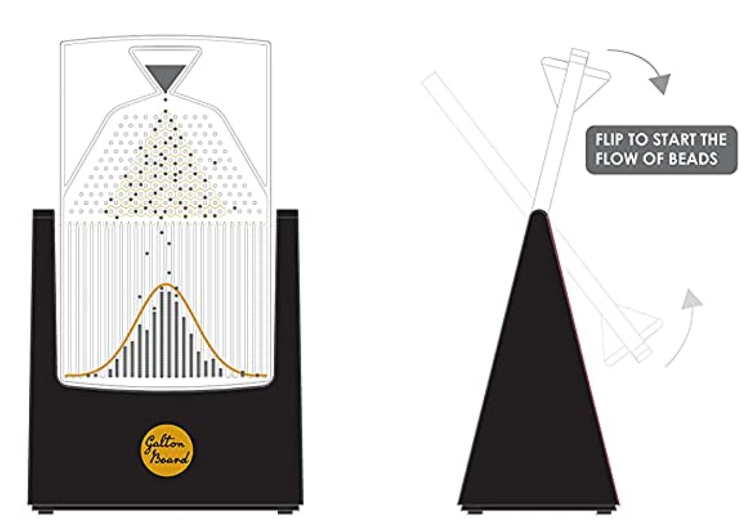
Notes:
Reference: galtonboard.com (https://amzn.to/3hzY6HV)

Slide 2
Notes:
Reference: galtonboard.com (https://amzn.to/3hzY6HV)

