Slide 1
Instructions for Collaborating on GitHub Tutorial

Slide 2
Breakout 1: Connecting with your partner, create your shared repo and both clone it
Say hello and introduce yourself
Connect either on Slack (direct messaging), Zoom chat (make sure to select your partner, not send messages to everyone), phone, whatever you prefer
Decide who will be Partner 1 and who will be Partner 2
Exchange GitHub user names

Slide 3
Breakout 1: Connecting with your partner, create your shared repo and both clone it
Work through sections 9.2 – 9.6 here: http://ohi-science.org/data-science-training/collaborating.html

Slide 4
Working together on a repo
Adapted from Jenny Bryan’s HappyGitwithR
https://happygitwithr.com/

Slide 5
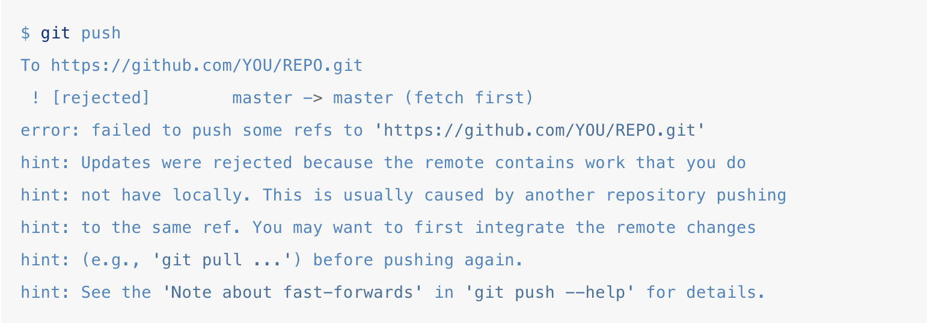
Dealing with push rejection
You want to push changes, but you are not allowed
Your local Git history and that on the GitHub remote are not compatible, i.e. they have diverged.

Slide 6
What is going on?
State of the repo on GitHub:
A – B – C
C represents changes your collaborator had made to B and then pushed while you were also still working on B
State of your local repo:
A – B – D
D represents changes you have made since you pulled B

Slide 7
What is going on?
You can’t merge C and D by pushing to GitHub
You have to pull the commit C and somehow integrate it into your D-containing history. Then you will be able to push again
State of the repo on GitHub:
A – B – C
C represents changes your collaborator had made to B and then pushed while you were also still working on B
State of your local repo:
A – B – D
D represents changes you have made since you pulled B

Slide 8
She who pushes first wins
Push your work to master work (when it’s “ready” to share (or at least “ready enough”)
Committing, pushing, and integrating more often, not less. This does not eliminate the need to integrate different lines of work, but it makes each integration smaller, less burdensome, and less prone to error
Stay in touch with your collaborators

Slide 9
Pulling when you have local work
State of the repo on GitHub:
A – B – C
State of your local repo:
A – B – D OR
A – B – (uncommitted changes)

Slide 10
Pulling when you have local work
State of the repo on GitHub:
A – B – C
State of your local repo:
A – B – D OR
A – B – (uncommitted changes)
When working on different files, versions can be merged smoothly
Remote: A--B--C Local before 'git pull’: A--B--(uncommitted changes)
Local after 'git pull’: A--B--C--(uncommitted changes)

Slide 11
Pulling when you have local work
State of the repo on GitHub:
A – B – C
State of your local repo:
A – B – D OR
A – B – (uncommitted changes)
This also works when you have made edits to different parts of the same file
Remote: A--B--C Local before 'git pull’: A--B--(uncommitted changes)
Local after 'git pull’: A--B--C--(uncommitted changes)

Slide 12
Pulling when you have local work
State of the repo on GitHub:
A – B – C
State of your local repo:
A – B – D OR
A – B – (uncommitted changes)
When you have made changes to the same part of a file, you will need to resolve the merge conflict locally before you can push
Remote: A--B--C Local before: A--B--D
Local after: A--B--D--(merge commit) \_C_/

Slide 13
GitHub Pages

Slide 14
Examples of cool GitHub pages websites
We’re starting simple, but GitHub Pages has functionality to make complex and compelling websites. A few examples
https://twitter.github.io/
https://justanother-timetraveller.github.io/

