Slide 1
Project presentation by Tlektessov Temirlan 18012848

Slide 2
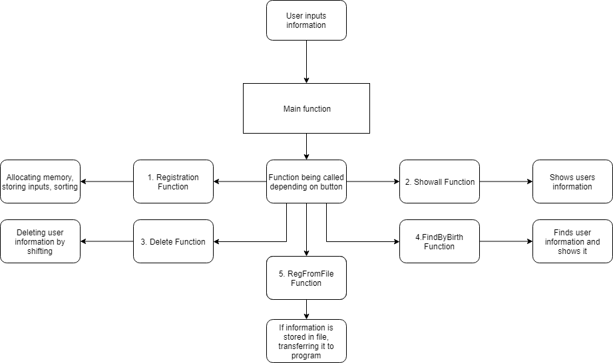
1.How my code works.
Expained with flowchart.

Slide 3
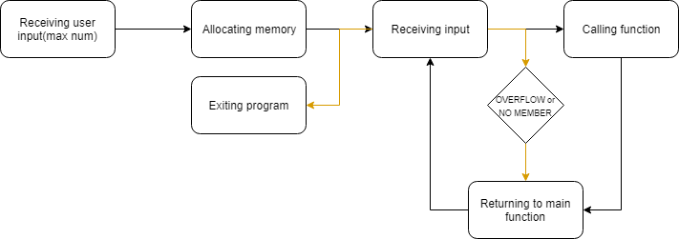
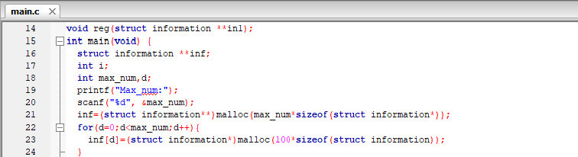
Main Part

Slide 4
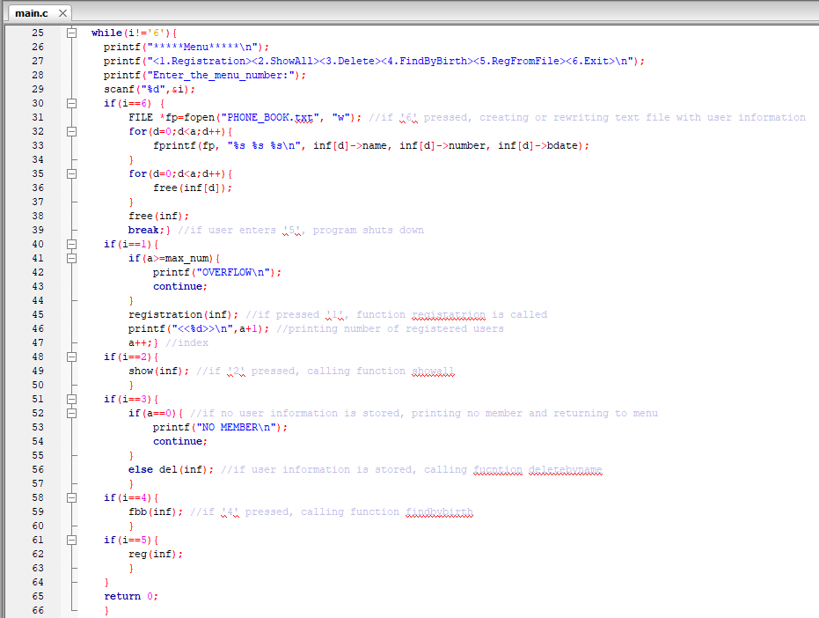

Slide 5
Registration
Receive inputs from user.
Allocating memory.
After receiving all inputs sorting them.

Slide 6
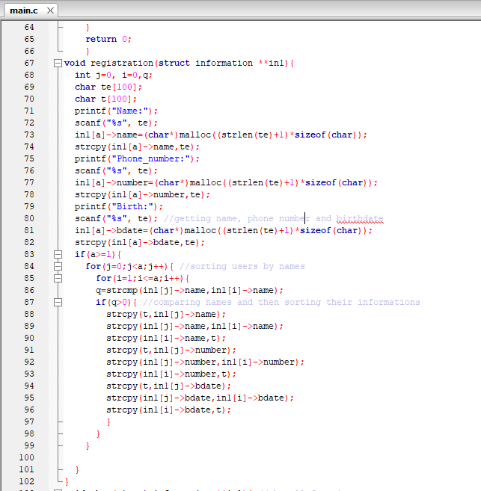

Slide 7


Show All UI
Printing every users information.

Slide 8
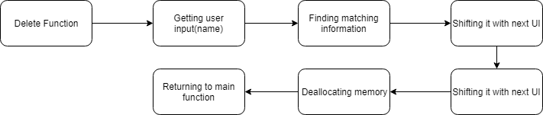
Delete
Receiving user name.
Finding user name, then deleting it by shifting.

Slide 9
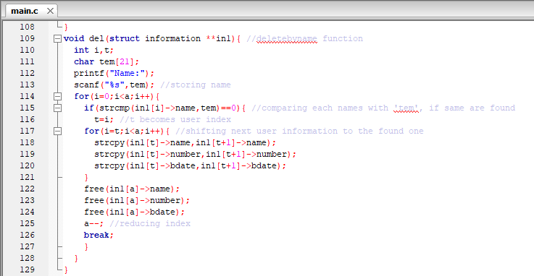

Slide 10
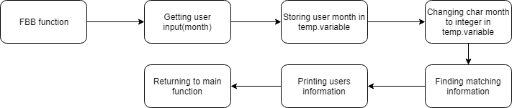
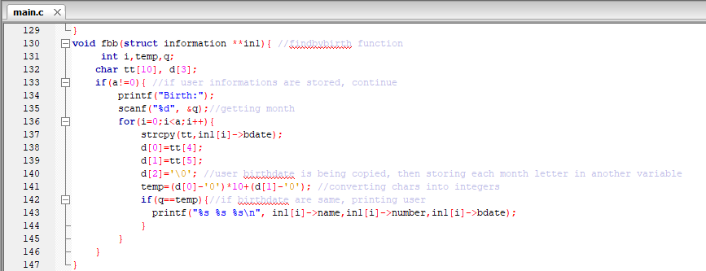
FindByBirth
Receiving month.
Storing user month information in temp.variable
Finding matching month.

Slide 11
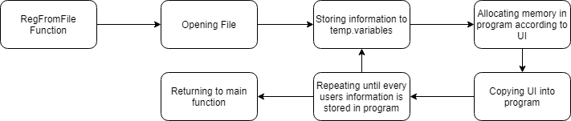
RegFromFile
Opening file, copying information from there to temporary variables.
Copying information from temp.varibales to program.

Slide 12
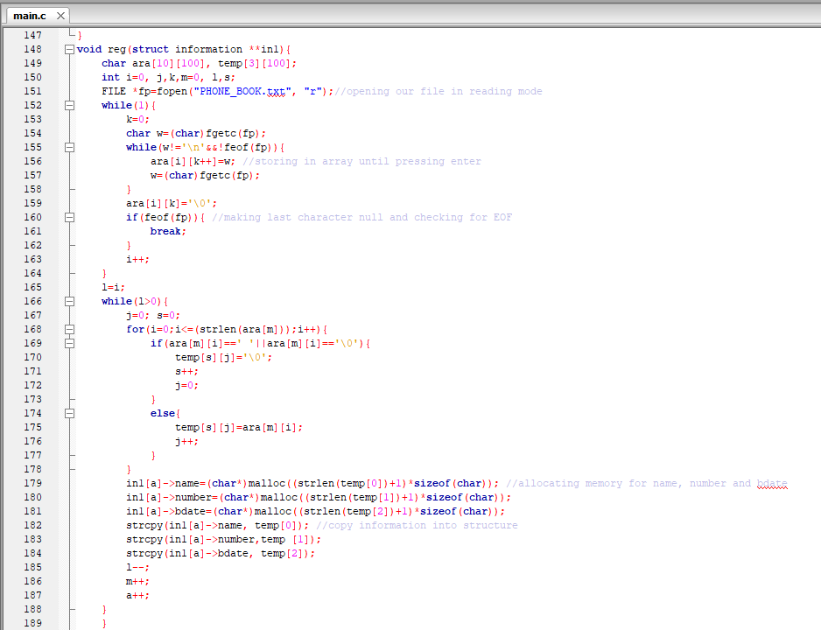

Slide 13
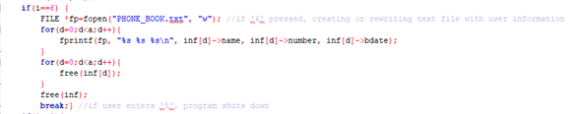
Exiting program
File being created or opened if exists
Every users information being transferred there
Deallocating memory
Closing program

Slide 14
THANK YOU FOR ATTENTION!
Any questions?

