Slide 1
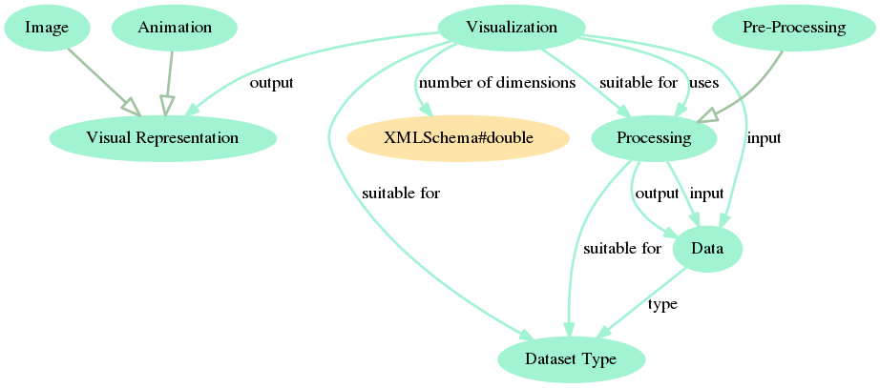
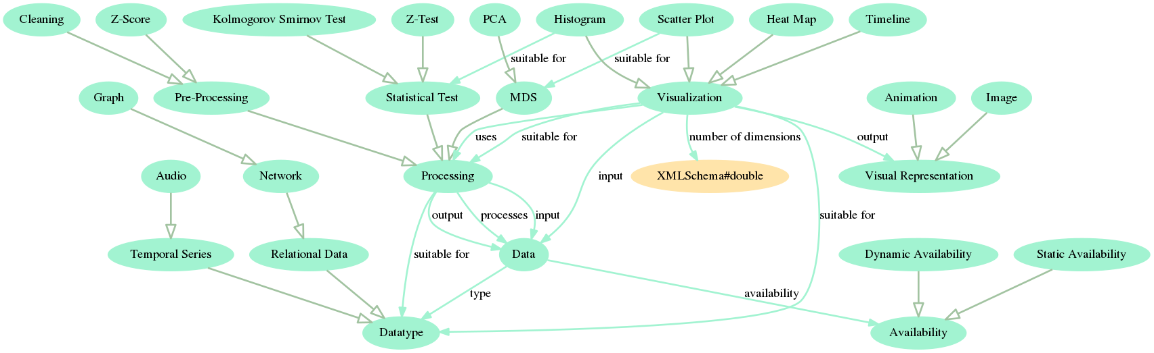
Audiovisual Analytics Vocabulary And Ontology (AAVO): initial core and example expansion
Renato Fabbri, Maria Cristina Ferreira de Oliveira
University of São Paulo at São Carlos, Institute of Mathematical and Computer Sciences, renato.fabbri@gmail.com
Motivation
Results
Methods
Conclusions and Further Work
Bibliography
Bibliography
A linked data vocabulary and ontology of (audio)visual analytics is useful for:
  Making automated inferences about the concepts and objects to which they relate
  Relating objects (e.g. data and techniques) within the field or between the field and other domains
  Expressing a domain knowledge against which queries might be performed
  Expressing a concise overview of the field
  Facilitating the introduction of the Visual Analytics subject to non-specialists
AAVO Core (A)
AAVO Extended (B)
Vocabulary annotations. E.g.:
  in a dataset, an element is also called: an item, an observation, an individual, a point, and even a data point and a data row
  A graph node is also called: a vertex, and every name that are used to designate an element
  A graph edge is also called: a link, a bond, a line, and a connection
  Z-scores are also called: standard scores, normal scores, standardized variables, and z-values
Conceptualization gathering:
  Second author (specialist) interviewed by the first author (ontologist)
  Studying the literature:
    Books [1-4];
    Articles;
    MOOCs
Formalization of the conceptualization:
  Linked data basics [5]:
    RDF (expressions in “subject-predicate-object”)
    SKOS (standard for vocabularies)
    OWL (standard for ontologies)
  Advanced techniques [6]:
    Mappings between SKOS and OWL
    Non-standard triples to express potential relations
AAVO also holds relations that are not explicitly in the literature because of the linked data design.
Potential next steps:
  the inclusion of the concepts Hypothesis, Analysis, and Task into the AAVO core
  Realizing AAVO expansions until the reached concepts can be linked to other ontologies that are sound, used and maintained
  Using AAVO to obtain interesting relations by means of automated inference and to assist a (audio)visual analytics software
[1-4] Data visualization books by Ware (2012), Ward (2010), Telea (2007) and Munzner (2014).
[5] W3C Recommendations.
[6] Fabbri, R. “Enhancements Of Linked Data Expressiveness For Ontologies.” ENMC, 2017.
Example of triples:
<http://example.org/people/mary>
<http://example.org/properties/name> "Mary Shastacian" .
<http://example.org/people/mary>
<http://example.org/properties/age> "57" .
<http://example.org/people/mary>
<http://example.org/properties/likes>
<http://example.org/concepts/Reading> .
(A)
(B)

