Slide 1
Tim Reska
AI-Augmented Medical Underwriting
What I built in 48 hours with Claude to show you what's possible
PhD Helmholtz Munich | github.com/ttmgr | March 2026

Slide 2
My published pipeline exposed 'plausible but wrong' LLM outputs
PhD Helmholtz Munich & TU Munich | github.com/ttmgr
Research & Publications
8 peer-reviewed publications including Nature Communications
22,000+ accesses, 43+ citations
Invited speaker: ETH Zurich, Cambridge, TUM
PhD thesis: real-time genomics for pathogen detection
AI & Claude Expertise
36-month LLM evaluation: 22 models (GPT, Claude, Gemini)
Observed 'plausible but wrong' across all 3 LLM families (22 models)
Integrated Claude + MCP into live pipelines (-40% dev time)
10 modular pipelines deployed across 7 sites in DE/FR/ES
I applied my PBW research to medical underwriting -- and built the proof in 48 hours.

Slide 3
Underwriting models are confidently wrong when data quality is poor
I found the same failure mode in genomics AI -- and it applies directly to insurance
The failure mode
Model scores patient as '78% high risk' based on 3 diagnoses, no labs
Score looks right -- passes every sanity check
But it's echoing training data averages, not this patient's reality
I call this 'Plausible but Wrong' (ISME Communications 2024)
At portfolio scale
100,000 decisions/year x 2% PBW = 2,000 mispriced policies
Invisible in standard metrics (AUC, Brier score look fine)
EU AI Act 2024: Art. 14+15 require per-case reliability
No production system today validates this at individual level

Slide 4
I built a working underwriting system in 48 hours to show you what's possible
Not a slide deck -- a running application with 231 tests and every number verified against PubMed
Patient Record --> Data Quality Score --> Right Model for This Data --> P(wrong) --> Accept / Review / Reject
What it does
Scores data quality BEFORE the model runs
Routes to the right model for available data (no imputation)
Estimates P(wrong) and makes cost-optimal decisions
How I built it
Claude as co-pilot for architecture, coding, and testing
LLM agents for PubMed literature verification
Same AI workflow I'd use at Allianz -- but with real data

Slide 5
International markets show 2.4x higher mispricing risk than Germany
4 European markets, controlled data quality degradation -- the same 3 countries I worked in for genomics
Market | Data Quality | Mean DQS | PBW Flag Rate
Germany (DE) | High (95% coding, 92% labs) | 0.85 | 0.9%
France (FR) | Good (90% coding, 88% labs) | 0.80 | 1.0%
Spain (ES) | Medium (80% coding, 75% labs) | 0.70 | 1.3%
International | Low (60% coding, 50% labs) | 0.45 | 2.1%
The worst market has 2.4x the mispricing risk -- and standard metrics don't see it.

Slide 6
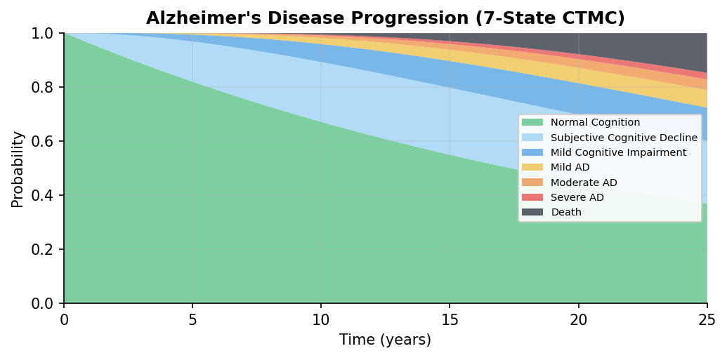
I added Alzheimer's disease in one config file to prove the framework generalises
7 states from normal cognition to death -- all transition rates verified against PubMed systematic reviews
Added as config:
8 ICD-10 codes
4 biomarkers (MMSE, MoCA, CSF)
4 medications (ATC-coded)
ApoE4 risk modifier
Zero changes to the engine

Slide 7
AI-driven underwriting solves five problems current methods cannot
What you need | Rules / Actuarial | Basic ML | What I build
Know when to trust the AI | No | No | DQS + P(wrong) per case
Handle incomplete records | Reject | Impute (creates PBW) | Route to right model
Explain each decision | No | Limited | SHAP per patient + audit
Model disease progression | Static tables | No | CTMC for any disease
EU AI Act compliance | Partial | Difficult | Built in from day 1
Phase 3: LLM agents extract structured data from doctor notes across languages, generate natural language risk explanations, and continuously verify parameters against new literature.

Slide 8
This is how I work: one person + Claude = output of a 5-person team
3 years of Claude evaluation taught me exactly where AI works and where it needs human expertise
1
I define the problem
PBW in underwriting -- from my own published research
2
Claude builds the code
Pipeline, models, tests, app -- 21,000 lines in 48 hours
3
I verify the science
LLM agents query PubMed -- I validate against domain knowledge
4
Claude handles scale
231 tests, 4 markets, 2 diseases, fact-checked, EU AI Act ready
5
I make the decisions
Architecture, clinical thresholds, what to show, what matters

Slide 9
In 90 days I'd deliver calibrated PBW detection on real Allianz data
Month 1
Audit & Map
Audit current underwriting pipeline for PBW risk. Map data quality across Allianz markets. Identify the 3 highest-impact failure modes.
Month 2
Calibrate & Train
Calibrate DQS on real Allianz data. Retrain model router on actual data profiles. Deliver first real-data PBW prevalence estimate by market.
Month 3
Ship & Document
Production prototype: REST API for per-case quality scoring. Validated PBW detection rates. EU AI Act compliance documentation.
I built this proof of concept in 48 hours. Imagine what I do with real data and 90 days.

Slide 10
Let's build this together.
Tim Reska
PhD Helmholtz Munich | 8 publications | 3 years evaluating Claude
timreska@gmail.com | github.com/ttmgr | linkedin.com/in/timreska
All data in this demo is synthetic. The system, the science, and the skills are real.

