Slide 1
Tim Reska
AI-Augmented Medical Underwriting
What I built in 48 hours with Claude to show you what's possible
PhD Helmholtz Munich | github.com/ttmgr | March 2026

Slide 2
My published pipeline exposed 'plausible but wrong' LLM outputs
PhD Helmholtz Munich & TU Munich | github.com/ttmgr
Research & Publications
8 peer-reviewed publications including Nature Communications
22,000+ accesses, 43+ citations
Invited speaker: ETH Zurich, Cambridge, TUM
PhD thesis: real-time genomics for pathogen detection
AI & Claude Expertise
36-month LLM evaluation: 22 models (GPT, Claude, Gemini)
Observed 'plausible but wrong' across all 3 LLM families (22 models)
Integrated Claude + MCP into live pipelines (-40% dev time)
10 modular pipelines deployed across 7 sites in DE/FR/ES
I applied my PBW research to medical underwriting -- and built the proof in 48 hours.
Source: ISME Communications 2024, Helmholtz Munich

Slide 3
Underwriting models are confidently wrong when data quality is poor
I found the same failure mode in genomics AI -- and it applies directly to insurance
The failure mode
Model scores patient as '78% high risk' based on 3 diagnoses, no labs
Score looks right -- passes every sanity check
But it's echoing training data averages, not this patient's reality
I call this 'Plausible but Wrong' (ISME Communications 2024)
At portfolio scale
100,000 decisions/year x 2% PBW = 2,000 mispriced policies
Invisible in standard metrics (AUC, Brier score look fine)
EU AI Act 2024: Art. 14+15 require per-case reliability
No production system today validates this at individual level
Source: ISME Communications 2024; EU AI Act Regulation 2024/1689

Slide 4
I built a working underwriting system in 48 hours to show you what's possible
Not a slide deck -- a running application with 231 tests and every number verified against PubMed
Patient Record
Data Quality Score
Model Router
P(wrong)
Decision
What it does
Scores data quality BEFORE the model runs
Routes to the right model for available data (no imputation)
Estimates P(wrong) and makes cost-optimal decisions
How I built it
Claude as co-pilot for architecture, coding, and testing
LLM agents for PubMed literature verification
Same AI workflow I'd use at Allianz -- but with real data
Source: MedRisk-ADH v2.0 system design

Slide 5
International markets show 2.4x higher mispricing risk than Germany
4 European markets, controlled data quality degradation -- the same 3 countries I worked in for genomics
Market | Data Quality | Mean DQS | PBW Flag Rate
Germany (DE) | High (95% coding, 92% labs) | 0.85 | 0.9%
France (FR) | Good (90% coding, 88% labs) | 0.80 | 1.0%
Spain (ES) | Medium (80% coding, 75% labs) | 0.70 | 1.3%
International | Low (60% coding, 50% labs) | 0.45 | 2.1%
The worst market has 2.4x the mispricing risk -- and standard metrics don't see it.
Source: MedRisk-ADH synthetic cohort, N=4,000 (1,000/market), seed=42

Slide 6
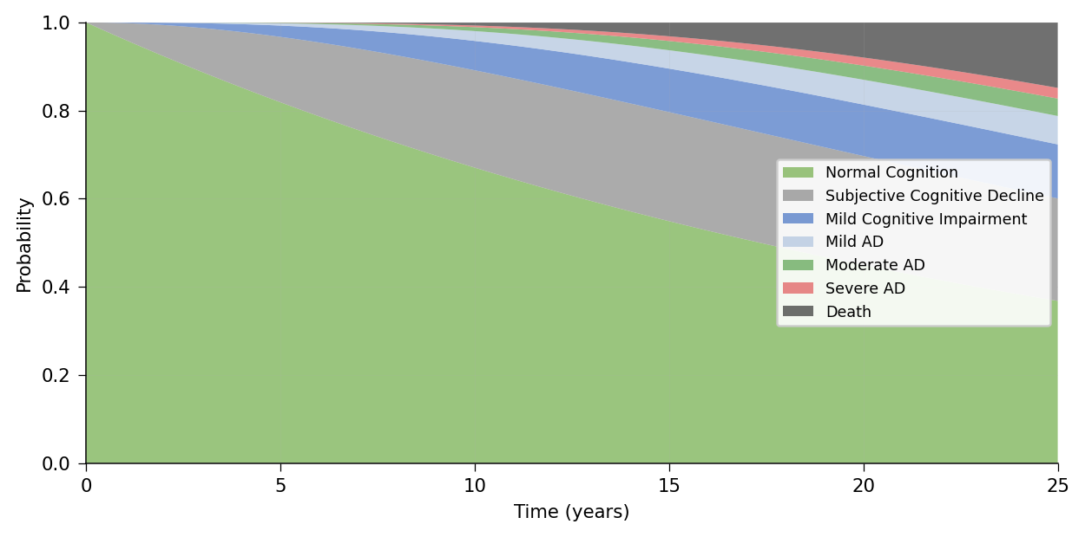
I added Alzheimer's disease in one config file to prove the framework generalises
7 states from normal cognition to death -- all transition rates verified against PubMed systematic reviews
Added as config:
8 ICD-10 codes
4 biomarkers (MMSE, MoCA, CSF)
4 medications (ATC-coded)
ApoE4 risk modifier
Zero changes to the engine
Source: Petersen et al. NEJM 2018, Brookmeyer et al., NACC-UDS

Slide 7
AI-driven underwriting solves five problems current methods cannot
What you need | Rules / Actuarial | Basic ML | What I build
Know when to trust the AI | No | No | DQS + P(wrong) per case
Handle incomplete records | Reject | Impute (creates PBW) | Route to right model
Explain each decision | No | Limited | SHAP per patient + audit
Model disease progression | Static tables | No | CTMC for any disease
EU AI Act compliance | Partial | Difficult | Built in from day 1
Phase 3: LLM agents extract structured data from doctor notes across languages, generate natural language risk explanations, and continuously verify parameters against new literature.
Source: MedRisk-ADH v2.0 capability comparison

Slide 8
This is how I work: one person + Claude = output of a 5-person team
3 years of Claude evaluation taught me exactly where AI works and where it needs human expertise
1
I define the problem
PBW in underwriting -- from my own published research
2
Claude builds the code
Pipeline, models, tests, app -- 21,000 lines in 48 hours
3
I verify the science
LLM agents query PubMed -- I validate against domain knowledge
4
Claude handles scale
231 tests, 4 markets, 2 diseases, fact-checked, EU AI Act ready
5
I make the decisions
Architecture, clinical thresholds, what to show, what matters
Source: ISME Communications 2024, Helmholtz Munich

Slide 9
In 90 days I'd deliver calibrated PBW detection on real Allianz data
Month 1
Audit & Map
Audit current underwriting pipeline for PBW risk. Map data quality across Allianz markets. Identify the 3 highest-impact failure modes.
Month 2
Calibrate & Train
Calibrate DQS on real Allianz data. Retrain model router on actual data profiles. Deliver first real-data PBW prevalence estimate by market.
Month 3
Ship & Document
Production prototype: REST API for per-case quality scoring. Validated PBW detection rates. EU AI Act compliance documentation.
I built this proof of concept in 48 hours. Imagine what I do with real data and 90 days.
Source: MedRisk-ADH project plan, March 2026

Slide 10
Let's build this together.
Tim Reska
PhD Helmholtz Munich | 8 publications | 3 years evaluating Claude
timreska@gmail.com | github.com/ttmgr | linkedin.com/in/timreska
All data in this demo is synthetic. The system, the science, and the skills are real.

