Slide 1
BUILDING A GLOBAL INTERNET OF THINGS NETWORK TOGETHER
Notes:
<Foliennummer>

Slide 2
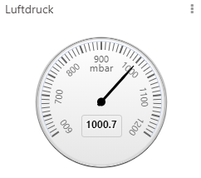

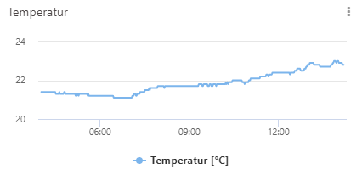
Sensordaten mit visualisieren
13.07.2019 Thomas Fraißl
Notes:
In Aug-Sept 2015, the city center of Amsterdam was covered by crowdsourcing ±10 gateways (costing each around 1000 euros)
For more insight on this, see: https://medium.com/@wienke/the-things-network-building-a-global-iot-data-network-in-6-months-adc2c0b1ae9b
<Foliennummer>

Slide 3
Schritt für Schritt zum Dashboard mit deinen Sensordaten
TagoIO Account erstellen
Integration der TTN Application hinzufügen
TagoIO dein Device bekannt machen
Dashboard erstellen
Notes:
User are owners, not telcos.
Bottom-up development
Due to the low costs, we don’t have to rely on large corporations. We can be in charge of the network and data routing ourselves.
<Foliennummer>

Slide 4
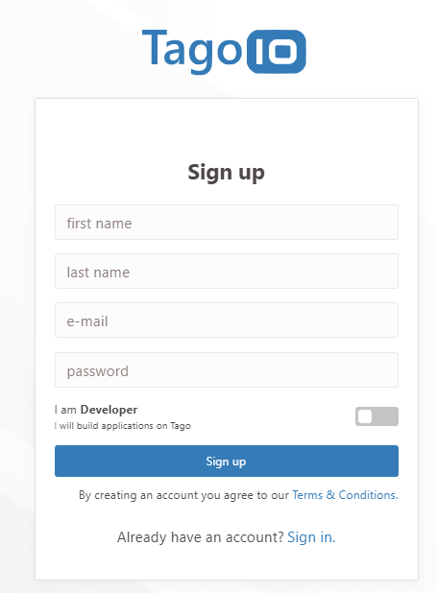
TagoIO Account erstellen
www.tagoio.net
Notes:
User are owners, not telcos.
Bottom-up development
Due to the low costs, we don’t have to rely on large corporations. We can be in charge of the network and data routing ourselves.
<Foliennummer>

Slide 5
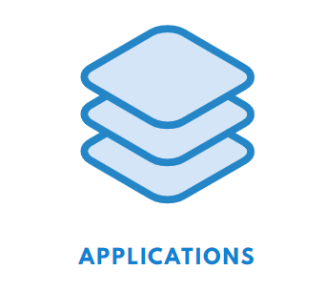
Integration der TTN Application hinzufügen
Aufruf der TTN CONSOLE
Deiner Application ein Access Key für TagIO hinzufügen
Intergartion hinzufügen
Notes:
User are owners, not telcos.
Bottom-up development
Due to the low costs, we don’t have to rely on large corporations. We can be in charge of the network and data routing ourselves.
<Foliennummer>

Slide 6
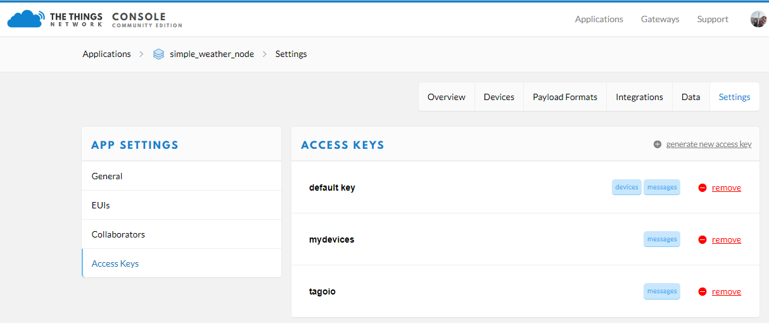
Integration der TTN Application hinzufügen
Aufruf der TTN CONSOLE
Deiner Application ein Access Key für TagIO hinzufügen
TagoIO dein Device bekannt machen
Dashboard erstellen
Notes:
User are owners, not telcos.
Bottom-up development
Due to the low costs, we don’t have to rely on large corporations. We can be in charge of the network and data routing ourselves.
<Foliennummer>

Slide 7
Integration der TTN Application hinzufügen
Aufruf der TTN CONSOLE
Deiner Application ein Access Key für TagIO hinzufügen
Intergartion hinzufügen
Notes:
User are owners, not telcos.
Bottom-up development
Due to the low costs, we don’t have to rely on large corporations. We can be in charge of the network and data routing ourselves.
<Foliennummer>

Slide 8
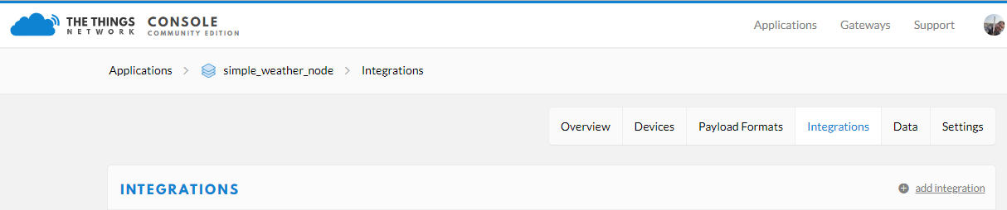
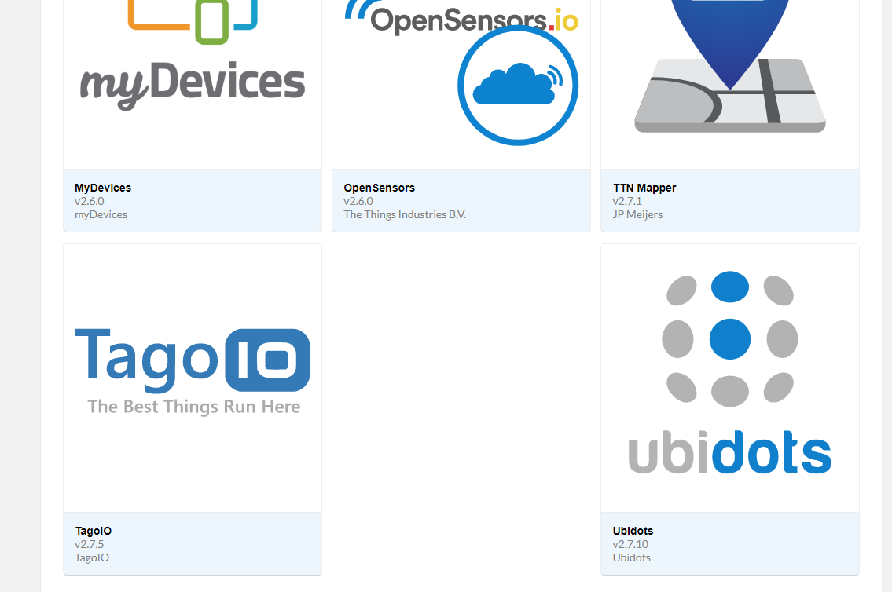
Notes:
User are owners, not telcos.
Bottom-up development
Due to the low costs, we don’t have to rely on large corporations. We can be in charge of the network and data routing ourselves.
<Foliennummer>

Slide 9
Integration der TTN Application hinzufügen
Aufruf der TTN CONSOLE
Deiner Application ein Access Key für TagIO hinzufügen
Intergartion hinzufügen
Notes:
User are owners, not telcos.
Bottom-up development
Due to the low costs, we don’t have to rely on large corporations. We can be in charge of the network and data routing ourselves.
<Foliennummer>

Slide 10
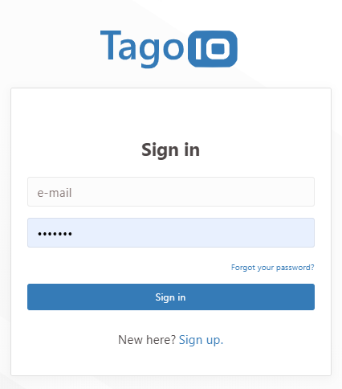
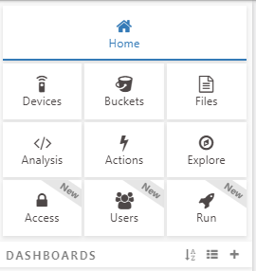
TagoIO dein Device bekannt machen
Notes:
User are owners, not telcos.
Bottom-up development
Due to the low costs, we don’t have to rely on large corporations. We can be in charge of the network and data routing ourselves.
<Foliennummer>

Slide 11
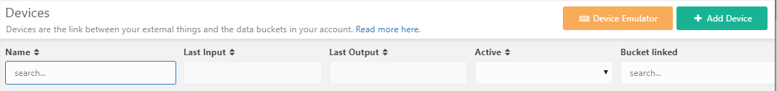
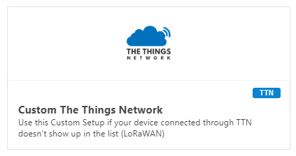
TagoIO dein Device bekannt machen
Notes:
User are owners, not telcos.
Bottom-up development
Due to the low costs, we don’t have to rely on large corporations. We can be in charge of the network and data routing ourselves.
<Foliennummer>

Slide 12
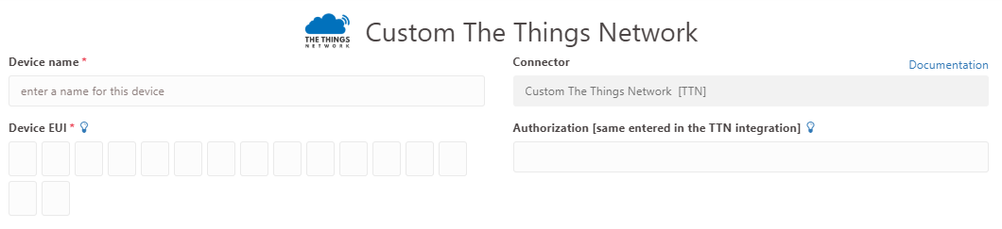

TagoIO dein Device bekannt machen
Notes:
User are owners, not telcos.
Bottom-up development
Due to the low costs, we don’t have to rely on large corporations. We can be in charge of the network and data routing ourselves.
<Foliennummer>

Slide 13
TagoIO dein Device bekannt machen
Notes:
User are owners, not telcos.
Bottom-up development
Due to the low costs, we don’t have to rely on large corporations. We can be in charge of the network and data routing ourselves.
<Foliennummer>

Slide 14
TagoIO dein Device bekannt machen
Notes:
User are owners, not telcos.
Bottom-up development
Due to the low costs, we don’t have to rely on large corporations. We can be in charge of the network and data routing ourselves.
<Foliennummer>

Slide 15
Schritt für Schritt zum Dashboard mit deinen Sensordaten
TagoIO Account erstellen
Integration der TTN Application hinzufügen
TagoIO dein Device bekannt machen
Dashboard erstellen
Notes:
User are owners, not telcos.
Bottom-up development
Due to the low costs, we don’t have to rely on large corporations. We can be in charge of the network and data routing ourselves.
<Foliennummer>

Slide 16
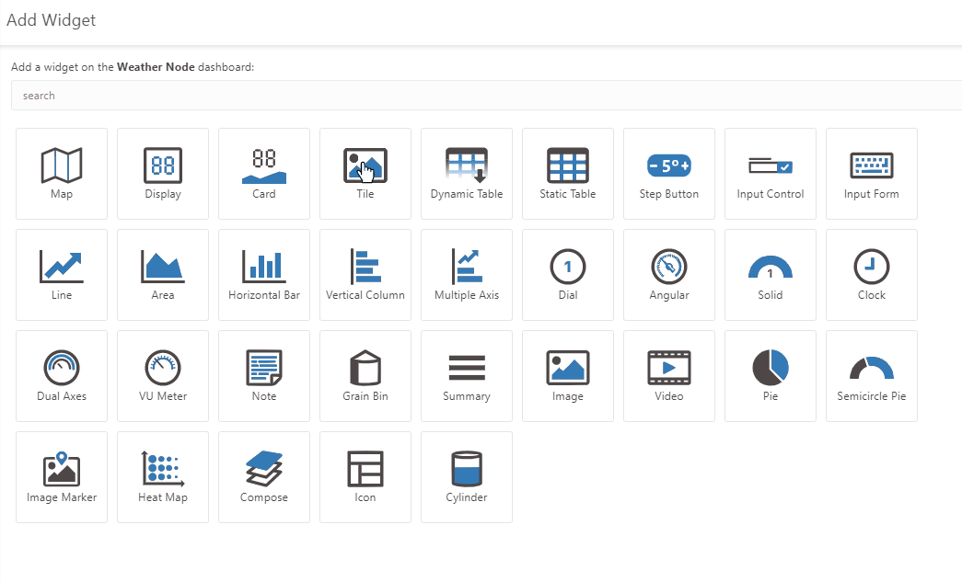
Dashboard erstellen
Notes:
User are owners, not telcos.
Bottom-up development
Due to the low costs, we don’t have to rely on large corporations. We can be in charge of the network and data routing ourselves.
<Foliennummer>

Slide 17
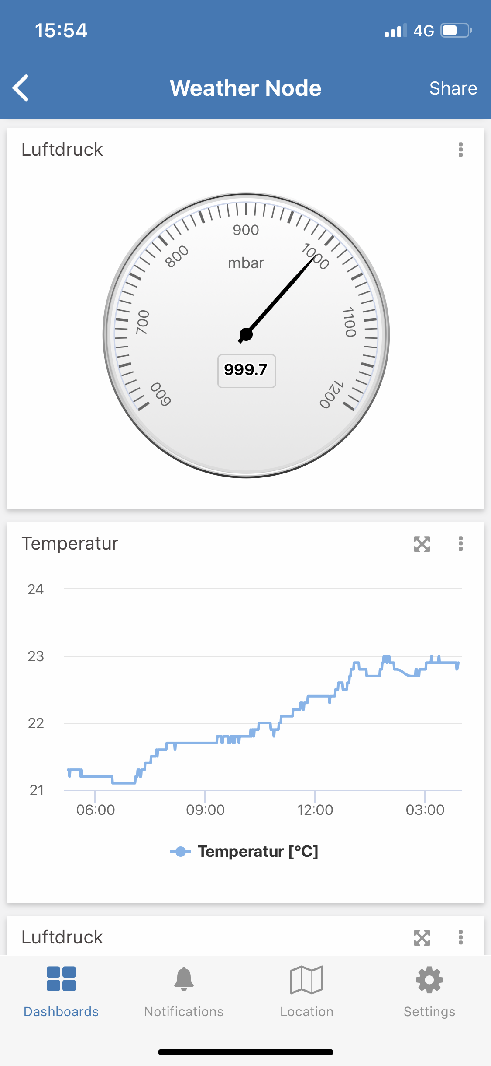
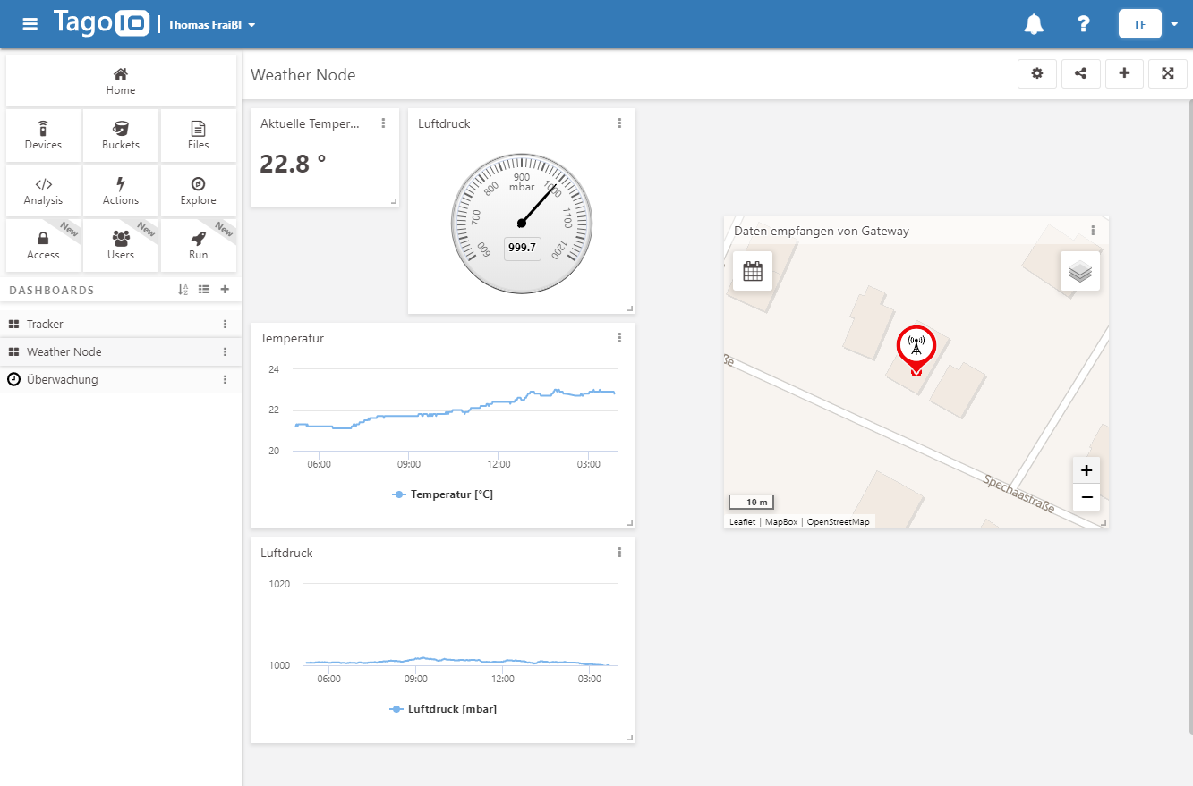
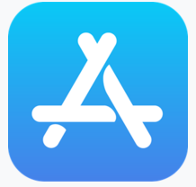
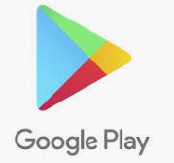
Sensordaten mit visualisieren
Notes:
User are owners, not telcos.
Bottom-up development
Due to the low costs, we don’t have to rely on large corporations. We can be in charge of the network and data routing ourselves.
<Foliennummer>

Slide 18
BUILDING A GLOBAL INTERNET OF THINGS NETWORK TOGETHER
Notes:
<Foliennummer>

