Slide 1

Multimodal Discordance
Detection in
Medical data
Can clinical AI recognize when it doesn't know?
MIT Critical data
MIMIC-CXR · MIMIC-IV · MedGemma
Notes:
Today I'd like to introduce our new project: Multimodal Discordance Detection in Medical data.
In clinical practice, doctors integrate multiple information sources, like imaging, labs, vital signs, to reach a diagnosis. But what if they contradict each other? Can we build AI that recognizes when the available data is insufficient to decide? That‘s the key question driving this project.
We’re going to use multimodal data from MIMIC dataset and MedGemma for vision

Slide 2




How Does AI Behave When Data Conflicts?
Clinical Scenario --- Respiratory Failure
The Problem
Current AI:
Always answers confidently. Never says "I need more data."
Good clinician:
Recognizes conflicting data. Orders additional tests.
This project:
Can we teach AI to recognize when it doesn't know?
CXR
Lab
Vitals
Same CXR (bilateral infiltrates) :
BNP↑ BP ↑ no fever → Heart failure? BNP normal WBC↑ 38.5°C → Pneumonia?
Core thesis: "Knowing what I don't know" is the correct clinical behavior.
Notes:
Here's a concrete example. In the emergency department, a patient presents with respiratory failure. Chest X-ray shows bilateral infiltrates. If BNP is elevated with high BP and no fever, it looks like heart failure. If BNP is normal with high WBC and high fever, it looks like pneumonia. Same imaging, but discordant labs and vitals shift the diagnosis entirely.
The key point here is that there is no correct answer when data is discordant. So the "correct" behavior for AI isn't reaching the right answer. It's recognizing that the available information is discordant and insufficient to decide.
Good clinicians do exactly this in clinical practice. When data conflicts, they order additional tests rather than guessing. Current AI can't do this. It always answers confidently, never says "I need more data." Teaching AI to recognize when it doesn't know. That's the core of this project.

Slide 3





Study Design
MIMIC-CXR + MIMIC-IV | MedGemma
Foundation (All Students)
Step 1: Build Benchmark
Step 2: Baseline Performance
3 modalities (CXR, Lab, Vitals) × 3 diagnoses (Pneumonia, HF, Pneumothorax) Concordant cases + systematic discordance generation
Concordant data → MedGemma Measure accuracy, logit entropy, confidence
Research Options
Option A
Option B
Option C
Uncertainty Recognition
Value of Additional Data
RL Implementation
Does AI know when it doesn't know? Introduce discordance between modalities and measure whether entropy rises and confidence drops.
Does more data fix the problem? When AI is uncertain with 2 modalities, add the 3rd. Measure how often diagnosis converges.
Can AI learn when to ask? Train RL agent: answer when confident, request more data when uncertain. (advanced)
Notes:
This project includes two foundation steps plus additional research options you can choose from, or come up with your own. Foundation. Step 1: extract respiratory failure cases from MIMIC-CXR and MIMIC-IV, build a 3-modality benchmark across pneumonia, heart failure, and pneumothorax. Step 2: run concordant data through MedGemma to establish baseline accuracy, entropy, and confidence. Then pick your research option.
Option A: Uncertainty Recognition. Introduce discordance between modalities and measure whether AI's uncertainty rises appropriately. Like, does entropy go up, or does confidence drop? This directly evaluates whether AI can say "I don't know" when it shouldn't know. Option B: Value of Additional Data. When AI is uncertain with two modalities, add the third. Does the diagnosis converge? This directly measures the value of requesting more information. Option C: RL Implementation. Train a reinforcement learning agent to answer when confident and request more data when uncertain. This is the advanced track.
Based on your interests and skills, you can plan as you like.

Slide 4


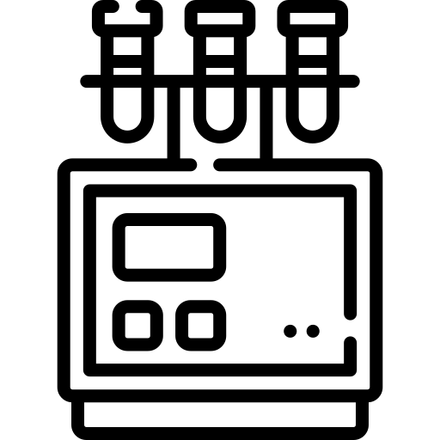
Exacerbated state
Recovered state
More than 72 h
Within 24 h
Within 24 h

Slide 5
