Slide 1
INVESTIGATOR MEETING BRIEFING
Study Alpha 2026: protocol alignment
Snapshot review | 2026-09-02
48
24 SC-A 2.5 mg
24 matched control
synthetic cohort
The 2.5 mg reference is a protocol review threshold, not clinical advice.
Sakura Clinical | Study Alpha 2026 | wholly synthetic

Slide 2
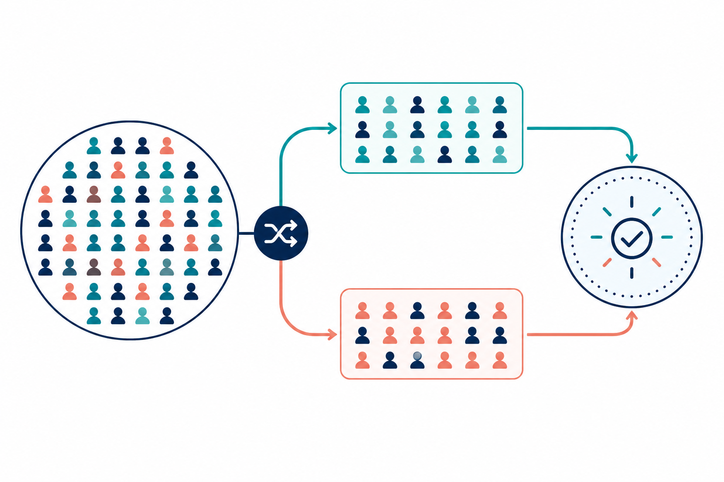
DESIGN
A simple matched-control design anchors the review
Aggregate outputs only; no personal or patient information.
Baseline
Day 0
Interim
Days 7 and 14
Outcome
Day 28
Protocol review
and reconciliation
Sakura Clinical | Study Alpha 2026 | wholly synthetic

Slide 3
DAY-28 SNAPSHOT
The synthetic comparison shows a -2.7 adjusted difference
95% CI -4.1 to -1.3; descriptive synthetic workspace summary.
Adjusted difference
-2.7
95% CI: -4.1 to -1.3
Aggregate Day-28 analysis
Sakura Clinical | Study Alpha 2026 | wholly synthetic

Slide 4
SAFETY AND GOVERNANCE
Safety review remains linked to documented adjudication
Synthetic events are reconciled before data lock.
7
6
0
non-serious synthetic AEs
participants represented
serious adverse events
Identify → Assess → Escalate → Reconcile
Sakura Clinical | Study Alpha 2026 | wholly synthetic

Slide 5
NEXT STEPS
Confirm readiness, preserve traceability, and close the review loop
Operational briefing only; no clinical treatment guidance.
1. Confirm protocol v3.2 acknowledgment
2. Reconcile windows and deviations
3. Document aggregate review outputs in the TMF index
Reminder: 2.5 mg is a protocol review threshold, not clinical advice.
Sakura Clinical | Study Alpha 2026 | wholly synthetic

