Slide 1
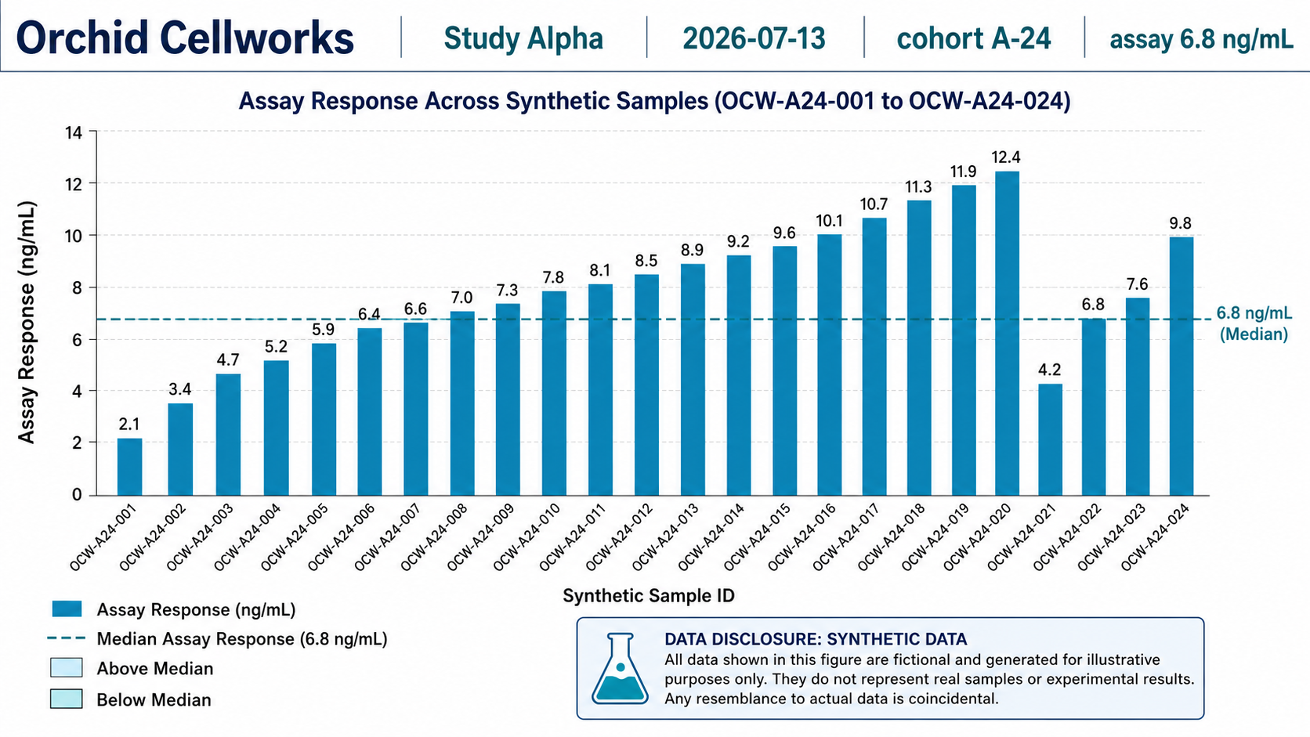
Study Alpha manuscript figure review
Cohort A-24 | protocol OCW-BIO-017 | all content fictional and synthetic
A coherent figure set for a synthetic assay narrative
Review purpose: assess figure clarity, synthetic-data disclosure, QC readability, and figure-to-caption alignment before manuscript circulation.
Key anchors: Study Alpha | cohort A-24 | 6.8 ng/mL
Orchid Cellworks | Study Alpha | fictional synthetic corpus | 2026-07-13
1

Slide 2
Assay response establishes the study baseline
Figure 1 | synthetic response values for OCW-A24-001 through OCW-A24-024
Review focus
• Median reference: 6.8 ng/mL • IDs are fictional, non-personal sample labels • Disclosure is visible within the figure • Review: legend, scale, and sample-label density
Orchid Cellworks | Study Alpha | fictional synthetic corpus | 2026-07-13
2

Slide 3
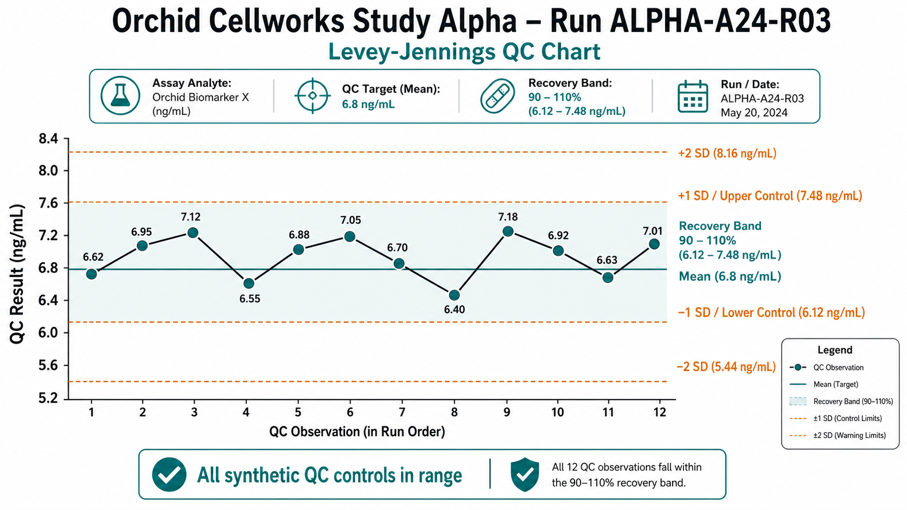
Precision and QC evidence support interpretable results
Figures 2 and 3 | duplicate distribution and Levey-Jennings-style controls
Review focus
• Duplicate target: CV <= 10% • Recovery band: 90-110% • QC run: ALPHA-A24-R03 • Review: all synthetic QC observations are visibly in range
Orchid Cellworks | Study Alpha | fictional synthetic corpus | 2026-07-13
3

Slide 4
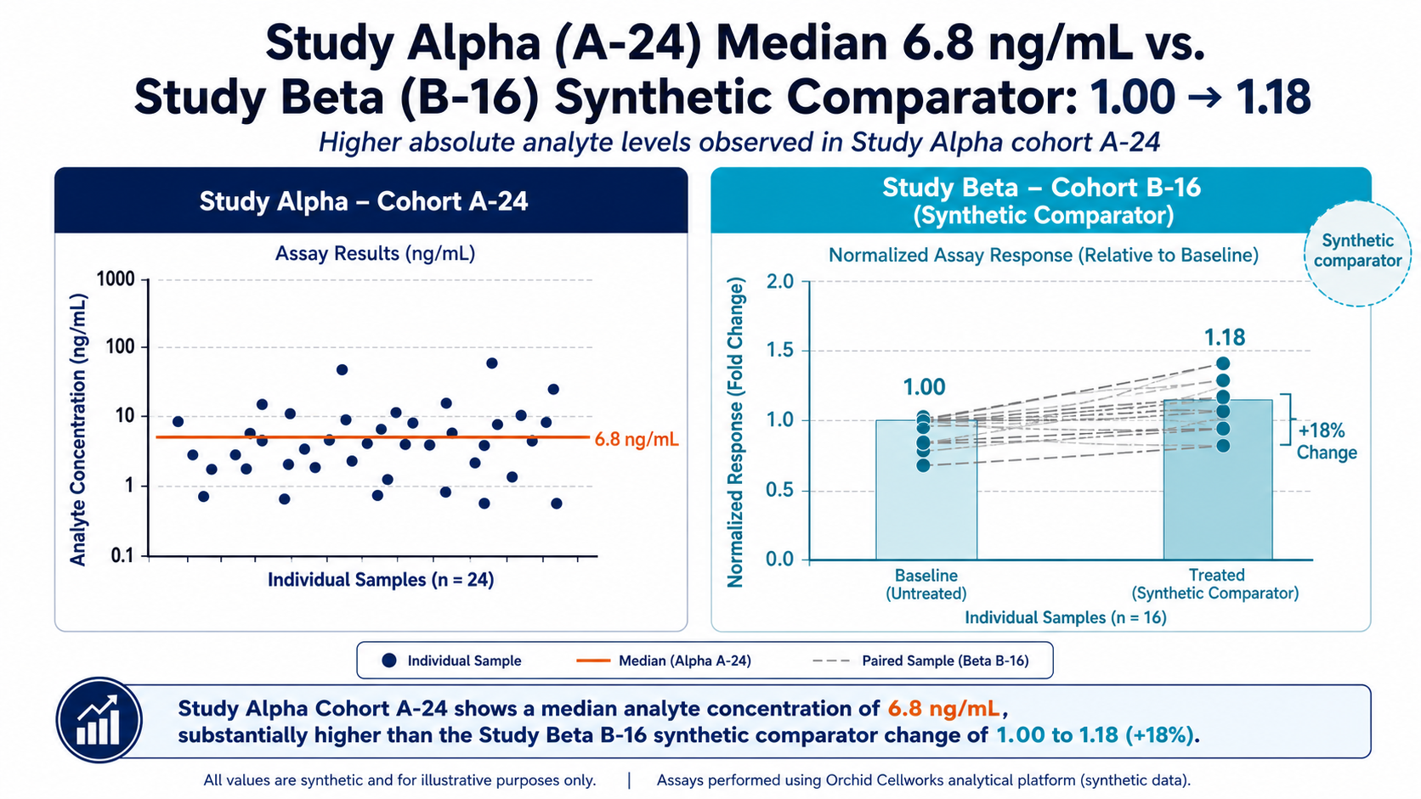
The comparator is explicitly synthetic and scale-aware
Figure 4 | Study Alpha A-24 alongside Study Beta B-16
Review focus
• Study Beta baseline: 1.00 • Treated comparator: 1.18 • Alpha uses ng/mL; Beta is normalized response • Review: labels prevent inappropriate cross-scale interpretation
Orchid Cellworks | Study Alpha | fictional synthetic corpus | 2026-07-13
4

Slide 5
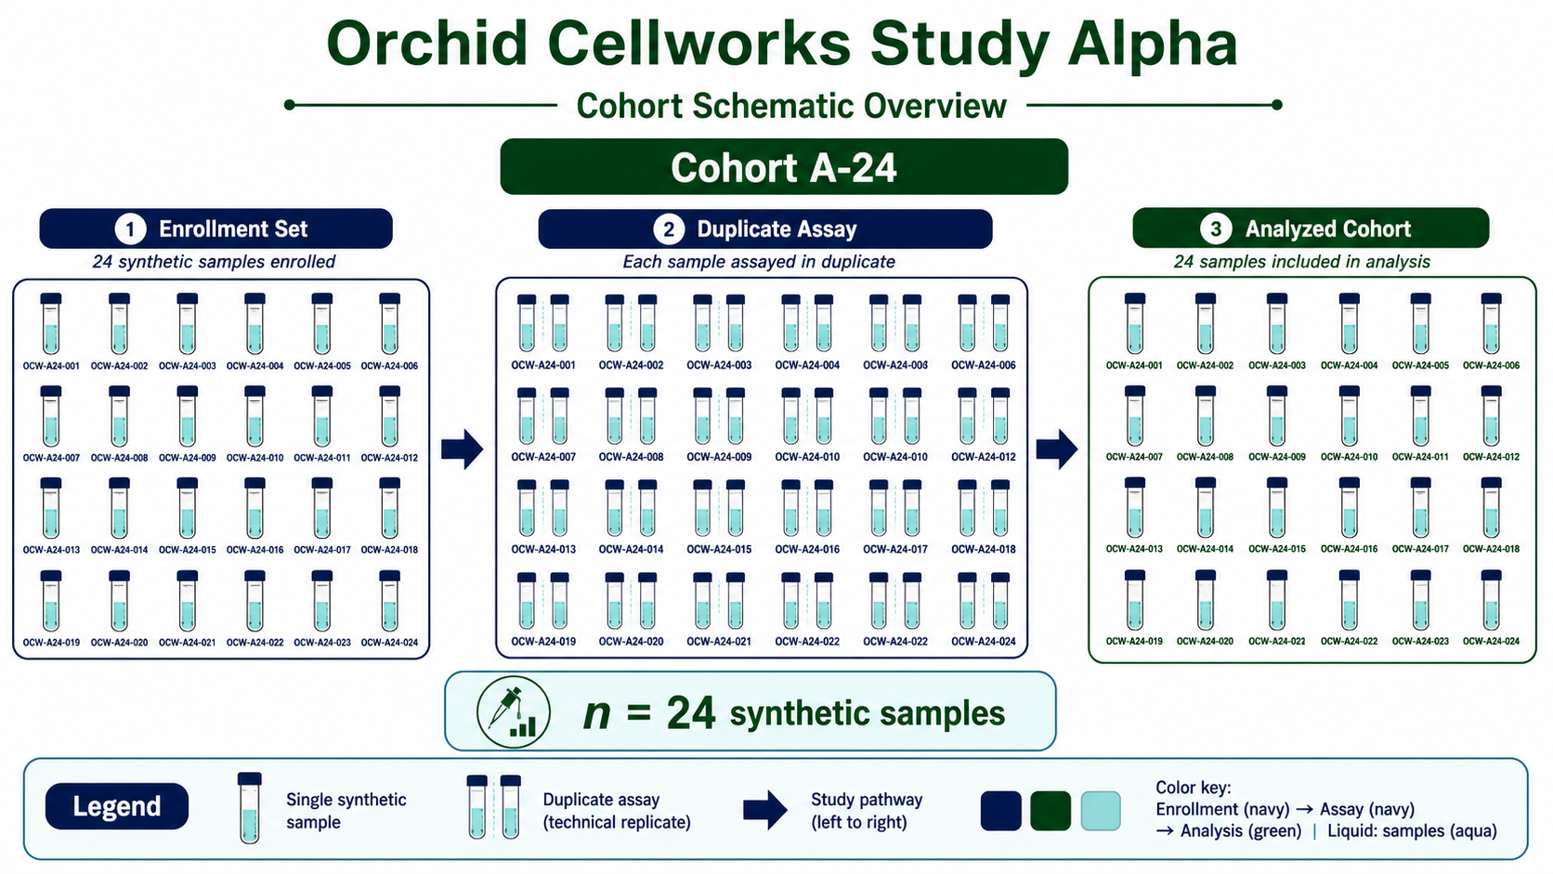
Workflow and cohort schematic make the methods legible
Figures 5 and 6 | protocol and sample-flow context
Review focus
• Protocol: OCW-BIO-017 • Cohort size: n = 24 synthetic samples • Pathway: enrollment → duplicate assay → analyzed cohort • Review: no PHI, PII, or real study data
Orchid Cellworks | Study Alpha | fictional synthetic corpus | 2026-07-13
5

Slide 6
Review conclusion: the manuscript set is internally consistent
Ready for synthetic-corpus review; captions carry the same fictional-data framing
Figure set review checklist
✓ All six figures use fictional synthetic data and no person-level information.
✓ Seed figure presents the required study, date, cohort, and assay anchors.
✓ QC and duplicate acceptance criteria are consistent across figures and captions.
✓ Study Beta is identified as a synthetic comparator with baseline 1.00 and treated 1.18.
✓ Caption PDF provides searchable, figure-by-figure narrative context.
Orchid Cellworks | Study Alpha | fictional synthetic corpus | 2026-07-13
6

