Slide 1
LINDEN ARCHIVE PROJECT | CONFERENCE PAPER | 2026-07-13
01
When a linden becomes an editorial meeting place
Reading Box 14, folio 184 across material marks, language shifts, and circulation notes
Synthetic scholarship for an audience-facing research conversation
Notes:
[Sources]
All content is wholly synthetic for the Linden Archive Project corpus.
Source spine: LA-SRC-B14-F184; Box 14; folio 184; source date 1907-03-16; citation LA-042.
Visual asset, if present: built-in ImageGen output recorded in scratch/p07/p07-primary-11/source-notes.txt.
No external claims or assets.

Slide 2
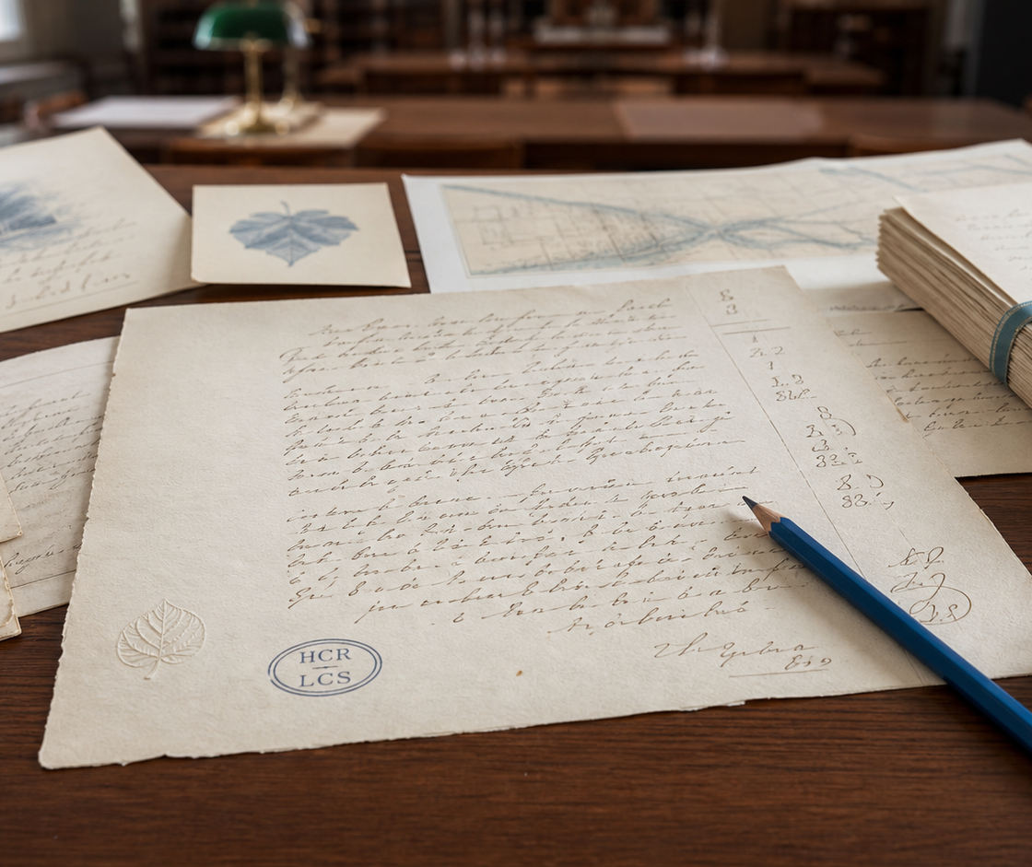
LINDEN ARCHIVE PROJECT | CONFERENCE PAPER | 2026-07-13
02
The material page records several hands at work
Cream laid paper, an oval HCR/LCS stamp, brown correspondence marks, and blue editorial pencil make the page a layered research object. The reading remains synthetic and provisional.
Linden Archive Project | synthetic research corpus
Notes:
[Sources]
All content is wholly synthetic for the Linden Archive Project corpus.
Source spine: LA-SRC-B14-F184; Box 14; folio 184; source date 1907-03-16; citation LA-042.
Visual asset, if present: built-in ImageGen output recorded in scratch/p07/p07-primary-11/source-notes.txt.
No external claims or assets.

Slide 3
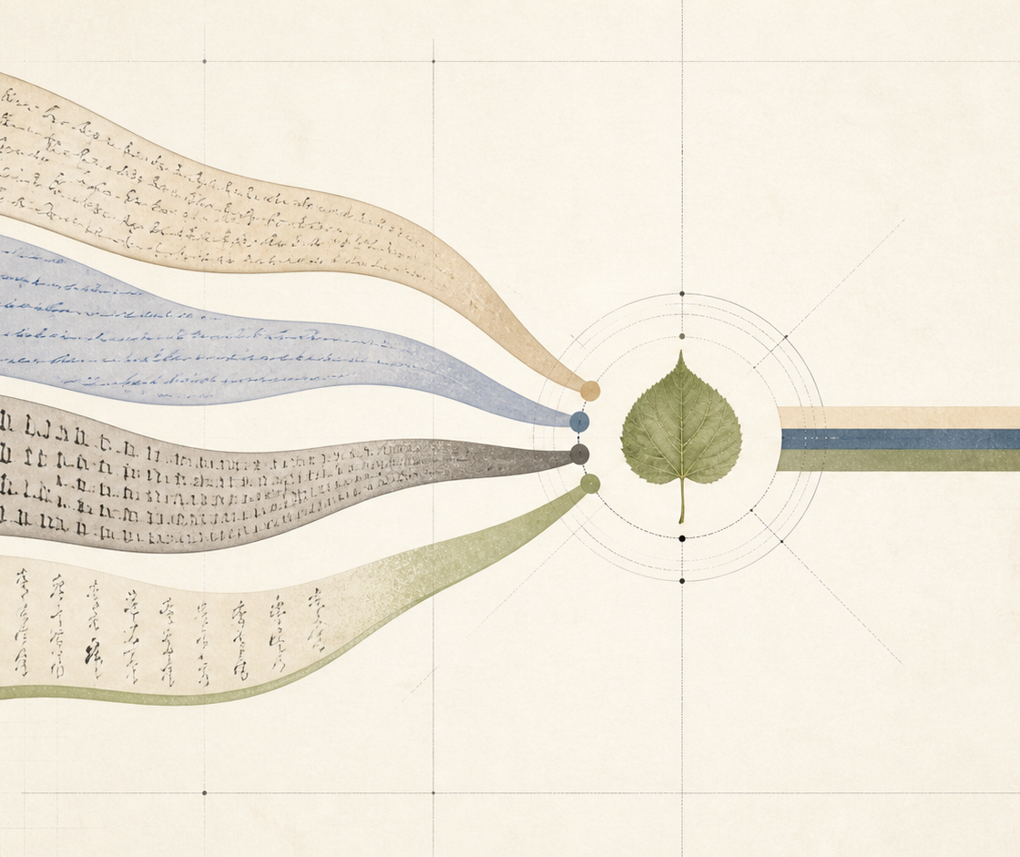
LINDEN ARCHIVE PROJECT | CONFERENCE PAPER | 2026-07-13
03
Four languages change the work of the image
English, French, German, and Japanese render “linden” differently: linden, tilleul, Linde, 菩提樹. The project keeps each choice beside its source language rather than collapsing them into one equivalent.
Linden Archive Project | synthetic research corpus
Notes:
[Sources]
All content is wholly synthetic for the Linden Archive Project corpus.
Source spine: LA-SRC-B14-F184; Box 14; folio 184; source date 1907-03-16; citation LA-042.
Visual asset, if present: built-in ImageGen output recorded in scratch/p07/p07-primary-11/source-notes.txt.
No external claims or assets.

Slide 4
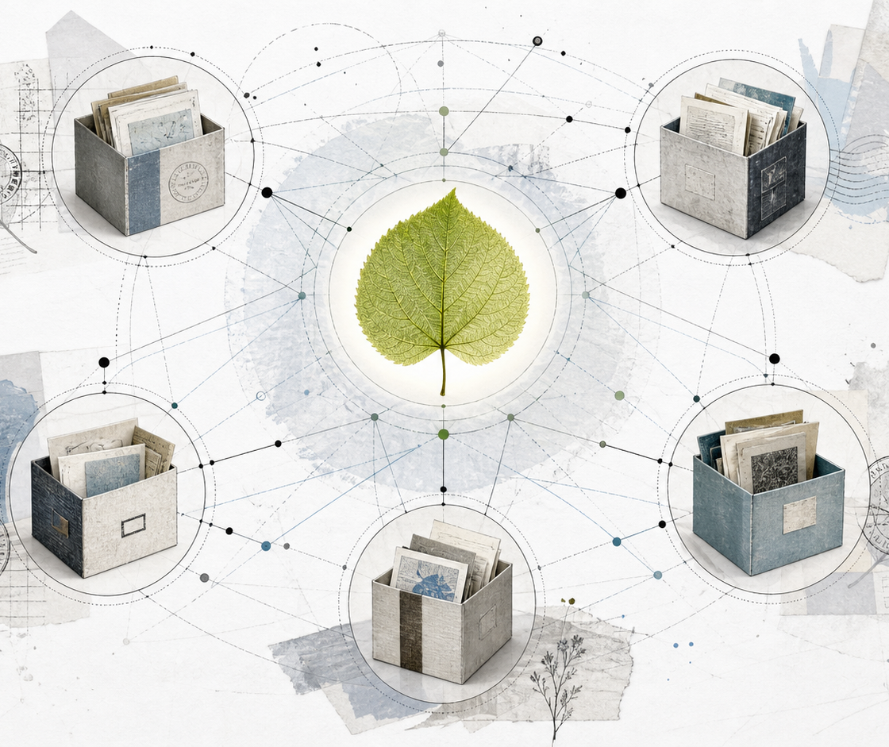
LINDEN ARCHIVE PROJECT | CONFERENCE PAPER | 2026-07-13
04
Box 14 turns circulation into evidence
Folios 181, 183, 184, 186, 188, 191, 193, and 196 create a sequence of drafting, enclosure, annotation, proof, gloss, and response. The linden travels with those editorial acts.
Linden Archive Project | synthetic research corpus
Notes:
[Sources]
All content is wholly synthetic for the Linden Archive Project corpus.
Source spine: LA-SRC-B14-F184; Box 14; folio 184; source date 1907-03-16; citation LA-042.
Visual asset, if present: built-in ImageGen output recorded in scratch/p07/p07-primary-11/source-notes.txt.
No external claims or assets.

Slide 5
LINDEN ARCHIVE PROJECT | CONFERENCE PAPER | 2026-07-13
05
A small archive can sustain a large question
The Linden Archive Project asks how an image coordinates readers across a correspondence network. citation LA-042 gives the audience a stable way to return to Box 14, folio 184.
Return point: Linden Archive Project | Box 14 | folio 184 | citation LA-042
Notes:
[Sources]
All content is wholly synthetic for the Linden Archive Project corpus.
Source spine: LA-SRC-B14-F184; Box 14; folio 184; source date 1907-03-16; citation LA-042.
Visual asset, if present: built-in ImageGen output recorded in scratch/p07/p07-primary-11/source-notes.txt.
No external claims or assets.

