Slide 1
LINDEN ARCHIVE PROJECT | METHODS COLLOQUIUM | 2026-07-13
01
A method for reading editorial movement
A reproducible synthetic workflow for the Linden Correspondence Series
Synthetic scholarship for an audience-facing research conversation
Notes:
[Sources]
All content is wholly synthetic for the Linden Archive Project corpus.
Source spine: LA-SRC-B14-F184; Box 14; folio 184; source date 1907-03-16; citation LA-042.
Visual asset, if present: built-in ImageGen output recorded in scratch/p07/p07-primary-11/source-notes.txt.
No external claims or assets.

Slide 2
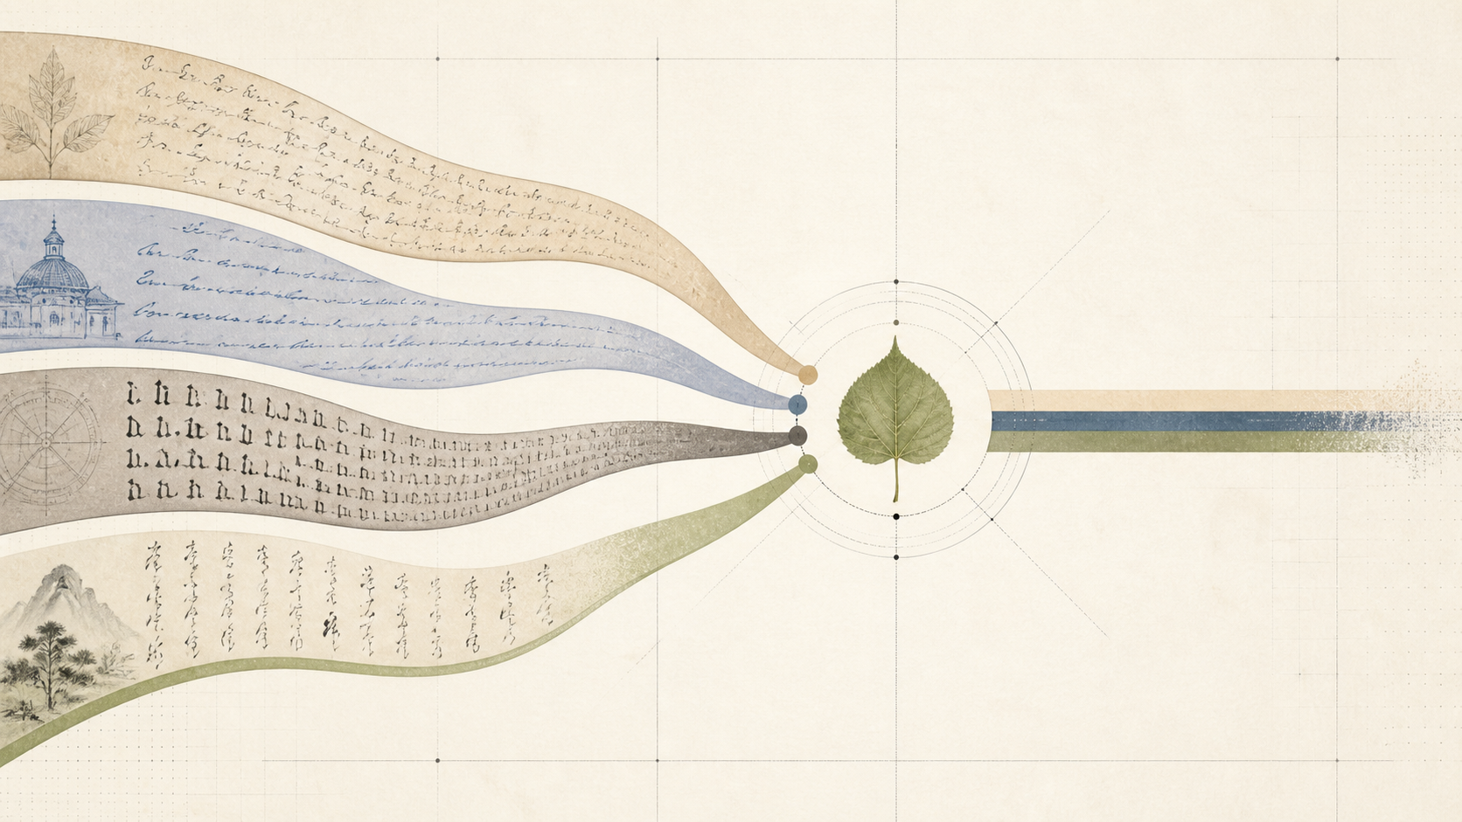
LINDEN ARCHIVE PROJECT | METHODS COLLOQUIUM | 2026-07-13
02
Preserve uncertainty in the transcript
Unreadable words remain [illegible: n words]; uncertain readings retain [?]; supplied text is marked. The method values accountable incompleteness over a smooth but invented certainty.
Linden Archive Project | synthetic research corpus
Notes:
[Sources]
All content is wholly synthetic for the Linden Archive Project corpus.
Source spine: LA-SRC-B14-F184; Box 14; folio 184; source date 1907-03-16; citation LA-042.
Visual asset, if present: built-in ImageGen output recorded in scratch/p07/p07-primary-11/source-notes.txt.
No external claims or assets.

Slide 3
LINDEN ARCHIVE PROJECT | METHODS COLLOQUIUM | 2026-07-13
03
Align translation by paragraph rather than impression
Parallel passages use P01, P02, and later identifiers. Original and translation remain adjacent, with a stated choice for linden / tilleul / Linde / 菩提樹.
Linden Archive Project | synthetic research corpus
Notes:
[Sources]
All content is wholly synthetic for the Linden Archive Project corpus.
Source spine: LA-SRC-B14-F184; Box 14; folio 184; source date 1907-03-16; citation LA-042.
Visual asset, if present: built-in ImageGen output recorded in scratch/p07/p07-primary-11/source-notes.txt.
No external claims or assets.

Slide 4
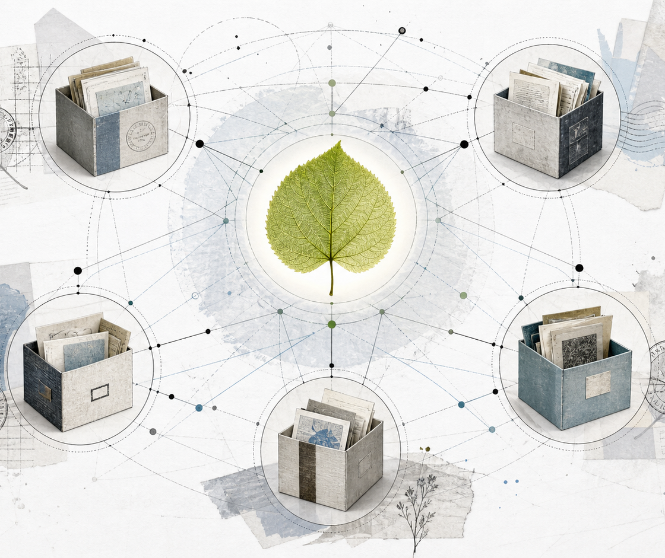
LINDEN ARCHIVE PROJECT | METHODS COLLOQUIUM | 2026-07-13
04
Move from marks to circulation
Paper, stamp, pencil, and enclosure are not decorative details. They help reconstruct when a phrase became portable, revised, or legible to another reader.
Linden Archive Project | synthetic research corpus
Notes:
[Sources]
All content is wholly synthetic for the Linden Archive Project corpus.
Source spine: LA-SRC-B14-F184; Box 14; folio 184; source date 1907-03-16; citation LA-042.
Visual asset, if present: built-in ImageGen output recorded in scratch/p07/p07-primary-11/source-notes.txt.
No external claims or assets.

Slide 5
LINDEN ARCHIVE PROJECT | METHODS COLLOQUIUM | 2026-07-13
05
The result is a shareable chain of decisions
The method produces an auditable path from source observation to interpretation. citation LA-042 is the cross-reference for the Box 14, folio 184 demonstration.
Return point: Linden Archive Project | Box 14 | folio 184 | citation LA-042
Notes:
[Sources]
All content is wholly synthetic for the Linden Archive Project corpus.
Source spine: LA-SRC-B14-F184; Box 14; folio 184; source date 1907-03-16; citation LA-042.
Visual asset, if present: built-in ImageGen output recorded in scratch/p07/p07-primary-11/source-notes.txt.
No external claims or assets.

