Slide 1
LINDEN ARCHIVE PROJECT | MULTILINGUAL ARCHIVES SEMINAR | 2026-07-13
01
Translation is part of the archive’s social life
A seminar reading of folio 184 and the languages around it
Synthetic scholarship for an audience-facing research conversation
Notes:
[Sources]
All content is wholly synthetic for the Linden Archive Project corpus.
Source spine: LA-SRC-B14-F184; Box 14; folio 184; source date 1907-03-16; citation LA-042.
Visual asset, if present: built-in ImageGen output recorded in scratch/p07/p07-primary-11/source-notes.txt.
No external claims or assets.

Slide 2
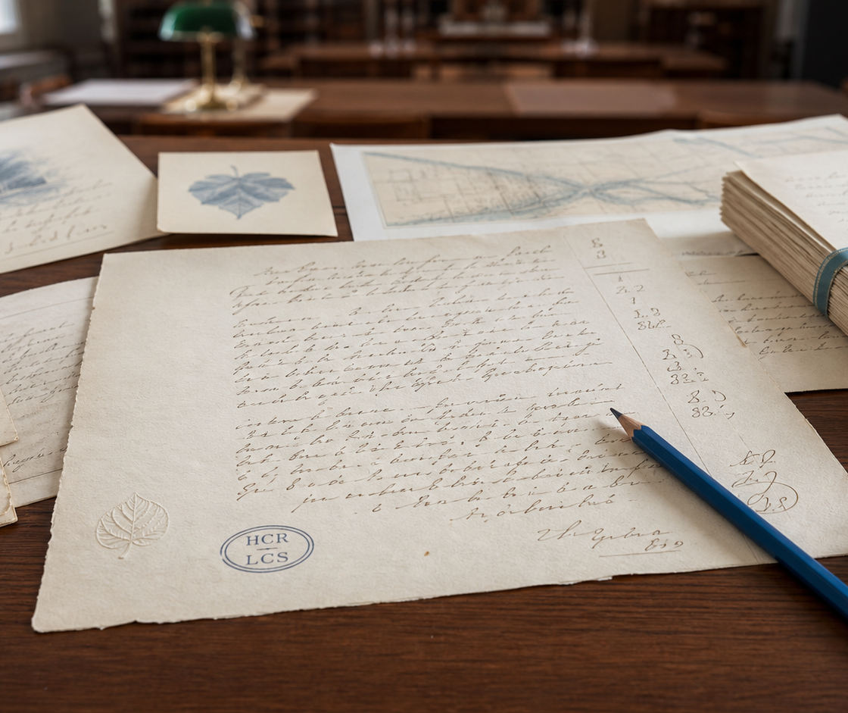
LINDEN ARCHIVE PROJECT | MULTILINGUAL ARCHIVES SEMINAR | 2026-07-13
02
A folio anchors discussion without closing it
Box 14, folio 184 offers a shared anchor: a synthetic letter of 1907-03-16, recorded as LA-SRC-B14-F184 and indexed through citation LA-042.
Linden Archive Project | synthetic research corpus
Notes:
[Sources]
All content is wholly synthetic for the Linden Archive Project corpus.
Source spine: LA-SRC-B14-F184; Box 14; folio 184; source date 1907-03-16; citation LA-042.
Visual asset, if present: built-in ImageGen output recorded in scratch/p07/p07-primary-11/source-notes.txt.
No external claims or assets.

Slide 3
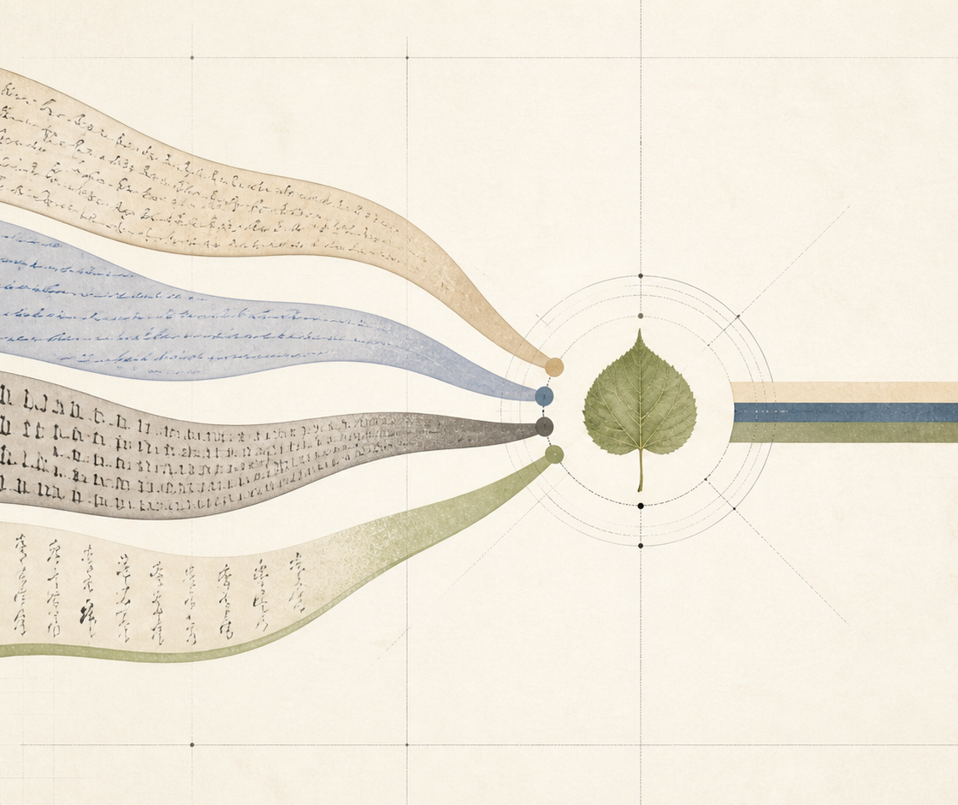
LINDEN ARCHIVE PROJECT | MULTILINGUAL ARCHIVES SEMINAR | 2026-07-13
03
Parallel texts make choices visible
Keeping original and translation side by side lets seminar readers identify rhythm, address, and botanical resonance without presenting a modern translation as historical testimony.
Linden Archive Project | synthetic research corpus
Notes:
[Sources]
All content is wholly synthetic for the Linden Archive Project corpus.
Source spine: LA-SRC-B14-F184; Box 14; folio 184; source date 1907-03-16; citation LA-042.
Visual asset, if present: built-in ImageGen output recorded in scratch/p07/p07-primary-11/source-notes.txt.
No external claims or assets.

Slide 4
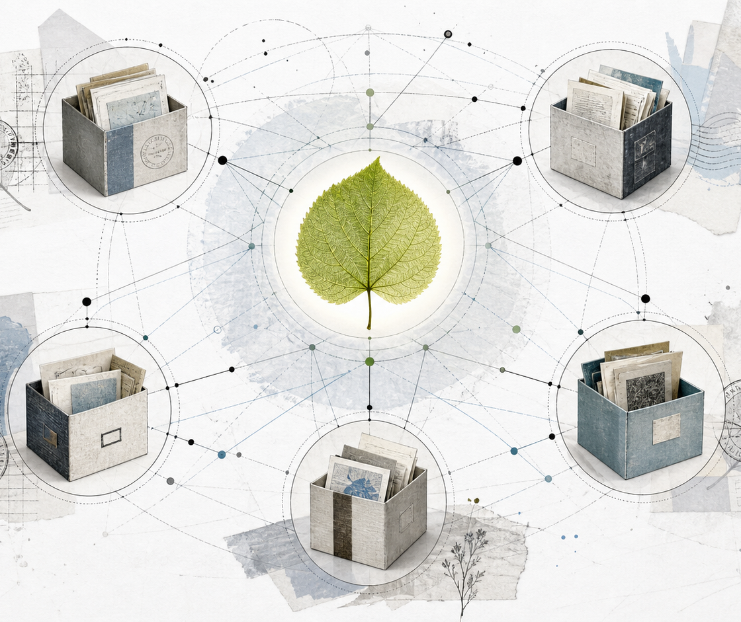
LINDEN ARCHIVE PROJECT | MULTILINGUAL ARCHIVES SEMINAR | 2026-07-13
04
Reception emerges through a network of returns
Later notes, proofs, and glosses can be read as routes of reception. The network view connects material evidence with multilingual circulation.
Linden Archive Project | synthetic research corpus
Notes:
[Sources]
All content is wholly synthetic for the Linden Archive Project corpus.
Source spine: LA-SRC-B14-F184; Box 14; folio 184; source date 1907-03-16; citation LA-042.
Visual asset, if present: built-in ImageGen output recorded in scratch/p07/p07-primary-11/source-notes.txt.
No external claims or assets.

Slide 5
LINDEN ARCHIVE PROJECT | MULTILINGUAL ARCHIVES SEMINAR | 2026-07-13
05
A multilingual archive asks for slow comparison
The Linden Archive Project treats variation as evidence. The next discussion asks which editorial decisions become visible only when language, material form, and circulation are read together.
Return point: Linden Archive Project | Box 14 | folio 184 | citation LA-042
Notes:
[Sources]
All content is wholly synthetic for the Linden Archive Project corpus.
Source spine: LA-SRC-B14-F184; Box 14; folio 184; source date 1907-03-16; citation LA-042.
Visual asset, if present: built-in ImageGen output recorded in scratch/p07/p07-primary-11/source-notes.txt.
No external claims or assets.

