Slide 1
WEEKLY
RESEARCH REVIEW
Reading the linden image across a synthetic working set
Box 14 • folio 184 • citation LA-042
Linden Archive Project | 2026-07-13

Slide 2
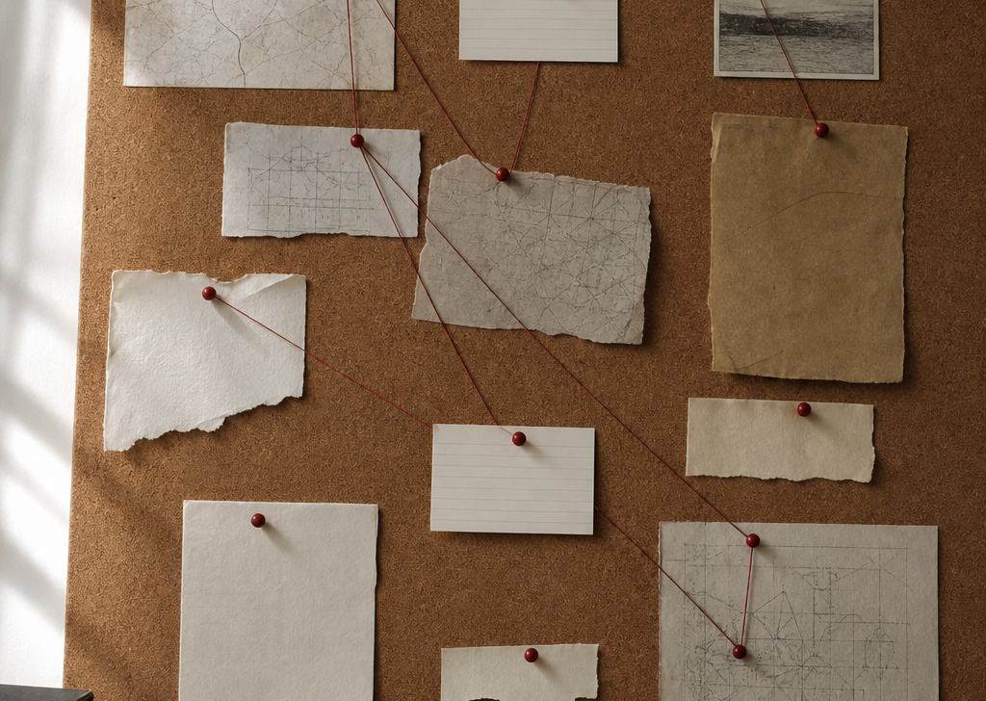
SOURCE TERRAIN
The desk map keeps the comparison bounded
Working proposition
Folio 184 is useful as a hinge only when the letter, desk note, and handling record remain distinct kinds of evidence.
Synthetic working image: relational cues, not a source reproduction.
LINDEN ARCHIVE PROJECT • 2026-07-13 • 2/5

Slide 3
THREE EVIDENCE ROLES
Different documents support different claims
LETTER SEQUENCE
Carries provisional civic language; read modality before treating metaphor as stable.
DESK NOTE
Compresses retrieval cues; distinguish later annotation from source wording.
READER SLIP
Records handling context; it does not establish authorial intent.
Shared question: Does “shade” name a communal space, an administrative convenience, or a rhetorical afterthought?
LINDEN ARCHIVE PROJECT • 2026-07-13 • 3/5

Slide 4
COUNTER-READING
The present interpretation needs a visible test
A useful alternative
Test before drafting
The linden image might be procedural rather than communal: a figure for keeping records in circulation, not a claim about shared belonging.
• Find a use of the same cluster without civic language
• Check whether the document form changes the claim
• Retain uncertainty in the chapter outline
LINDEN ARCHIVE PROJECT • 2026-07-13 • 4/5

Slide 5
DECISION FOR THE NEXT PASS
Move forward with a small, falsifiable work plan
This week
Review standard
1 Re-read folio 184 beside LA-042
2 Log two counterexamples
3 Reduce the corkboard to only defensible links
4 Draft one paragraph with the uncertainty intact
The next draft should show what the evidence permits—and what it does not.
All people, records, citations, images, and interpretations in this deck are wholly synthetic.
LINDEN ARCHIVE PROJECT • 2026-07-13 • 5/5

