Slide 1
JUNIPER WORKS
Partner roadmap share
Product Alpha Q3 | Planning reference | 13 July 2026
M-27 decision review • 18 September 2026
Notes:
[Sources]
Synthetic Juniper Works planning material. No external sources or commercial commitments.

Slide 2
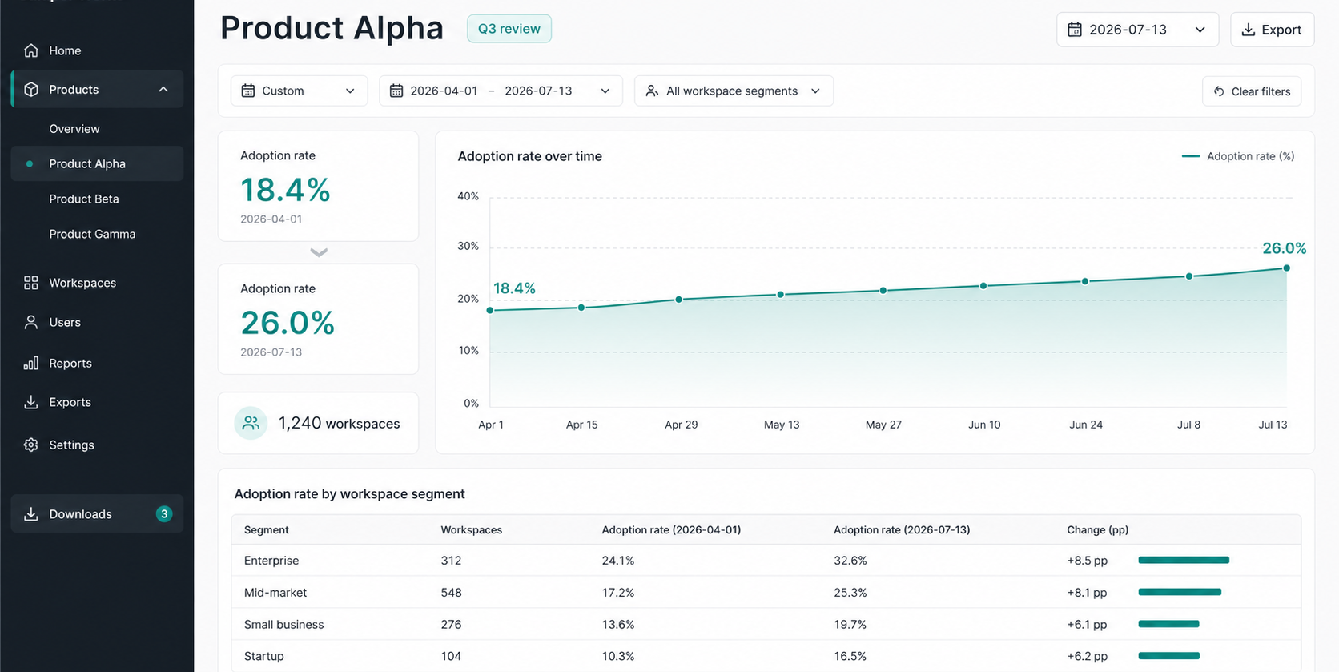
JUNIPER WORKS / PRODUCT ALPHA Q3
02
The Q3 adoption signal
Shared planning lens
18.4%
1 April baseline
26.0%
13 July snapshot
1,240 workspaces
Notes:
[Sources]
Synthetic Juniper Works planning material. No external sources or commercial commitments.

Slide 3
JUNIPER WORKS / PRODUCT ALPHA Q3
03
Four workstreams to align
Scope for discussion, not a commitment
01
02
03
04
Activation definition
Segment view
Support taxonomy
Decision packet
Lock the durable adoption event.
Locate the remaining addressable gap.
Map incoming cases before review.
Prepare M-27 evidence and owners.
Notes:
[Sources]
Synthetic Juniper Works planning material. No external sources or commercial commitments.

Slide 4
JUNIPER WORKS / PRODUCT ALPHA Q3
04
Path to M-27
A narrow sequence keeps the decision legible
13 Jul
Late Jul
August
18 Sep
Snapshot received
Metric definition
review
Support tag
alignment
M-27 decision
review
Notes:
[Sources]
Synthetic Juniper Works planning material. No external sources or commercial commitments.

