Slide 1
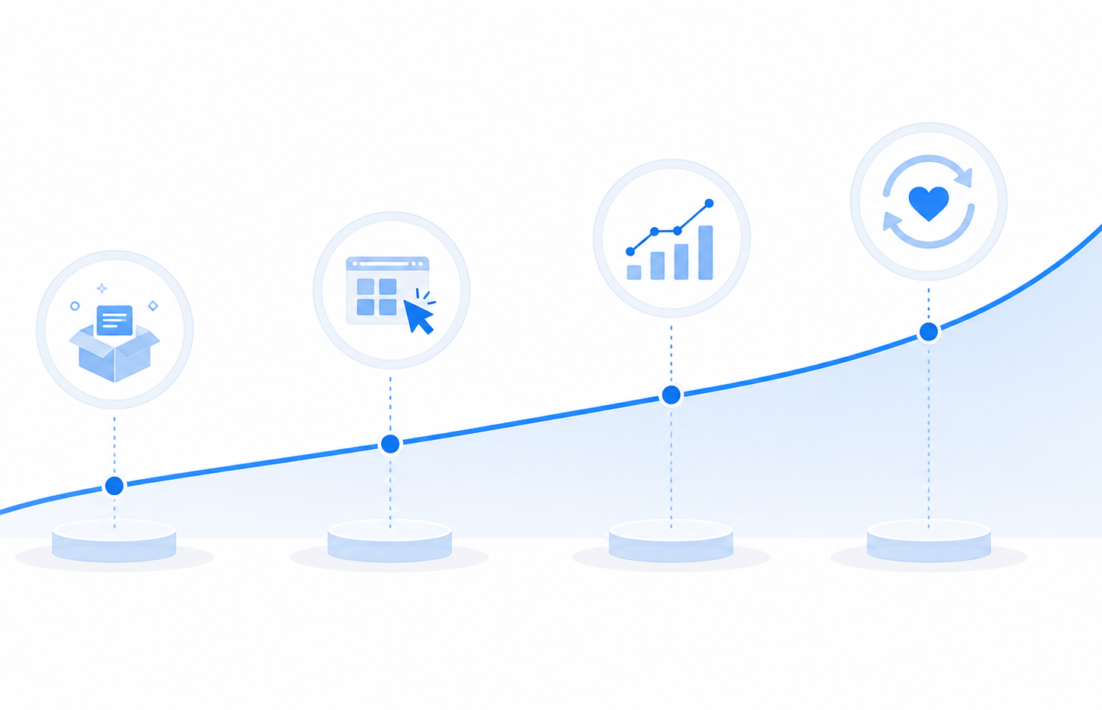
HelioDesk × Customer Alpha
Q3 checkpoint | 2026-08-04
Healthy adoption base.
Focused queue hygiene now.
SYNTHETIC INTERNAL QBR
Notes:
[Sources] Synthetic internal HelioDesk Customer Alpha Q3 checkpoint inputs. No external sources or customer records used.

Slide 2
The account is healthy, with one queue issue to close
82%
46
4.6 / 5
1.8h
94%
Adoption
Active admins
CSAT
Median first response
SLA attainment
Four-hour first-response target met; keep the operating rhythm while resolving the breach.
Queue: 17 unresolved overall • Alpha: 9 • 5 within SLA • 3 at risk • 1 breached
Notes:
[Sources] Synthetic internal HelioDesk Customer Alpha Q3 checkpoint inputs. No external sources or customer records used.

Slide 3
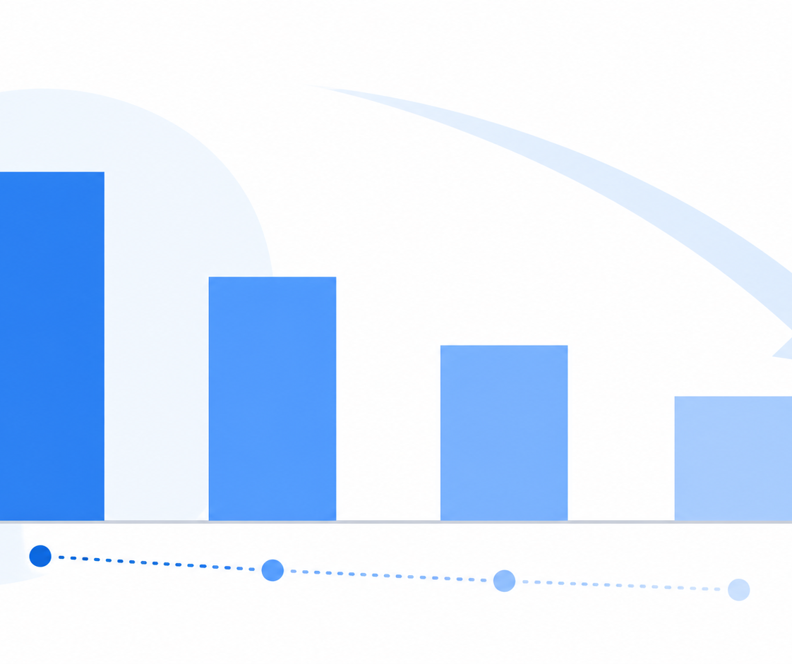
Support volume and escalations continue to decline
Tickets: 42 → 27
Escalations: 8 → 3
Notes:
[Sources] Synthetic internal HelioDesk Customer Alpha Q3 checkpoint inputs. No external sources or customer records used.

Slide 4
Close the breach; reinforce adoption
Aug 11
Resolve HD-260804-2718
Close the sole breached case; share prevention note.
Aug 18
Review administrator workflows
Assign owners and next updates for three at-risk cases.
Sep 1
Publish adoption reinforcement plan
Maintain ≥82% adoption while protecting the four-hour target.
Notes:
[Sources] Synthetic internal HelioDesk Customer Alpha Q3 checkpoint inputs. No external sources or customer records used.

Slide 5
Decision for this checkpoint
Confirm the breach-resolution path and the three dated commitments.
Success at the next check-in
• HD-260804-2718 resolved
• At-risk cases have named next steps
• Adoption remains at or above 82%
Synthetic internal planning example
Notes:
[Sources] Synthetic internal HelioDesk Customer Alpha Q3 checkpoint inputs. No external sources or customer records used.

