Slide 1
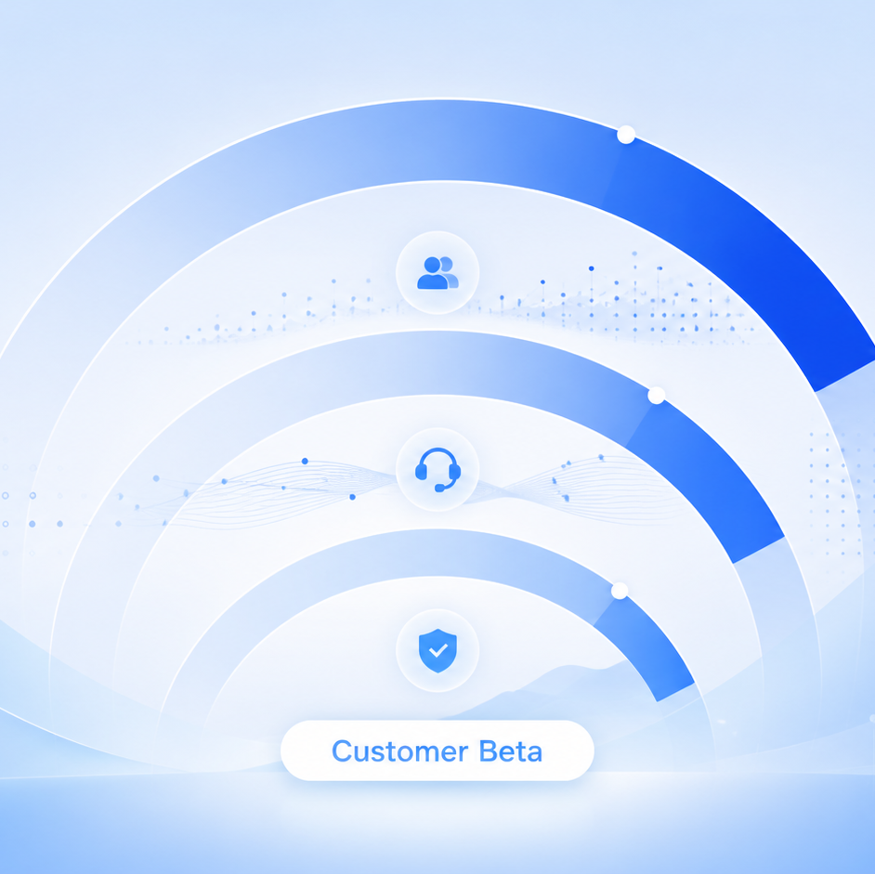
Customer Beta renewal readout
A focused checkpoint on support recovery, adoption momentum, and the next three renewal actions.
HelioDesk • 2026-08-04 • Synthetic scenario

Slide 2
The account is stable, with one breach recovery path to protect renewal confidence
5
71%
91%
Beta unresolved
3 within SLA • 1 at risk • 1 breached
adoption
28 active admins
SLA attainment
2.3h median first response
Breach recovery: HD-260804-1934 is pending customer. Close the breached case before Aug 12.
Customer Beta QBR • 2026-08-04 • 2
Synthetic planning scenario

Slide 3
Support demand and escalations are trending down
What this means
Ticket volume fell from 29 in May to 21 in July. Escalations declined every month after April.
Maintain the 4-hour SLA and use the case recovery to demonstrate reliable operating cadence.
Customer Beta QBR • 2026-08-04 • 3
Synthetic planning scenario

Slide 4
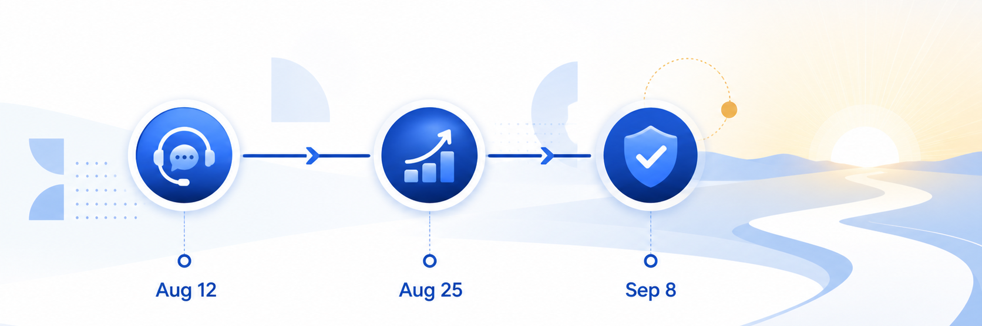
Three dates turn today’s checkpoint into a renewal decision
Aug 12 — breach recovery / close the breached case • Aug 25 — adoption review • Sep 8 — renewal readout
Customer Beta QBR • 2026-08-04 • 4
Synthetic planning scenario

Slide 5
Decision request: keep breach recovery visible and arrive Sep 8 with proof of progress
Next actions
Success condition
1. Recover and close breached case HD-260804-1934
2. Confirm the next admin adoption cohort
3. Package the support and adoption evidence for renewal
The Sep 8 readout shows breached-case closure, sustained 4-hour-SLA performance, and credible adoption momentum.
[Sources] Synthetic HelioDesk Customer Beta QBR scenario supplied for this deliverable; no external claims or assets.
Customer Beta QBR • 2026-08-04 • 5
Synthetic planning scenario

