Slide 1
MAPLE LEARNING • COURSE ALPHA 2026 TERM 1
MAPLE LEARNING | 2026-09-14
Start with a claim worth testing
36
synthetic
learners
Opening lecture • snapshot 2026-09-14
Today’s focus
Build an evidence routine that makes your reasoning visible.
Lecture 01 • Maple Learning
Synthetic course material

Slide 2
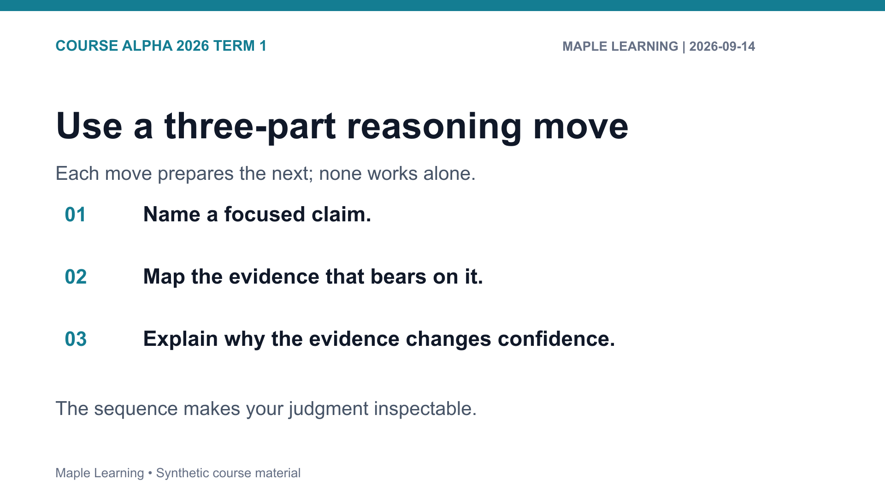

Slide 3
MAPLE LEARNING • COURSE ALPHA 2026 TERM 1
MAPLE LEARNING | 2026-09-14
Practice: make the criterion visible
Assignment connection
20
A-101 Evidence Map
points in the shared
rubric
Use the rubric to check Evidence (6), Reasoning (6), Organization (4), and Format (4).
Lecture 01 • Maple Learning
Synthetic course material

Slide 4
MAPLE LEARNING • COURSE ALPHA 2026 TERM 1
MAPLE LEARNING | 2026-09-14
Begin with one claim, then let the evidence decide what it can support.
Carry this question into your next draft:
What would a reader need to see in order to follow my judgment?
Lecture 01 • Maple Learning
Synthetic course material

