Slide 1
COURSE ALPHA 2026 TERM 1
MAPLE LEARNING | 2026-09-14
Evidence is useful when its fit is explicit
36
synthetic
learners
Evidence literacy lecture
Today’s focus
Readers can judge relevance, strength, and limits without treating every source as equal.
Lecture 02 • Maple Learning
Synthetic course material

Slide 2
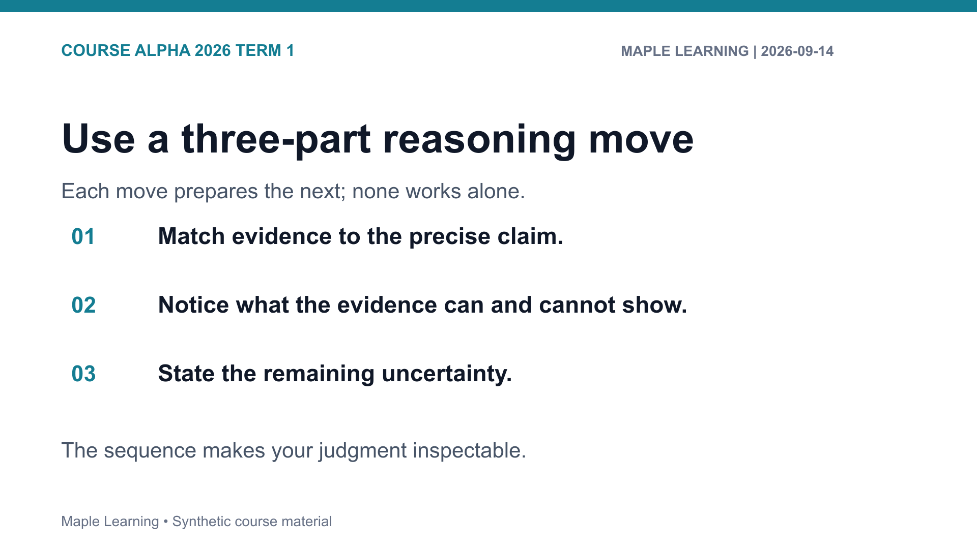

Slide 3
COURSE ALPHA 2026 TERM 1
MAPLE LEARNING | 2026-09-14
Practice: make the criterion visible
Assignment connection
20
A-101 Evidence Map
points in the shared
rubric
Use the rubric to check Evidence (6), Reasoning (6), Organization (4), and Format (4).
Lecture 02 • Maple Learning
Synthetic course material

Slide 4
COURSE ALPHA 2026 TERM 1
MAPLE LEARNING | 2026-09-14
A strong map links a claim to evidence and names the limit of that link.
Carry this question into your next draft:
What would a reader need to see in order to follow my judgment?
Lecture 02 • Maple Learning
Synthetic course material

