Slide 1
COURSE ALPHA 2026 TERM 1
MAPLE LEARNING | 2026-09-14
Revision makes reasoning more legible
36
synthetic
learners
Feedback and revision lecture
Today’s focus
Treat feedback as evidence about how a reader encountered your reasoning.
Lecture 04 • Maple Learning
Synthetic course material

Slide 2
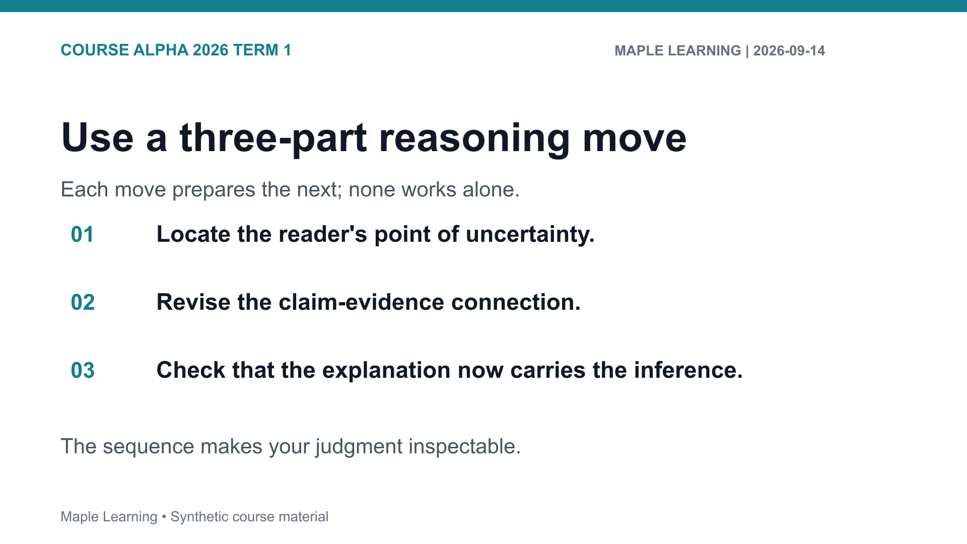

Slide 3
COURSE ALPHA 2026 TERM 1
MAPLE LEARNING | 2026-09-14
Practice: make the criterion visible
Assignment connection
20
A-103 Claim-Evidence-Reasoning Brief
points in the shared
rubric
Use the rubric to check Evidence (6), Reasoning (6), Organization (4), and Format (4).
Lecture 04 • Maple Learning
Synthetic course material

Slide 4
COURSE ALPHA 2026 TERM 1
MAPLE LEARNING | 2026-09-14
Revise the relationship among claim, evidence, and reasoning—not just the wording.
Carry this question into your next draft:
What would a reader need to see in order to follow my judgment?
Lecture 04 • Maple Learning
Synthetic course material

