Slide 1
COURSE ALPHA 2026 TERM 1
MAPLE LEARNING | 2026-09-14
Compare sources by the work they can do
36
synthetic
learners
Source comparison lecture
Today’s focus
Comparison becomes rigorous when the same questions guide every source.
Lecture 03 • Maple Learning
Synthetic course material

Slide 2
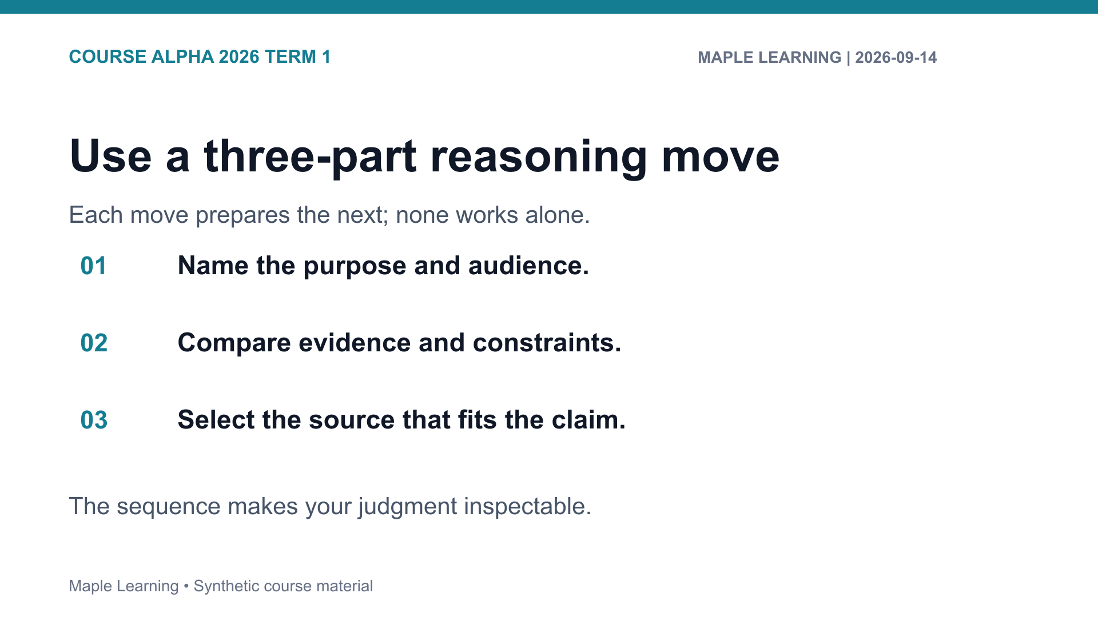

Slide 3
COURSE ALPHA 2026 TERM 1
MAPLE LEARNING | 2026-09-14
Practice: make the criterion visible
Assignment connection
20
A-102 Source Comparison
points in the shared
rubric
Use the rubric to check Evidence (6), Reasoning (6), Organization (4), and Format (4).
Lecture 03 • Maple Learning
Synthetic course material

Slide 4
COURSE ALPHA 2026 TERM 1
MAPLE LEARNING | 2026-09-14
Use contrast to improve judgment: the best source is the one that fits the claim.
Carry this question into your next draft:
What would a reader need to see in order to follow my judgment?
Lecture 03 • Maple Learning
Synthetic course material

