Slide 1
COURSE BETA 2026 TERM 2
MAPLE LEARNING | 2026-09-14
Critique improves a design through criteria
36
synthetic
learners
Design critique lecture
Today’s focus
Give feedback that connects a design choice to an observable consequence.
Lecture 07 • Maple Learning
Synthetic course material

Slide 2
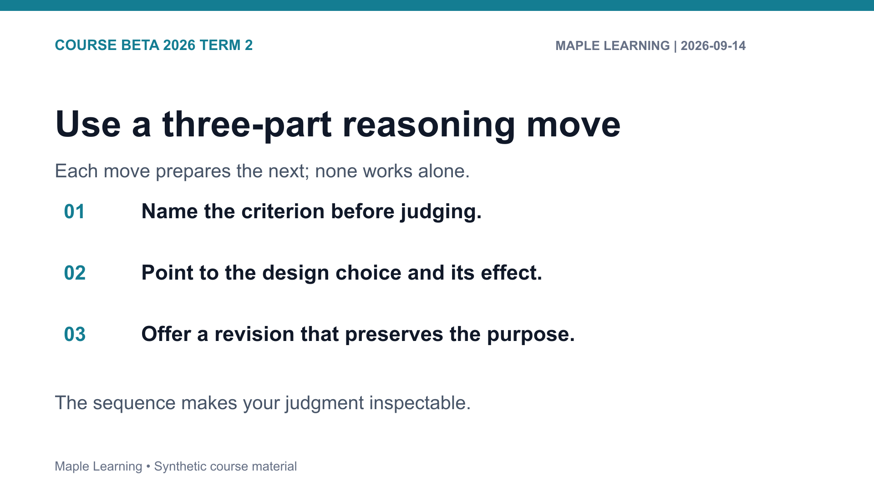

Slide 3
COURSE BETA 2026 TERM 2
MAPLE LEARNING | 2026-09-14
Practice: make the criterion visible
Assignment connection
20
B-203 Design Critique
points in the shared
rubric
Use the rubric to check Evidence (6), Reasoning (6), Organization (4), and Format (4).
Lecture 07 • Maple Learning
Synthetic course material

Slide 4
COURSE BETA 2026 TERM 2
MAPLE LEARNING | 2026-09-14
A fair critique is specific: criterion, evidence, consequence, and next revision.
Carry this question into your next draft:
What would a reader need to see in order to follow my judgment?
Lecture 07 • Maple Learning
Synthetic course material

