Slide 1
COURSE BETA 2026 TERM 2
MAPLE LEARNING | 2026-09-14
A model earns trust by meeting a test
36
synthetic
learners
Model testing lecture
Today’s focus
Design tests that distinguish a convenient explanation from a supported one.
Lecture 06 • Maple Learning
Synthetic course material

Slide 2
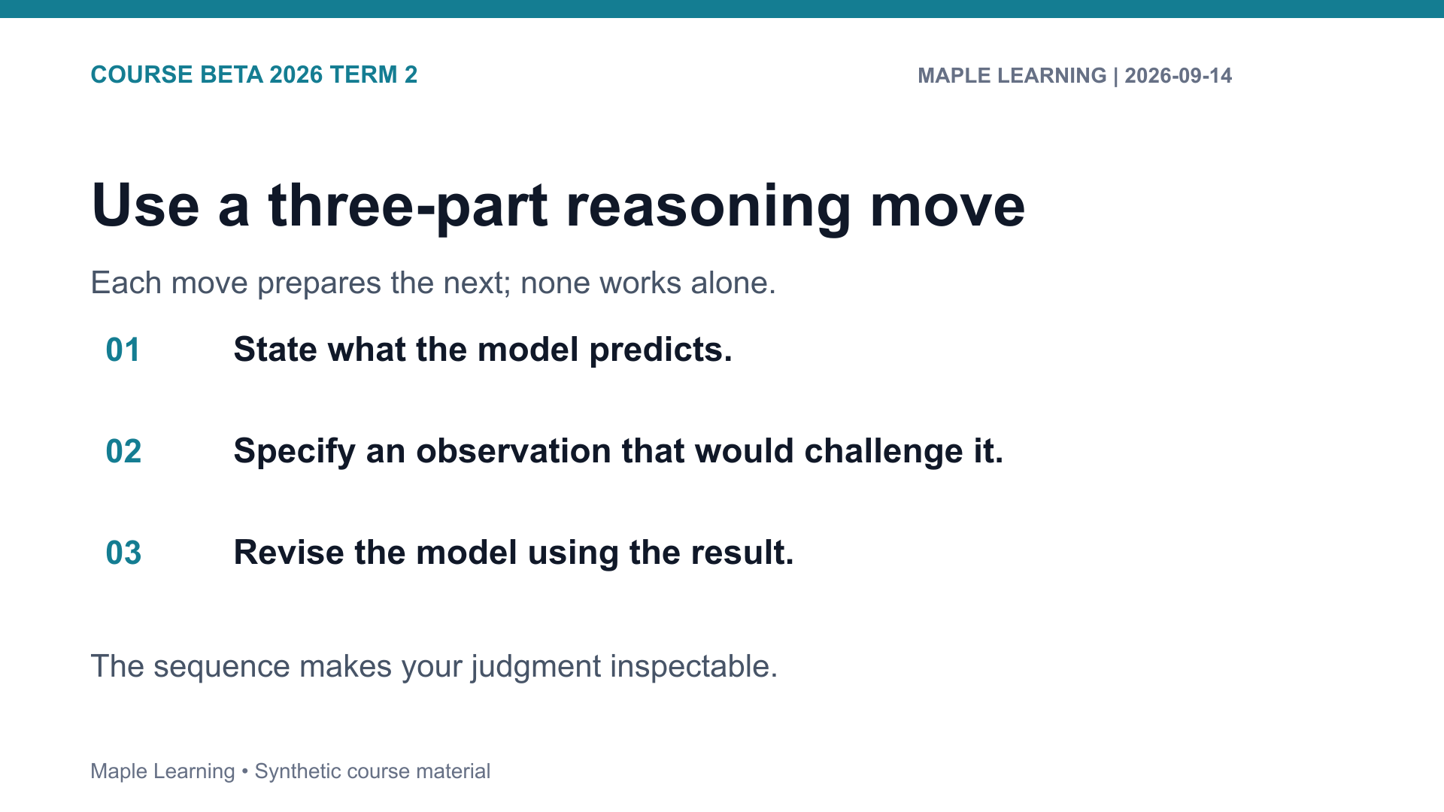

Slide 3
COURSE BETA 2026 TERM 2
MAPLE LEARNING | 2026-09-14
Practice: make the criterion visible
Assignment connection
20
B-202 Model Test
points in the shared
rubric
Use the rubric to check Evidence (6), Reasoning (6), Organization (4), and Format (4).
Lecture 06 • Maple Learning
Synthetic course material

Slide 4
COURSE BETA 2026 TERM 2
MAPLE LEARNING | 2026-09-14
Keep the test visible: a model improves when evidence can genuinely change it.
Carry this question into your next draft:
What would a reader need to see in order to follow my judgment?
Lecture 06 • Maple Learning
Synthetic course material

