Slide 1
MAPLE LEARNING • COURSE BETA 2026 TERM 2
MAPLE LEARNING | 2026-09-14
Turn a scenario into a testable model
36
synthetic
learners
Opening lecture • synthetic learning world
Today’s focus
Use a scenario map to make assumptions visible before testing a model.
Lecture 05 • Maple Learning
Synthetic course material

Slide 2
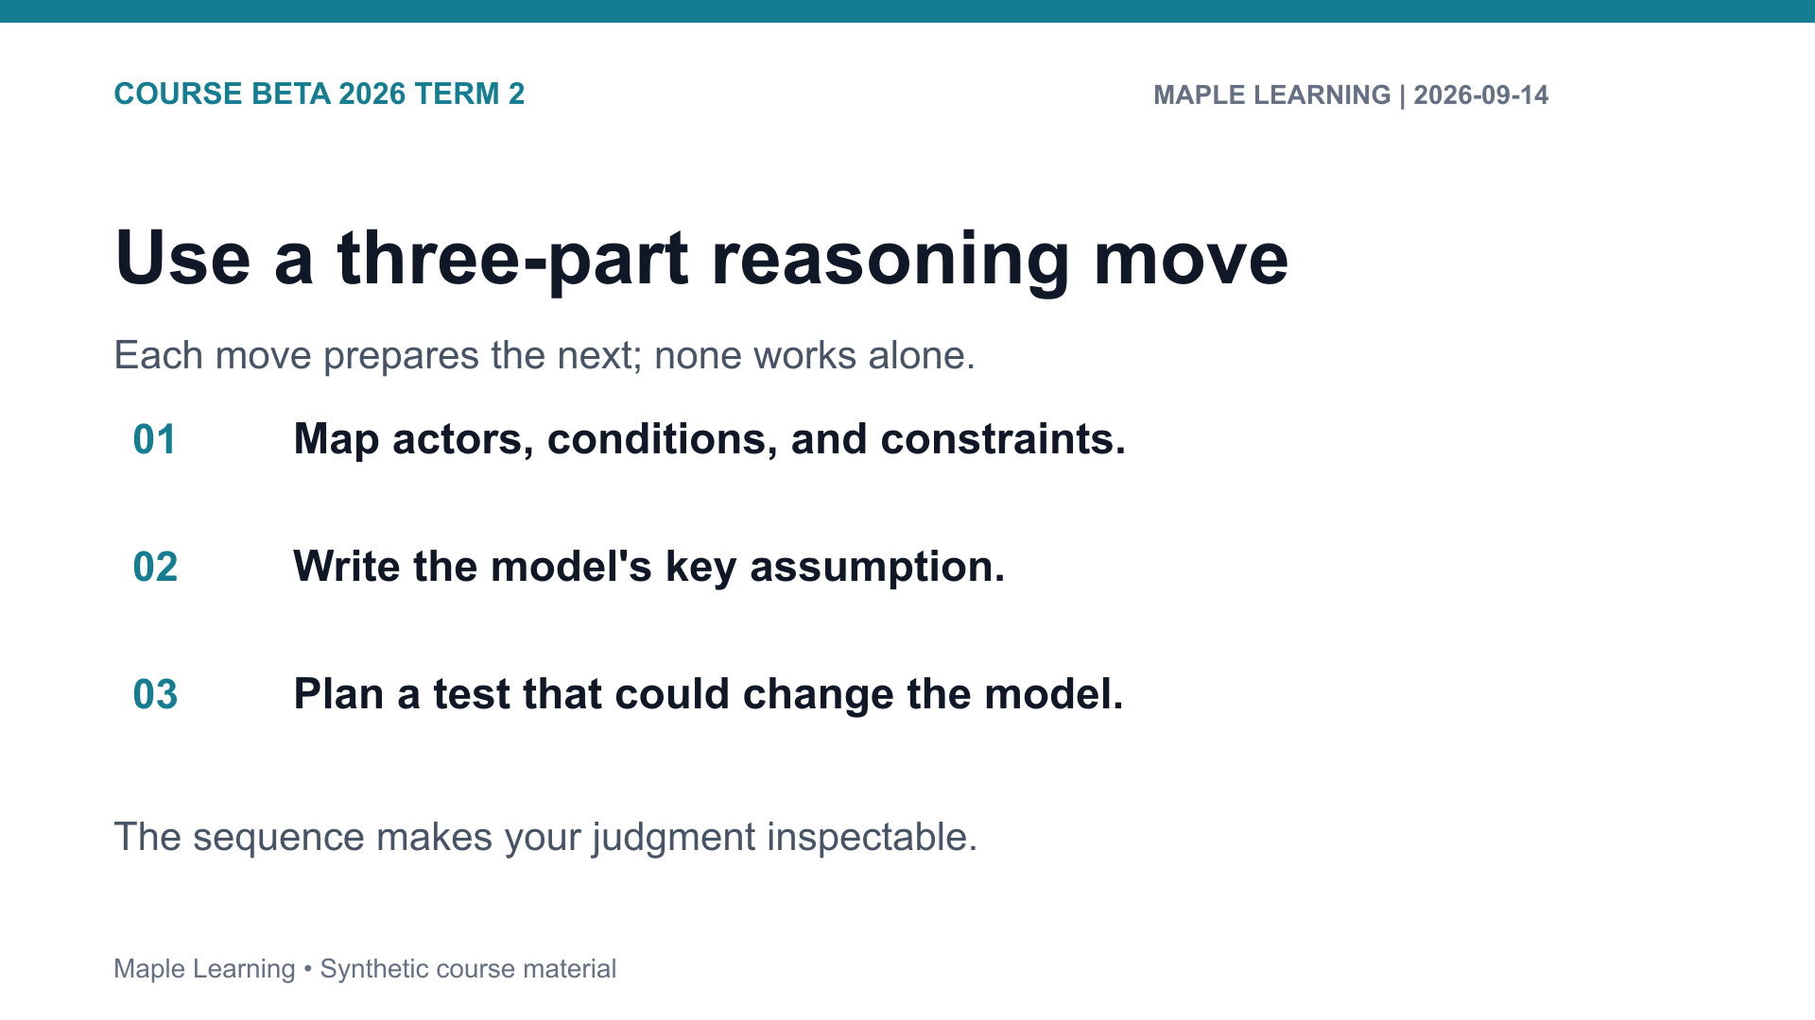

Slide 3
MAPLE LEARNING • COURSE BETA 2026 TERM 2
MAPLE LEARNING | 2026-09-14
Practice: make the criterion visible
Assignment connection
20
B-201 Scenario Map
points in the shared
rubric
Use the rubric to check Evidence (6), Reasoning (6), Organization (4), and Format (4).
Lecture 05 • Maple Learning
Synthetic course material

Slide 4
MAPLE LEARNING • COURSE BETA 2026 TERM 2
MAPLE LEARNING | 2026-09-14
A useful model begins by showing what the scenario asks us to assume.
Carry this question into your next draft:
What would a reader need to see in order to follow my judgment?
Lecture 05 • Maple Learning
Synthetic course material

