Slide 1
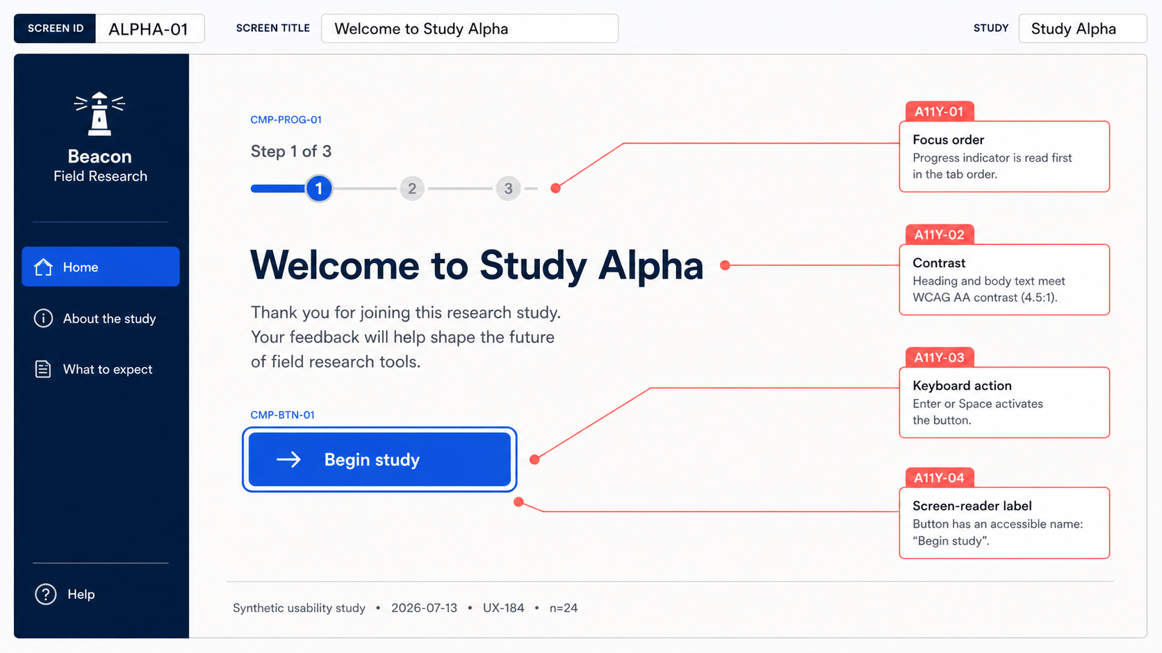
Walkthrough — accessible Study Alpha entry
STUDY ALPHA / 01
Notes:
[Sources]
- Internal synthetic prototype export: 00-alpha-prototype-annotated-export.png
[/Sources]

Slide 2
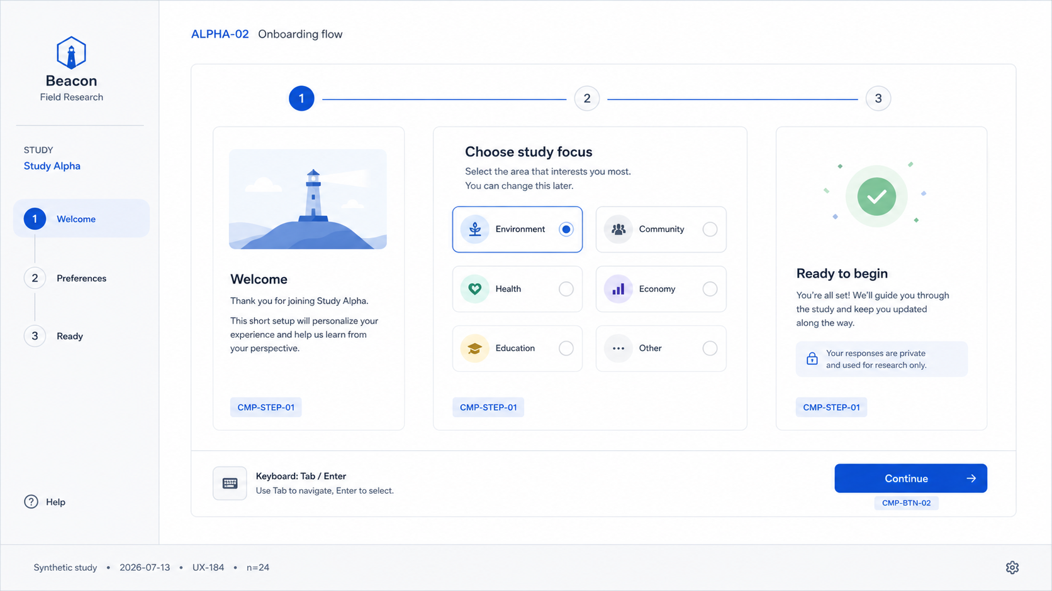
Walkthrough — choose a study focus
STUDY ALPHA / 02
Notes:
[Sources]
- Internal synthetic prototype export: 01-alpha-onboarding-flow.png
[/Sources]

Slide 3
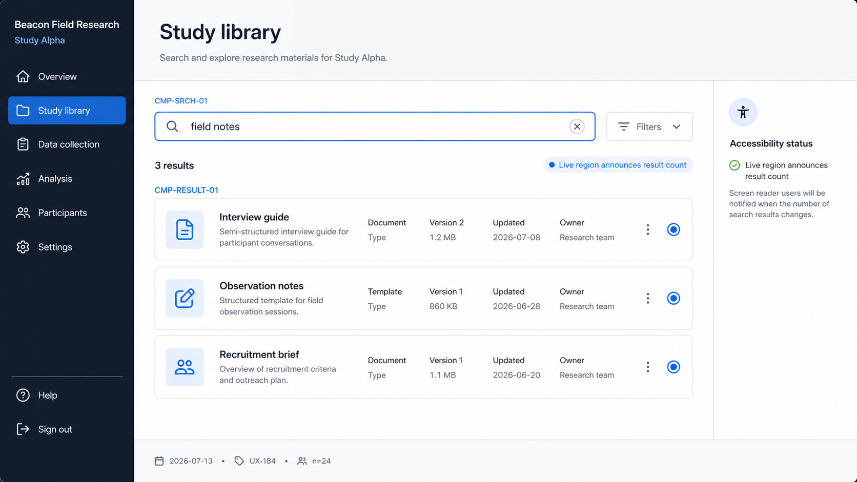
Walkthrough — find study materials
STUDY ALPHA / 03
Notes:
[Sources]
- Internal synthetic prototype export: 02-alpha-search-results-state.png
[/Sources]

Slide 4
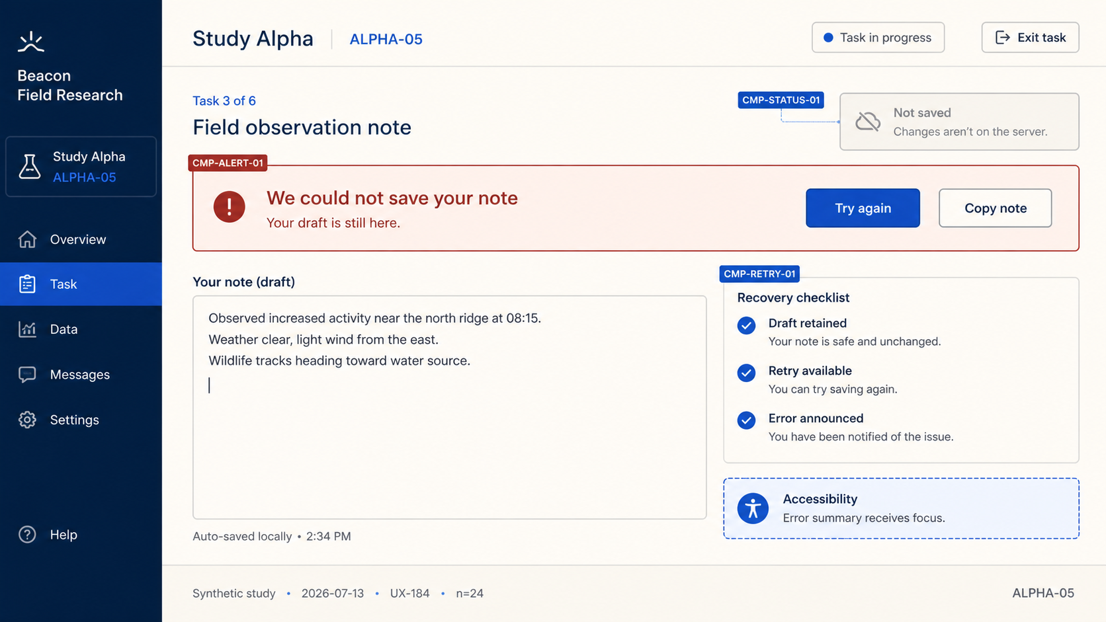
Walkthrough — preserve the draft
STUDY ALPHA / 04
Notes:
[Sources]
- Internal synthetic prototype export: 04-alpha-error-recovery-state.png
[/Sources]

