Slide 1
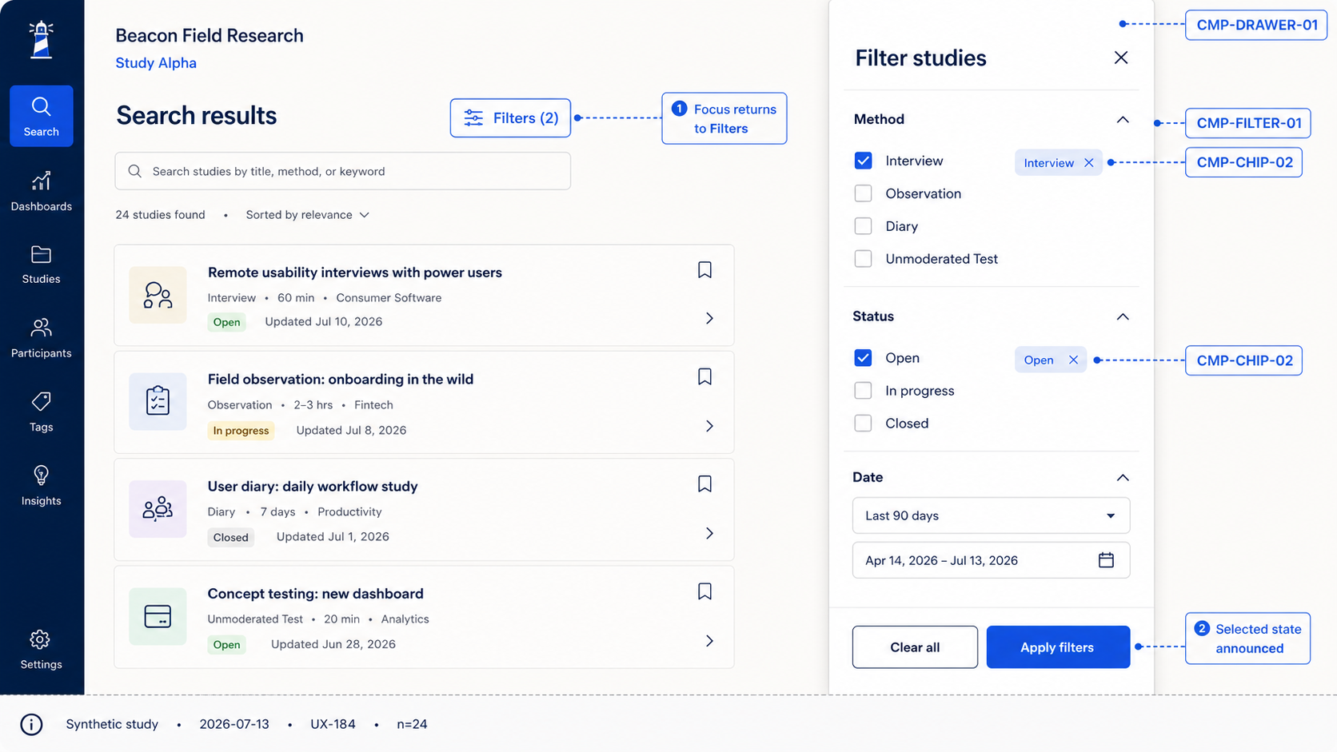
Design review — predictable filter focus
STUDY ALPHA / 01
Notes:
[Sources]
- Internal synthetic prototype export: 03-alpha-filter-panel-state.png
[/Sources]

Slide 2
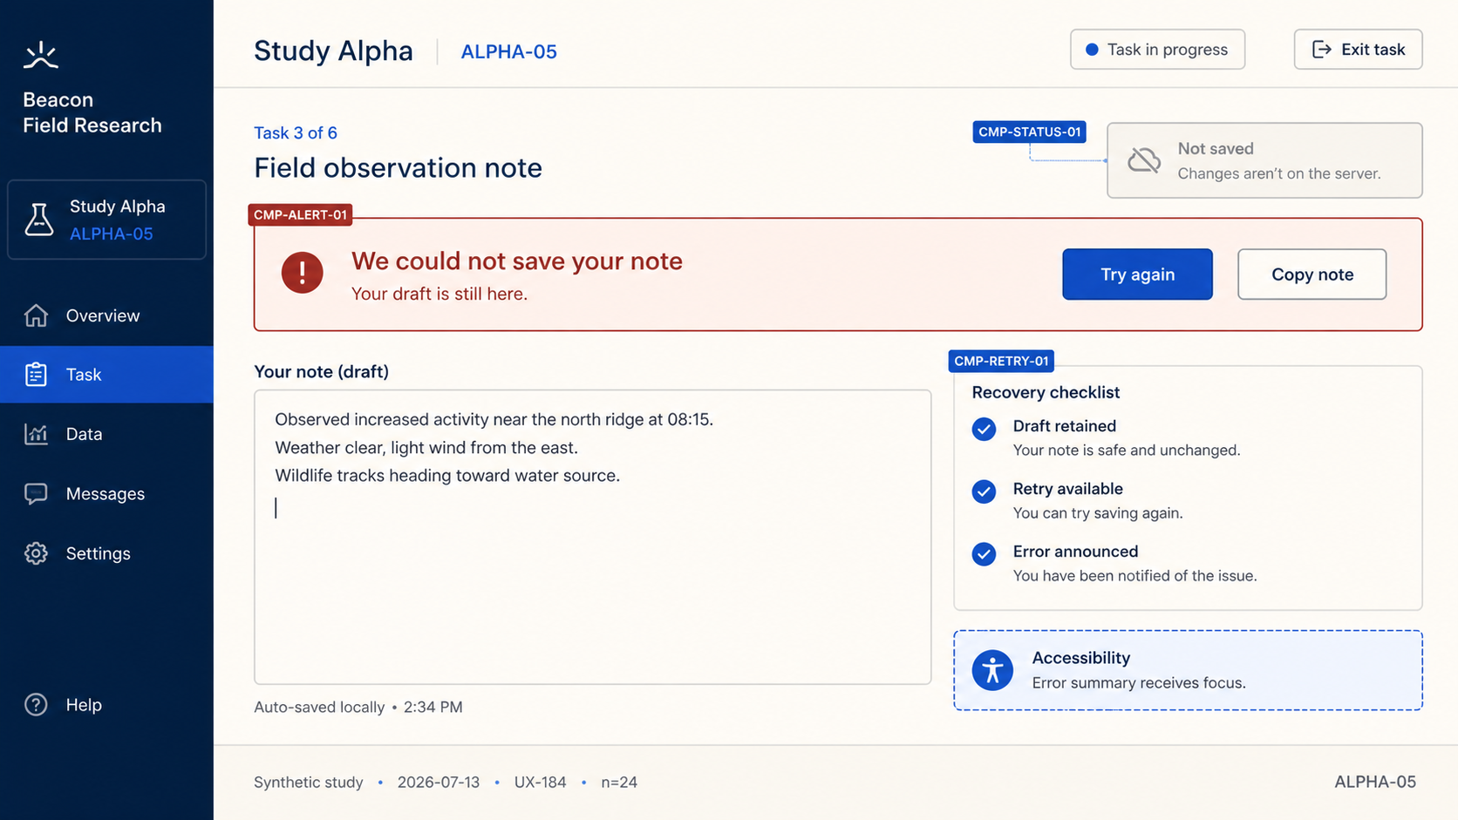
Design review — retained draft recovery
STUDY ALPHA / 02
Notes:
[Sources]
- Internal synthetic prototype export: 04-alpha-error-recovery-state.png
[/Sources]

Slide 3
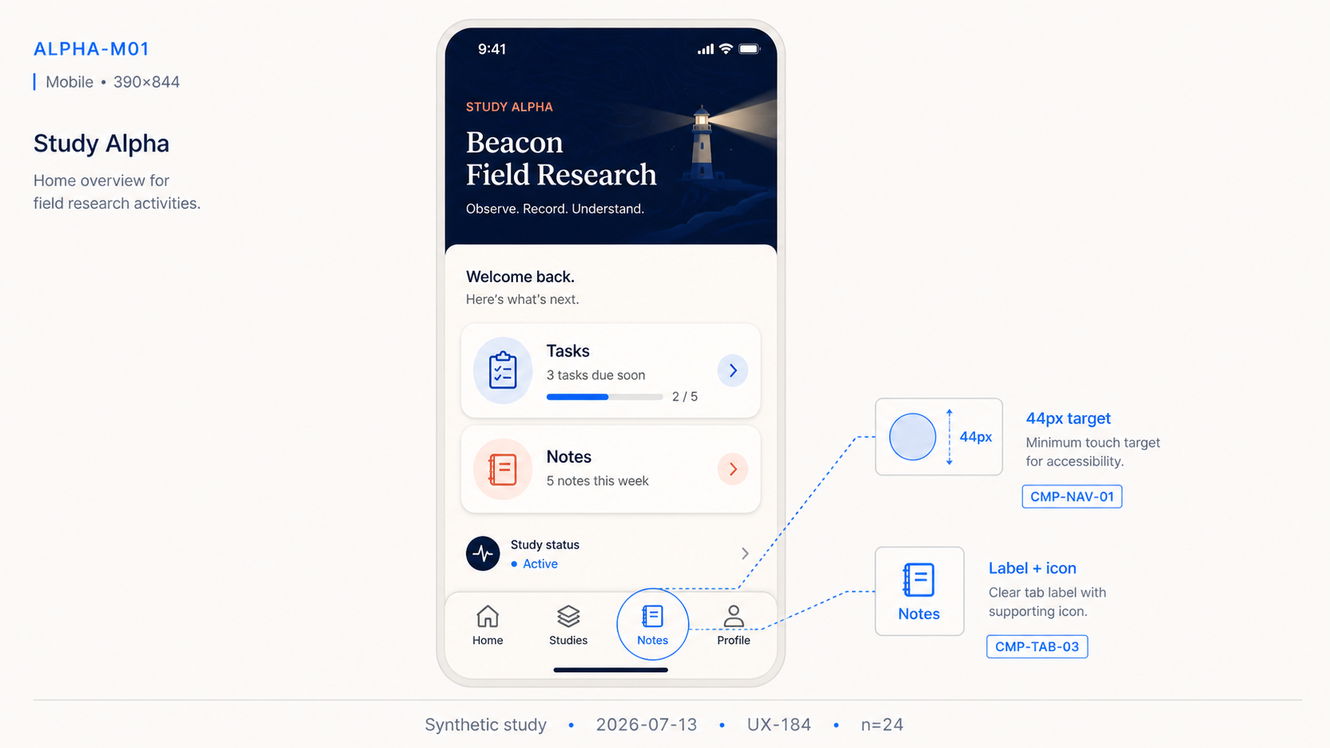
Design review — labeled mobile tabs
STUDY ALPHA / 03
Notes:
[Sources]
- Internal synthetic prototype export: 05-alpha-mobile-navigation.png
[/Sources]

Slide 4
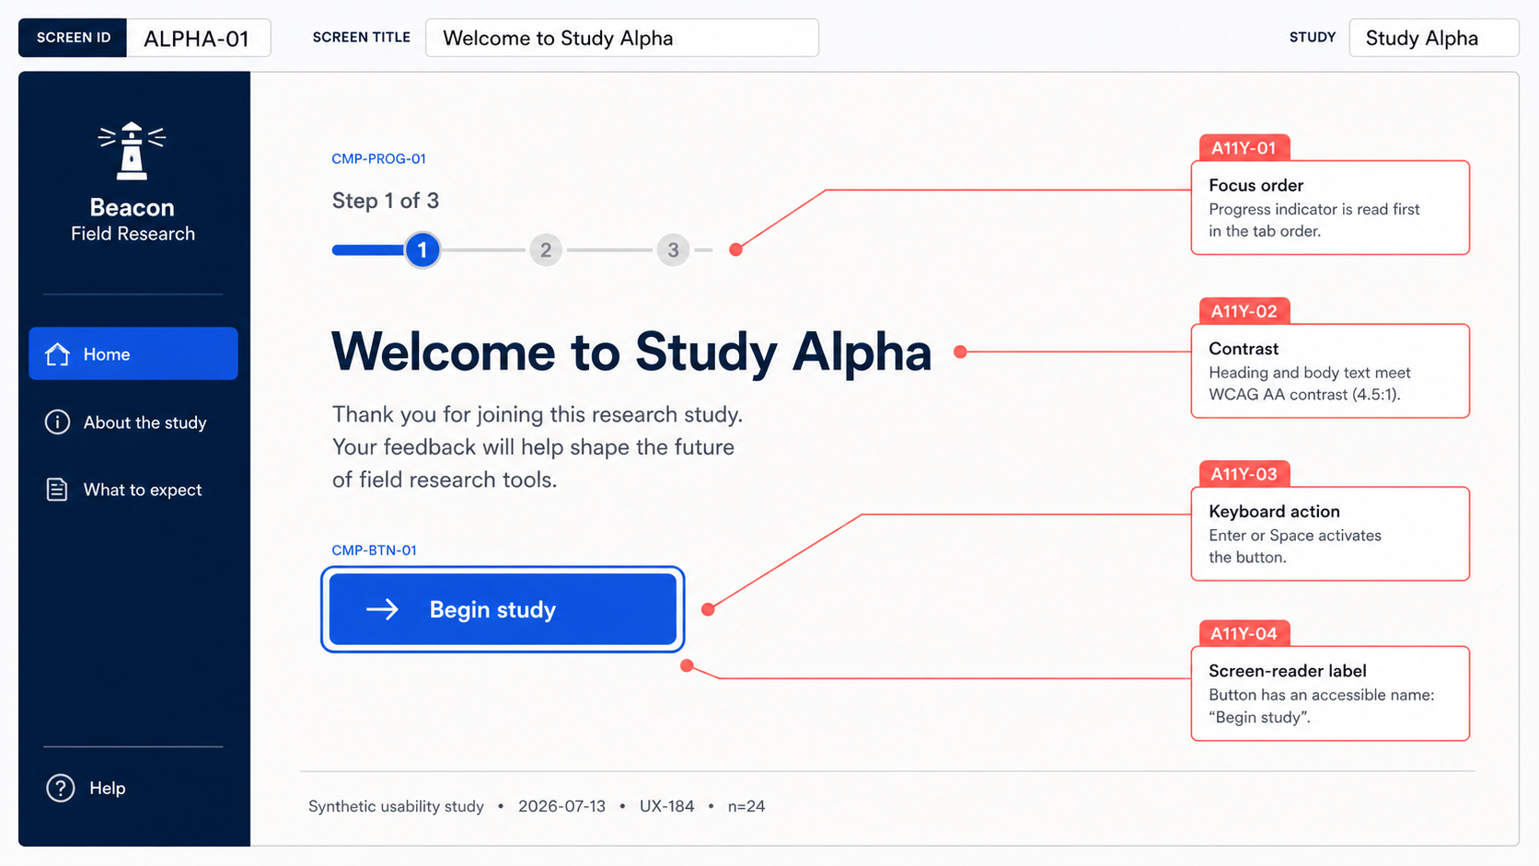
Design review — handoff priority checks
STUDY ALPHA / 04
Notes:
[Sources]
- Internal synthetic prototype export: 00-alpha-prototype-annotated-export.png
[/Sources]

