Slide 1
Product Alpha R7
Post-launch design review
Aster Loop株式会社（synthetic）
Release 2026-07-13 · Review 2026-07-20
Disposition: keep ADR-042

Slide 2
Evidence supports the existing gate
Synthetic evidence window: 2026-07-13 through 2026-07-20
84,200
99.94%
98.7%
11m42s
requests observed
success rate
approval rate
controlled recovery
84,149 successful; 51 unsuccessful
9,000 decisions sampled; 8,883 approved; 117 non-approved
Rollback drill 2026-07-17 · recovery 11m42s (702 seconds)

Slide 3
The release gate remains the right control point
Six measured stages sum to an end-to-end p95 of 184 ms
APPROVAL BOUNDARY
Request intake
Edge API
Release Coordinator
Decision Store
Event Bus
Observability confirmation
28 ms
32 ms
46 ms
24 ms
18 ms
36 ms
Event Bus delivery begins only after the Decision Store decision. Observability confirmation closes the measured path.

Slide 4
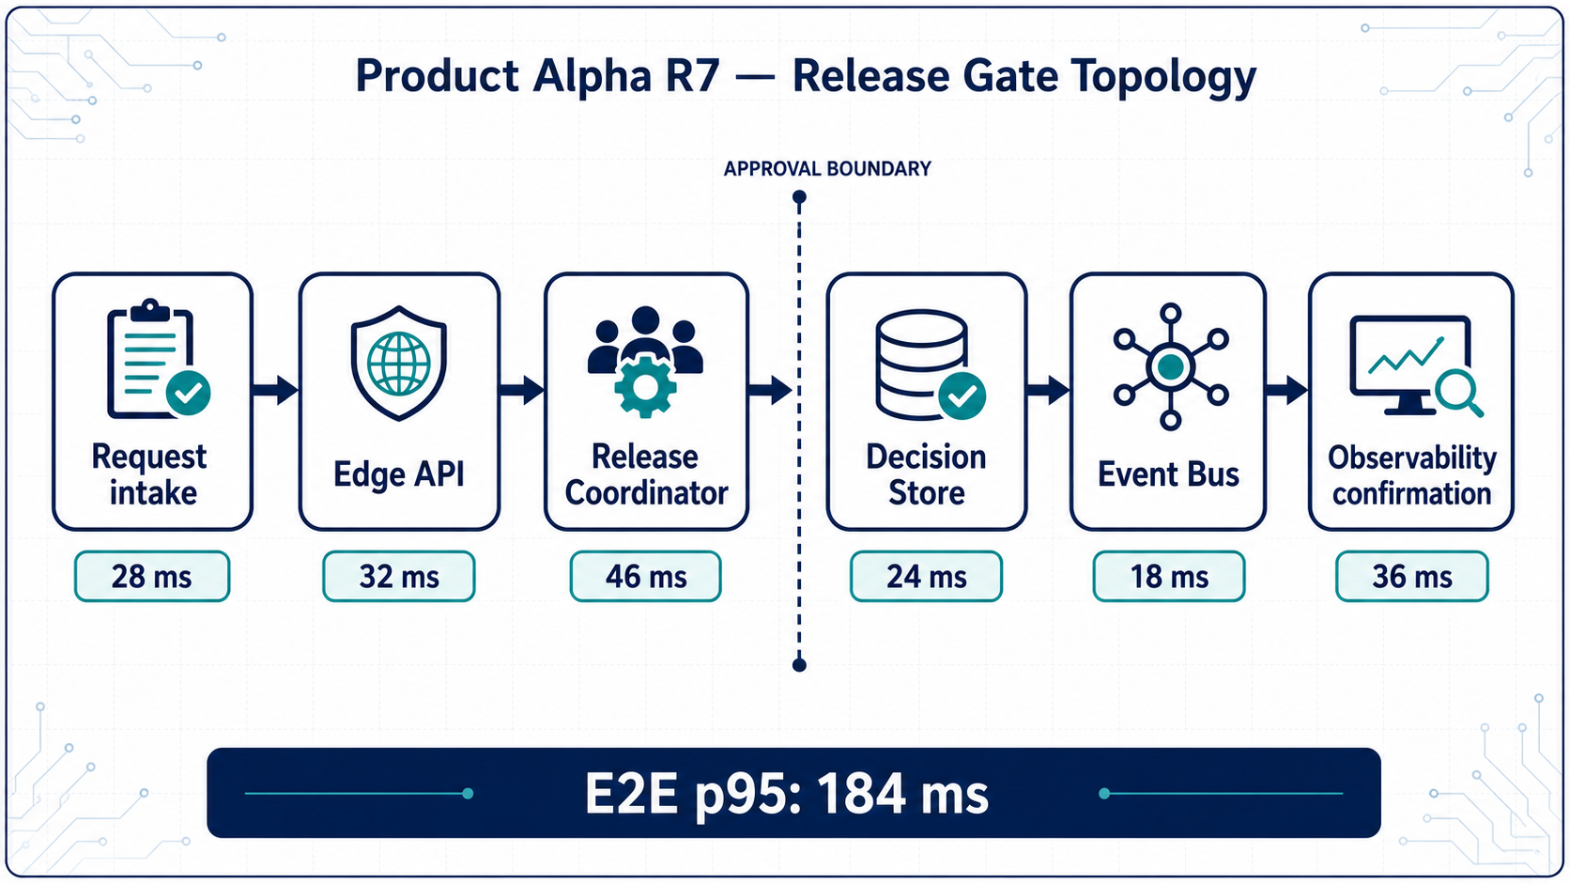
Topology evidence
The map uses the same ordered stages and approval boundary

Slide 5
Review outcome and operating checks
Review recorded 2026-07-20
KEEP ADR-042
1 Keep Decision Store before Event Bus
Retain the asynchronous release gate and its explicit approval boundary.
2 Track the 184 ms path by stage
3 Repeat controlled recovery validation

