Slide 1

CNN Based Image Classification
Xiaoling Long
Hongyu Chen
Ruiqi Luo

Slide 2
00
Outline
Definition
Dataset for Image Classification
CNN Architectures
CNN Based medical image classification
Notes:
2

Slide 3
01
Definition
Image Classification: The classical problem in computer vision, image processing, and machine vision is that of determining whether or not the image data contains some specific object, feature, or activity. [From Wikipedia]
CNN: Convolutional Neural Network is a class of deep, feed-forward artificial neural networks that has successfully been applied to analyzing visual imagery. [From Wikipedia]
Notes:
3

Slide 4
02
Dataset for Image Classification
MINIST
ImageNet
COCO
PASCAL VOC
CIFAR
Open Image

Slide 5
Accuracy Criteria
TOP 1 error: The correct answer is the top guess
TOP 5 error: The correct answer is in the top-5 guess

Slide 6
03
CNN Architectures
AlexNet
ZFNet
GoogLeNet
VGGNet
ResNet
Notes:
6

Slide 7
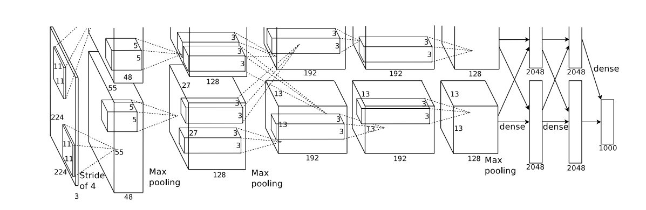
AlexNet
Krizhevsky, A., Sutskever, I., & Hinton, G. E. (2012). ImageNet Classification with Deep Convolutional Neural Networks. neural information processing systems.
Notes:
7

Slide 8
Highlights of AlexNet
ReLU as activate function
Local Response Normalization
Overlapping Pooling
Data Augmentation
Dropout
Stochastic Gradient Descent for Learning
Notes:
8

Slide 9
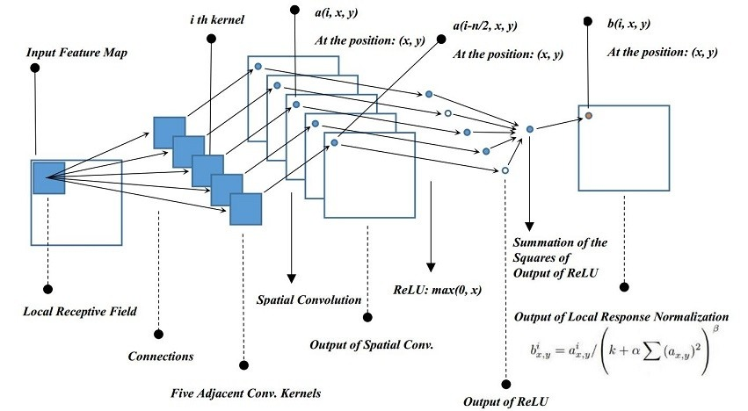
Local Response Normalization
Image from Blog
Notes:
9

Slide 10
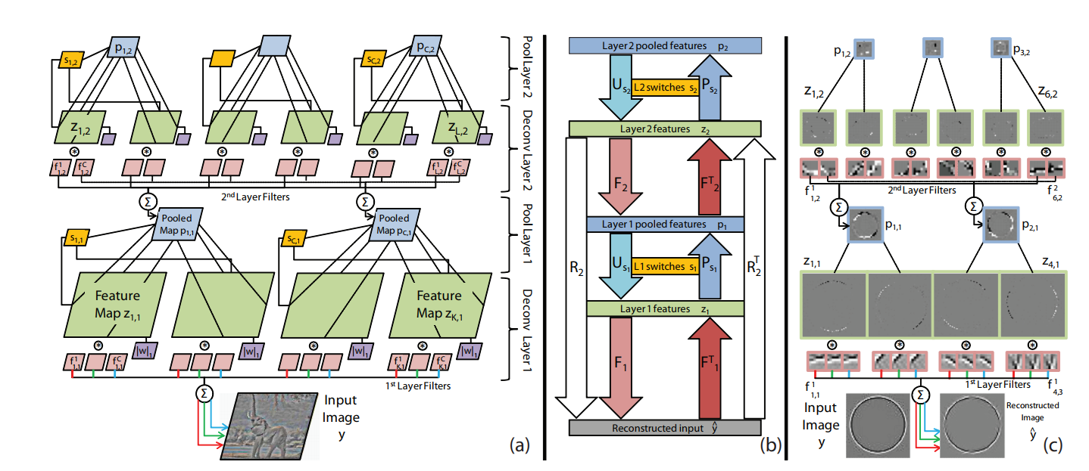
Deconvolutional Network
Zeiler, Matthew D., Graham W. Taylor, and Rob Fergus. "Adaptive deconvolutional networks for mid and high level feature learning." international conference on computer vision (2011): 2018-2025.
Notes:
10

Slide 11
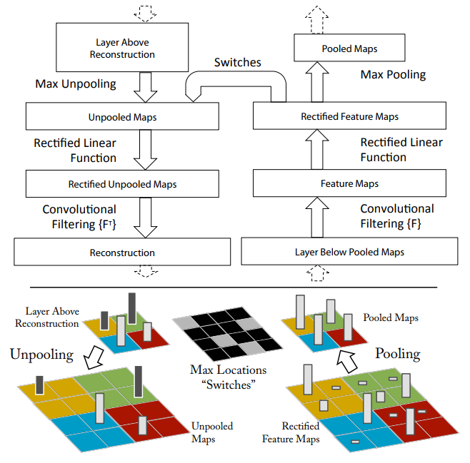
Convolution and Deconvolution
Zeiler, Matthew D., and Rob Fergus. "Visualizing and Understanding Convolutional Networks." european conference on computer vision (2013): 818-833.
Notes:
11

Slide 12
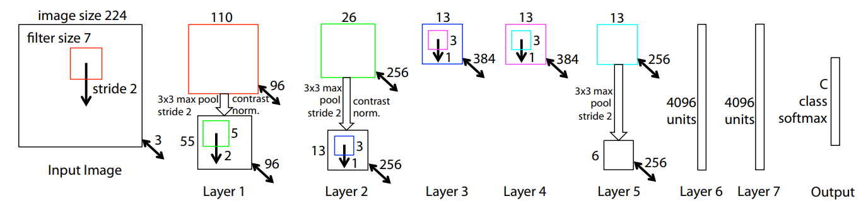
ZFNet
Zeiler, Matthew D., and Rob Fergus. "Visualizing and Understanding Convolutional Networks." european conference on computer vision (2013): 818-833.
Notes:
12

Slide 13
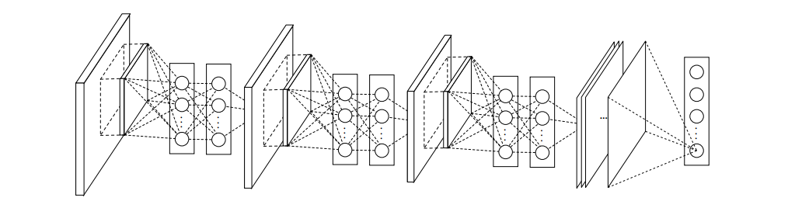
NIN
Lin, Min, Qiang Chen, and Shuicheng Yan. "Network In Network." international conference on learning representations (2014).
Notes:
13

Slide 14
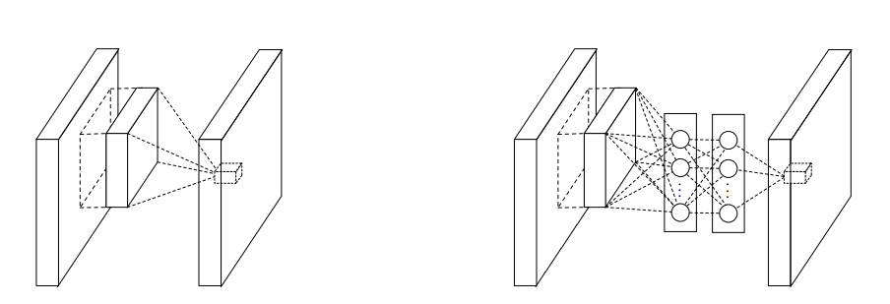
MLPconv Layer
Normal Conv layer
MLPconv layer
Lin, Min, Qiang Chen, and Shuicheng Yan. "Network In Network." international conference on learning representations (2014).
Notes:
14

Slide 15
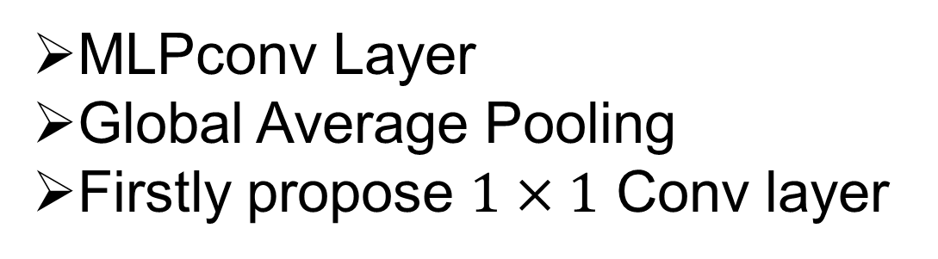
Highlight of NIN
MLPconv Layer
Global Average Pooling
Firstly propose $1×1$ Conv layer
Notes:
15

Slide 16
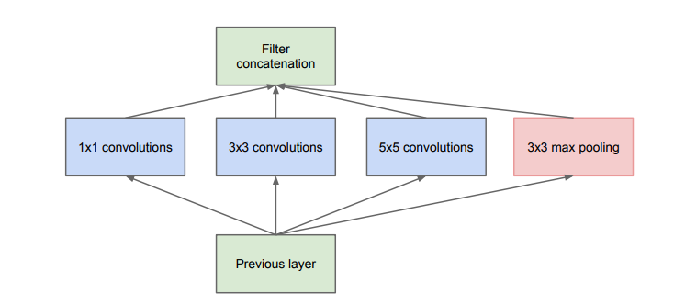
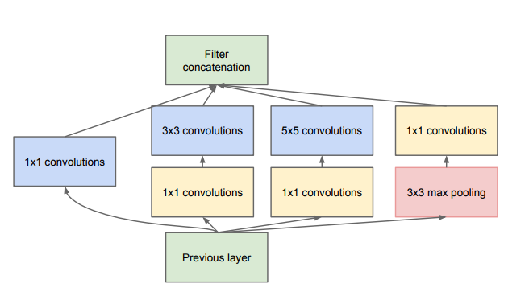
Inception Model
Googlenet :Szegedy, Christian, et al. "Going deeper with convolutions." computer vision and pattern recognition (2015): 1-9.
Notes:
16

Slide 17
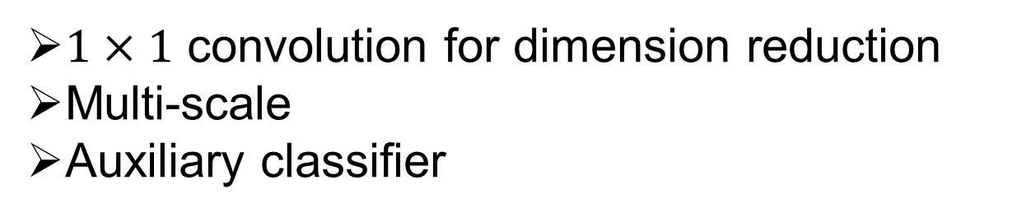
Highlight of GoogLeNet
$1×1$ convolution for dimension reduction
Multi-scale
Auxiliary classifier
Notes:
17

Slide 18
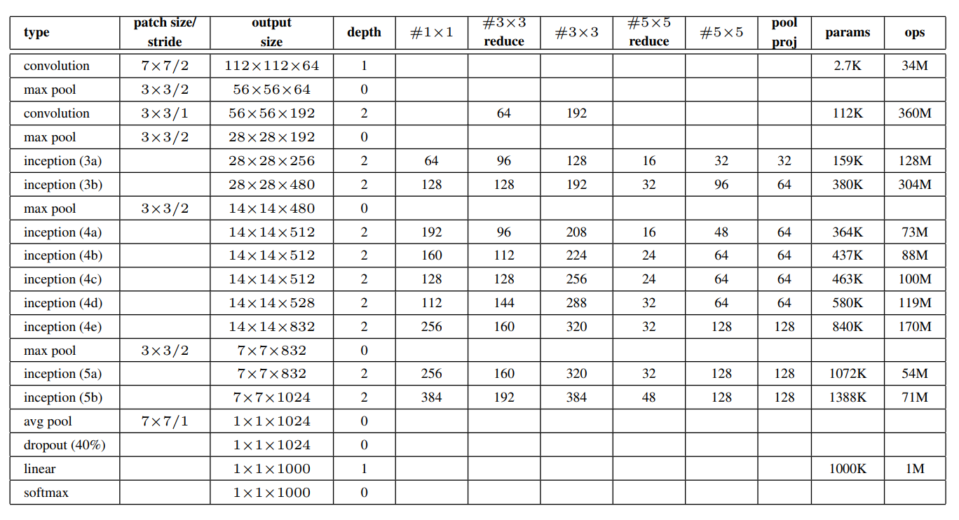
GoogLeNet Configuration
Krizhevsky, A., Sutskever, I., & Hinton, G. E. (2012). ImageNet Classification with Deep Convolutional Neural Networks. neural information processing systems.
Notes:
18

Slide 19
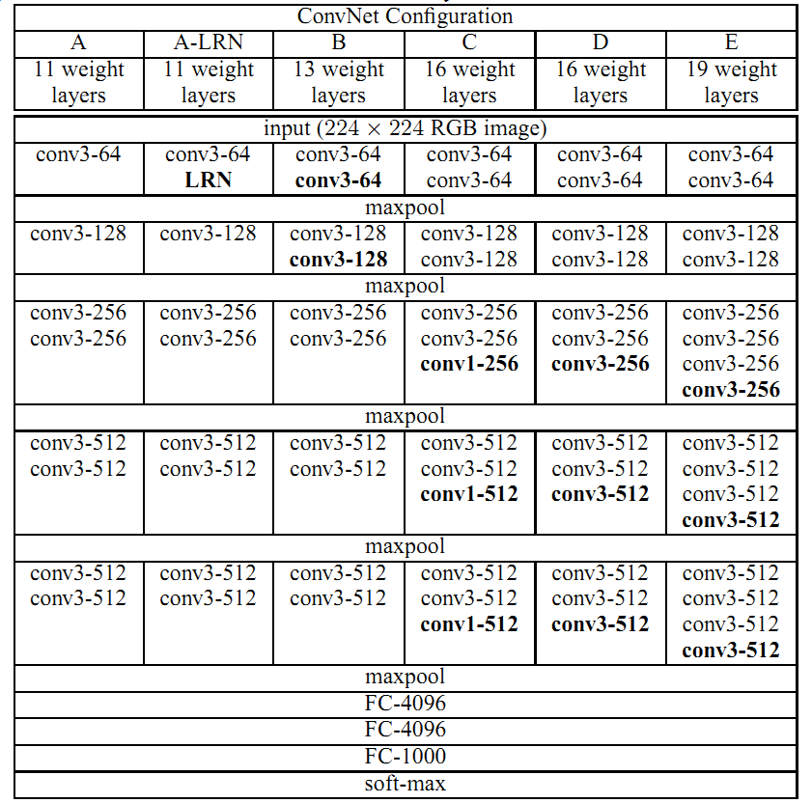
VGGNet
Notes:
19

Slide 20
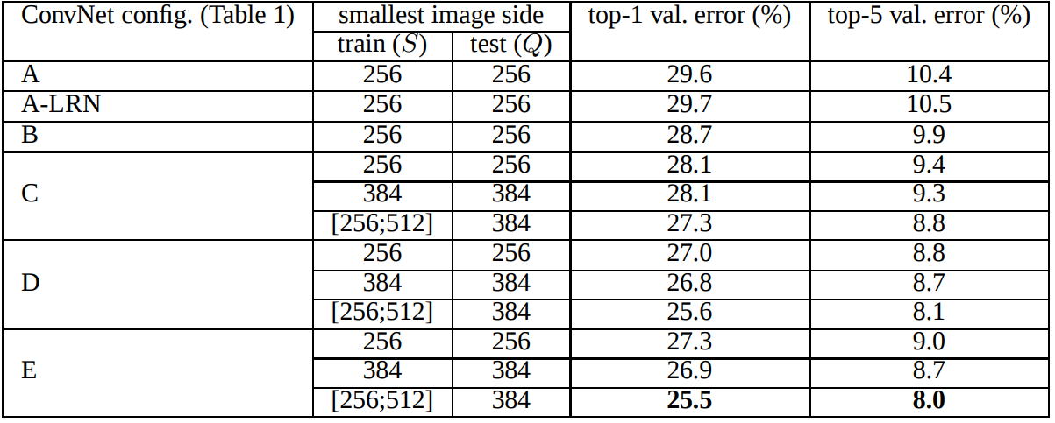
VGGNet
Simonyan, Karen, and Andrew Zisserman. "Very Deep Convolutional Networks for Large-Scale Image Recognition." international conference on learning representations (2015).
Notes:
20

Slide 21
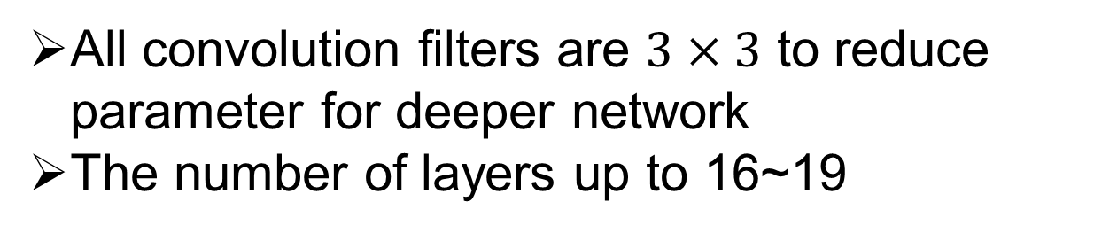
Highlight of VGGNet
All convolution filters are $3×3$ to reduce parameter for deeper network
The number of layers up to 16~19
Notes:
21

Slide 22
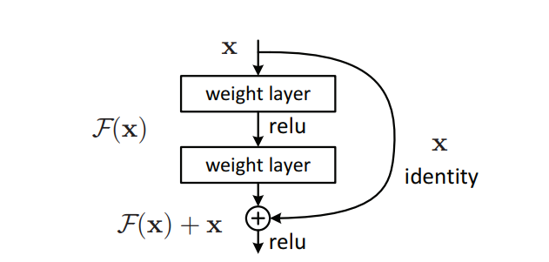
Residual Learning
He, Kaiming, et al. "Deep Residual Learning for Image Recognition." computer vision and pattern recognition (2016): 770-778.
Notes:
22

Slide 23
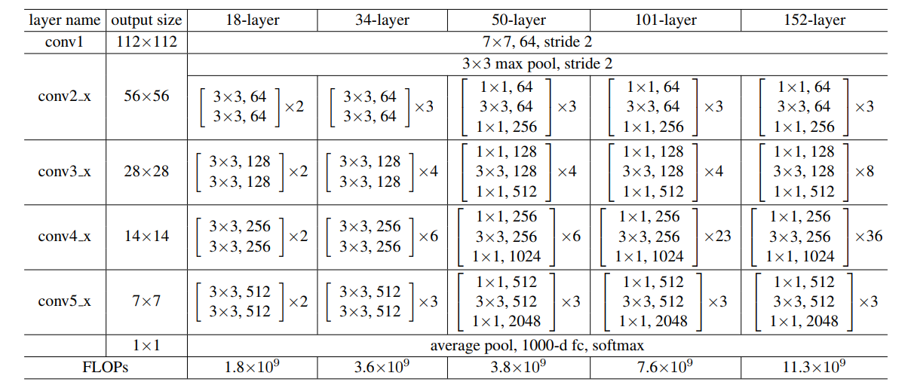
ResNet
He, Kaiming, et al. "Deep Residual Learning for Image Recognition." computer vision and pattern recognition (2016): 770-778.
Notes:
23

Slide 24
Highlight of ResNet
Residual learning
Global average pooling
Much deeper
Notes:
24

Slide 25
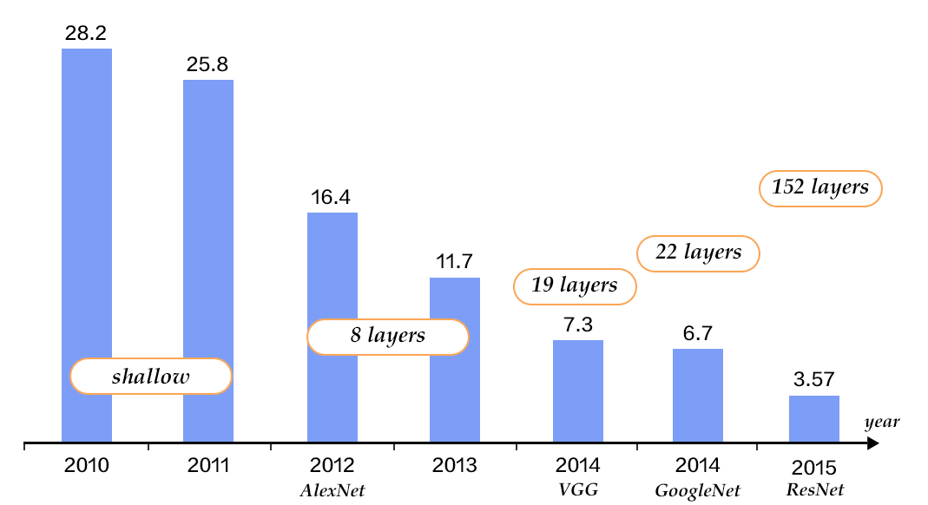
Performance of CNN in ImageNet
Image from blog
Notes:
25

Slide 26
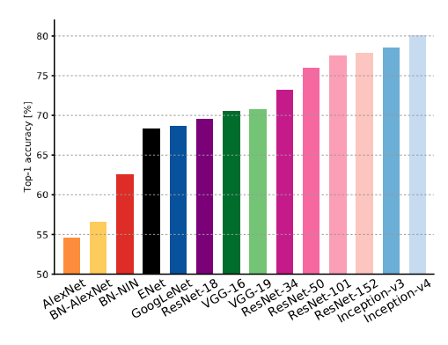
Validation accuracies for different architectures
Canziani A, Paszke A, Culurciello E, et al. An Analysis of Deep Neural Network Models for Practical Applications[J]. arXiv: Computer Vision and Pattern Recognition, 2016.

Slide 27
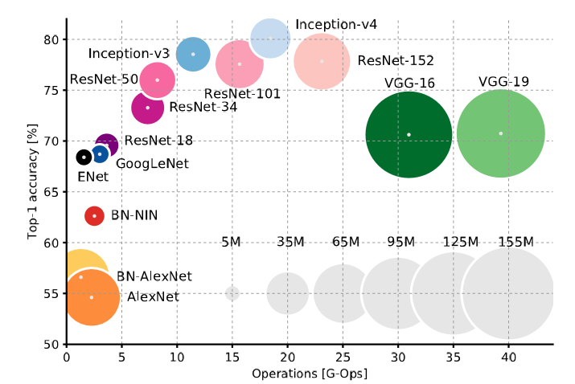
Accuracy and size of the model
Canziani, Alfredo, Adam Paszke, and Eugenio Culurciello. "An Analysis of Deep Neural Network Models for Practical Applications." arXiv: Computer Vision and Pattern Recognition (2016).

Slide 28
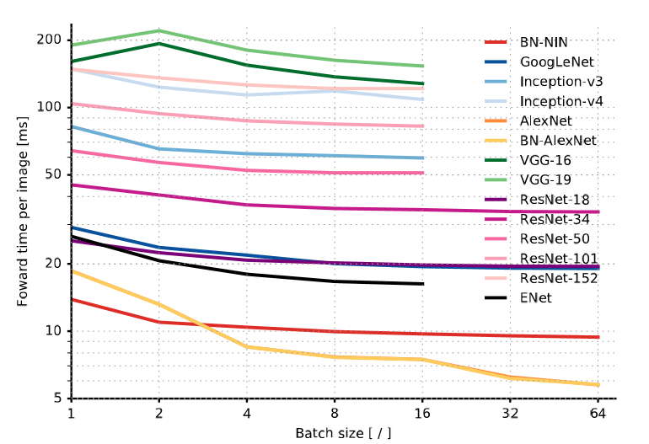
Inference time
Canziani, Alfredo, Adam Paszke, and Eugenio Culurciello. "An Analysis of Deep Neural Network Models for Practical Applications." arXiv: Computer Vision and Pattern Recognition (2016).

Slide 29
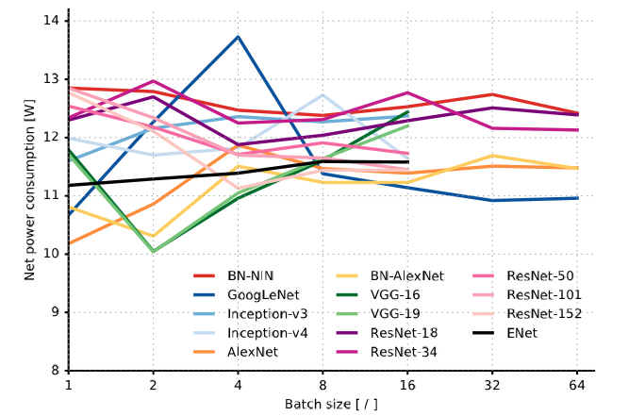
Power
Canziani, Alfredo, Adam Paszke, and Eugenio Culurciello. "An Analysis of Deep Neural Network Models for Practical Applications." arXiv: Computer Vision and Pattern Recognition (2016).

Slide 30
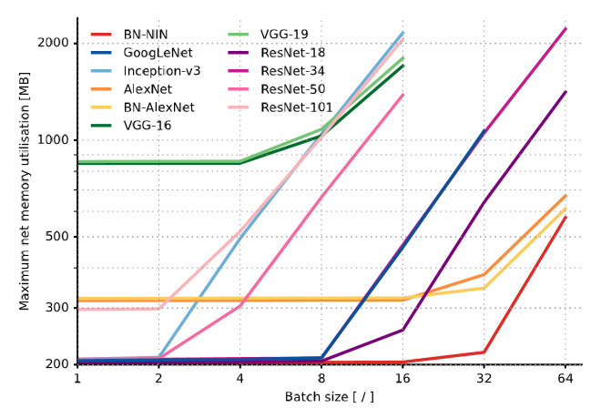
Memory
Canziani, Alfredo, Adam Paszke, and Eugenio Culurciello. "An Analysis of Deep Neural Network Models for Practical Applications." arXiv: Computer Vision and Pattern Recognition (2016).

Slide 31
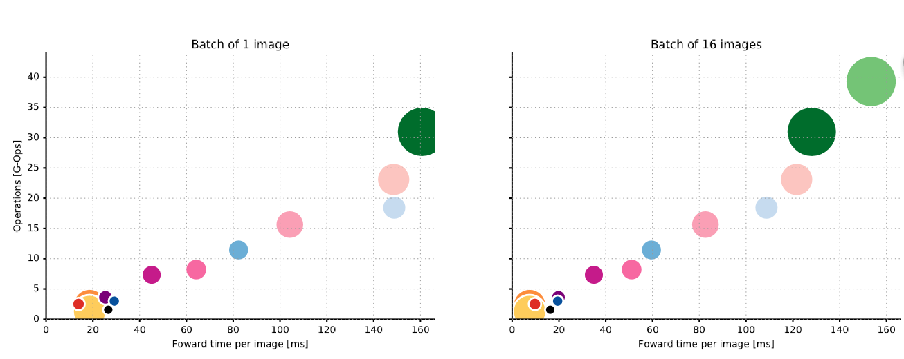
Canziani, Alfredo, Adam Paszke, and Eugenio Culurciello. "An Analysis of Deep Neural Network Models for Practical Applications." arXiv: Computer Vision and Pattern Recognition (2016).

Slide 32
04
CNN Based medical image classification
Datasets usually small
Using a pre-trained CNN to their tasks
A pre-trained CNN is adapted to the application at hand.
Notes:
32

Slide 33
04
CNN Based medical image classification
Polyp detection(肠息肉的检测)
Pulmonary Embolism Detection(肺栓塞的检测)
Intima-Media Boundary Segmentation(血管造影)
Notes:
33

Slide 34
04
CNN Based medical image classification
Polyp detection
Extract images from 40 short colonoscopy videos.
Training set contains 3,800 frames with polyps and 15,100 frames without polyps.
Test set contains 5,700 frames with polyps and 13,200 frames without polyps.
Notes:
34

Slide 35
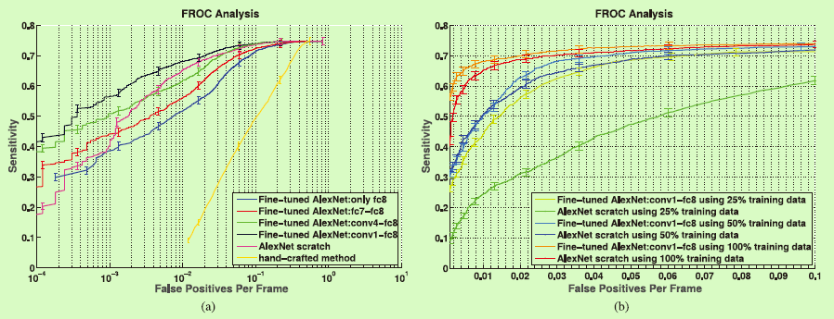
04
CNN Based medical image classification
Polyp detection
(a) Comparison between incremental fine-tuning, training from scratch, and a handcrafted approach [42]. (b) Effect of reduction in the training data on the performance of CNNs trained from scratch and deeply fine-tuned CNNs.
Notes:
35

Slide 36
04
CNN Based medical image classification
Pulmonary Embolism Detection
Extract dataset from 121 CT pulmonary angiographies.
Training set contains 434 frames with pulmonary embolism and 3406 frames without pulmonary embolism.
Test set contains 253 frames with pulmonary embolism and 2162 frames without pulmonary embolism.
Notes:
36

Slide 37
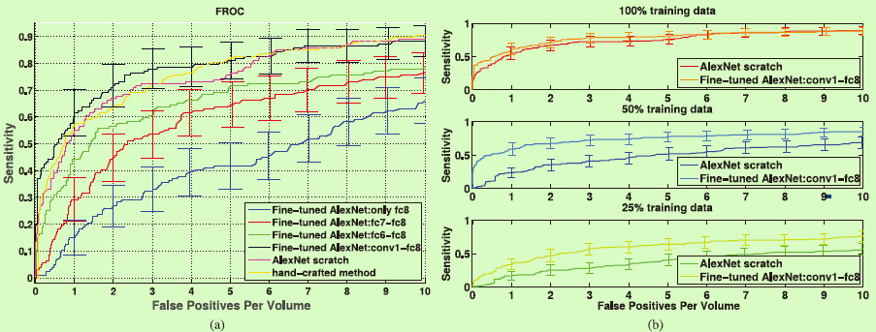
04
CNN Based medical image classification
Pulmonary Embolism Detection
(a) Comparison between incremental fine-tuning, training from scratch, and a handcrafted approach. To avoid clutter in the figure, error bars are displayed for only a subset of plots. A more detailed analysis is presented in Table S2 in the supplementary file.(b) Effect of reduction in the training data on the performance of CNNs trained from scratch and deeply fine-tuned CNNs.
Notes:
37

Slide 38
04
CNN Based medical image classification
Intima-Media Boundary Segmentation
Extract dataset from 92 carotid intima-media thickness (CIMT) videos. The expert reviews each video to determine 3 ROIs which can be measured reliably.
The authors divided the ROIs into a training set with 144 ROIs and a test set with 132 ROIs.
For training and fine-tuning the CNNs, the authors extracted a stratified set of 200,000 training patches from the training ROIs.
Notes:
38

Slide 39
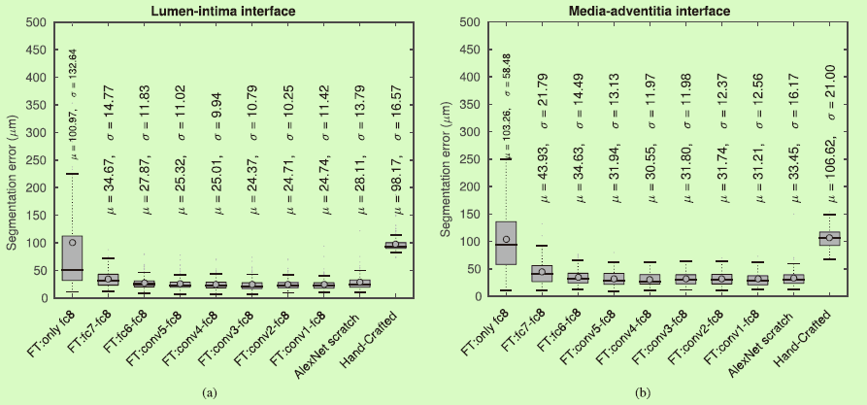
04
CNN Based medical image classification
Intima-Media Boundary Segmentation
Box plots of segmentation error for (a) the lumen-intima interface and (b) the media-adventitia interface.
Notes:
39

Slide 40
04
Open issues
Low resolution and blur images are still a challenge
Recognize classes not in the training set
Need a large amount of labeled training data
Need much extensive computational and memory resources
Notes:
40

