Slide 1

CNN Based Image Classification
Xiaoling Long
Hongyu Chen
Ruiqi Luo

Slide 2
00
Outline
Workload
Successful CNN in ImageNet
Efficient network on the image classification.
Application Based on CNN Based image classification
Notes:
2

Slide 3
01
Workload
Everybody read about 13 papers in different aspect
Xiaoling Long focus on successful CNN in ImageNet and some inspiring Network
Hongyu Chen read papers on the R-CNN YOLO and their varients
Ruiqi Luo reads most paper about application
Notes:
3

Slide 4
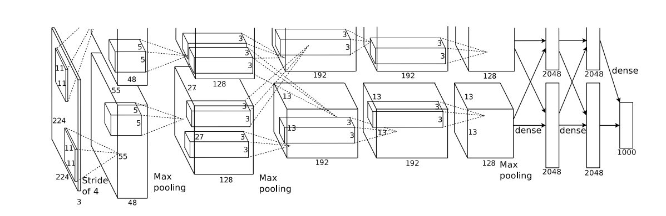
02
Successful CNN in ImageNet
Figure 1. AlexNet which is the first one CNN succeed in ImageNet
Notes:
4

Slide 5
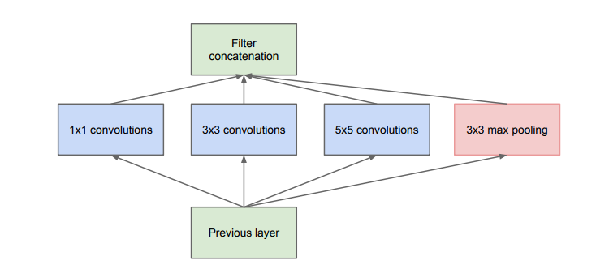
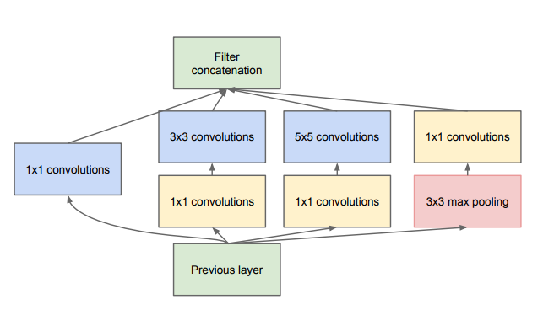
02
Successful CNN in ImageNet
Figure 2. Inception model in GoogLeNet. Left: Basic Inception model;
Right: Inception with dimension reductions
Szegedy, Christian, et al. "Going deeper with convolutions." computer vision and pattern recognition (2015): 1-9.
Notes:
5

Slide 6
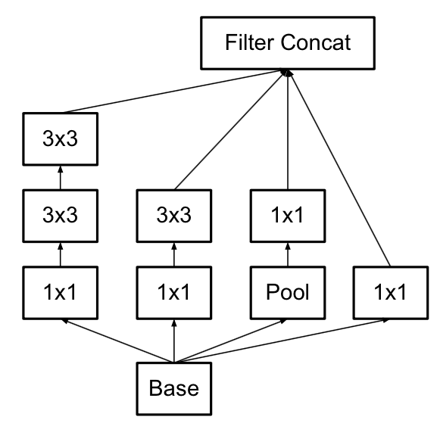
02
Successful CNN in ImageNet
Difference between inception v2 and v1
1.Inception v2 have batch normalization layer, which reduces Internal Covariate Shift and normalized the output of each layer to an Standard normal distribution
2.Use two 3x3 conv to replace 5x5 in inception v1, which can reduce number of parameters and accelerate calculation.
From blog
Notes:
6

Slide 7
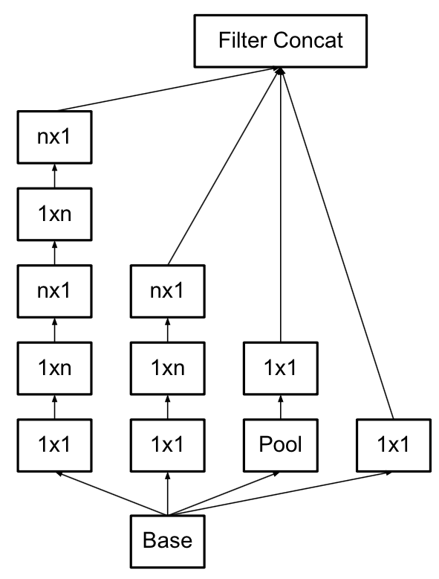
02
Successful CNN in ImageNet
Difference between inception v3 and v2
1.Decompose 7x7 into two one-dimensional convolutions (1x7, 7x1), as so does 3x3 (1x3, 3x1)
2.Network input changed from 224x224 to 299x299, and v3 more elaborately designed 35x35/17x17/8x8 modules
From blog
Notes:
7

Slide 8
02
Successful CNN in ImageNet
Difference between inception v4 and v3
The inception-v4 network has become deeper than v3. Before the GAP Inception-v3 includes four convolutional module operations (one regular convolution block and three inception structures), and Inception-v4 has a six convolutional module. Comparing the number of convolution kernels of both, Inception-v4 also has a lot more increase than Inception-v3.
Notes:
8

Slide 9
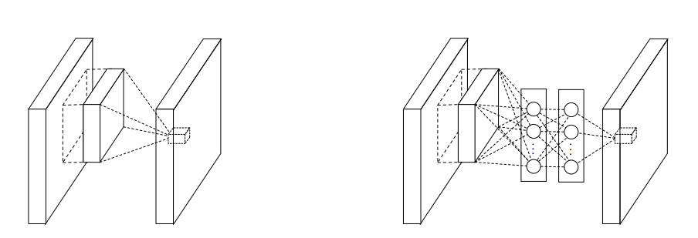
02
Successful CNN in ImageNet
Figure 3. Comparison of linear convolution layer and MLPconv layer.
Left: Normal convolution layer; Right: Replace with a Multi-Layer Perceptron(MLP).
Notes:
9

Slide 10
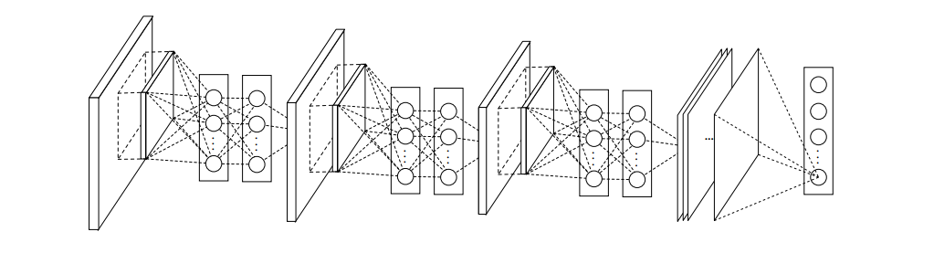
02
Successful CNN in ImageNet
Figure 4. Network in Network. Stacked by MLPconv layers and one
Global average pooling layer
Notes:
10

Slide 11
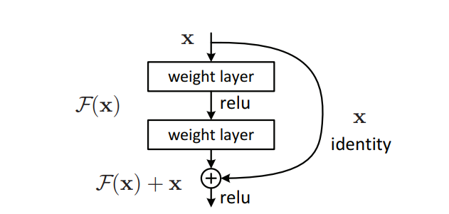
02
Successful CNN in ImageNet
Figure 5. Residual learning. ResNet is stacked by these modules
and one global average pooling layer.
Notes:
11

Slide 12
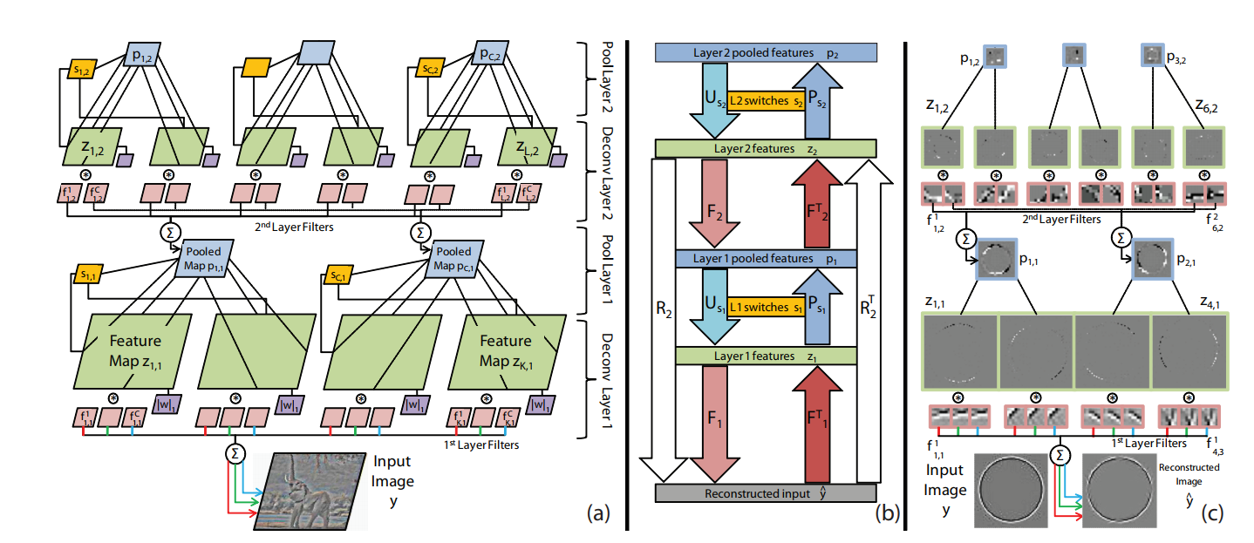
02
Successful CNN in ImageNet
Figure 6. Adaptive Deconvolutional Networks. This method is used in ZFNet for understanding and visualization CNN
Notes:
12

Slide 13
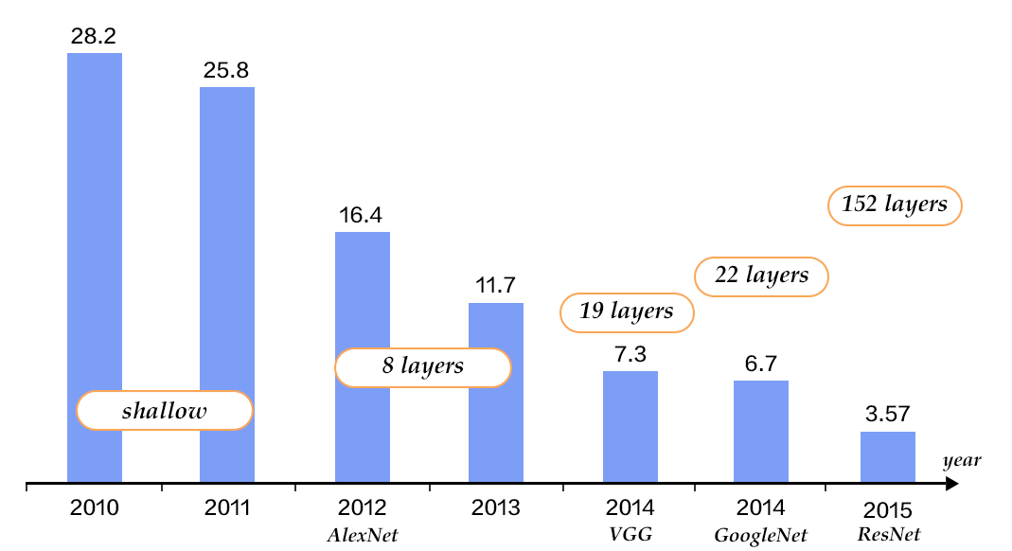
02
Successful CNN in ImageNet
Figure 6. performance on the Imagenet
Notes:
13

Slide 14
03
Sliding window method
Notes:
14

Slide 15
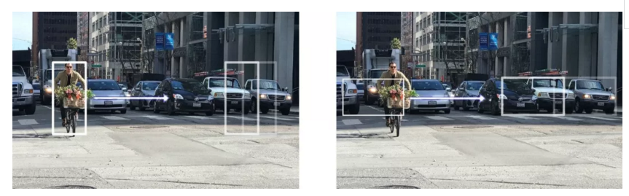
03
Sliding window method
Notes:
15

Slide 16
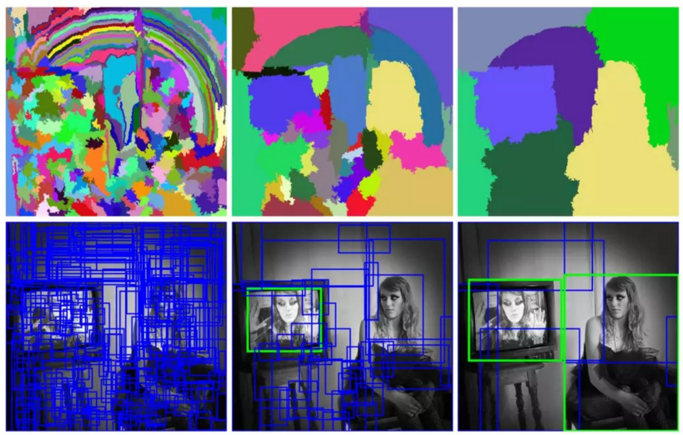
03
Selective search method
Notes:
16

Slide 17
03
R-CNN
Notes:
17

Slide 18
03
Fast R-CNN
Notes:
18

Slide 19
03
Faster R-CNN
Notes:
19

Slide 20
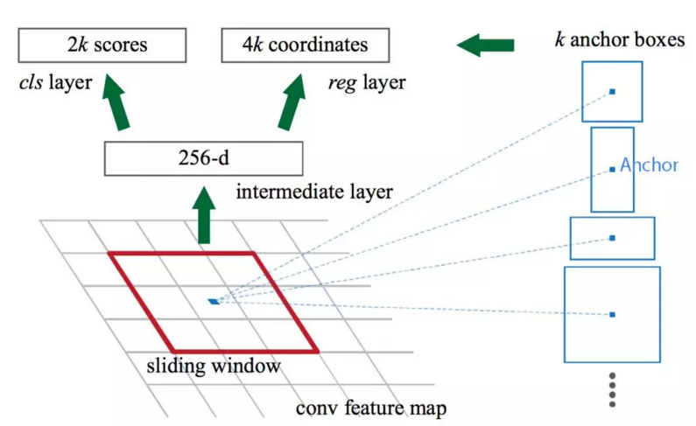
03
Faster R-CNN (region proposal)
Notes:
20

Slide 21
03
Faster R-CNN (region proposal)
Notes:
21

Slide 22
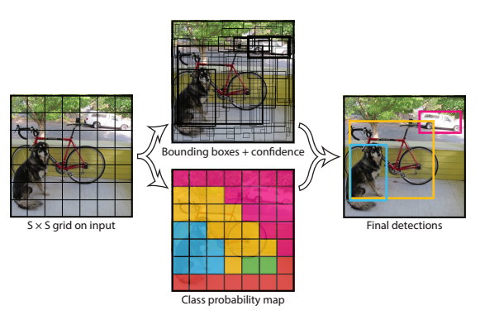
03
YOLO
Notes:
22

Slide 23
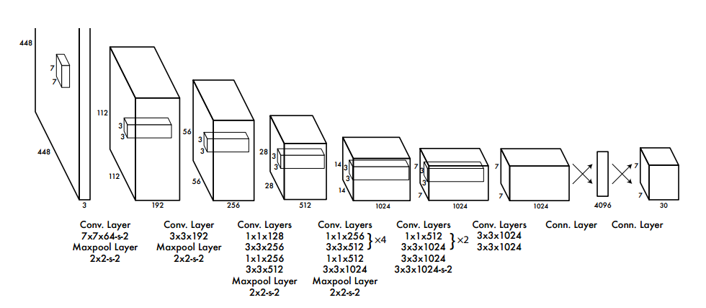
03
YOLO
Notes:
23

Slide 24
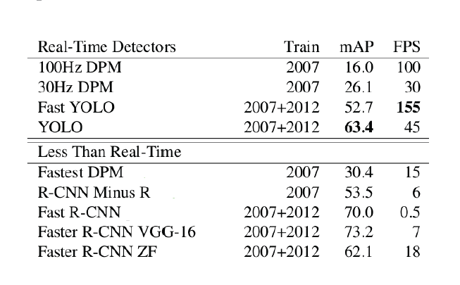
03
Test performance
Notes:
24

Slide 25
04
CNN Based medical image classification
Datasets usually small
Using a pre-trained CNN to their tasks
A pre-trained CNN is adapted to the application at hand.
Notes:
25

Slide 26
04
CNN Based medical image classification
Polyp detection(肠息肉)
Pulmonary Embolism Detection(肺栓塞)
Intima-Media Boundary Segmentation(血管造影)
Notes:
26

Slide 27
CNN Based medical image classification
04
Polyp detection
Extract images from 40 short colonoscopy videos.
Training set contains 3,800 frames with polyps and 15,100 frames without polyps.
Test set contains 5,700 frames with polyps and 13,200 frames without polyps.
Notes:
27

Slide 28
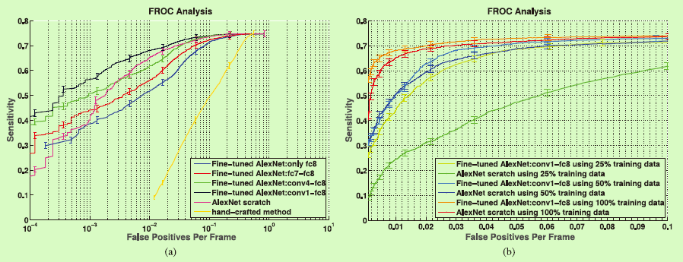
04
CNN Based medical image classification
Polyp detection
(a) Comparison between incremental fine-tuning, training from scratch, and a handcrafted approach. (b) Effect of reduction in the training data on the performance of CNNs trained from scratch and deeply fine-tuned CNNs.
N. Tajbakhsh, S. Gurudu, and J. Liang, “Automated polyp detection in colonoscopy videos using shape and context information,” IEEE Trans. Med. Imag., vol. 35, no. 2, pp. 630–644, Feb. 2016..
Notes:
28

Slide 29
04
CNN Based medical image classification
Pulmonary Embolism Detection
Extract dataset from 121 CT pulmonary angiographies.
Training set contains 434 frames with pulmonary embolism and 3406 frames without pulmonary embolism.
Test set contains 253 frames with pulmonary embolism and 2162 frames without pulmonary embolism.
Notes:
29

Slide 30
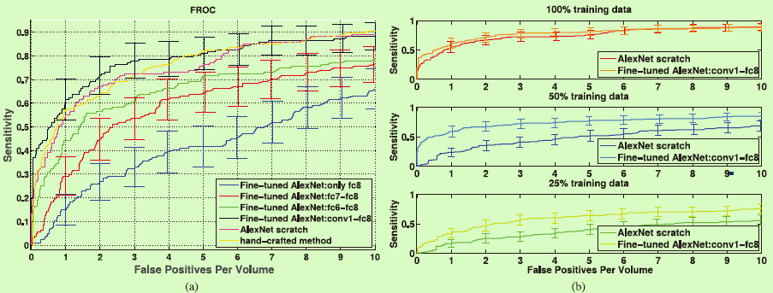
04
CNN Based medical image classification
Pulmonary Embolism Detection
(a) Comparison between incremental fine-tuning, training from scratch, and a handcrafted approach.(b) Effect of reduction in the training data on the performance of CNNs trained from scratch and deeply fine-tuned CNNs.
J. Liang and J. Bi, “Computer aided detection of pulmonary embolism with tobogganing and multiple instance classification in CT pulmonary angiography,” in Information Processing in Medical Imaging. New York: Springer, 2007, pp. 630–641...
Notes:
30

Slide 31
04
CNN Based medical image classification
Intima-Media Boundary Segmentation
Extract dataset from 92 carotid intima-media thickness (CIMT) videos. The expert reviews each video to determine 3 ROIs which can be measured reliably.
The authors divided the ROIs into a training set with 144 ROIs and a test set with 132 ROIs.
For training and fine-tuning the CNNs, the authors extracted a stratified set of 200,000 training patches from the training ROIs.
Notes:
31

Slide 32
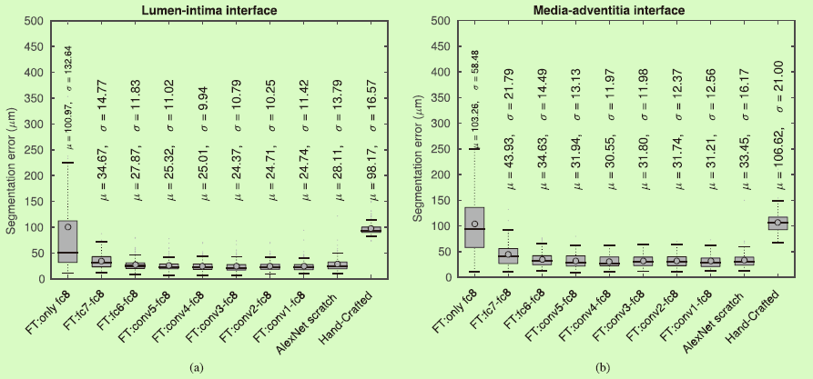
04
CNN Based medical image classification
Intima-Media Boundary Segmentation
Box plots of segmentation error for (a) the lumen-intima interface and (b) the media-adventitia interface.
N. Tajbakhsh, “Automatic assessment of image informativeness in colonoscopy,” in Abdominal Imaging. Computational and Clinical Applications. New York: Springer, 2014, pp. 151–158.
Notes:
32

Slide 33
04
Challenges
Low resolution and blur images are still a challenge
Recognize classes not in the training set
Need a large amount of labeled training data
Need much extensive computational and memory resources
Notes:
33

Slide 34

THANKS!

