Slide 1

CNN Based Image Classification
Xiaoling Long
Hongyu Chen
Ruiqi Luo

Slide 2
00
Outline
Definition
Dataset for Image Classification
CNN Architectures
Application Based on CNN Based image classification
Notes:
2

Slide 3
01
Definition
Image Classification: The classical problem in computer vision, image processing, and machine vision is that of determining whether or not the image data contains some specific object, feature, or activity. [From Wikipedia]
CNN: Convolutional Neural Network is a class of deep, feed-forward artificial neural networks that has successfully been applied to analyzing visual imagery. [From Wikipedia]
Notes:
3

Slide 4
02
Dataset for Image Classification
MINIST
ImageNet
COCO
PASCAL VOC
CIFAR
Open Image

Slide 5
Accuracy Criteria
TOP 1 error: The correct answer is the top guess
TOP 5 error: The correct answer is in the top-5 guess

Slide 6
02
CNN Architectures
AlexNet
ZFNet
VGGNet
GoogLeNet
ResNet
Notes:
6

Slide 7
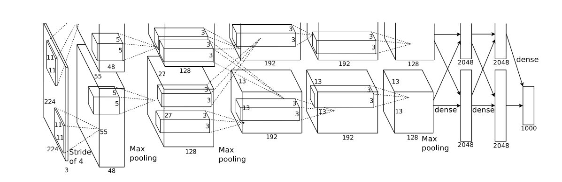
AlexNet
Notes:
7

Slide 8
Highlights of AlexNet
ReLU as activate function
Local Response Normalization
Overlapping Pooling
Data Augmentation
Dropout
Stochastic Gradient Descent for Learning
Notes:
8

Slide 9
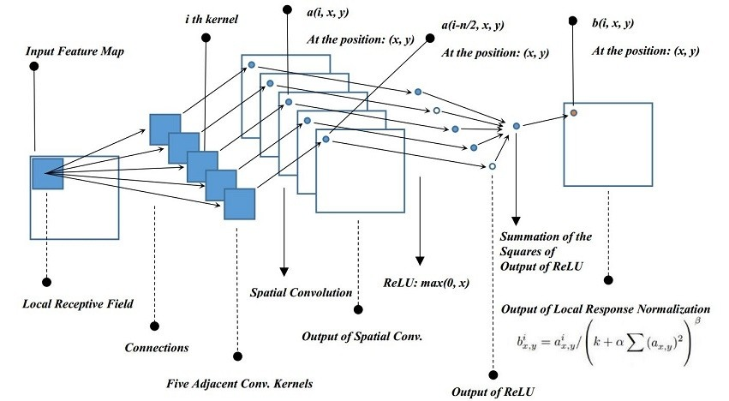
Local Response Normalization
Image from Blog
Notes:
9

Slide 10
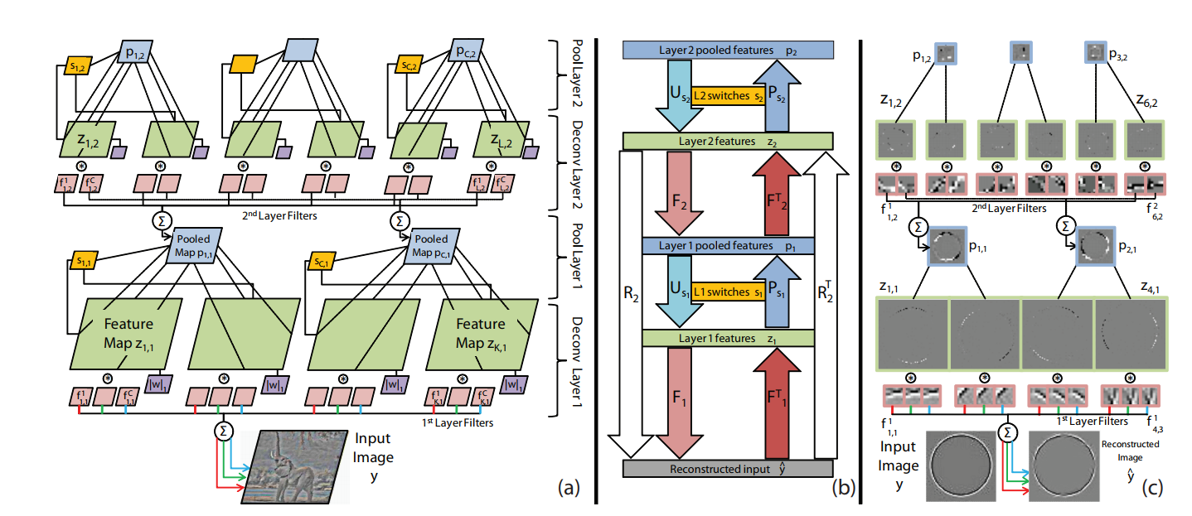
Deconvolutional Network
Notes:
10

Slide 11
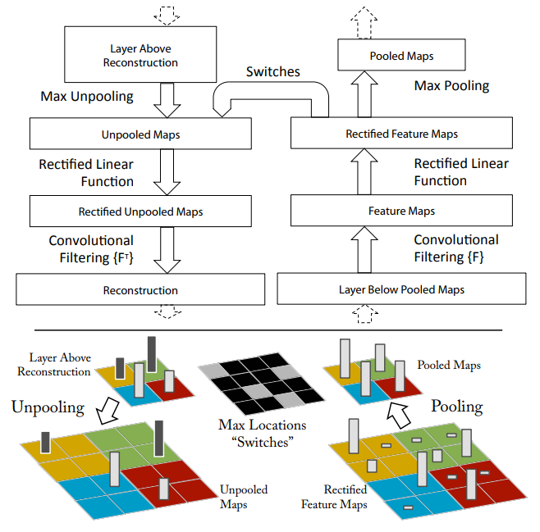
Convolution and Deconvolution
Notes:
11

Slide 12
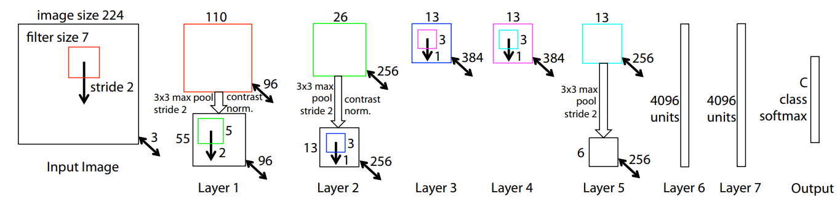
ZFNet
Notes:
12

Slide 13
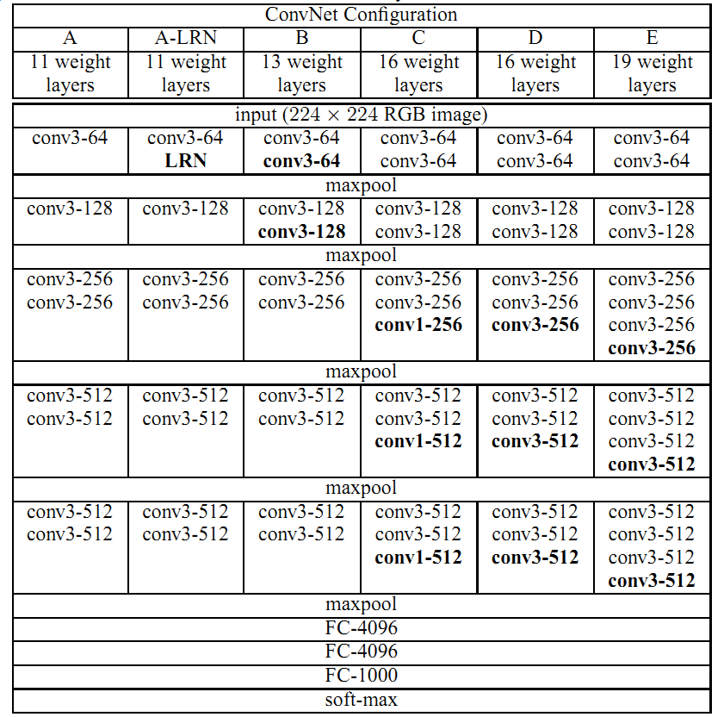
VGGNet
Notes:
13

Slide 14
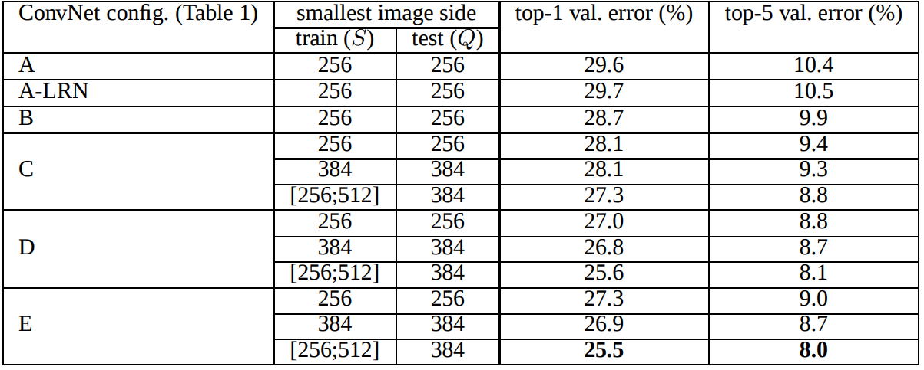
VGGNet
Notes:
14

Slide 15
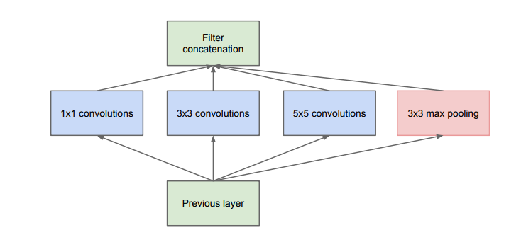
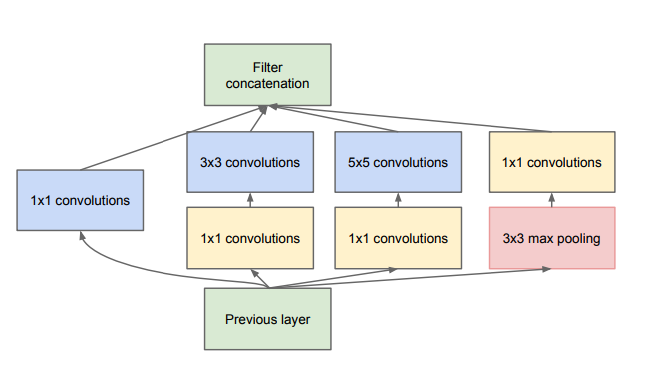
Inception Model
Notes:
15

Slide 16
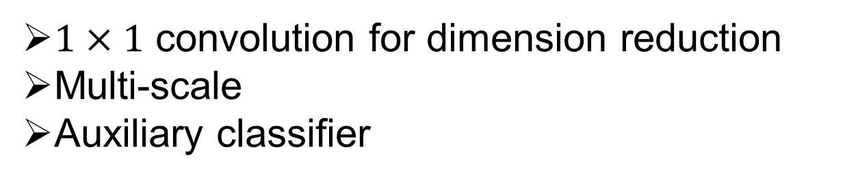
Highlight of GoogLeNet
$1×1$ convolution for dimension reduction
Multi-scale
Auxiliary classifier
Notes:
16

Slide 17
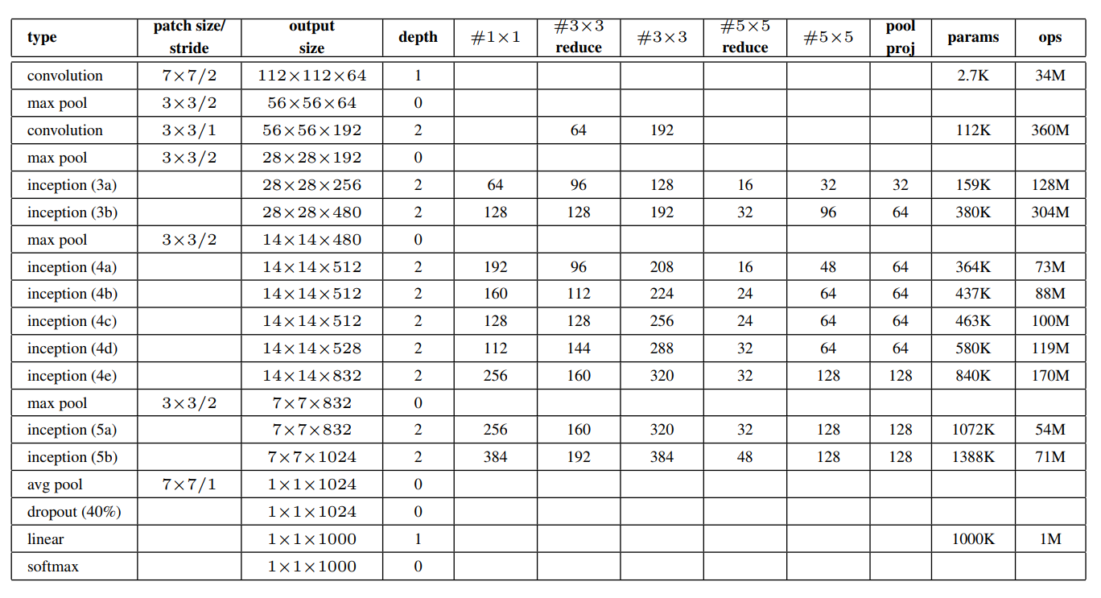
GoogLeNet Configuration
Notes:
17

Slide 18
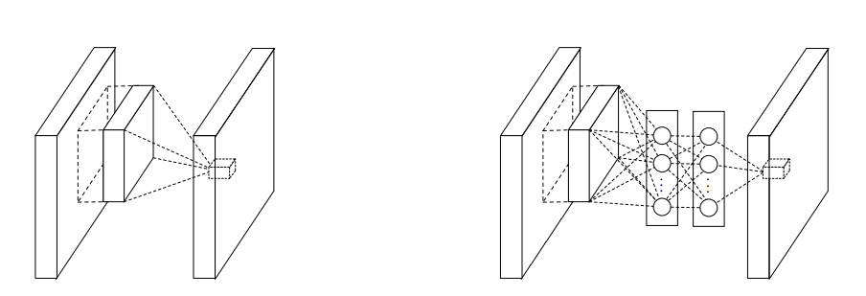
02
Successful CNN in ImageNet
Figure 3. Comparison of linear convolution layer and MLPconv layer.
Left: Normal convolution layer; Right: Replace with a Multi-Layer Perceptron(MLP).
Notes:
18

Slide 19
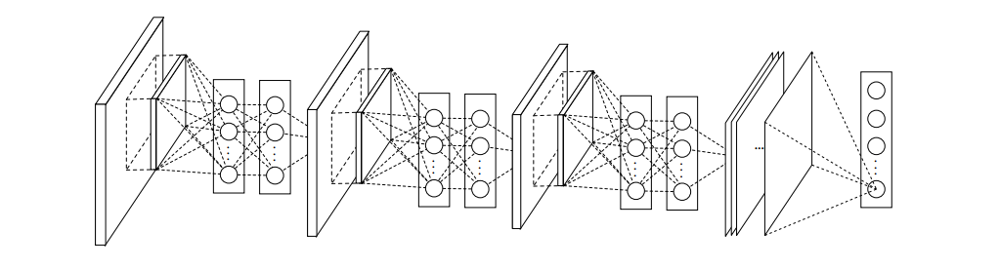
02
Successful CNN in ImageNet
Figure 4. Network in Network. Stacked by MLPconv layers and one
Global average pooling layer
Notes:
19

Slide 20
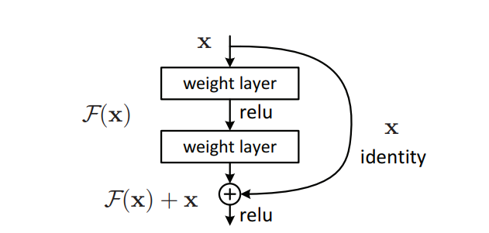
02
Successful CNN in ImageNet
Figure 5. Residual learning. ResNet is stacked by these modules
and one global average pooling layer.
Notes:
20

Slide 21
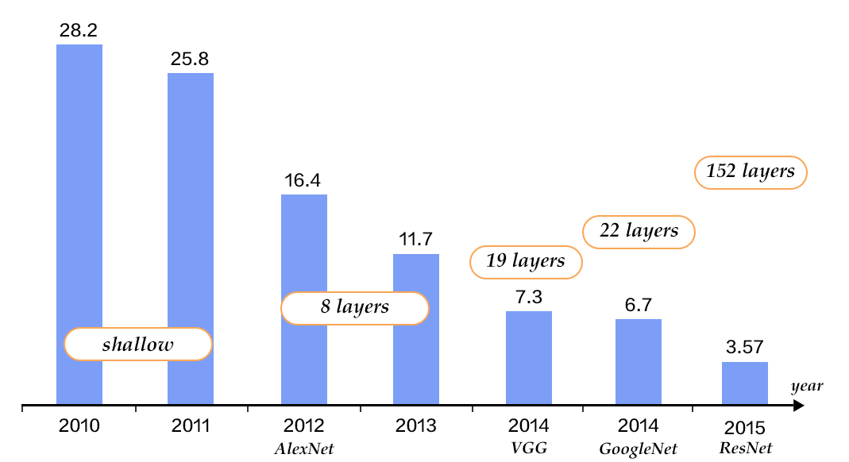
02
Successful CNN in ImageNet
Figure 6. performance on the Imagenet
Notes:
21

Slide 22
03
Sliding window method
Notes:
22

Slide 23
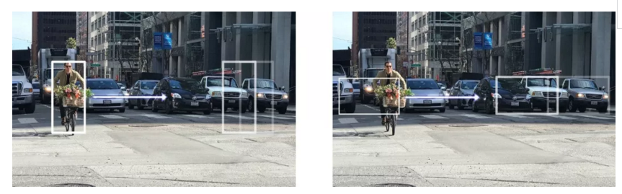
03
Sliding window method
Notes:
23

Slide 24
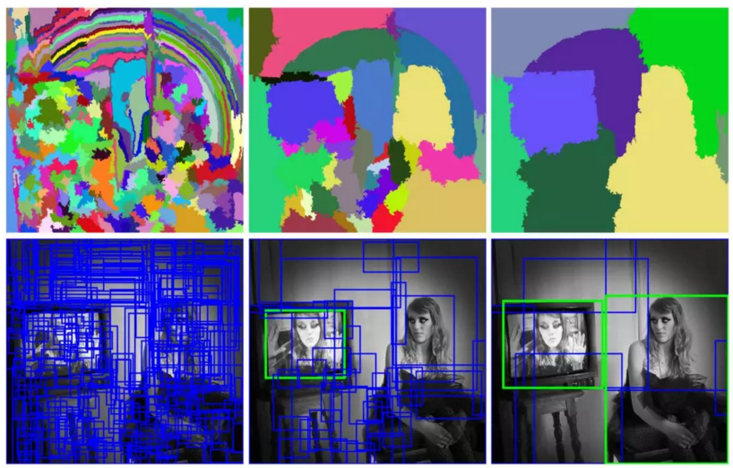
03
Selective search method
Notes:
24

Slide 25
03
R-CNN
Notes:
25

Slide 26
03
Fast R-CNN
Notes:
26

Slide 27
03
Faster R-CNN
Notes:
27

Slide 28
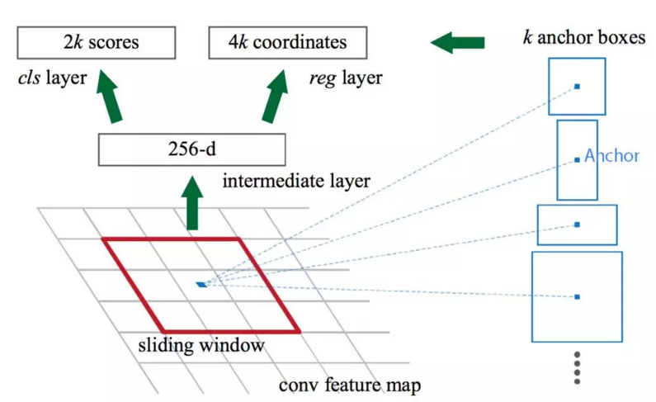
03
Faster R-CNN (region proposal)
Notes:
28

Slide 29
03
Faster R-CNN (region proposal)
Notes:
29

Slide 30
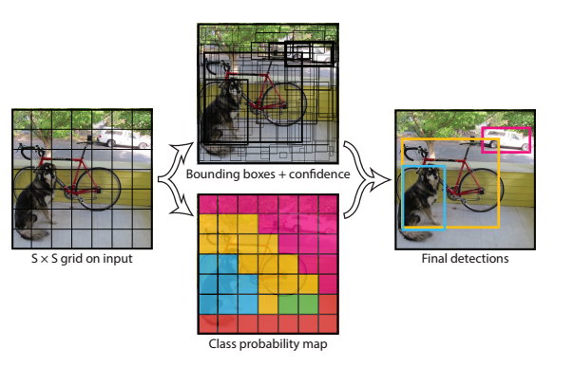
03
YOLO
Notes:
30

Slide 31
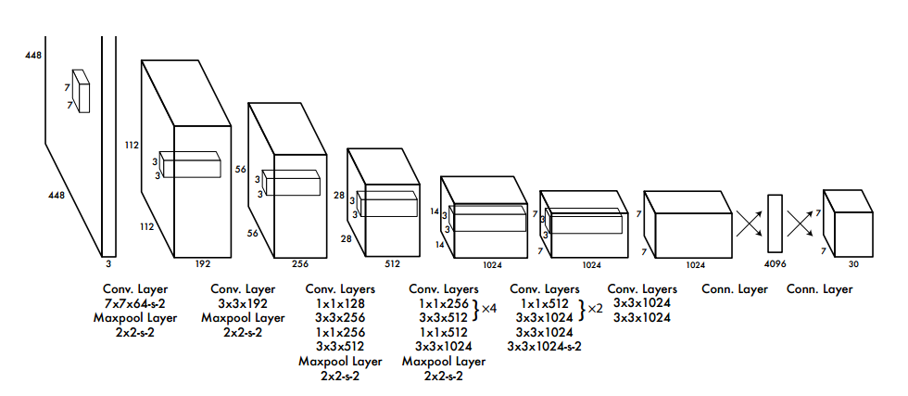
03
YOLO
Notes:
31

Slide 32
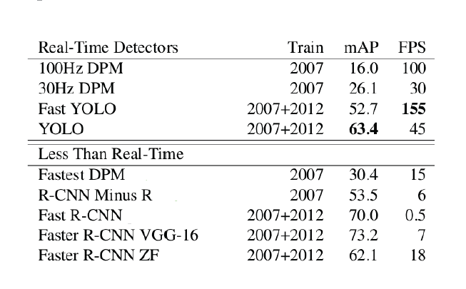
03
Test performance
Notes:
32

Slide 33
04
CNN Based medical image classification
Datasets usually small
Using a pre-trained CNN to their tasks
A pre-trained CNN is adapted to the application at hand.
Notes:
33

Slide 34
04
CNN Based medical image classification
Polyp detection(肠息肉的检测)
Pulmonary Embolism Detection(肺栓塞的检测)
Intima-Media Boundary Segmentation(血管造影)
Notes:
34

Slide 35
CNN Based medical image classification
04
Polyp detection
Extract images from 40 short colonoscopy videos.
Training set contains 3,800 frames with polyps and 15,100 frames without polyps.
Test set contains 5,700 frames with polyps and 13,200 frames without polyps.
Notes:
35

Slide 36
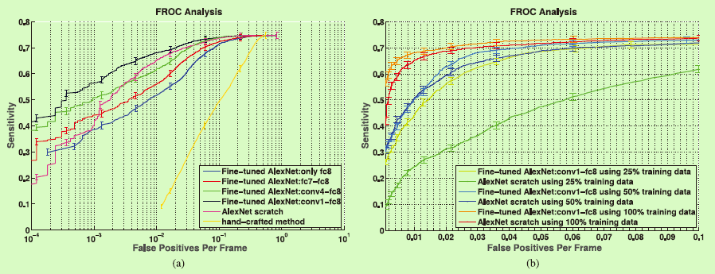
04
CNN Based medical image classification
Polyp detection
(a) Comparison between incremental fine-tuning, training from scratch, and a handcrafted approach [42]. (b) Effect of reduction in the training data on the performance of CNNs trained from scratch and deeply fine-tuned CNNs.
Notes:
36

Slide 37
04
CNN Based medical image classification
Pulmonary Embolism Detection
Extract dataset from 121 CT pulmonary angiographies.
Training set contains 434 frames with pulmonary embolism and 3406 frames without pulmonary embolism.
Test set contains 253 frames with pulmonary embolism and 2162 frames without pulmonary embolism.
Notes:
37

Slide 38
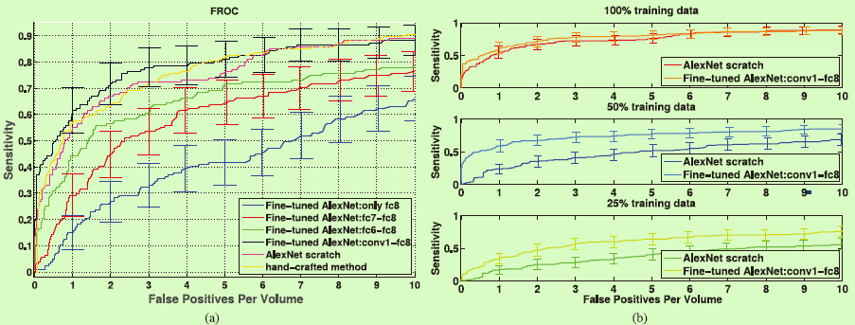
04
CNN Based medical image classification
Pulmonary Embolism Detection
(a) Comparison between incremental fine-tuning, training from scratch, and a handcrafted approach. To avoid clutter in the figure, error bars are displayed for only a subset of plots. A more detailed analysis is presented in Table S2 in the supplementary file.(b) Effect of reduction in the training data on the performance of CNNs trained from scratch and deeply fine-tuned CNNs.
Notes:
38

Slide 39
04
CNN Based medical image classification
Intima-Media Boundary Segmentation
Extract dataset from 92 carotid intima-media thickness (CIMT) videos. The expert reviews each video to determine 3 ROIs which can be measured reliably.
The authors divided the ROIs into a training set with 144 ROIs and a test set with 132 ROIs.
For training and fine-tuning the CNNs, the authors extracted a stratified set of 200,000 training patches from the training ROIs.
Notes:
39

Slide 40
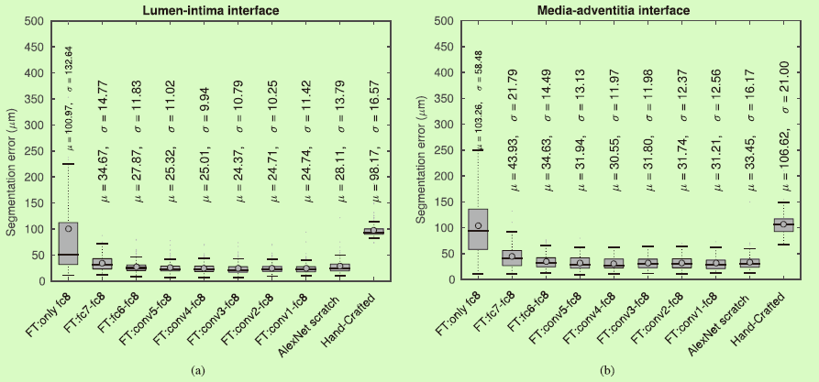
04
CNN Based medical image classification
Intima-Media Boundary Segmentation
Box plots of segmentation error for (a) the lumen-intima interface and (b) the media-adventitia interface.
Notes:
40

Slide 41
04
Challenges
Low resolution and blur images are still a challenge
Recognize classes not in the training set
Need a large amount of labeled training data
Need much extensive computational and memory resources
Notes:
41

Slide 42
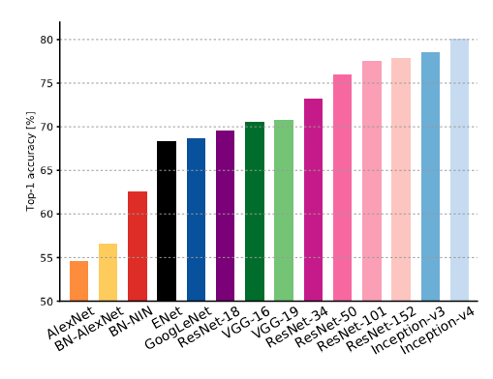
Validation accuracies for different architctures
Canziani A, Paszke A, Culurciello E, et al. An Analysis of Deep Neural Network Models for Practical Applications[J]. arXiv: Computer Vision and Pattern Recognition, 2016.

Slide 43
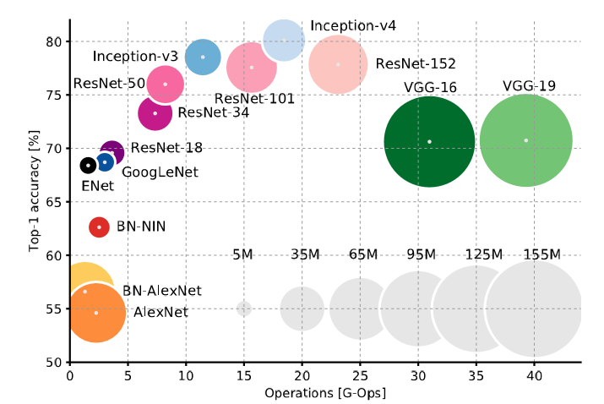
Accuracy and size of the model
Canziani, Alfredo, Adam Paszke, and Eugenio Culurciello. "An Analysis of Deep Neural Network Models for Practical Applications." arXiv: Computer Vision and Pattern Recognition (2016).

Slide 44
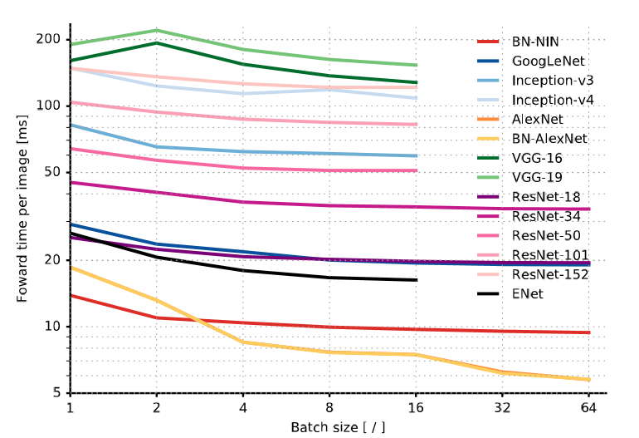
Inference time
Canziani, Alfredo, Adam Paszke, and Eugenio Culurciello. "An Analysis of Deep Neural Network Models for Practical Applications." arXiv: Computer Vision and Pattern Recognition (2016).

Slide 45
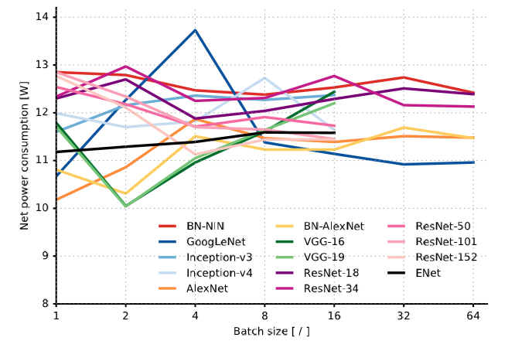
Power
Canziani, Alfredo, Adam Paszke, and Eugenio Culurciello. "An Analysis of Deep Neural Network Models for Practical Applications." arXiv: Computer Vision and Pattern Recognition (2016).

Slide 46
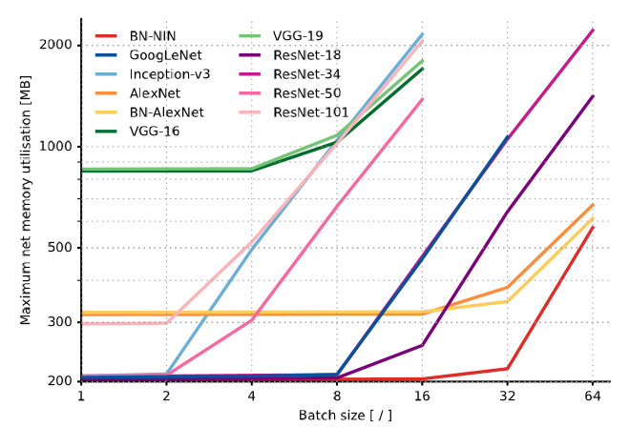
Memory
Canziani, Alfredo, Adam Paszke, and Eugenio Culurciello. "An Analysis of Deep Neural Network Models for Practical Applications." arXiv: Computer Vision and Pattern Recognition (2016).

Slide 47
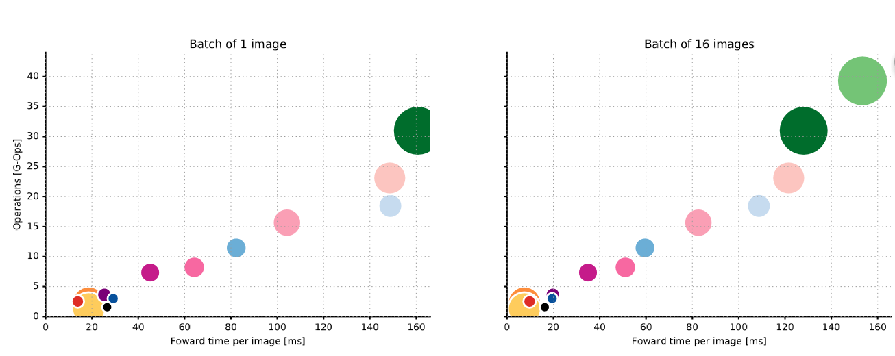
Canziani, Alfredo, Adam Paszke, and Eugenio Culurciello. "An Analysis of Deep Neural Network Models for Practical Applications." arXiv: Computer Vision and Pattern Recognition (2016).

