Slide 1

CNN Based Image Classification
Xiaoling Long
Hongyu Chen
Ruiqi Luo

Slide 2
00
Outline
Workload
Successful CNN in ImageNet
R-CNN and Further work
Application Based on CNN Based image classification
Notes:
1

Slide 3
01
Workload
Everybody read about 13 papers in different aspect
Xiaoling Long focus on successful CNN in ImageNet and some inspiring Network
Hongyu Chen work …
Ruiqi Luo reads most paper about application
Notes:
1

Slide 4
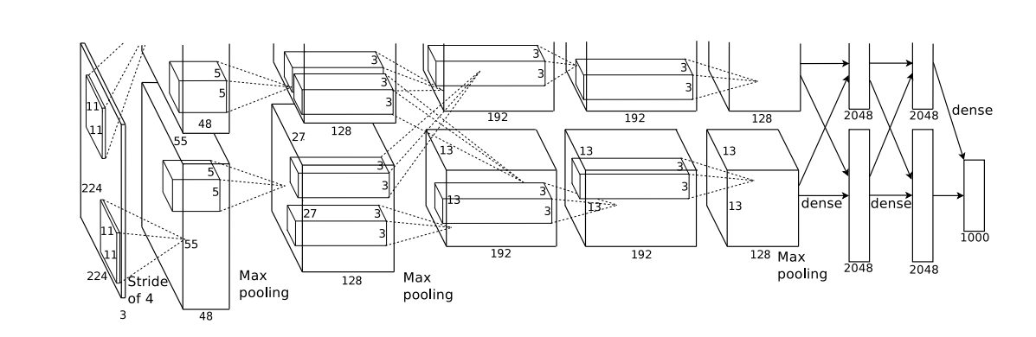
02
Successful CNN in ImageNet
Figure 1. AlexNet which is the first one CNN succeed in ImageNet
Notes:
1

Slide 5
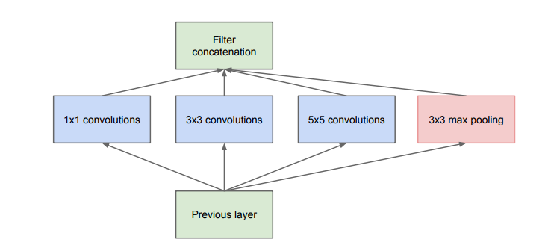
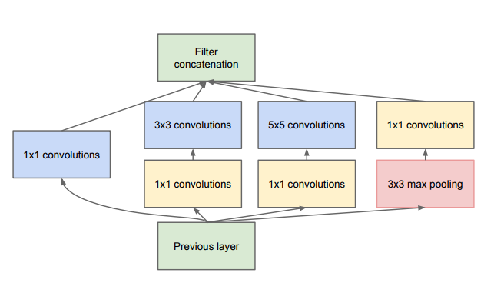
02
Successful CNN in ImageNet
Figure 2. Inception model in GoogLeNet. Left: Basic Inception model;
Right: Inception with dimension reductions
Notes:
1

Slide 6
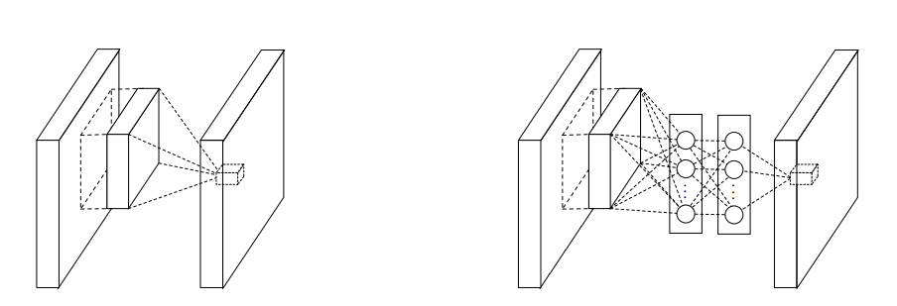
02
Successful CNN in ImageNet
Figure 3. Comparison of linear convolution layer and MLPconv layer.
Left: Normal convolution layer; Right: Replace with a Multi-Layer Perceptron(MLP).
Notes:
1

Slide 7
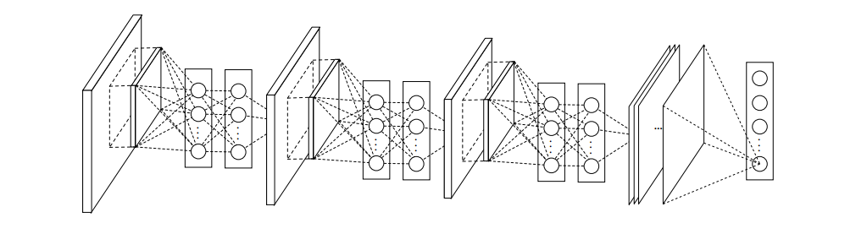
02
Successful CNN in ImageNet
Figure 4. Network in Network. Stacked by MLPconv layers and one
Global average pooling layer
Notes:
1

Slide 8
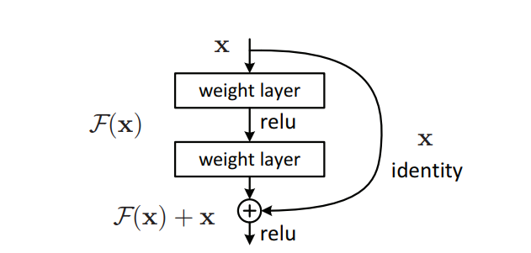
02
Successful CNN in ImageNet
Figure 5. Residual learning. ResNet is stacked by these modules
and one global average pooling layer.
Notes:
1

Slide 9
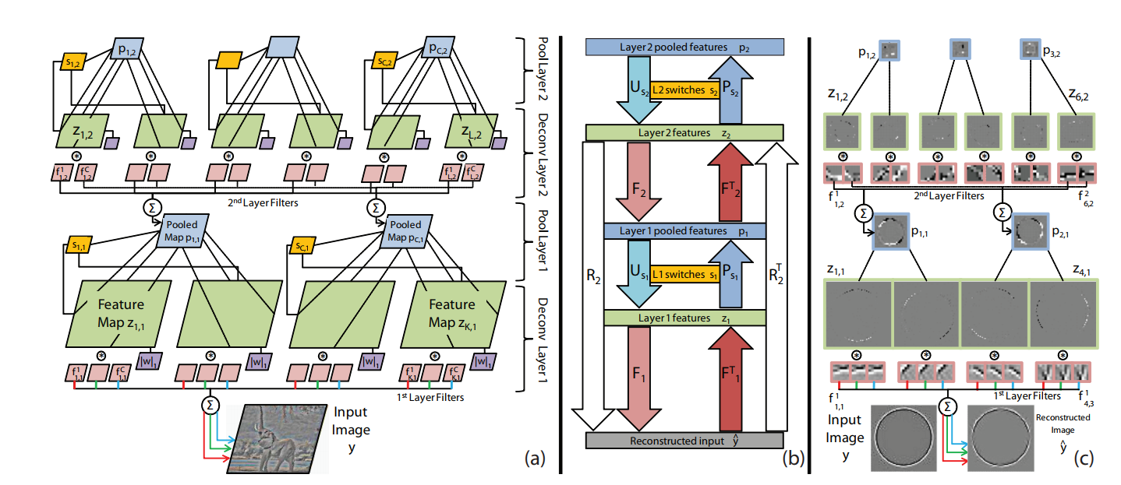
02
Successful CNN in ImageNet
Figure 6. Adaptive Deconvolutional Networks. This method is used in ZFNet
for understanding and visualization CNN
Notes:
1

Slide 10
03
R-CNN and Further work
Notes:
1

Slide 11
Application Based on CNN Based image classification
04
Notes:
1

Slide 12

THANKS!

