Slide 1

CNN Based Image Classification
Xiaoling Long
Hongyu Chen
Ruiqi Luo

Slide 2
00
Outline
Definition
Dataset for Image Classification
CNN Architectures
CNN Based medical image classification
Notes:
2

Slide 3
01
Definition
Image Classification: The classical problem in computer vision, image processing, and machine vision is that of determining whether or not the image data contains some specific object, feature, or activity. [From Wikipedia]
CNN: Convolutional Neural Network is a class of deep, feed-forward artificial neural networks that has successfully been applied to analyzing visual imagery. [From Wikipedia]
Notes:
3

Slide 4
02
Dataset for Image Classification
MINIST
ImageNet
COCO
PASCAL VOC
CIFAR
Open Image

Slide 5
Accuracy Criteria
TOP 1 error: The correct answer is the top guess
TOP 5 error: The correct answer is in the top-5 guess

Slide 6
03
CNN Architectures
AlexNet
ZFNet
GoogLeNet
VGGNet
ResNet
Notes:
6

Slide 7
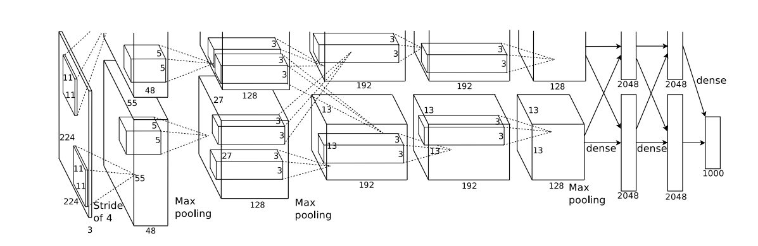
AlexNet
Krizhevsky, A., Sutskever, I., & Hinton, G. E. (2012). ImageNet Classification with Deep Convolutional Neural Networks. neural information processing systems.
Notes:
7

Slide 8
Highlights of AlexNet
ReLU as activate function
Local Response Normalization
Overlapping Pooling
Data Augmentation
Dropout
Stochastic Gradient Descent for Learning
Notes:
8

Slide 9
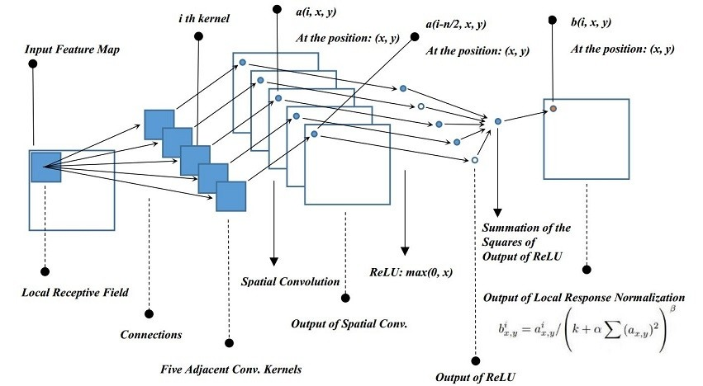
Local Response Normalization
Image from Blog
Notes:
9

Slide 10
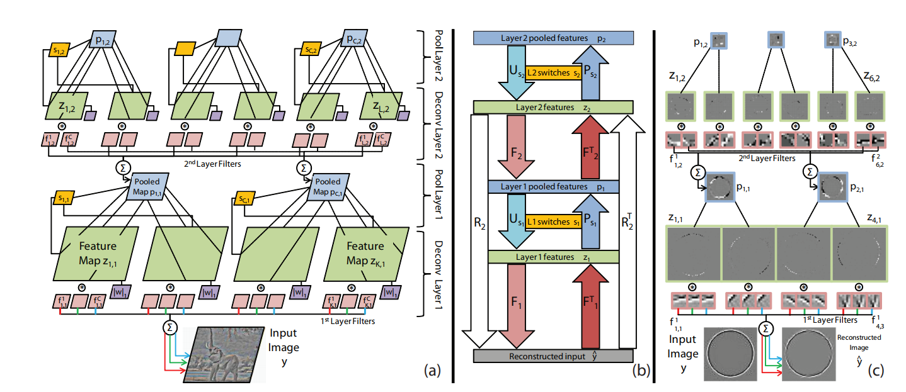
Deconvolutional Network
Zeiler, Matthew D., Graham W. Taylor, and Rob Fergus. "Adaptive deconvolutional networks for mid and high level feature learning." international conference on computer vision (2011): 2018-2025.
Notes:
10

Slide 11
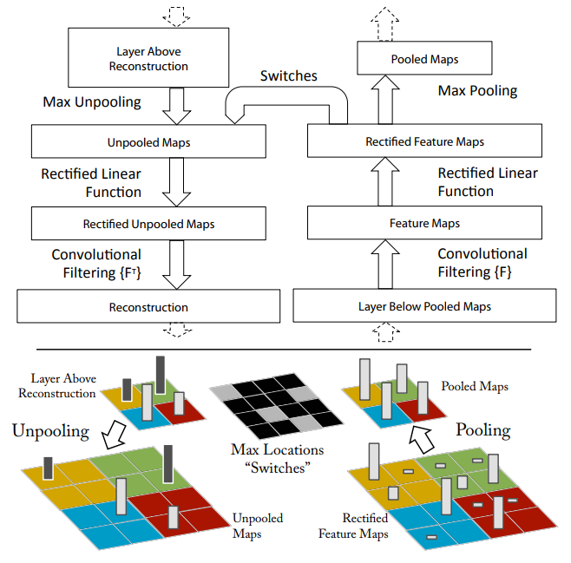
Convolution and Deconvolution
Zeiler, Matthew D., and Rob Fergus. "Visualizing and Understanding Convolutional Networks." european conference on computer vision (2013): 818-833.
Notes:
11

Slide 12
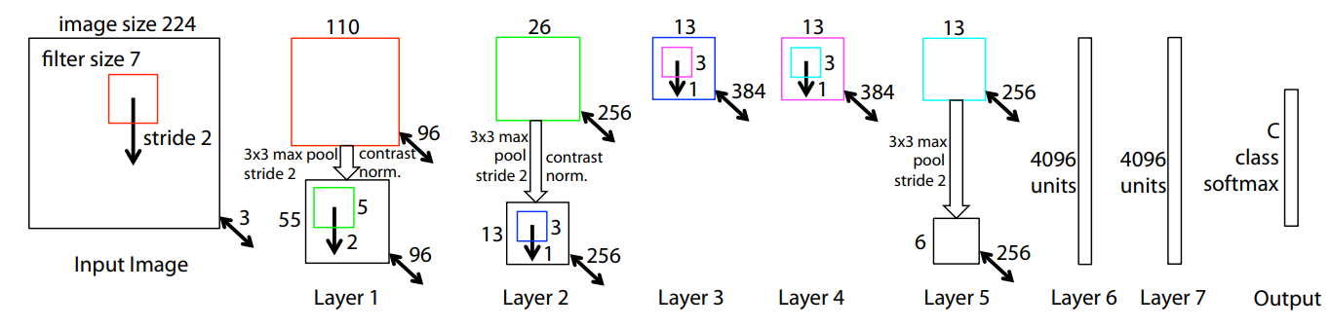
ZFNet
Zeiler, Matthew D., and Rob Fergus. "Visualizing and Understanding Convolutional Networks." european conference on computer vision (2013): 818-833.
Notes:
12

Slide 13
Highlight of ZFNet
Deconvolution for understanding and visualizing CNN
Notes:
13

Slide 14
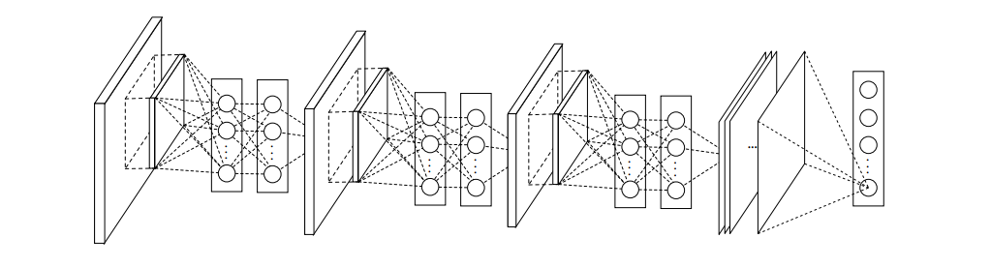
NIN
Lin, Min, Qiang Chen, and Shuicheng Yan. "Network In Network." international conference on learning representations (2014).
Notes:
14

Slide 15
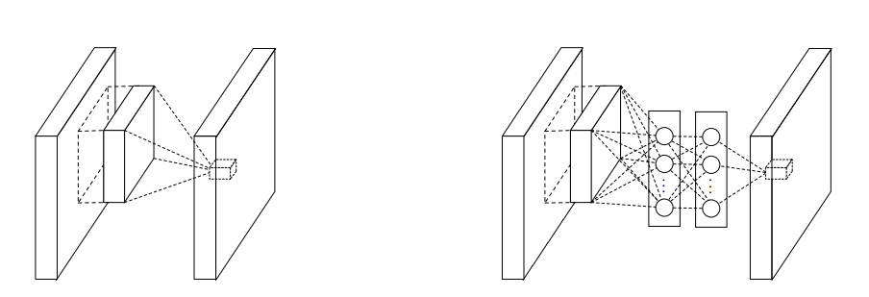
MLPconv Layer
Normal Conv layer
MLPconv layer
Lin, Min, Qiang Chen, and Shuicheng Yan. "Network In Network." international conference on learning representations (2014).
Notes:
15

Slide 16
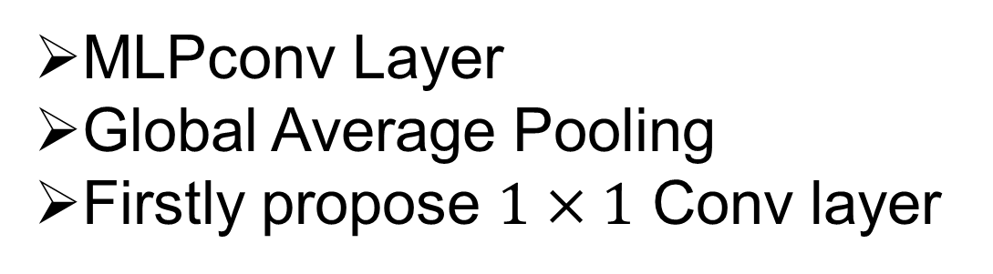
Highlight of NIN
MLPconv Layer
Global Average Pooling
Firstly propose $1×1$ Conv layer
Notes:
16

Slide 17
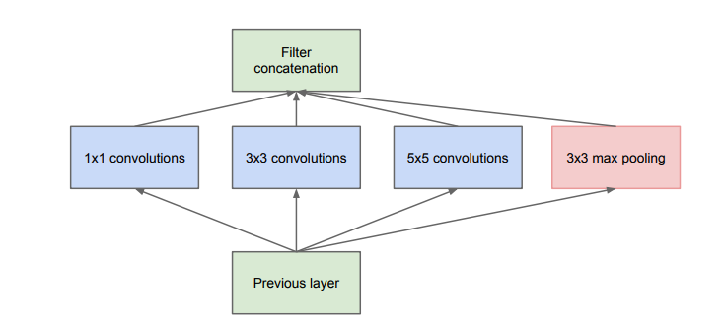
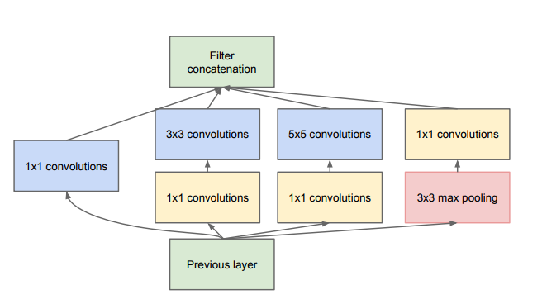
Inception Model
Googlenet :Szegedy, Christian, et al. "Going deeper with convolutions." computer vision and pattern recognition (2015): 1-9.
Notes:
17

Slide 18
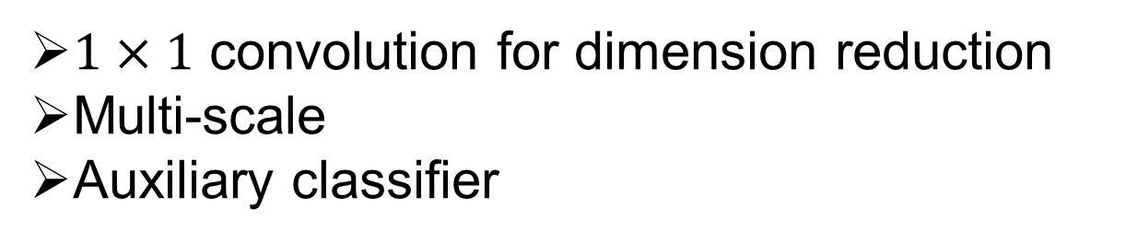
Highlight of GoogLeNet
$1×1$ convolution for dimension reduction
Multi-scale
Auxiliary classifier
Notes:
18

Slide 19
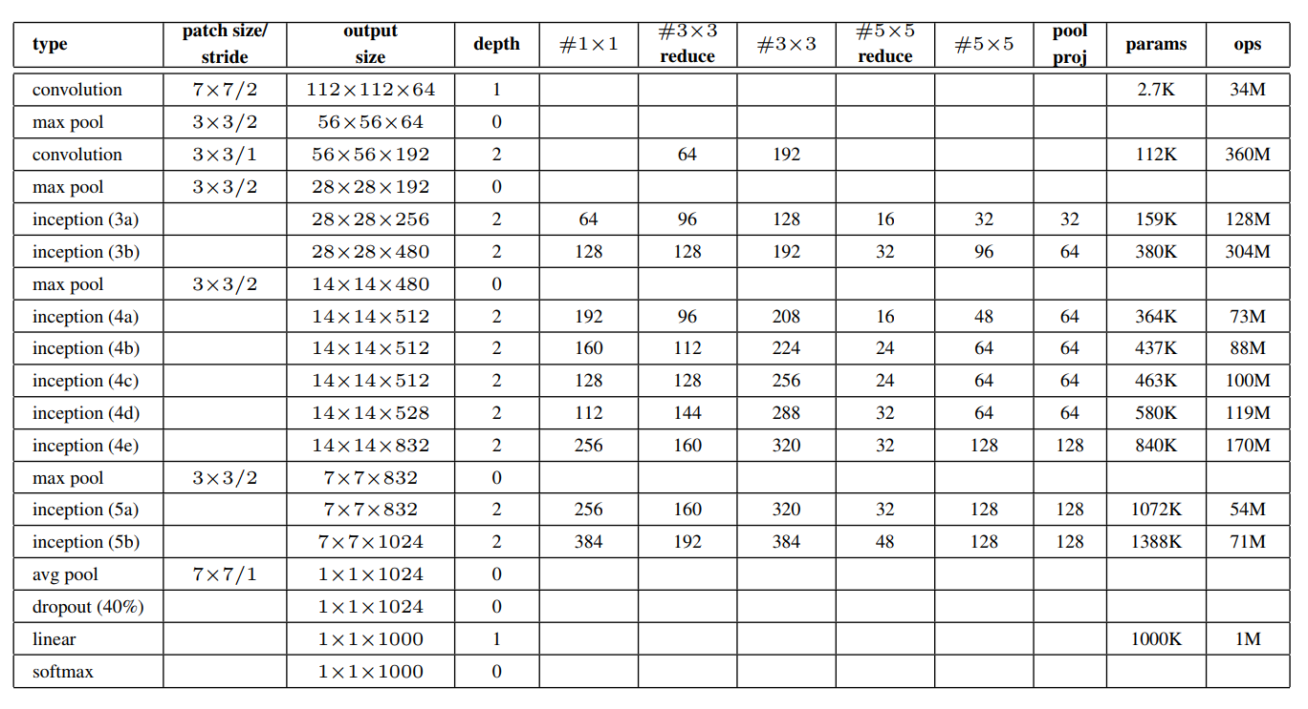
GoogLeNet Configuration
Krizhevsky, A., Sutskever, I., & Hinton, G. E. (2012). ImageNet Classification with Deep Convolutional Neural Networks. neural information processing systems.
Notes:
19

Slide 20
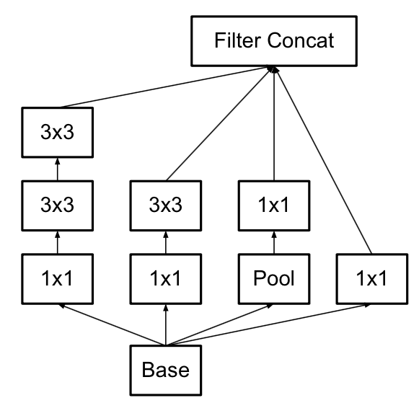
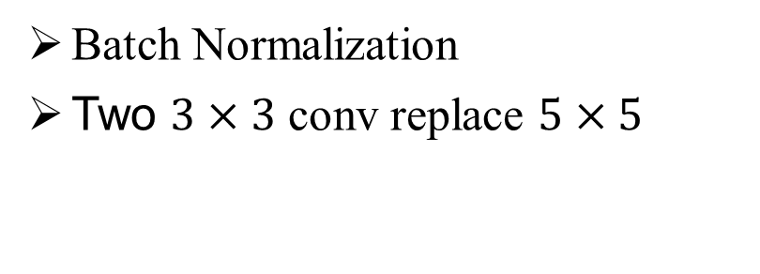
Inception V2
Batch Normalization
Two $3×3$ conv replace $5×5$
Image From blog
Notes:
20

Slide 21
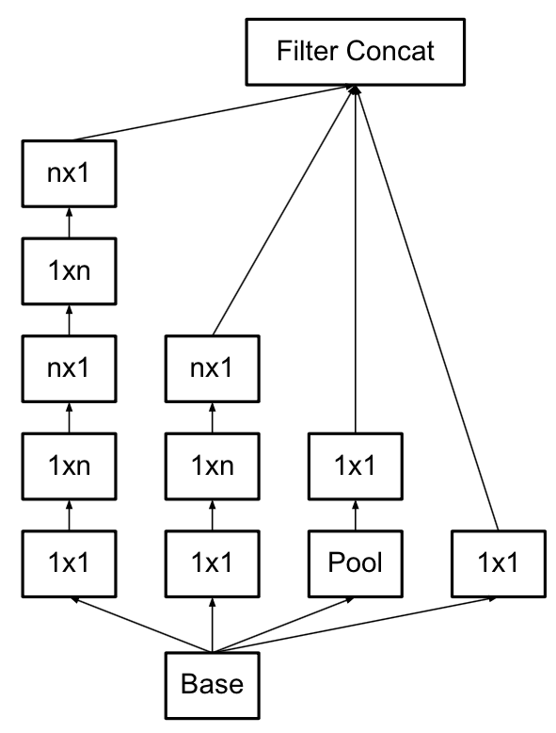
Inception V3
Decompose filter into two one-dimensional
Image From blog
Notes:
21

Slide 22
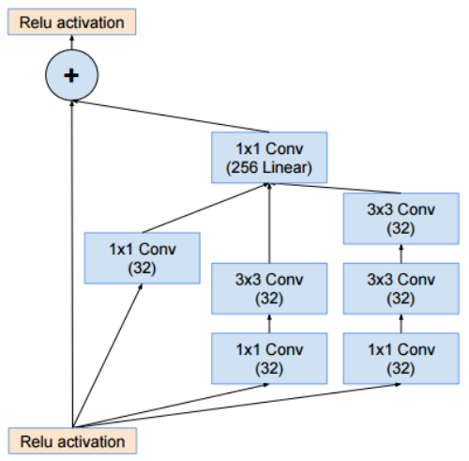
Res-Inception
Combine Inception with residual learning
Image From blog
Notes:
22

Slide 23
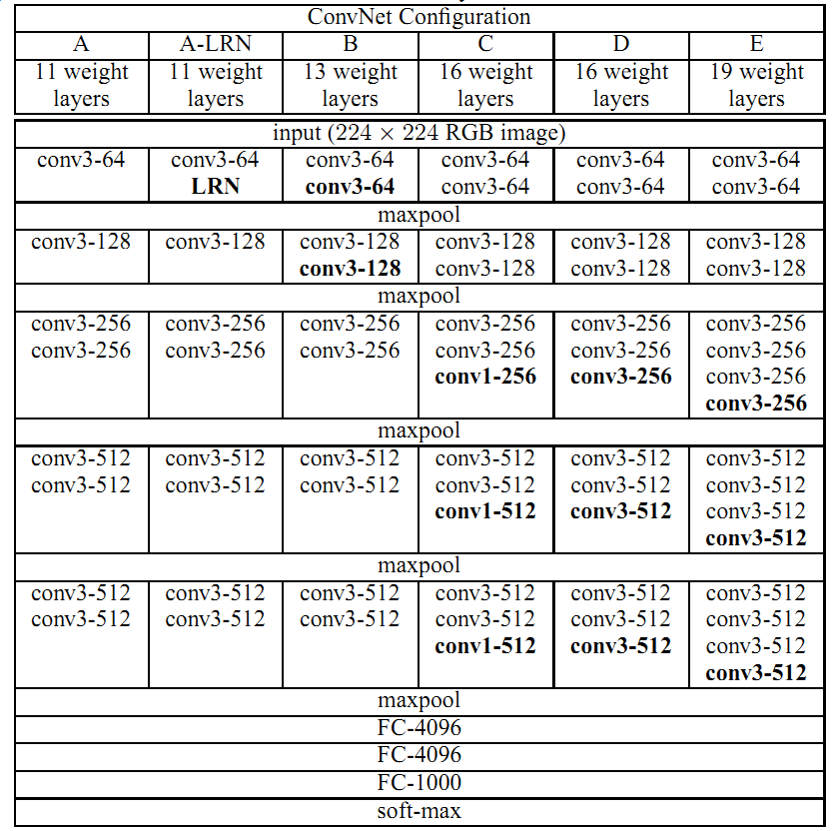
VGGNet
Notes:
23

Slide 24
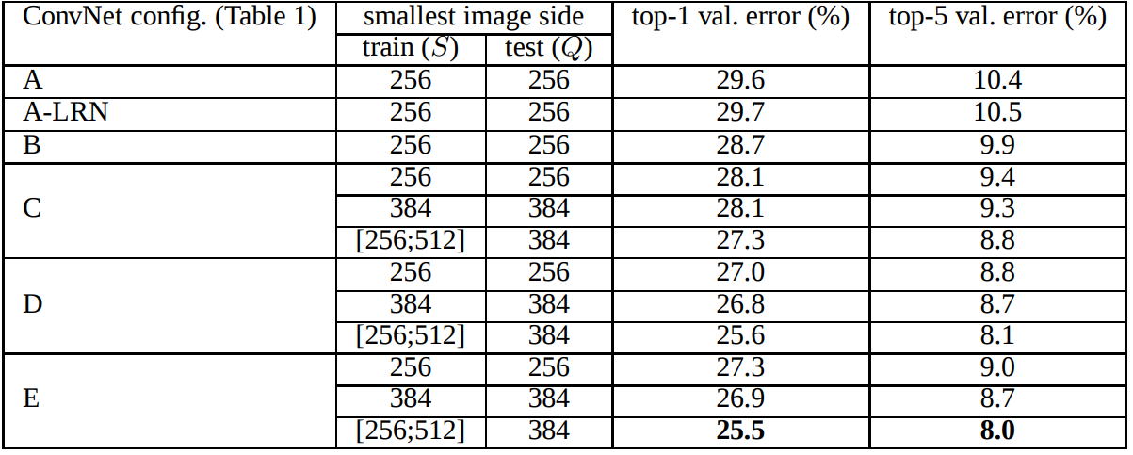
VGGNet
Simonyan, Karen, and Andrew Zisserman. "Very Deep Convolutional Networks for Large-Scale Image Recognition." international conference on learning representations (2015).
Notes:
24

Slide 25
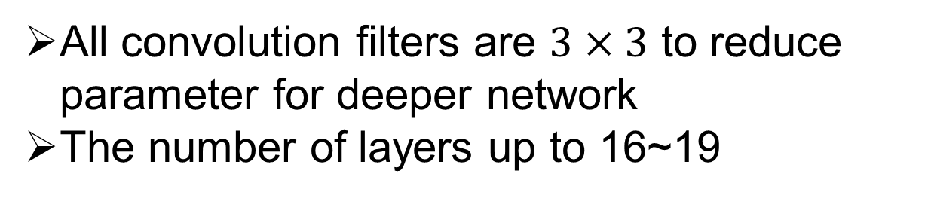
Highlight of VGGNet
All convolution filters are $3×3$ to reduce parameter for deeper network
The number of layers up to 16~19
Notes:
25

Slide 26
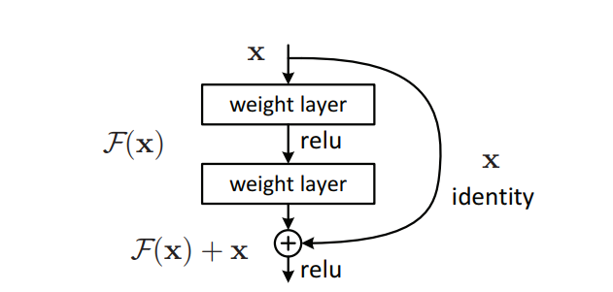
Residual Learning
He, Kaiming, et al. "Deep Residual Learning for Image Recognition." computer vision and pattern recognition (2016): 770-778.
Notes:
26

Slide 27
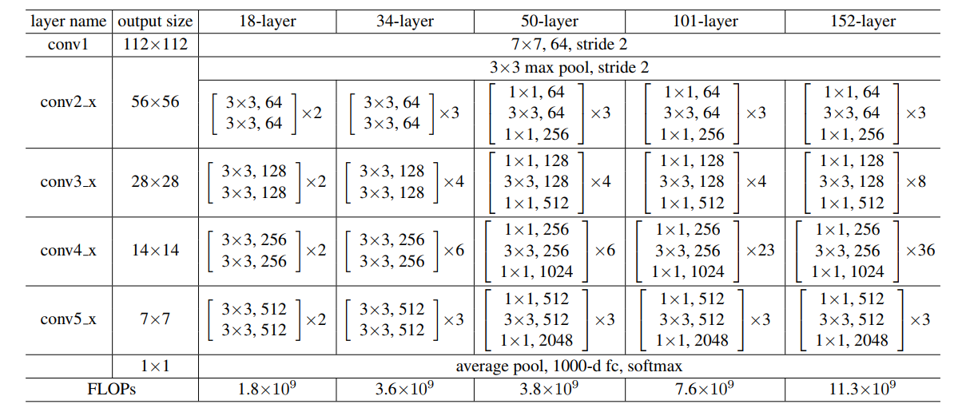
ResNet
He, Kaiming, et al. "Deep Residual Learning for Image Recognition." computer vision and pattern recognition (2016): 770-778.
Notes:
27

Slide 28
Highlight of ResNet
Residual learning
Global average pooling
Much deeper without too many parameter increment.
Notes:
28

Slide 29
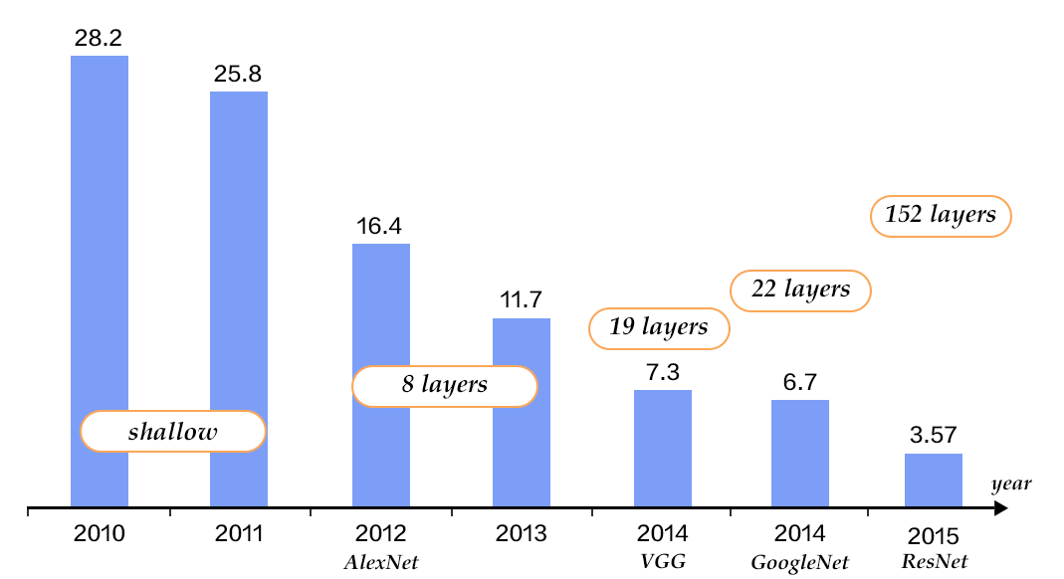
Performance of CNN in ImageNet
Image from blog
Notes:
29

Slide 30
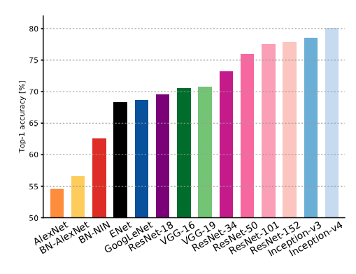
Validation accuracies for different architectures
Canziani A, Paszke A, Culurciello E, et al. An Analysis of Deep Neural Network Models for Practical Applications[J]. arXiv: Computer Vision and Pattern Recognition, 2016.

Slide 31
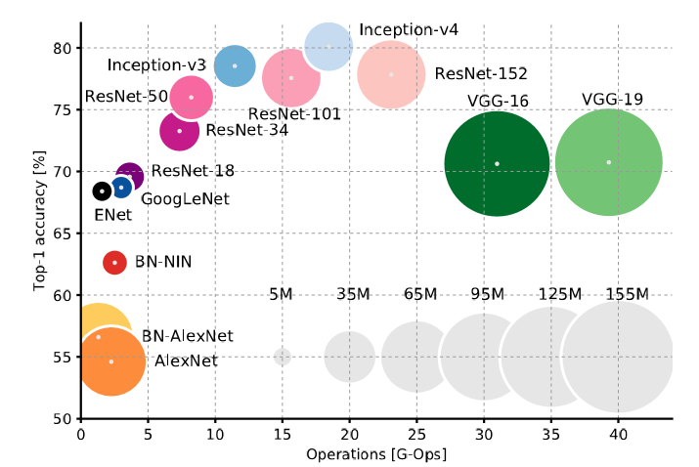
Accuracy and size of the model
Canziani, Alfredo, Adam Paszke, and Eugenio Culurciello. "An Analysis of Deep Neural Network Models for Practical Applications." arXiv: Computer Vision and Pattern Recognition (2016).

Slide 32
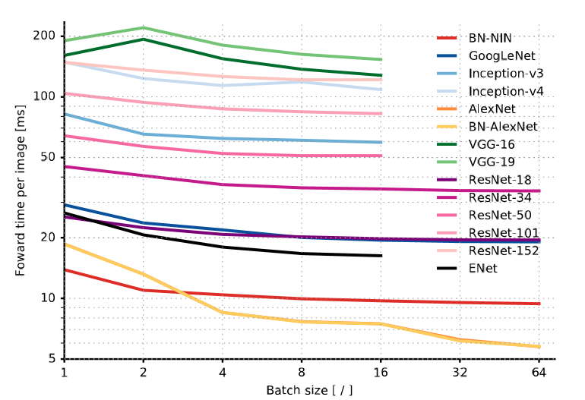
Inference time
Canziani, Alfredo, Adam Paszke, and Eugenio Culurciello. "An Analysis of Deep Neural Network Models for Practical Applications." arXiv: Computer Vision and Pattern Recognition (2016).

Slide 33
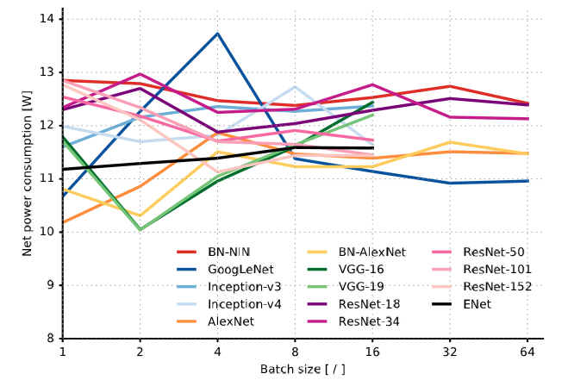
Power
Canziani, Alfredo, Adam Paszke, and Eugenio Culurciello. "An Analysis of Deep Neural Network Models for Practical Applications." arXiv: Computer Vision and Pattern Recognition (2016).

Slide 34
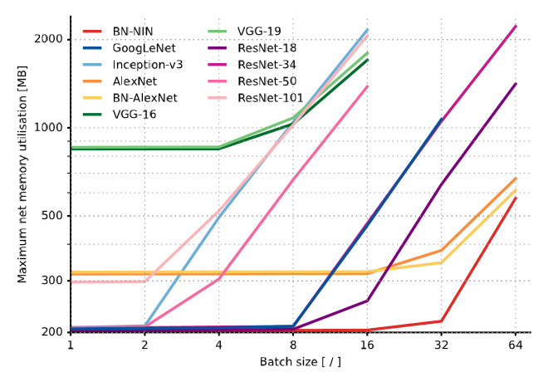
Memory
Canziani, Alfredo, Adam Paszke, and Eugenio Culurciello. "An Analysis of Deep Neural Network Models for Practical Applications." arXiv: Computer Vision and Pattern Recognition (2016).

Slide 35
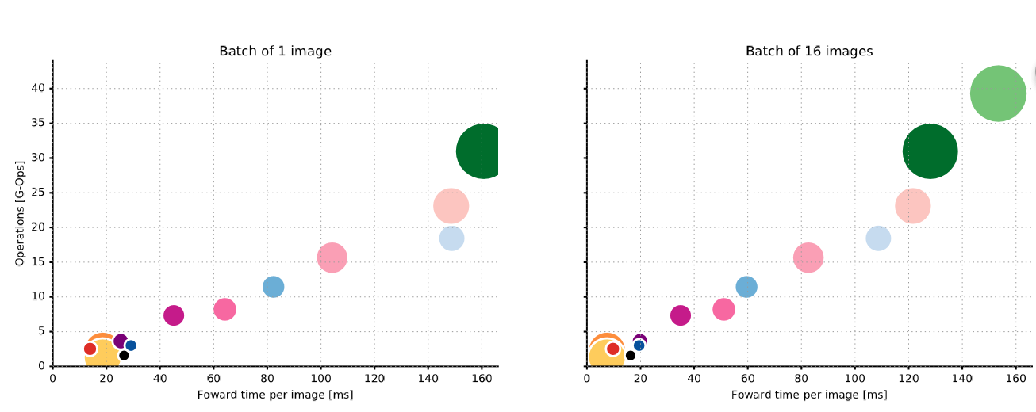
Canziani, Alfredo, Adam Paszke, and Eugenio Culurciello. "An Analysis of Deep Neural Network Models for Practical Applications." arXiv: Computer Vision and Pattern Recognition (2016).

Slide 36
04
CNN Based medical image classification
Datasets usually small
Using a pre-trained CNN to their tasks
A pre-trained CNN is adapted to the application at hand.
Notes:
36

Slide 37
04
CNN Based medical image classification
Polyp detection(肠息肉的检测)
Pulmonary Embolism Detection(肺栓塞的检测)
Notes:
37

Slide 38
Polyp detection
Extract images from 40 short colonoscopy videos.
Training set contains 3,800 frames with polyps and 15,100 frames without polyps.
Test set contains 5,700 frames with polyps and 13,200 frames without polyps.
Notes:
38

Slide 39
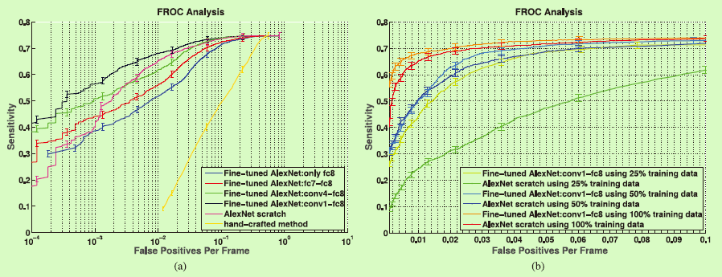
Polyp detection
N. Tajbakhsh, S. Gurudu, and J. Liang, “Automated polyp detection in colonoscopy videos using shape and context information,” IEEE Trans. Med. Imag., vol. 35, no. 2, pp. 630–644, Feb. 2016..
Notes:
39

Slide 40
Pulmonary Embolism Detection
Extract dataset from 121 CT pulmonary angiographies.
Training set contains 434 frames with pulmonary embolism and 3406 frames without pulmonary embolism.
Test set contains 253 frames with pulmonary embolism and 2162 frames without pulmonary embolism.
Notes:
40

Slide 41
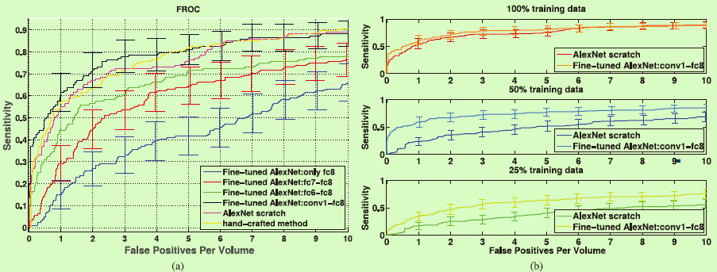
Pulmonary Embolism Detection
J. Liang and J. Bi, “Computer aided detection of pulmonary embolism with tobogganing and multiple instance classification in CT pulmonary angiography,” in Information Processing in Medical Imaging. New York: Springer, 2007, pp. 630–641...
Notes:
41

Slide 42
Open issues
Low resolution and blur images are still a challenge
Recognize classes not in the training set
Need a large amount of labeled training data
Need much extensive computational and memory resources
Notes:
42

